Slide 1
Radiation Detectors
Khayrudinov Vladislav
Ismail Belmostefa
XX00AA41-2004 Sensor Technology
Helsinki Metropolia University of Applied Sciences
2014

Slide 2
Content of the presentation
History of silicon radiation detectors
Strip silicon radiation detectors
Materials and manufacturing technologies
Silicon radiation detectors characteristics
Interface electronic circuits

Slide 3
History of silicon radiation detectors
Before 1982:
Lithium-drifted
Low working temperature (77k=-196ºC)
Impossible at room temperature
Instable surfaces
After 1982:
Planar technology
Strip silicon radiation detectors
Room working temperature
Lower noise and capacitance

Slide 4
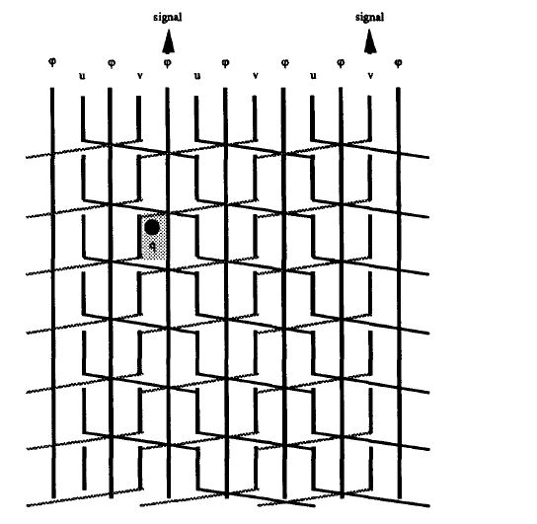
Strip silicon radiation detectors
N type material
P type aluminium strips
Thin insulator
High efficiency
Special resolution

Slide 5
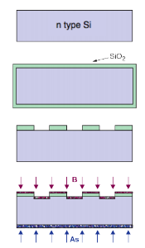
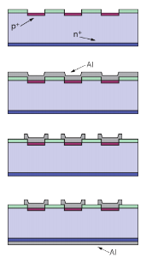
Materials and manufacturing technologies
Made of n type material
On surface p type aluminium strips
Package detector material depends on its use
Manufacturing process consist of 9 steps
Notes:
In speech tell about steps of the manufacturing process and define what is the material itself.

Slide 6
Silicon radiation detectors characteristics
High sensitive
Sensitivity depends on material
After measuring and analyzing spectrum can find the transfer function of the sensors
4 major charasteristics:
  Active area
  Dark current
  Capacitance
  Shunt resistance
Notes:
In speech define what charasteristics mean and sensitivity word itself.

Slide 7
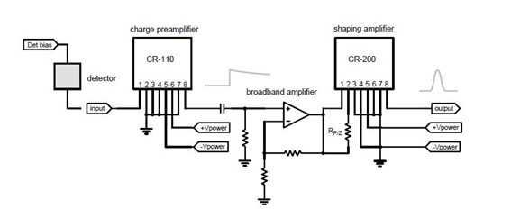
Interface electronic circuits
Detectors must be interfaced
Cremat CR-110 preamplifier and CR-200 shaping amplifier
Gain 0 to 1000
Analog system

Slide 8
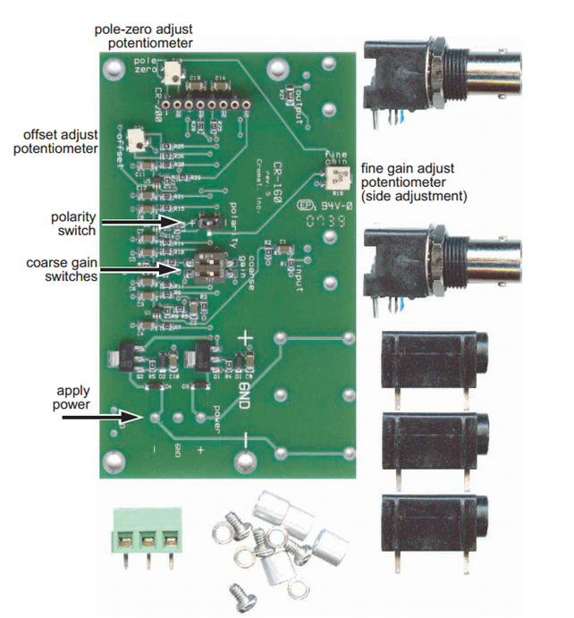
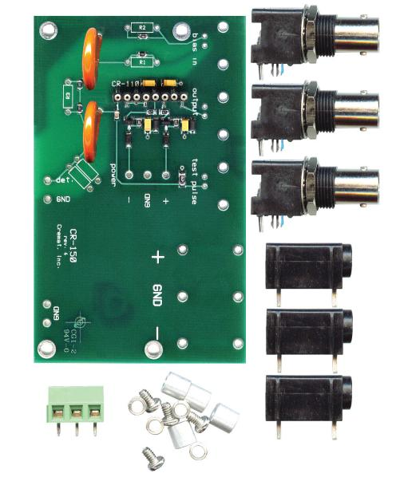
Interface electronic circuits

Slide 9
Thank you

