Slide 1
Position Sensors
Little knowledge on position sensor helps at some point in your carrier.
    By Riku Sorsa and Suman Dahal

Slide 2
TABLE OF CONTENTS
INTRO
01
02
03
04
Materials used and manufacturing process
Working process
Interfacing with electronic circuits
Ultrasonic sensor

Slide 3
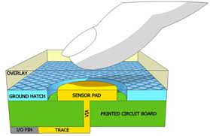
Introduction
    Position sensors are the electronic devices that permits position measurement. There are various types of position sensors. Generally they measure either absolute or relative position.
    These sensors can output either linear, Angular or multi-axis positions.
    There are various kinds of positions sensors. However on this presentation we are focusing on the capacitive sensor and it’s manufacturing and working process and brief discussion on the ultrasonic sensor.
Capacitive sensors are the sensors that detect human body capacitance based on capacitive coupling.
    These sensors consists of electrical insulator plated with electronically conductive material. When human touch creates an electric field in the sensor, there is the capacitive change which is measured by the sensor.

Slide 4
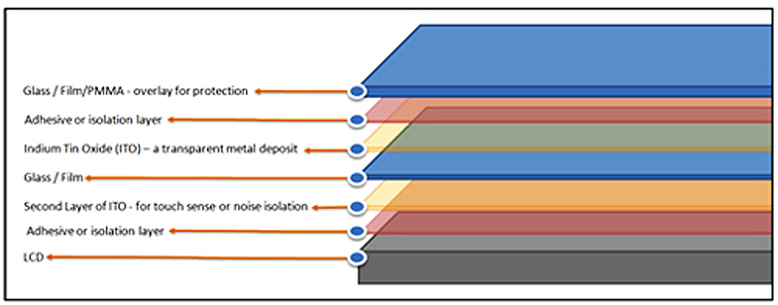
MATERIALS USED AND MANUFACTURING PROCESS
    These kinds of capacitive sensors can be made using various materials as long as they can sense the change in capacitance. However, generally used materials during the manufacture of capacitive sensors are copper, ITO(Indium tin Oxide), Glass, Acrylic. Silver ink.
    However resistance of the material must also be taken into account when choosing the material.
    For example, ITO has a high resistance, which might need a PreScaler, which is used to slow down frequency in the CSD User Module for cap sense to facilitate optimum performance. ITO is broadly used in touchscreens and handling. Touchscreens use 1 to 3 layers of ITO depending on the specific product design considerations.
IPhone and Samsung Galaxy are constructed using several layers of materials as seen in figure below. These layers are called ‘stack up’
    The top layer is a protective layer made up of anti-scratch coated glass or PMMA(Polymethyl Methacrylate), which is also known as acrylic or Plexiglas. Directly underneath the surface layer is a thin adhesive layer or isolation layer and then the electrically conductive layers for touch sensing.

Slide 5
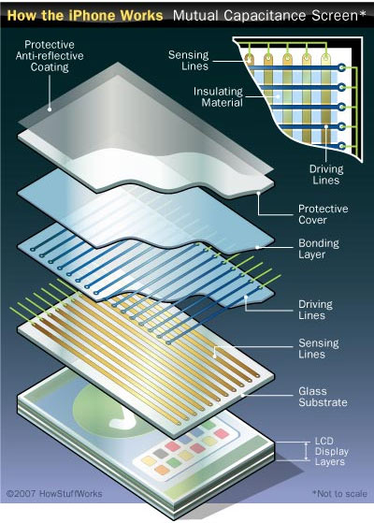
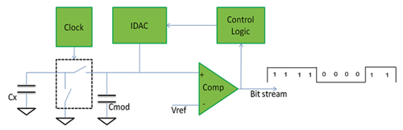
Working process
    IPhone working process
    IPhone has a circuitry which can detect changes at each point along the grid. Every point has it’s own unique signal when touched and relays that to the iPhone’s processor. This helps iPhone to determine the location and movement of simultaneous touches in multiple locations on the phone’s touch screen.
    As iPhone relies on these capacitive materials, they don’t detect with stylus or non-conductive materials .
Capacitive sensor converts measured capacitance into a digital value called Raw counts.
    As the sensor detect change in capacitance even if we are not touching the screen, the raw count helps detecting is the finger near or on the sensor. These raw counts are calculated by special capacitive touch sensing pre-processing circuit as shown in the figure aside.

Slide 6
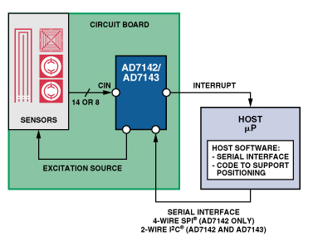
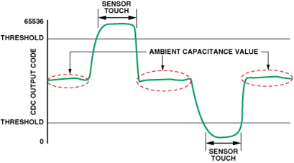
Interfacing with electronic circuits
      AD7142, is programmable controller for capacitance touch screen. It can interface to external capacitance sensors implementing functions.
    A shunt method is used to sense capacitance. Using this method, an excitation source is connected to a transmitter generating an electric field to a receiver. When finger or other grounded object interferes with the field, some of the field lines are shunted to ground and do not reach the receiver.
Therefore the capacitance increases when the finger is touching screen or a button and it decreases when finger is moving away of the screen.

Slide 7
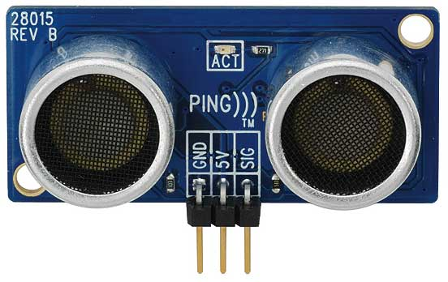
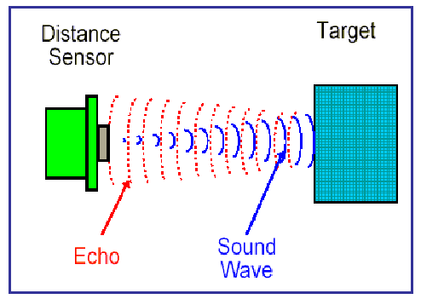
ULTRASONIC SENSOR
Ultrasonic sensors emit a high frequency sound waves and evaluate echo which is received back by the sensor. Same principle is used in radars and sonars.
Sensor calculates the time interval between sending the signal and receiving the echo to determine the distance to an object.
Capacitive sensors are also called as transceivers/transducers, and this is because the sensor sends and receives at the same time.
Ultrasonic sensor cant tell the difference between a small and large objects.

