Slide 1
Pressure sensors
Presenters
  Joonas Virtanen
  Vu Nguyen 08 May 2014

Slide 2
table of contents
01
Physical principles of pressure sensing
04
Interface electronic circuits
02
Typical characteristics of piezoelectric transducers
05
Materials and manufacturing technologies
03
Applications of pressure sensors

Slide 3
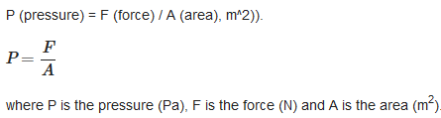


Physical principles of pressure sensing
    Static pressure: defined as the force exerted perpendicularly on a unit area
    Volume pressure: defined as mass per unit volume
    Liquid pressure: e.g a person lies inside then bathtub

Slide 4

Typical characteristics of piezoelectric transducers
    Transfer function
    Sensitivity: the change in output resulting from a change in input
    -33pC/bar
    Operating temperature range:
    -20 to 350 degrees
    Measuring range:
    0 to 300 bar (non-SI unit, like Pa)

Slide 5

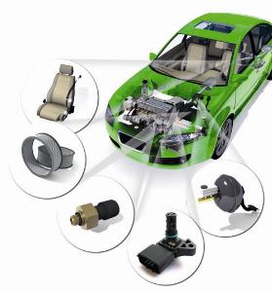
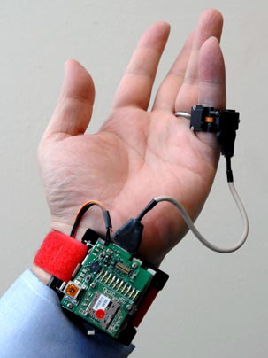
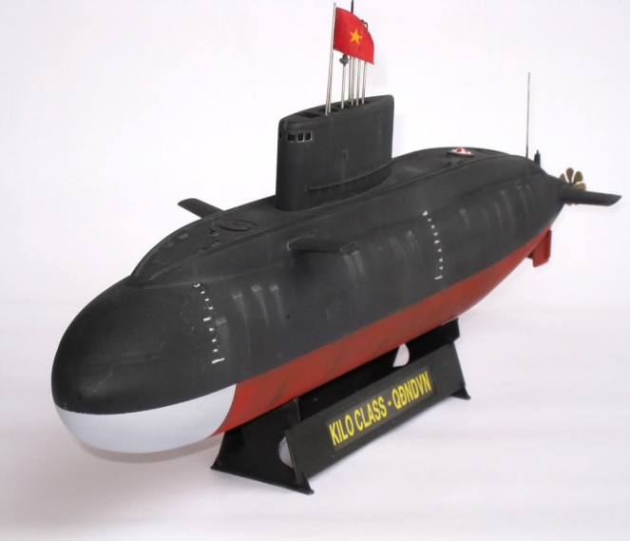
Applications of pressure sensors
    Touch screen devices
    Automotive industry
    Biomedical
    Aviation
    Marine industry

Slide 6
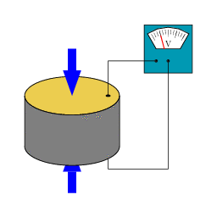

Interface electronic circuit
A typical piezoelectric PiezoStar pressure sensor
      A piezoelectric substance which is a crystalline mineral that responds to a mechanical force by generating an electric charge.
    Piezoelectric sensor component includes a microchip which sends information that can be collected by using voltmeter.
    In PiezoStar sensors a signal-conditioning circuit must have low input impedance but piezoelectric transducer have high input impedance which is bad thing for piezoelectric sensor. A typical input impedance for piezoelectric transducer is 3500 kΩ.
    The system has some output noise which is approximately some hundreds of nV/sqrt Hz (nanovolts per root Hertz). Noises are coming from voltage and current.
    Piezoelectric sensors are usually very stable so they don't need calibration
    The pressure sensor input variants about the pressure, temperature and material.
    The input bias currents of this type of amplifier is usually below 100 pA, it should be fine as long as the feedback resistor value is below 1 GΩ. Specified voltage for all standard ICP sensors and amplifiers is generally within the range of 18 to 30 volts.
    The signal is converted to digital signal with an A/D converter.

Slide 7
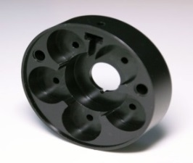
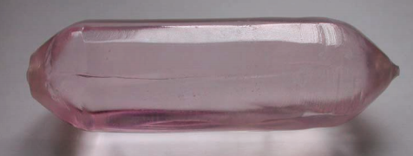
Materials
Piezoelectric pressure sensors
      The PiezoStar is Kistlers company’s own material.
      -Crystal
      -Dynamic and low frequency (quasi-static)
      -Increased stability and temperature range
      -Higher sensitivity
      -Useable for low and high impedance sensors
      Consists of Nickel or Copper or both materials
      They also consist of metallized quartz or ceramic materials.
      Plastic is not used in piezoelectric sensors because it can’t cope with the massive pressure. Metal is harder and can take the pressure better compared to plastics, so metal is a good material to use in this case. Ceramics and crystals are easier to get piezoelectric so that’s why they are in common use.

Slide 8
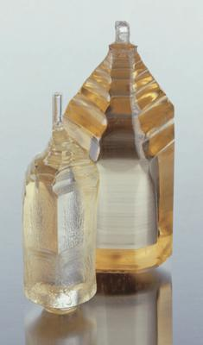
Manufacturing technologies
Piezoelectric pressure sensors
      Kistler PiezoStar® Pressure Sensor has about 200 manufacturing steps before it will reliable sensor and ready to use. One of the first phases of manufacturing process is X-raying and it is used to determine properties of the sensor element.
      All components are checked and measured extremely precisely: after milling it is cutted, lapped and coated. Lastly it is re-coated. Quartz and crystal components can be cutted and measured precisely
      .
      After this it’s easy to design how small the sensor will be. The sensor must be well designed for rapidly changing pressure changes and high temperatures

Slide 9
Q & A
Thank you !

