Slide 1
Light sensors
Sensor Technology
Metropolia University
07.05.2014
Kiia Tammi
Jonathan Malangoni

Slide 2
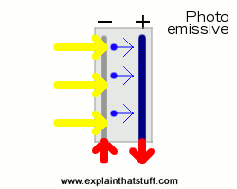
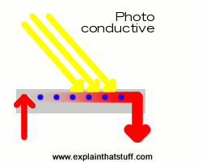
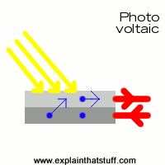
Basic types of light sensors
Light sensors indicate light intensity by measuring radiant energy of photons in a range of frequencies.
There are 2 main categories of light sensors, each with its own operating principle(s)
Generates electricity when illuminated
  Photo-emissive
  Photo-voltaic
Changes electrical properties when illuminated
  Photo-conductive
Figure 1: Summary of light sensor operating principles

Slide 3
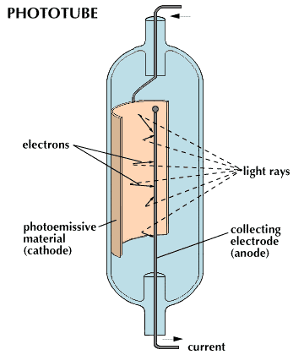
Photo-emissive sensors
Operation:
Photons hit a light-sensitive material, releasing free electrons
Electrons are collected in anode, forming a current
The current is measured, and is dependent on photon intensity and frequency
Figure 2: Photo-emissive (phototube) operation

Slide 4
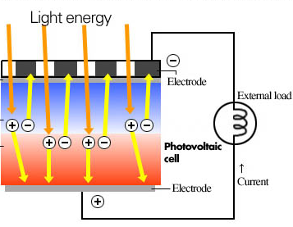
Photo-voltaic sensors
Operation:
Photons hit a light-sensitive semiconductor, producing electron-hole pairs
Electrons move across the semiconductor’s p-n junction, producing a voltage across it
The current produced by this voltage is measured
Figure 3: Photo-voltaic cell operation

Slide 5
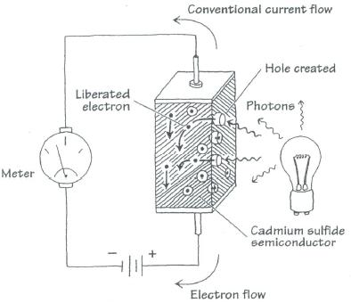
Photo-conductive sensors
Operation:
Photons hit a light-sensitive semiconductor, producing electron-hole pairs
Instead of accumulating a voltage (as in the photo-voltaic process), this semiconductor reduces its resistance
This increases the amount of current flowing through the semiconductor, which is ten measured
Figure 4: Photo-conductive operation

Slide 6
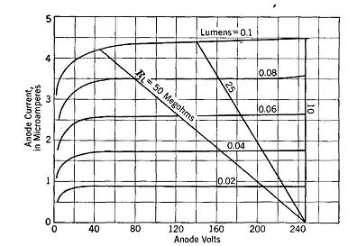
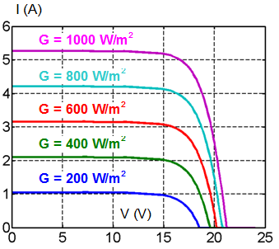
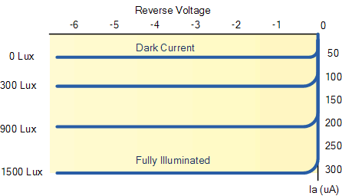
Light sensor characteristics: responses to light
Figure 6: Photo-emissive (vacuum) phototube
Figure 5: Photo-voltaic cell (G = solar irradiance)
Figure 7: Photo-conductive photoresistor

Slide 7
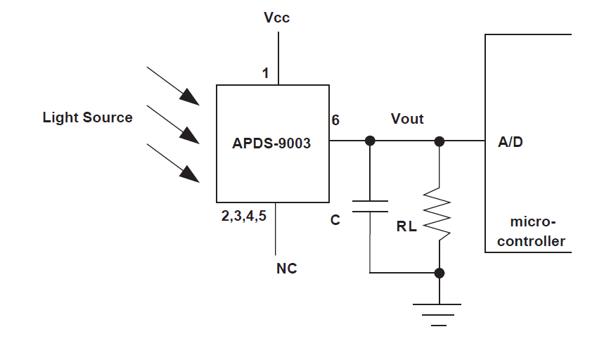
Interface electronic circuits
Needs usually an amplifier
The output depends on the load resistor
Change in wavelength changes the sensitivity response
Input voltage is needed so the sensor is not passive
Low pass filter is required parallel with the load resistor to decrease the noise
Typically white light is used
Figure 8: Sample electronic configuration for an ambient light photo sensor

Slide 8

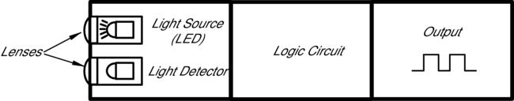
Applications
Burglar alarm where the light is send from one to another sensor, if the light is interrupted, the alarm will go on
Barcode scanner where the scanner illuminates the barcode and collects information
Remote control with infrared light sensor
Telecommunication use light emitting diode to send information with the optical fiber
Mobile phones have many different light sensors
Figure 9: Barcode scanner and typical photoelectric sensor components

