Slide 1
Laser
Distance measurement
    by Aleksi Väisänen
    Pauli Korhonen

Slide 2
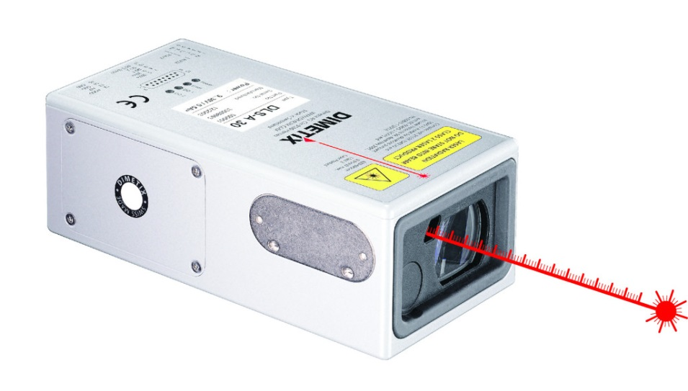
Distance sensing
There are two main techniques to measure the distance with laser beam.
  One way is to pulse the laser beam and measure the time between emitted and reflected pulse. Second way is to beam laser constantly and then shoot the camera with special filter to measure how much the dot of the laser has moved on obstacle. The latter is the cheaper method as it does not need that special processor that is capable of sampling at nanoscale timeframe.

Slide 3
Complementary Metal Oxide Semiconductor (CMOS)
        CMOS
      If laser beam is projected inside camera focal area then it is possible to resolve the distance using simple math. The optical axis of camera and laser beam should ideally be aligned perfectly. However, it is possible to add constant angle correction into math if angle is not perfectly aligned.
      A relatively simple algoritm can be used to find brightest pixels. This method assumes that the brightest pixels are laser dot which is the case usually indoors but not necessarely outdoors. Thats why red pass filter should be used to lessen disturbance of other light sources. When laser dot is resolved from image we can calcute the distance because the dot position in the image frame is known.
        CMOS - PSD
      PSD method based on the same method which is used for focusing in SLR cameras. The light is divided with beam splitter in two rays and then by comparing the two rays' phase the distance can be measured. There is movable lens and its position is known so when two beams are perfectly aligned the distance can be determined by current lens position.
PSD method is similar to CMOS but PSD can be more accurate though only with matte or specular surfaces.

Slide 4
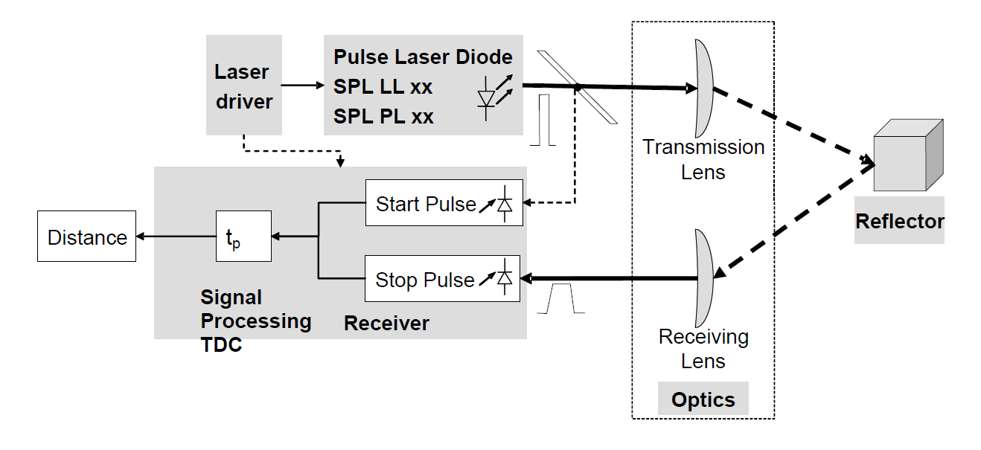
Pulse Time-of-Flight
(PToF)
        Distance of remote object can also be calculated when the speed of light and the time is known. Figure shows the basic principle of the measurement method.
        A very short laser pulse is emitted from laser diode and it immediately partially reflects from front glass of the device. The reflection is captured and the system starts to measure the time for the second incoming pulse of light.
        When the second reflection from the obstacle reaches the sensor, TDC (time-to-digital converter) returns elapsed time in digital format.
PToF method is more expensive than CMOS but also more accurate.

Slide 5
Comparison
CMOS vs PToF
Model | URG-04LX-UG01 (PToF) | Parallax Laser Range Finder (CMOS)
Typical accuracy | < 3 % | < 5 %
Input span | 0,02...4m | 15-122cm
Power requirements | 500mA@5VDC | 150mA@5VDC
Output form | digital | digital
Weight | 160g | 10g
Source: Placeholder example

Slide 6
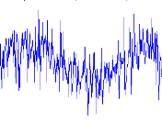
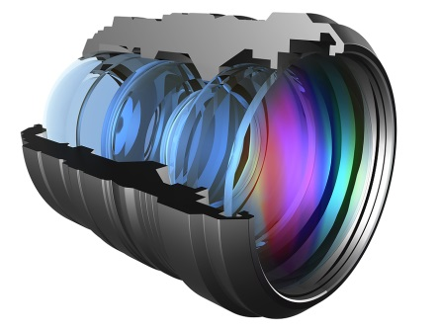
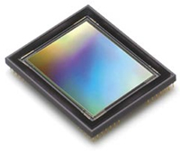
Interesting details
      Noise
      The amount of noise is dependant of meters bandwidth. The bandwith is defined usually by the point where output voltage is dropped 3 dB or 30%. The noise is distributed over all frequencies but it can be reduced by filtering which limits bandwidth.
      Materials
      Plastic is a good material to use for case because it is cheap and durable.
      The lenses inside are made of glass as it refracts laser light better than plastic lenses.
      History
      CMOS sensors became more common in late 1990s.
      That made possible to integrate CMOS sensor on laser metering devices nowadays.

Slide 7

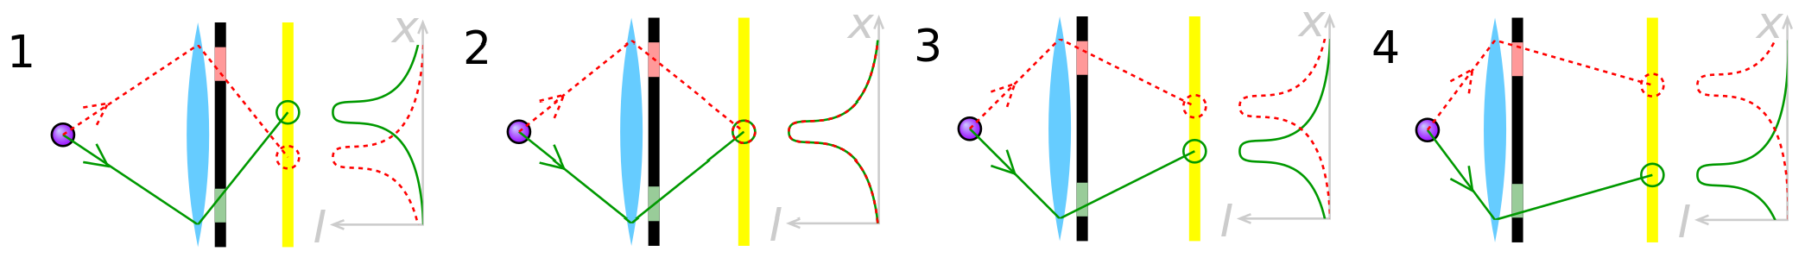
Summary
      A laser distance meter is a device which uses a laser beam to determine the distance to an object.
      Depending on usage one should choose the right operating method (CMOS or PToF).
      Nowadays laser metering devices are relatively affordable.
Fun Fact: CMOS is 16 times lighter than PToF
Figure 2: Distance measurement with PSD. Figures 1 to 4 represent conditions where the lens is focused (1) too near, (2) correctly, (3) too far and (4) much too far.

