Slide 1
POLITIZATION
OF THE REFUGEE ISSUE
Hanne Verstraete, Karen Moonen, Simon Van Meervenne & Stan Driesens (students)
Bart Van Bouchaute & Tim Vanhove (lecturers)
Bachelor Social Work – specialisation social policy
Arteveldehogeschool
Academiejaar 2015-16

Slide 2
Research project with students 3th year social work- specialisation social policy
Three research projects based on specific questions of organizations in our working field
One central focus
    “What is the role of civil society organizations
    in the politization of the refugee issue?”

Slide 3
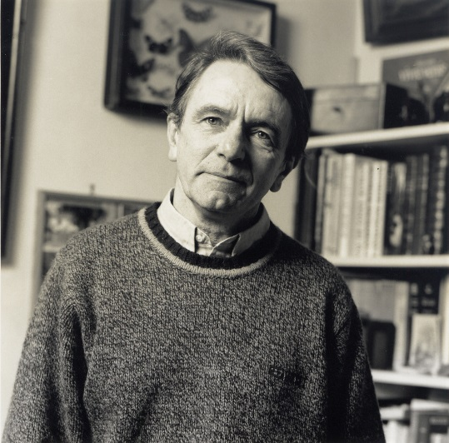
Politization?
Challenging the existing order
The existing social order
  Everyone and everything has his right place
  This order is considered as normal, as common sense
Every existing order creates its own inequalities
  Modern democratic societies claim that all members are equal
  But in reality this equality never exists
Politization
  is the process of questioning and challenging the existing order
  based on the assumption that we are all equal
In this process everyone can act political
  all kinds of methods and actions can be used,
  the key point is that people start to think and act ‘political’
Jacques Rancière

Slide 4
Politization challenging the existing order around refugees
’REFUGEES’
have very specific places
in the existing order:
”the asylum seeker”
”the recognized refugee”
”… not recognized...”
”undocumented immigrants”…
with proper procedures, (no) rights, position in society, (no) voice…
and this existing order is considered ”normal”
(How) can people question and challenge this existing order?
The existing social order
  is considered as normal
  creates its own inequalities
Politization
  questioning and challenging the existing order
  based on the assumption that we are all equal

Slide 5
Politization of the refugee issue?
Three research projects
ORGANISATION | ACTOR | ISSUE
NGO ’Refugee Flanders’ | ADVOCACY ORGANISATION | How can an NGO influence the creation of safe and legal access to Belgium/EU?
Municipal social welfare | WELFARE WORKERS | How can public welfare workers realise human rights for refugees?
Voluntary organisations in Gent | VOLUNTEERS | How can volunteers become politicised?

Slide 6
How CAN volunteers become politicized?

Slide 7
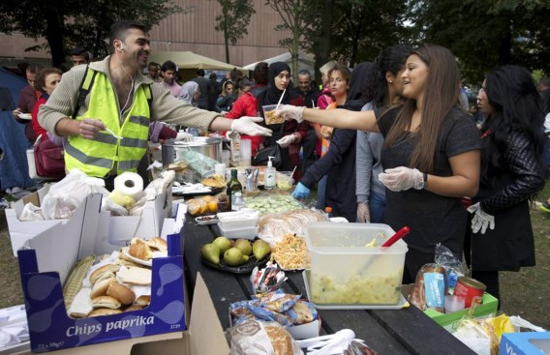
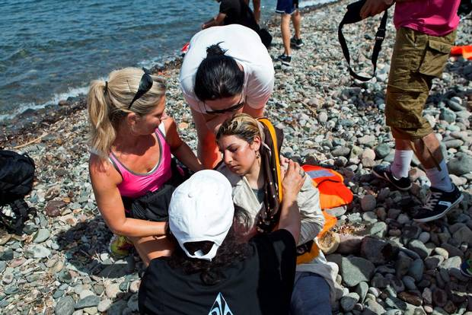
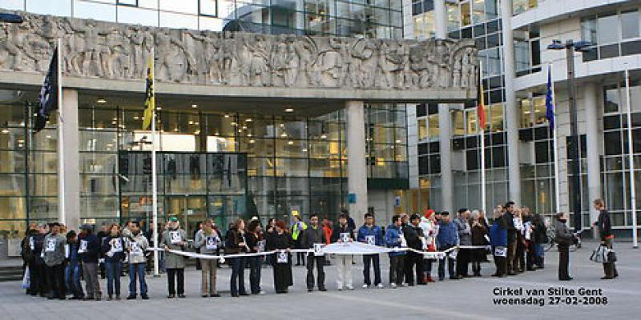
Volunteer initiatives
Collecting for Calais
Lesbos refugees aid
Solidarity chain Ghent
Notes:
Solidarity chain Ghent

Slide 8
Volunteer organisations are …
depoliticising
politicising
  Replace the failing support of the responsible authorities
  Limit solidarity with refugees to first aid support
Volunteer initiatives obstruct a more structural approach to maximise human rights
Citizens take action where governments fail
They draw attention to the responsabilities of services and authorities
They stimulate awareness of the involved volunteers

Slide 9
Research Questions
How can volunteers become politicised?
Do volunteers see the social needs of refugees?
Do they question the existing order?
Do they undertake actions?
How can volunteer organisations stimulate this politization process?

Slide 10
Research method
Focus on voluntary work for/with undocumented immigrants (“paperless”)
Exploratory interviews with key persons
Participatory observations in volunteer organisations
Analysis & conclusions
We present one case

Slide 11
Hand in Hand
Started as antiracist campaign
Focused on support for the “paperless”
Actions
  Support the complete integration process
    Practical, juridical, …
    Claiming papers (regularisation)
    Language, schools, work,…
  Public campaigns
Mission statement:
undocumented immigrants are seen as equal
notions of ‘human rights’ & ‘human dignity’

Slide 12
Politization of volunteers in ‘Hand in Hand’(1)
Assumption: volunteers & refugees are equal
  Former “paperless” involved in all actions
  Brunch where everything is discussed
Broad & accurate view on social needs:
  Material needs, education, social contacts, language, parenting support, legal aid….
  Based on continuous dialogue with refugees

Slide 13
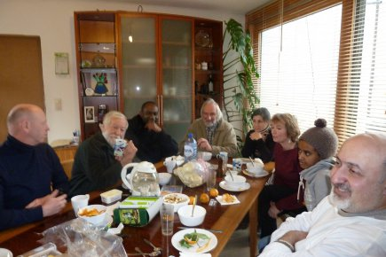
Brunch with volunteers

Slide 14
Politization of volunteers in ‘Hand in Hand’ (2)
[racist posters that black refugees spread illnesses]
“Do I look sick to you? These people I work with are humans. The only one that is sick is you. Sick in your mind.”
Questioning the existing order
    Prejudices in media & public opinion
    Lack of support for actual asylum seekers
    End of the integration program for the “paperless” in Ghent
    …
Undertaking actions targeted on:
    Individuals: Ghanees volunteer confronts neighbours
    Services: challenging professionals to deliver services according to the real actual needs
    Society: remembrance wake for the falen during the dangerous trip to safety

Slide 15
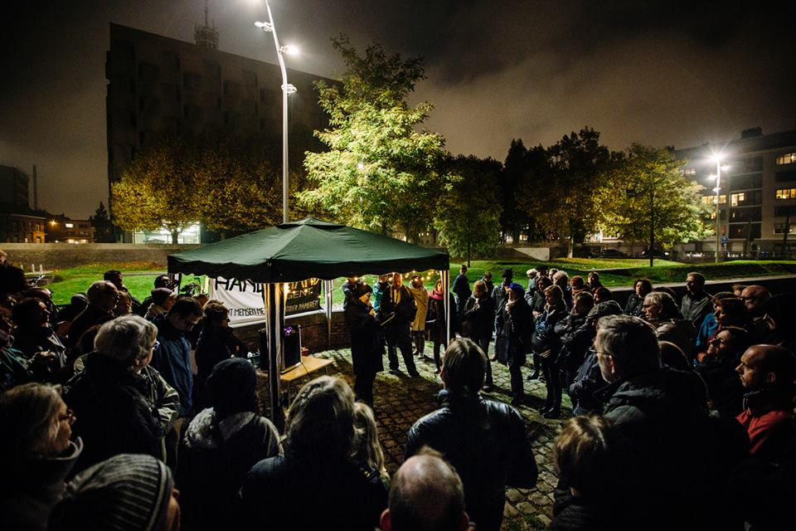
Remembrance wake Nov 2th 2015

Slide 16
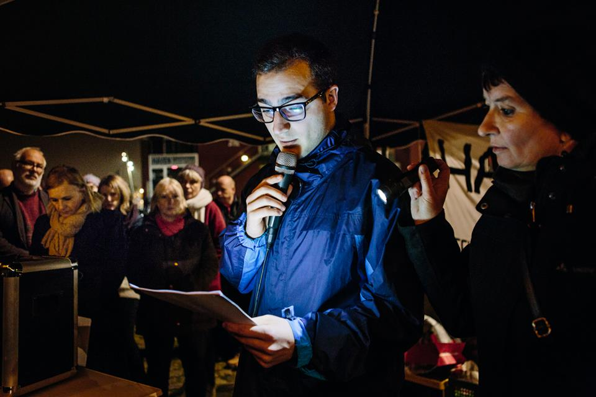

Slide 17
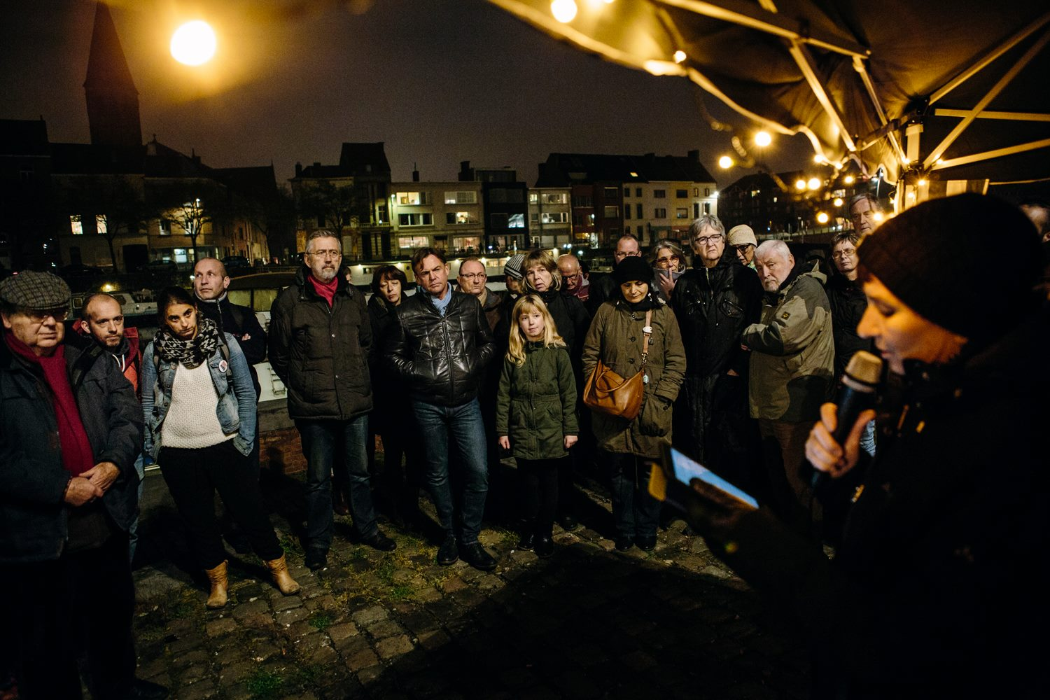

Slide 18
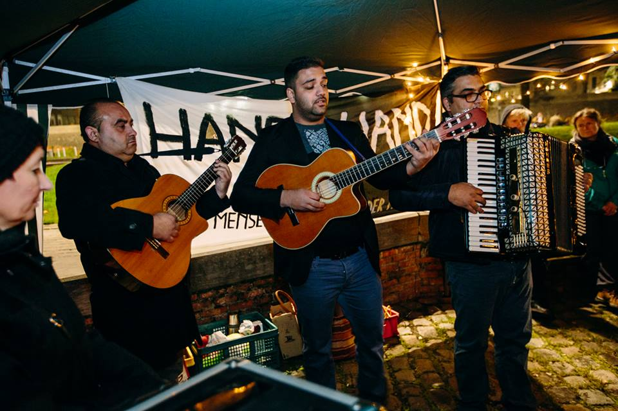

Slide 19
How is politization of the volunteers stimulated in Hand-in-hand?
Equality in a horizontal organization
  Experienced volunteers, ex-paperless, students… = all equal
  Refugees are not passive recievers of help
Mission > politized practices – volunteers can participate
  Support for and with the “paperless”
  Sensibilisation with volunteers in school, associations, clubs, …
  Public actions and statements
Sharing relevant information
  Informal during all activitities, brunch…
  Formal: thematic infosessions, magazine…
Position in the work field
  Constructive & critical in a network with other organizations
  Total independent from the government

Slide 20
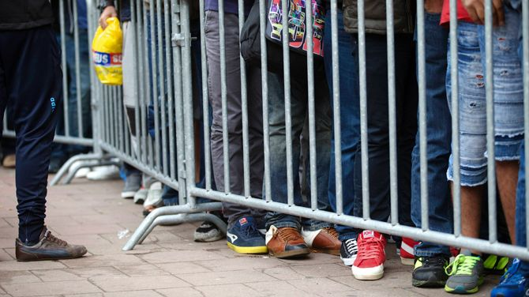
How can public welfare workers realise human rights for refugees*
* How can we activate them towards that goal

Slide 21
The question :
Complaints of refugee organisations
  Incorrect or incomplete aid by welfare workers
  Refusal of aid
Problems with specific procedures
[depending on legal status of refugees]
  Danger for stigmatisation
  Contradiction with equality-principle
  Different treatment in a positive and negative way

Slide 22
Research methodology
Exploratory interviews with experts
    Human right researchers – field workers – scholars - …
Depth interviews with municipal public welfare institutions
    Bottom-up (case workers)
    Top-down (political board)
  Diversity of political background and demographic situation

Slide 23
Profile public welfare worker
(Boeie)(Bovens & Zouridis)
Strong aim and incentive towards procedures and technical correctness
Implementing and controlling function
  You get something – for something policy
Pressure on the role and autonomy of the welfare worker
  Municipal Welfare center
  First line service led by political board
  Finnish ‘Kela’ & Dutch ‘Gemeentelijke sociale dienst’

Slide 24
Problems within public welfare for refugees
Different municipality – different treatment
  “not in my backyard syndrome”
Problems with access of public welfare
  Out of fear
  Out of disinformation
  Because of specialization within social work
Notes:
Aanvullen met :
In Belgium we estimate that 60 % of asylum seekers will be granted asylum. A large group of people who already live in the shadows (undocumented) the 100.00 I spoke about will probably be joined with a lot of the 40 % who will not get asylum. That’s a reality who get’s ignored by policy makers and social welfare institutions.

Slide 25
Reasons?
Internal constraints
Public Welfare workers see themselves as facilitators
Trapped position between client and boss
Accept that their actions will not lead to results
Too weak to voice their concerns or opinions
Lacking knowledge of influencing politics and public opinion
Administrative pressure

Slide 26
Reasons ?
External constraints
Strong influence on decision-making by the Council
Depending on regional and national funding
Influence by national policy making
Trends in society

Slide 27
Solutions on the level of the public welfare worker
Welfare workers should take discretionary space
  Every rule needs his interpretation (De Haene, 2015)
  Discretionary space >>
  space for promoting human rights for ‘refugees’ (asylum seekers, refugees, undocumented immigrants…)
Knowledge, skills and ethics of the welfare worker

Slide 28
Solutions in the environment of public welfare worker
  Social education (training the minds)
  Uniting individual social workers
  Influencing policy-makers
  Installing pride of social work (winning the minds)
  Fight to get municipal social work less influenced by policy makers but based on universal human rights and solidarity

Slide 29
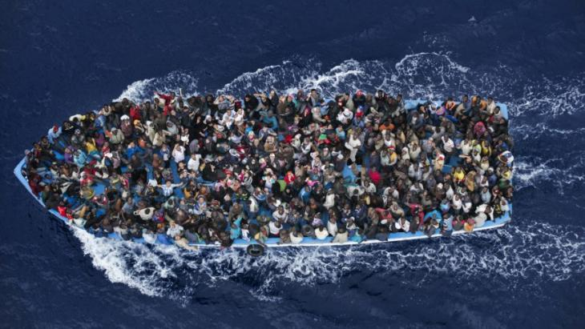
How can an NGO influence the creation of safe and legal access to Belgium/EU?
Notes:
.

Slide 30
Context
Refugee Work Flanders in a dual position
  Service > works as a partner with the government
  Advocacy > is critical for the government policy
Aim:
  Convince political parties to create safe and legal ways to enter Belgium and the European Union.
Method
  Lobbying
  Problem: negative change in public perception
politization

Slide 31
Research Methodology
Parliamentary documents
Opinion
of the political parties
4 Newspapers
5 interviews

Slide 32
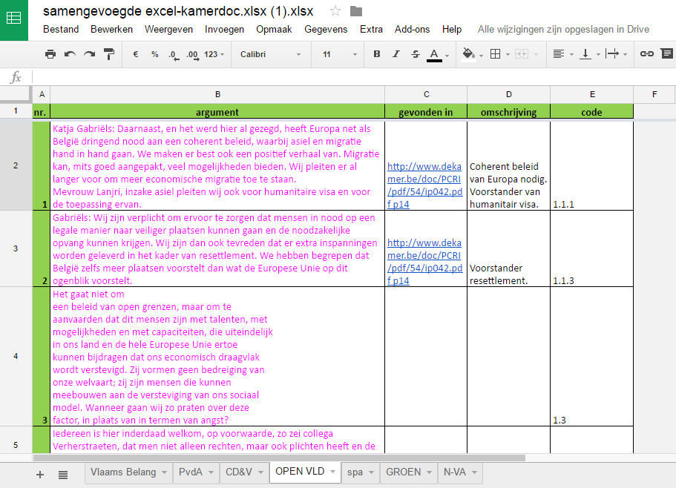

Slide 33
Analysis
Positive towards
Safe and legal acces
CD&V
(Christian Democrats)
Groen
(Greens)
N-VA
(Flemisch Nationalists)
Open VLD
(Liberals)
Sp.a
(Socialists)
Vlaams Belang
(Extreme right)
Notes:
Blauw:
sp.a, CD&V en Groen delen standpunten op vlak van toegang.
Toegang gaat over legale toegangswegen tot België en Europa voor mensen die op de vlucht zijn.
Daarnaast zeggen deze drie partijen ook voor een eengemaakt Europees beleid te zijn.
Groen:
Coalitie van de 5 grootste partijen als het gaat over:
‘Nederlands leren en werken’
‘voorstander van een federaal spreidingsplan’
Vrijwillige als het kan, gedwongen als het moet over vertrek
België moet zijn verantwoordelijkheid nemen binnen de EU.
Paars:
N-VA, Open VLD en sp.a zijn voor het tijdelijker maken van het statuut voor oorlogsvluchtelingen. Groen is daar expliciet tegen. Van CD&V is hier geen informatie over.
grijs:
N-Va en Vlaams Belang zijn voor het aanpassen van de conventie van genève: aanpassen = verstrengen
Bruin:
Aanpassen sociale zekerheid: N-VA en Open vld
Onthouden; vlaams belang en groen
Expliciet tegen: cd&v en spa
Rood: Humanitair visum:
Spa, CD&V, groen en Open vld: komen overeen op belangrijkste punten. => Open VLD spreekt zichzelf wel soms tegen…
(nl. uitbreiding en duidelijk definiëren)
- N-VA is akkoord met het huidige humanitair visum, maar haakt af als het gaat over uitbreiding of verandering.

Slide 34
Recommendations
Bringing key figures together -> pressure on right wing nationalists (N-VA)
Reference to past initiatives
  Belgium: Kosovo (1999)
Use of examples of other countries
  Germany
  Switzerland

Slide 35
Strategic dilemma?
Aim: safe & legal access
Problem: negative climate for progression
Strategy: search for common ground with political parties in the Belgian government
Consensus strategy
Questioning the existing order | reinforcing the existing order
Notes:
.

Slide 36
Our approach …
Politization is not in the first place a specific method or action, it is a process: everyone can think and act ‘political’ starting from the idea of a more equal society and that is what really matters.

