Slide 1
1. Innovations: How can I tell if I have made an innovation?
Juha Järvinen

Slide 2
Concretize your idea
Idea
+
Substance
=
Invention
+
Commercialisation
=
Innovation
> original, new and important outcome/improvement that breaks
into a market (or to the society).

Slide 3
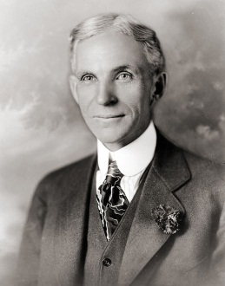
Henry Ford
1863-1947
An American industrialist, the founder of the Ford Motor Company, and sponsor of the development of the assembly line technique of mass production. Idea: anyone should have the opportunity to buy a private car

Slide 4
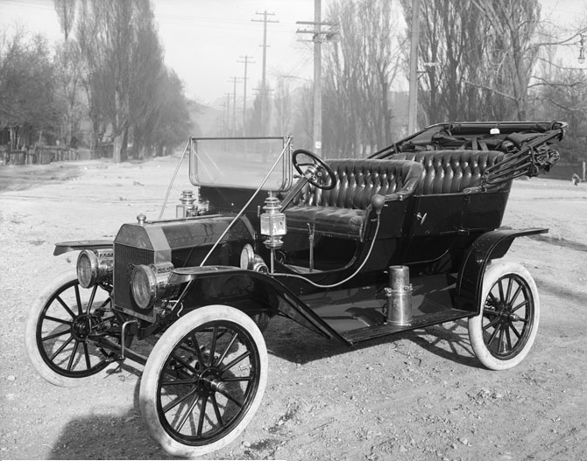
15.000.000
Ford Model T (1908-1927). Designers: Henry Ford, Joseph A. Galamb (head of design), Eugene Farkas, Childe Harold Wills (Ford logo), Henry Love, C. J. Smith, Gus Degner and Peter E. Martin.

Slide 5
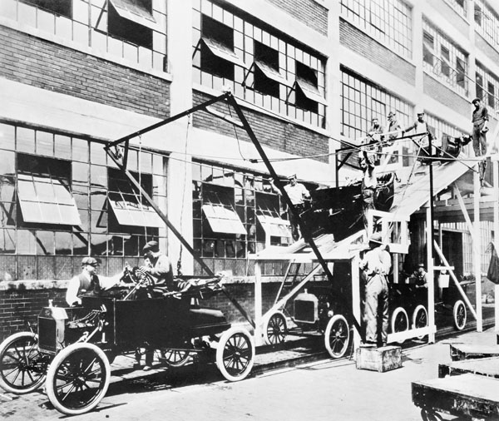
Innovation: new mobility, utilising existing inventions
in a new way.
Image source: NARA via Wikimedia Commons. Photo: unknown.

Slide 6
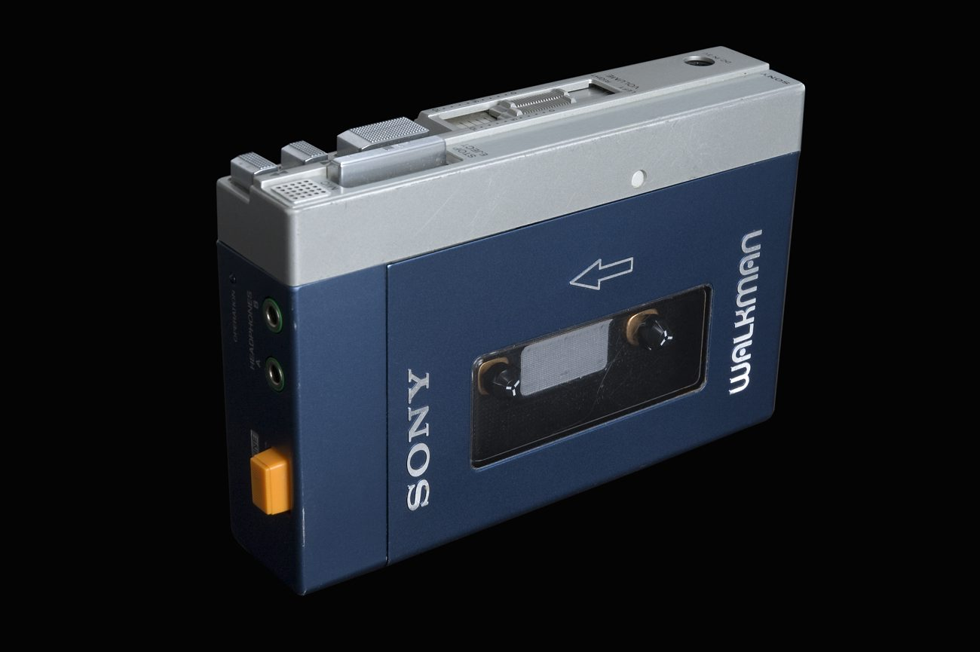
Sony Walkman. Designer: Nobutoshi Kihara. Image: Wikimedia Commons; Anna Gerdén.

Slide 7
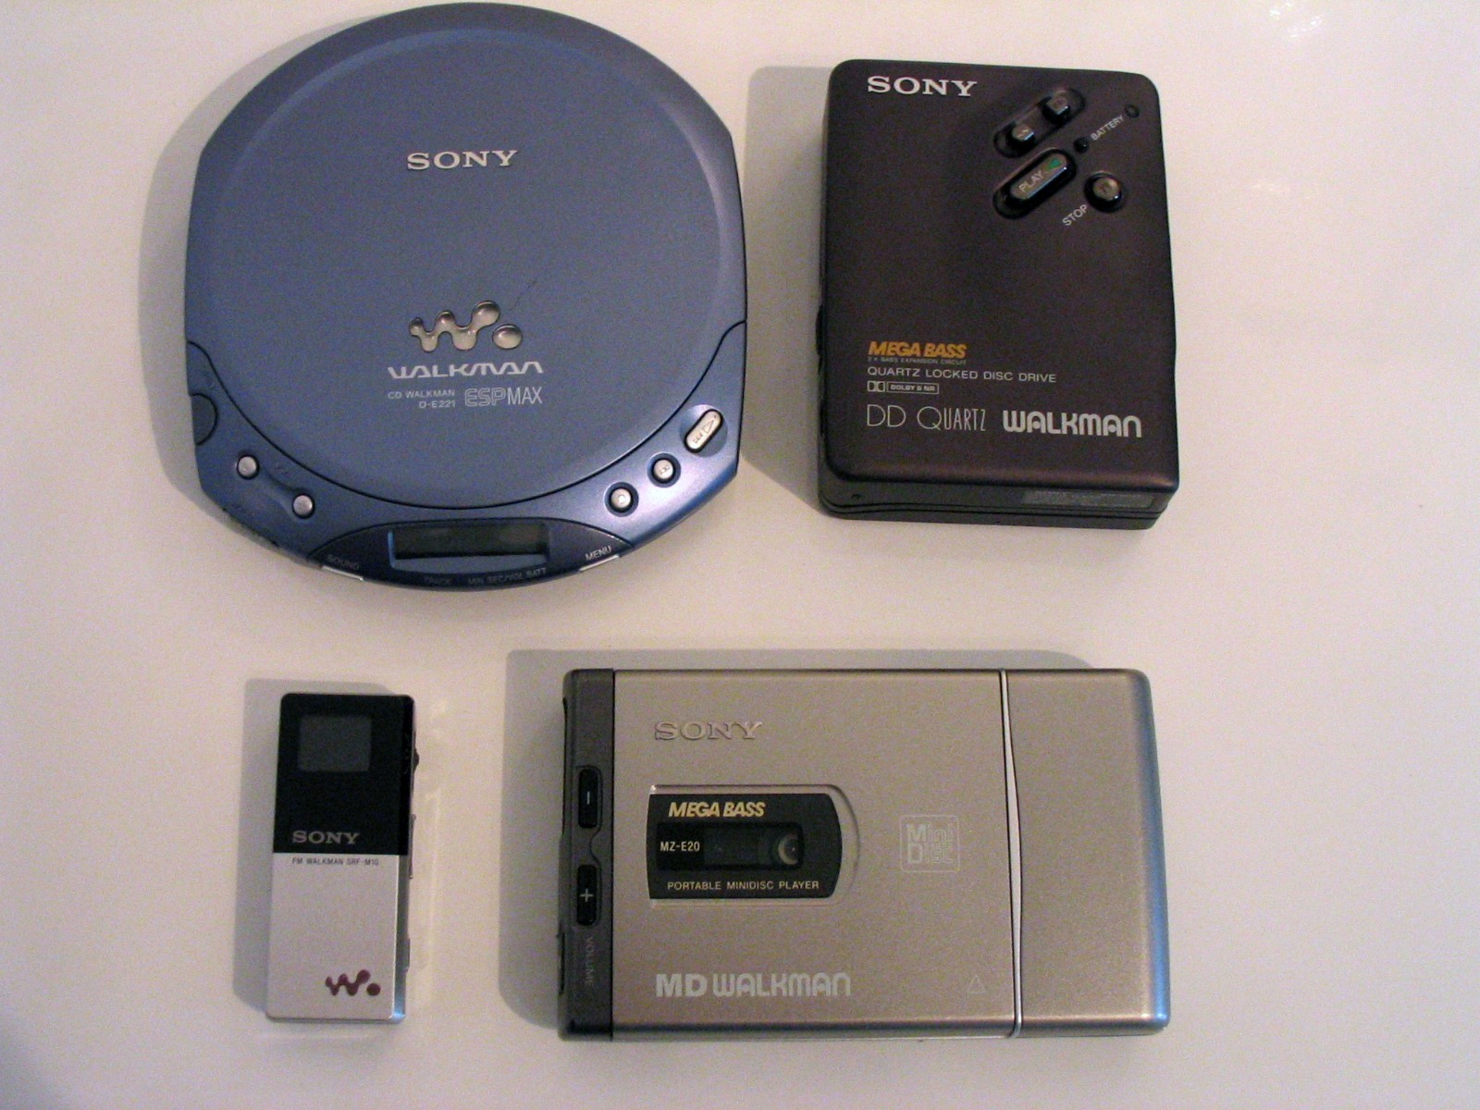
Innovation: new mobile lifestyle
Image source: Wikimedia Commons. Photo: Marc Zimmermann.

Slide 8
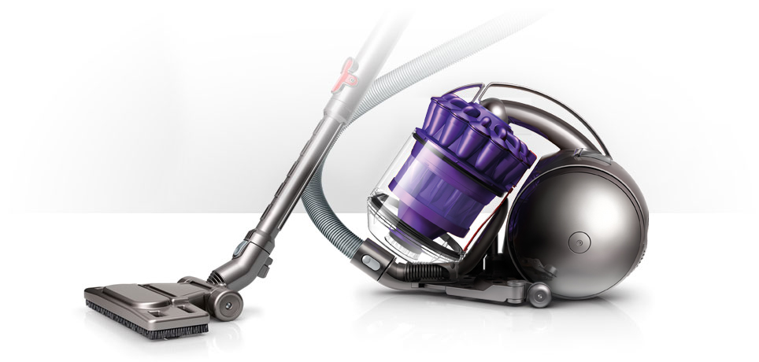
5.127
Innovation: original, new improvement to a already existing device
Image: Dyson.

Slide 9
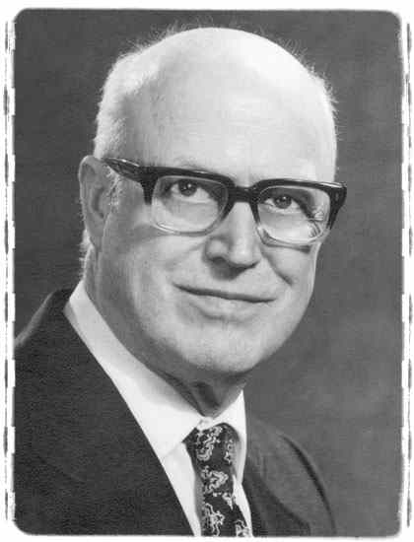

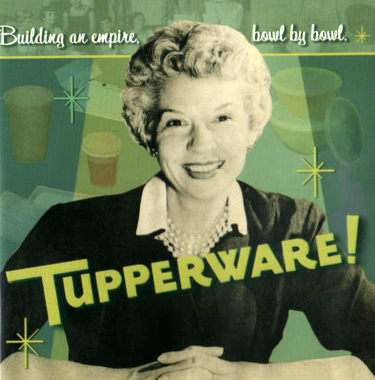
Earl Tupper
1907-1983
Stanley Co.
Innovation: new product, new business model
Brownie Wise (1913-1992)
Kuva.

Slide 10
Idea Evaluation Checklist
What is it?
Why it is (is it?) needed? (what problem it solves?)
For whom it is intended to?
What is your target group?
What about markets for it?

Slide 11
Idea Evaluation Checklist
Can it be utilised in different countries, cultures and markets without major (expensive) changes?
Who would produce it and where?
  (Establishing a factory should not be your primary idea)
What is your personal objective?
  Entrepreneurship?
  Licencing
  Something else?

Slide 12
Your Checklist
Is your idea a single product? Or do you have a multitude of ideas?
A single product concept is sometimes a good foundation to an innovation, but could your idea also serve as a basis for a whole family of new solutions?

Slide 13
Your Checklist
A simple solution to everyday problem (sliced bread or Post-It®-stickers) can sometimes turn out far more profitable than a complex solution to a obscure problem (“how could man fly to Mars? How all could use public transport instead of private cars?” etc.)
Avoid becoming too fond of your idea(s) and do not get carried away: you may forget realities, such as market needs = waste time and money.

Slide 14
Your Checklist
Work with your ideas, create new constantly!
Expose your ideas to new opinions
Contact Metropolia, ask for support and help with your ideas
Remember agreements, Agreements on the Assignments of Rights and confidentiality
If necessary, protect your work (Patents ym.)

Slide 15
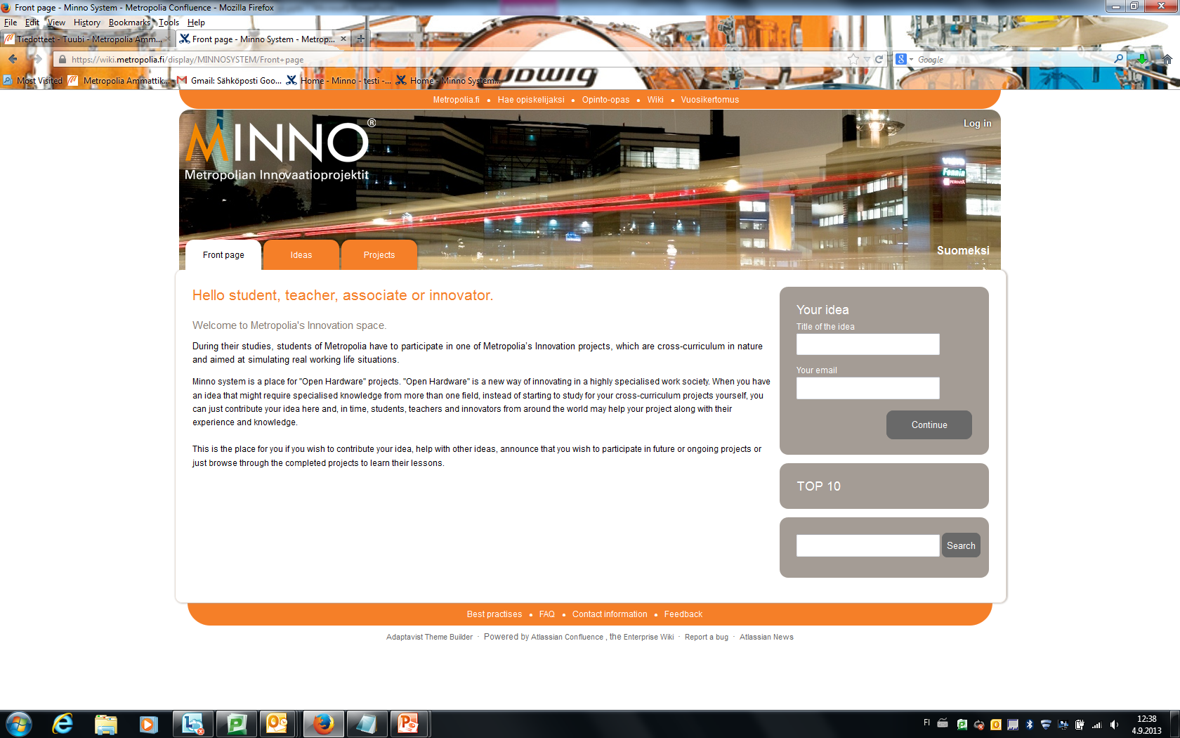
minno.metropolia.fi

Slide 16
2. What is an agreement and how to make one?

Slide 17
What is an agreement / Contract and how to make one
A voluntary agreement between two or more parties to create obligations between them.
Usually done in writing, though contracts may be made entirely orally. However…
In Metropolia, it is preferred to use agreement templates
Key issue: remember to make an agreement!

Slide 18
What is an agreement / Contract: process
xxxx

Slide 19
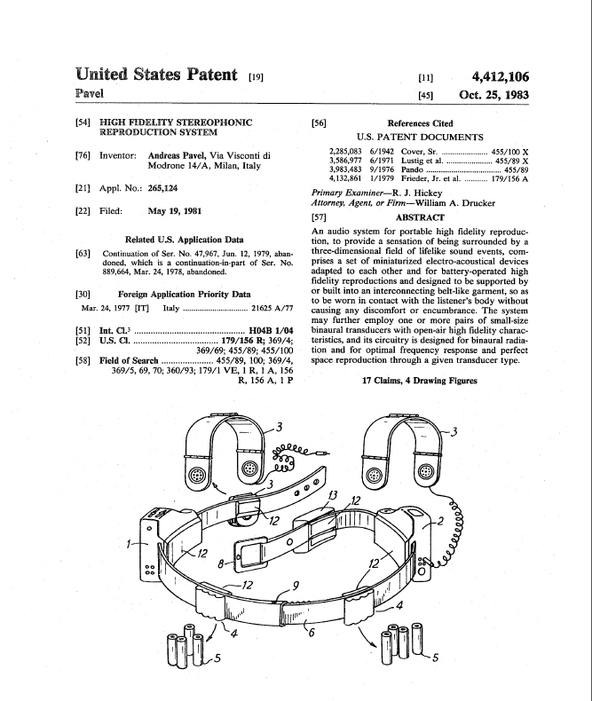

Slide 20
Thank you!
juha.jarvinen@metropolia.fi
minno@metropolia.fi

