Slide 1
MINNO® Innovation project
Final project report of the team 30/15
Team 30/15 and Laura-Maija Hero
”A modern cafe house of enlightment”
Date: 02.06-24.04
Agoston Feher, Greta Beccarello, Katariina Kumpulainen, Hanna Pekkala, Valentine del Giudice

Slide 2
3015 – Divide To Share
HOW CAN WE CREATE A PLACE FOR CREATIVE PEOPLE AND BUSINESS PEOPLE TO MEET AND FIND THE SAFE AND INSPIRING ENVIRONMENT TO SETTLE INNOVATIVE PROJECTS?

Slide 3
What is MINNO®? What is innovation?
Minno is a co-operation between Metropolia students who are doing innovation studies.
Innovation is an implemented novelty what solves a problem therefore generates value.

Slide 4
Team 30/15
Agoston Feher
tonyfeher18@freemail.hu
Greta Beccarello
gretabeccarello@gmail.com
Katariina Kumpulainen
kumpulainen.heidikatariina@gmail.com
Hanna Pekkala
hamustiina@gmail.com
Valentine del Giudice
delgiudice.valentine@gmail.com

Slide 5
A Creative Well-being space
Create a creative wellbeing space for futurists and creative people to meet
Working partner: 1530 Research, Markus Keränen
Teacher: Laura-Maija. Hero

Slide 6
Solution – Project description
A cozy café where creative and business people can meet and exchange ideas, each table would have a specific topic, or artistic field and each participant is invited to seat where he wants to take part and invest personally, creatively or financially.

Slide 7
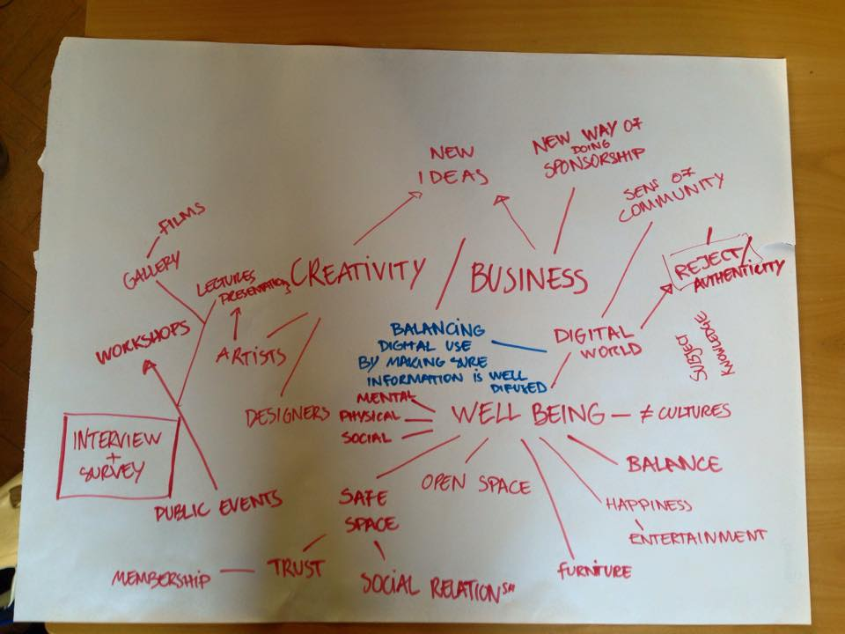
Brainstorming

Slide 8
5 developed concepts
Divide to Share: A cozy and stress free area with good cafe where each table represents a topic to discuss. Participants could freely choose between the different topics and take part in an open discussion. A viral space serves as parallel to the real discussions where people can join in or post their questions. No phone rule to avoid distraction and initiate real conversations.
“Come as you are”: Based on the Danish model the “common third” we would use different activities such as events, performances, workshops and discussion groups to trigger open discussion. Creative games, cultural gatherings, short movies would serve as the perfect foundation for sharing and creating innovative ideas.
A shared showroom: We would create an open gallery space where anyone could share. People would send their portfolio online and we would put it on the walls with their contact information. This way many talents and ideas could be shared at the same time without the stress of presentations and would be accessible to everyone in the opening hours given us by the company.
A new cafe house of enlightenment: Based on the structures of 18th century’s coffee houses we would create a cafe for the “elite” with closed membership. The space would be offered only to the successful professionals of different fields, famous or influential people who could meet up in an elegant environment and exchange ideas about creativity, innovations or the future.
Changing the hierarchy: In this concept we would put the emphasis on the students and future-business man by putting them into the center of attention. We would provide a space to meet up and organise events about their everyday concerns. We would organize CV writing/application writing workshops, provide information about internships and different courses.

Slide 9
Divide to share
The chosen concept
Instead of the traditional model of presentations, participants will discuss a topic together. They will be divided into groups by different fields or viewpoints and will look at the same problem from their own angles.
If the topic is for example “connections” the company could invite participants from different fields such as economics, social sciences or arts to discuss how they connect. Companies like Sonera would have very different answers for the question “how to connect with people?” than for example Marimekko. Once the participants discusses the questions they will come together as one big group and share their ideas with the rest of the group.

Slide 10
Creating a booklet
The outcome of the project
Our project plan is to create a booklet. In this booklet we will give simple but throughout step by step instructions on how to facilitate a meeting where all participants become an active part of the innovative process.

Slide 11
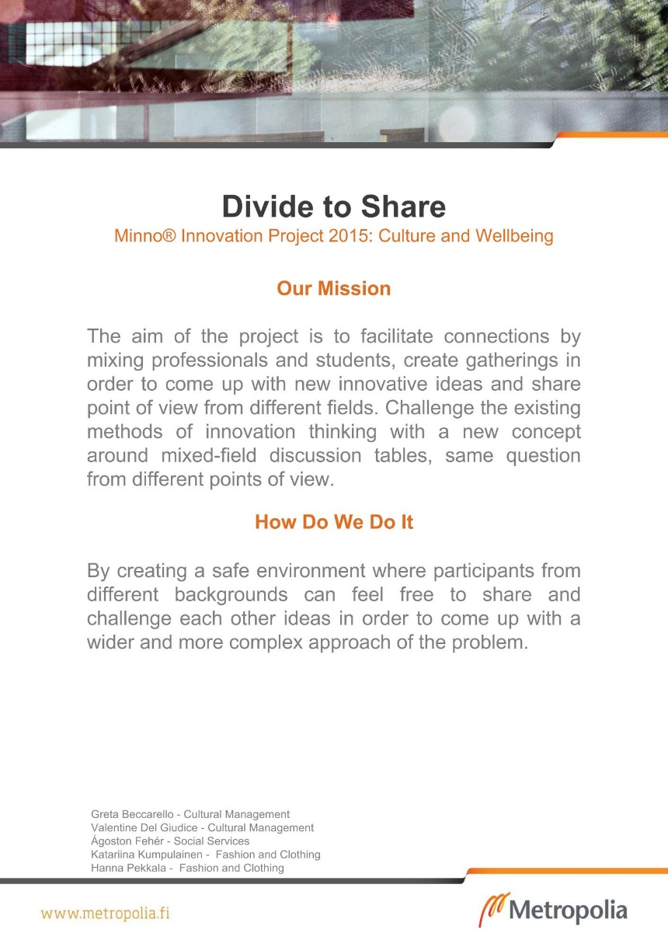
Poster

Slide 12
Project plusses and minuses
+
-
Working together with people of different fields
Possibilities for Networking
Teamwork
Improving communication skills
Practicing real-life flexibility
Not enough interaction with the company
Workload hours
Orientation was sometimes unclear

Slide 13
Team work – how did you guys succeed in that?
Team work was good. The workload was shared fairly and everyone participated in the preparations and making of the project. Networking and communication went smoothly but there was too much hours of workload considering that we had other courses, work and different schedules in the same time.

Slide 14
Internal and external communications
Communication within the group was great. We used the viral space and google docs smoothly.
Communication with the teacher was easy and smooth.
Communication with the company was difficult because of their very busy schedule.

Slide 15
What have you learnt as a group?
We learnt to work in a team with people of different professions and cultures.
We learnt how to create a project plan and a booklet as a group.
We learnt how to use efficiently google docs and found new ways to work through the virtual space.

Slide 16
How should we develop the innovation project? How would you learn even more?
Initiate participation from the companies so they would work with the students
Give more clear instructions
The work hours are very hard to accomplish

Slide 17
