Slide 1

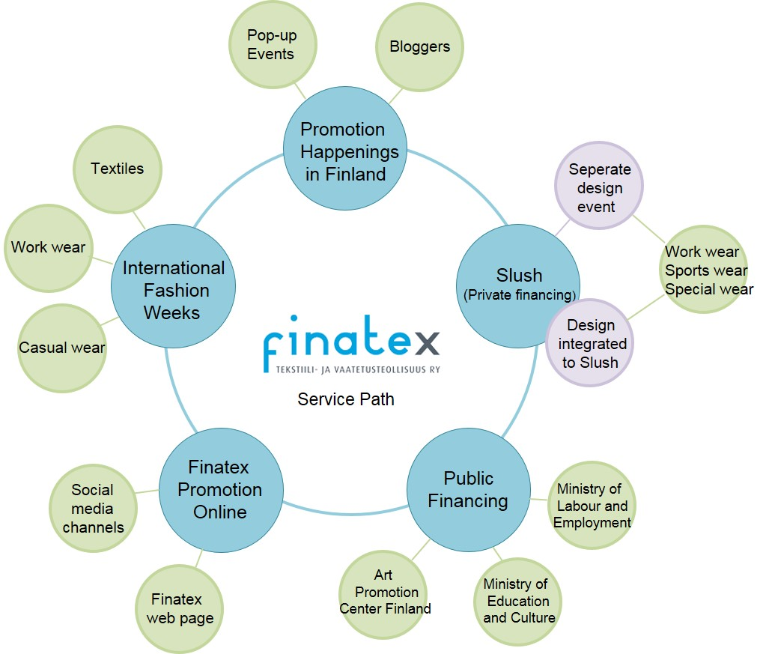






- Finnish Fashion Abroad
Minno® Innovation Project 2015: Culture and Wellbeing
Mission
To innovate tools for increasing and creating the networking of Finnish clothing SMEs at international markets
End Result
A concept plan combining Slush and fashion, participating in fashion weeks, creating pop-up events and building up social media channels

