Slide 1
MINNO® Innovation project 2015 – Final project report
The InnoIV Group
15/30 Research
10.4.2015

Slide 2
Our innovation project
Our innovation is the InnoWindow concept. It is an interactive window idea which will provoke the passers by to respond to certain questions, to collect their feedback which can be useful for instance, for a survey or business expansion.

Slide 3
What is MINNO®? What is innovation?
MINNO is a multidisciplinary Innovation Project in Metropolia which aims at creating new value in the work life by developing creative and innovative solutions in our surrounding society.
So Innovation is something new, it can be a product or a new way of doing some old process and they crerate a positive value for life by being used.

Slide 4
The InnoIV Group
Fiorenza Marani
Inka Vähäkuopus inka.vahakuopus@metropolia.fi
Didi Slavtcheva
Shweta Phull

Slide 5
Solution – Project description
Our challenge: Creating a well being space, either virtual or/and physical for the creative people to meet, feel energized and share ideas.
Solution: creative space here, is the InnoWindow which will serve the purpose of the idea generation through crowd sourcing. The novelty is in using the windows of shops and offices as means of communication and interaction between businesses and the randomness of passersby. The ways of interactions can be endless: from touch screen technology to the low tech options of markers and post-it notes.

Slide 6
Outcome
The InnoIV group developed a brochure and a power point presentation for 15/30 Research to use in their business activities.

Slide 7
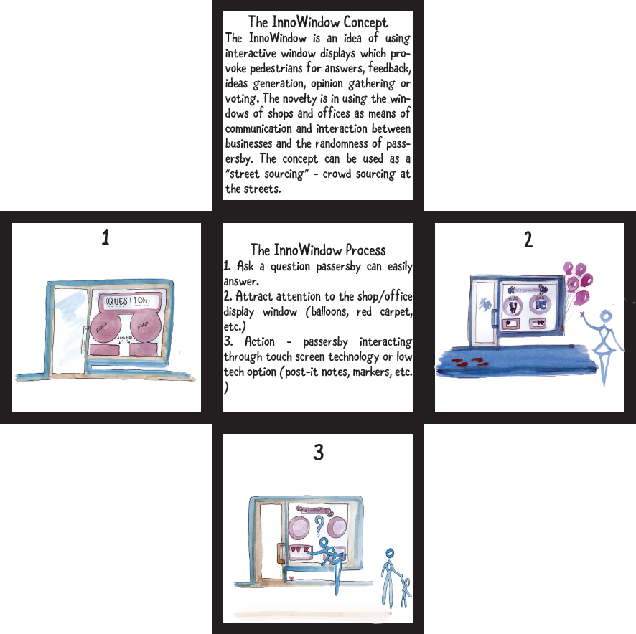

Our brochure

Slide 8
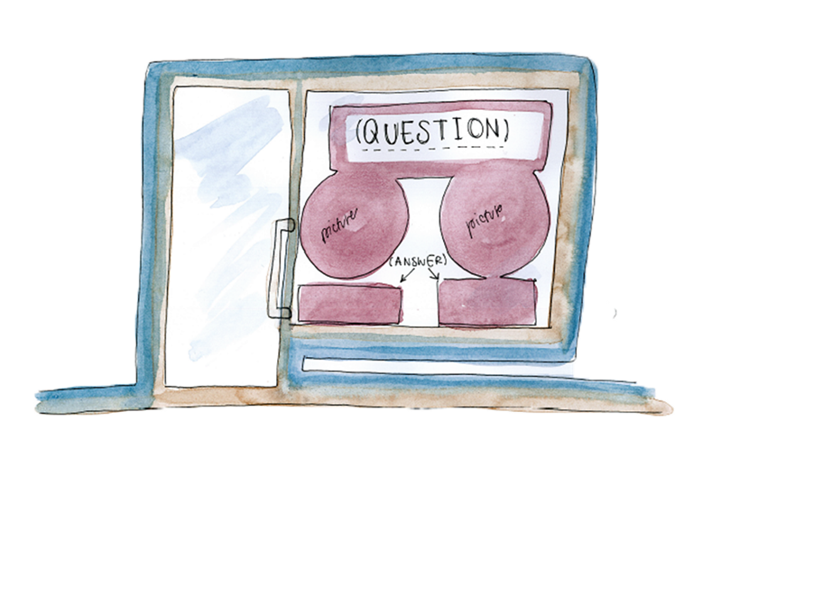
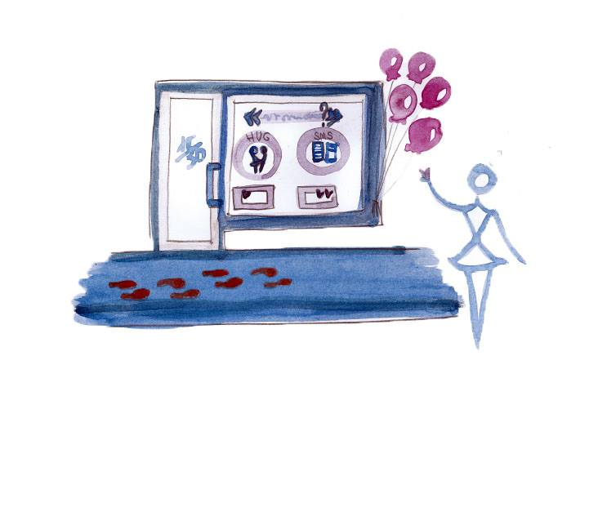
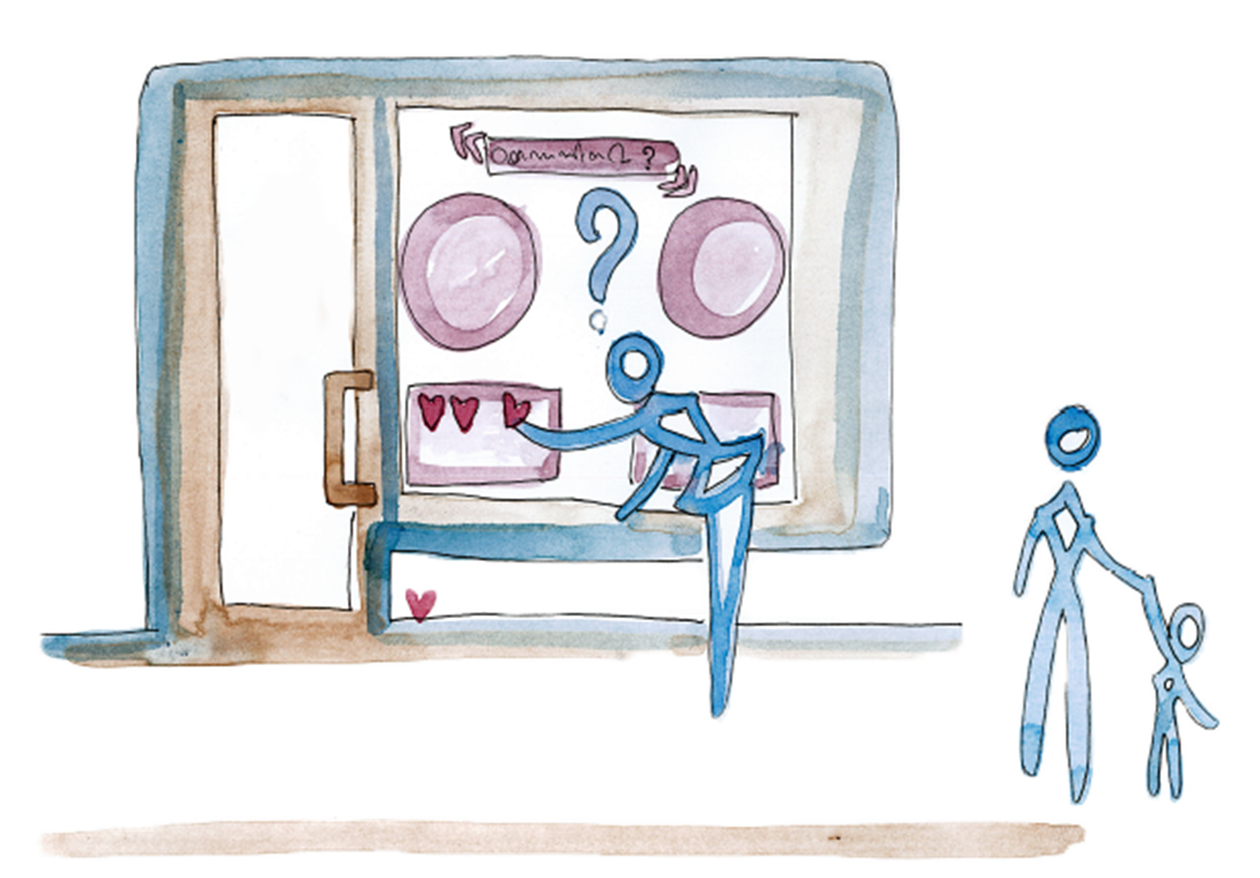
InnoWindow Process

Slide 9
Project plusses and minuses
+
-
Creative
Imaginative
Futuristic aspect
Business aspect
Freedom to work with our imaginations
Lack of communication from the client
Timeless(because of the other courses)
Lack of guidelines
Continue to next page

Slide 10
Team work – how did we succeed…
Through the willingness to work together.
Through effective communication, trust and openess in the group.
Creative and diverse ideas originated from different backgrounds
By planning everything ahead
Through organizing group meetings
Through effective division of work

Slide 11
Internal and external communications
Fcaebook discussions
Contact teaching
Group meetings at the school

Slide 12
We learned….
Innovation skills: cognition
Communication skills: making ourselves understandable to others.
Social skills: team work, cooperation
Networking skills: trust towards others
Creative skills: willing to experiment, imagination, having a futuristic vision.

Slide 13
We can learn more through…
More free time in the schedule for the group work as all the group members come from different field of study and so have the different schedules.
More guidance from the client

Slide 14



InnoWindow
Our challenge: Our challenge: Creating a well being space, either virtual or/and physical for the creative people to meet, feel energized and share ideas.
Solution: creative space here, is the InnoWindow which will serve the purpose of the idea generation through crowd sourcing. The novelty is in using the windows of shops and offices as means of communication and interaction between businesses and the randomness of passersby. The ways of interactions can be endless: from touch screen technology to the low tech options of markers and post-it notes.
Outcome: We, the InnoIV group developed a brochure and a power point presentation for 15/30 Research to use in their business activities.
Notes:
Susanna Tikkanen DEVELOPER, COMMUNICATIONS SHERIFF susanna.tikkanen@iki.fi
Heini Honkaniemi DEVELOPER, CONTENT MANAGER heinihonkaniemi@gmail.com
Arttu Volanto DEVELOPER, PROJECT MANAGER arttu.volanto@gmail.com

Slide 15

InnoWindow
Our patner from work life : Markus Keränen,15/30 Research
Teacher’s name: Laura-Maija Hero
Team members names and diciplines:
Shweta Phull, Social Services, SP13S1
Dimitrinka Slavtcheva, Social Services, SP13S1
Inka Vähäkuopus, Occupational Therapy, SG13K1
Fiorenza Marani, Fashion Design, KF12S2, KF12S1
Project manager: Fiorenza Marani

Slide 16
