Slide 1
Helsinki Metropolia meets Mahara
Dr Terhi-Maija Itkonen-Isakov and Timo Raatikainen

Slide 2
Structure of the Presentation
About RPL in Helsinki Metropolia UAS
Aspects to be evaluated and requirements for e-portfolio platform
What is Mahara and how it works
Mahara Metropolia in practice
Students’ experiences
Present thoughts about e-portfolio platforms and their possibilities

Slide 3
Recognizing Prior Learning (RPL)
Learning does not always take place in the classroom: it also happens on the job, at home, and in the community. The recognition of prior learning is a reliable process that takes into consideration All learning by examining what a person knows and can do. http://www.aeei.gov.sk.ca/rpl

Slide 4
RPL project in Helsinki Metropolia UAS 2008 - 2010
Spring 2008: first educations to staff about RPL and Lifelong learning requirements, decision to start RPL project
Autumn 2008: project group created, process and blankets were created
Spring 2009: piloting groups started in four fields of study
Autumn 2009: more piloting groups, more detailed process, also student’s opinions, development of electronic personal curriculum starts
Spring 2010: sharing of good practises in RPL, need of e-portfolio
Autumn 2010: end of RPL piloting, start of Mahara piloting

Slide 5



Education & Employment History
How to recognize?

Slide 6


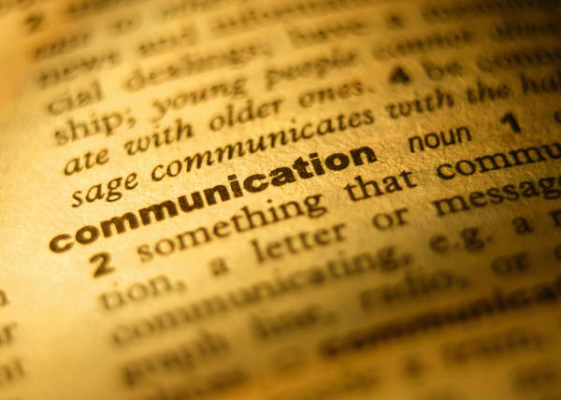





Skills, publications, certificates
How to recognize?

Slide 7

Where to Collect, Select & Share?
How to show the skills?
Safety & ownership of data?
Social networking functionality?
Flexible control of the visibility?
Is everything lost, if I quit?

Slide 8
What is Mahara and how it works

Slide 9
Mahara - Te Reo Māori to ‘think’ or ‘thought’
New Zealand 2006
Electronic portfolio, weblog, resume builder and social networking system
Piloted at Helsinki Metropolia UAS since August 2010
  About 600 users until now.

Slide 10
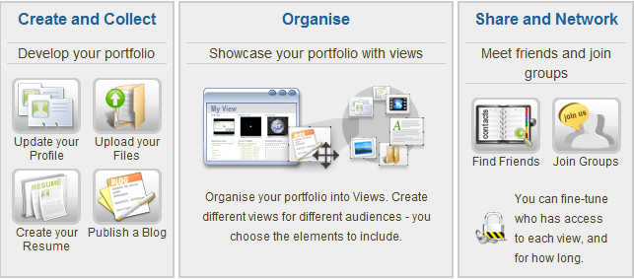
The Main Point of Mahara
http://demo.mahara.org/

Slide 11
Mahara to Collect, Select & Share
Safe platform, on its’ own server
Open source, free of charge
Users own their data
Social networking functionality
Different views for different audiences
Exportation of data at any time

Slide 12
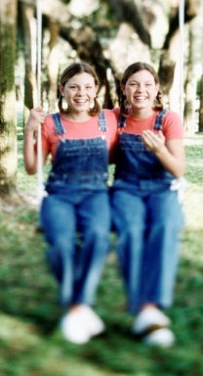
Mahara PLE & Moodle VLE
Educational Videos
made with
Connect Pro
-Jing
-Camtasia Studio
Catch everything into
M O O D L E
Teacher’s
Blog
and
Course’s
Wiki
on
some platform
Linked by weblinks
Linked
by feeds
Linked by weblink
Linked by feeds
Linked by feeds
Students
Wikis
on
different platforms
Mahara
E-portfolio and
Networking
platform
Students
Blogs
on
different platforms

Slide 13
Mahara-Moodle integration possibilities (=Mahoodle)
single-sign on between both systems
users' profile information is ported across
possible to submit Mahara Views to Moodle for assessment

Slide 14

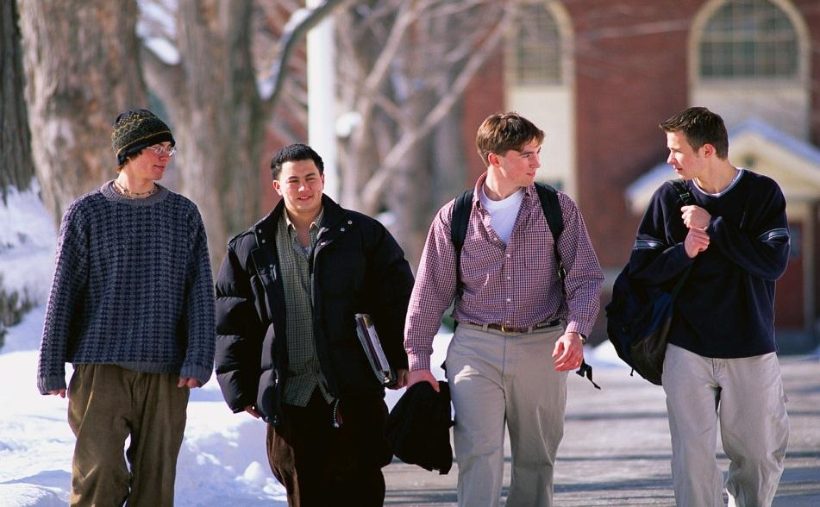


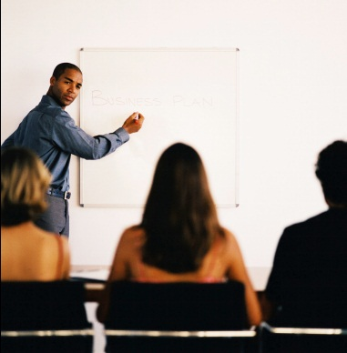
Moodle VLE, Mahara PLE & WWW

Slide 15
Mahara Metropolia in practice

Slide 16
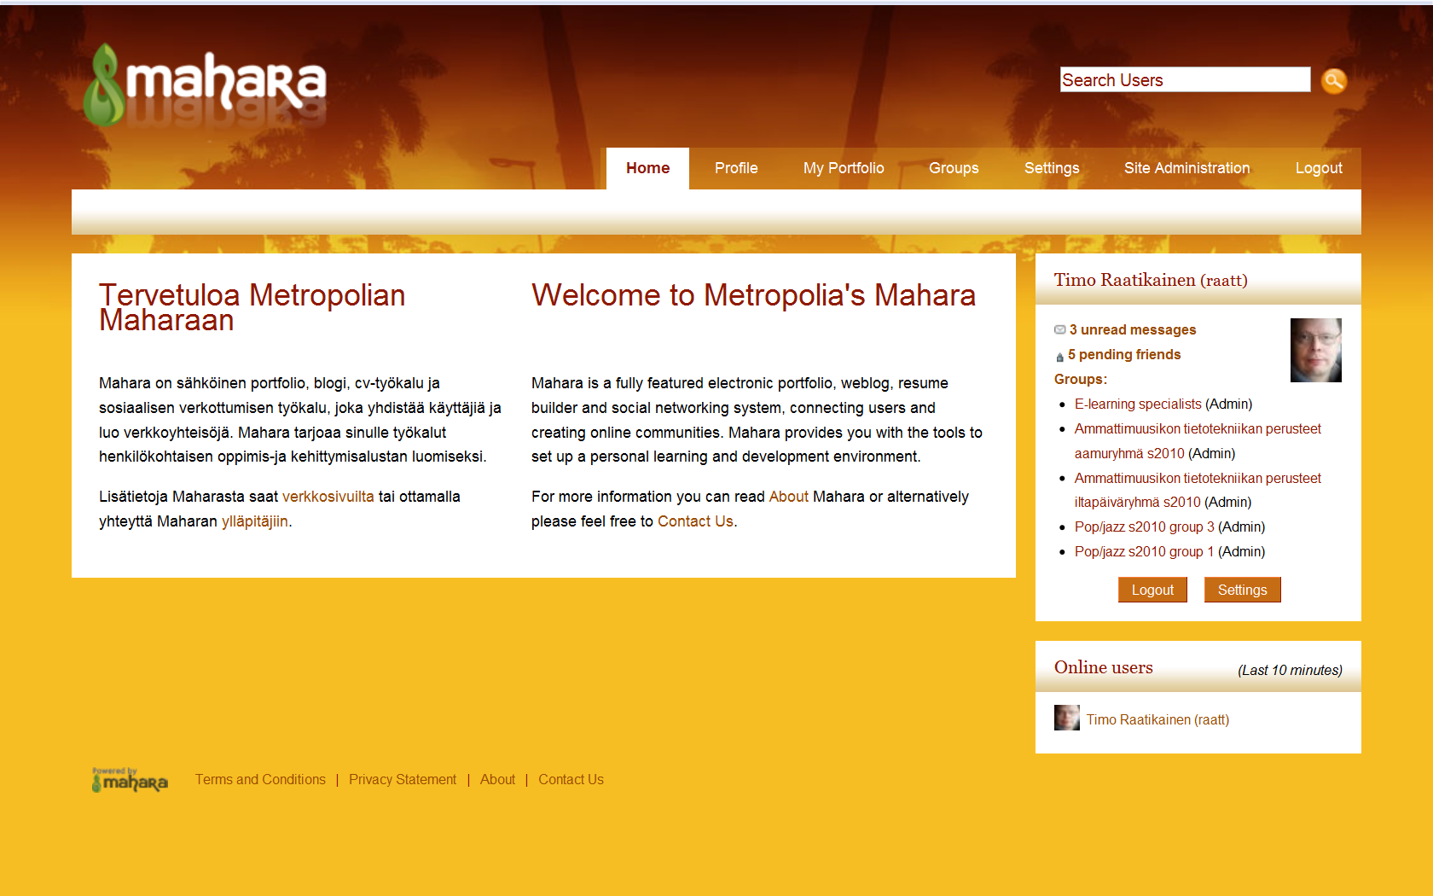
Entering

Slide 17
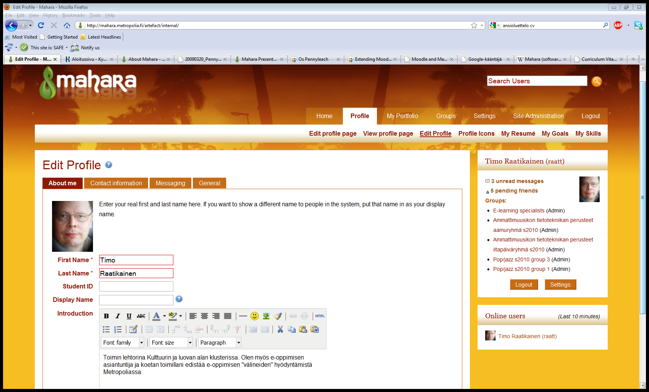
Editing Profile

Slide 18
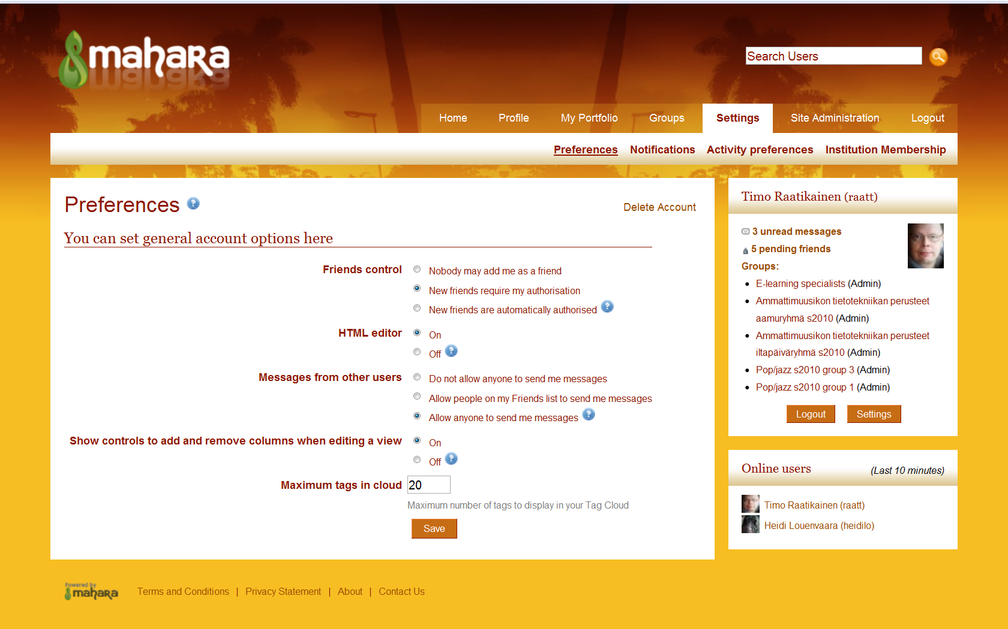
Setting Options

Slide 19
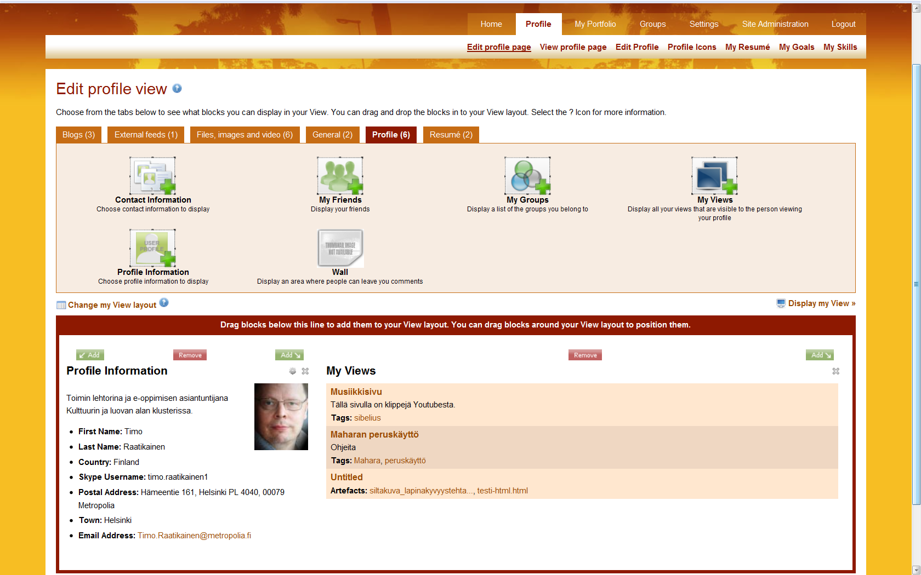
Others see your profile page
My Friends
My Groups
My Views
Wall
available
only on the profile page

Slide 20
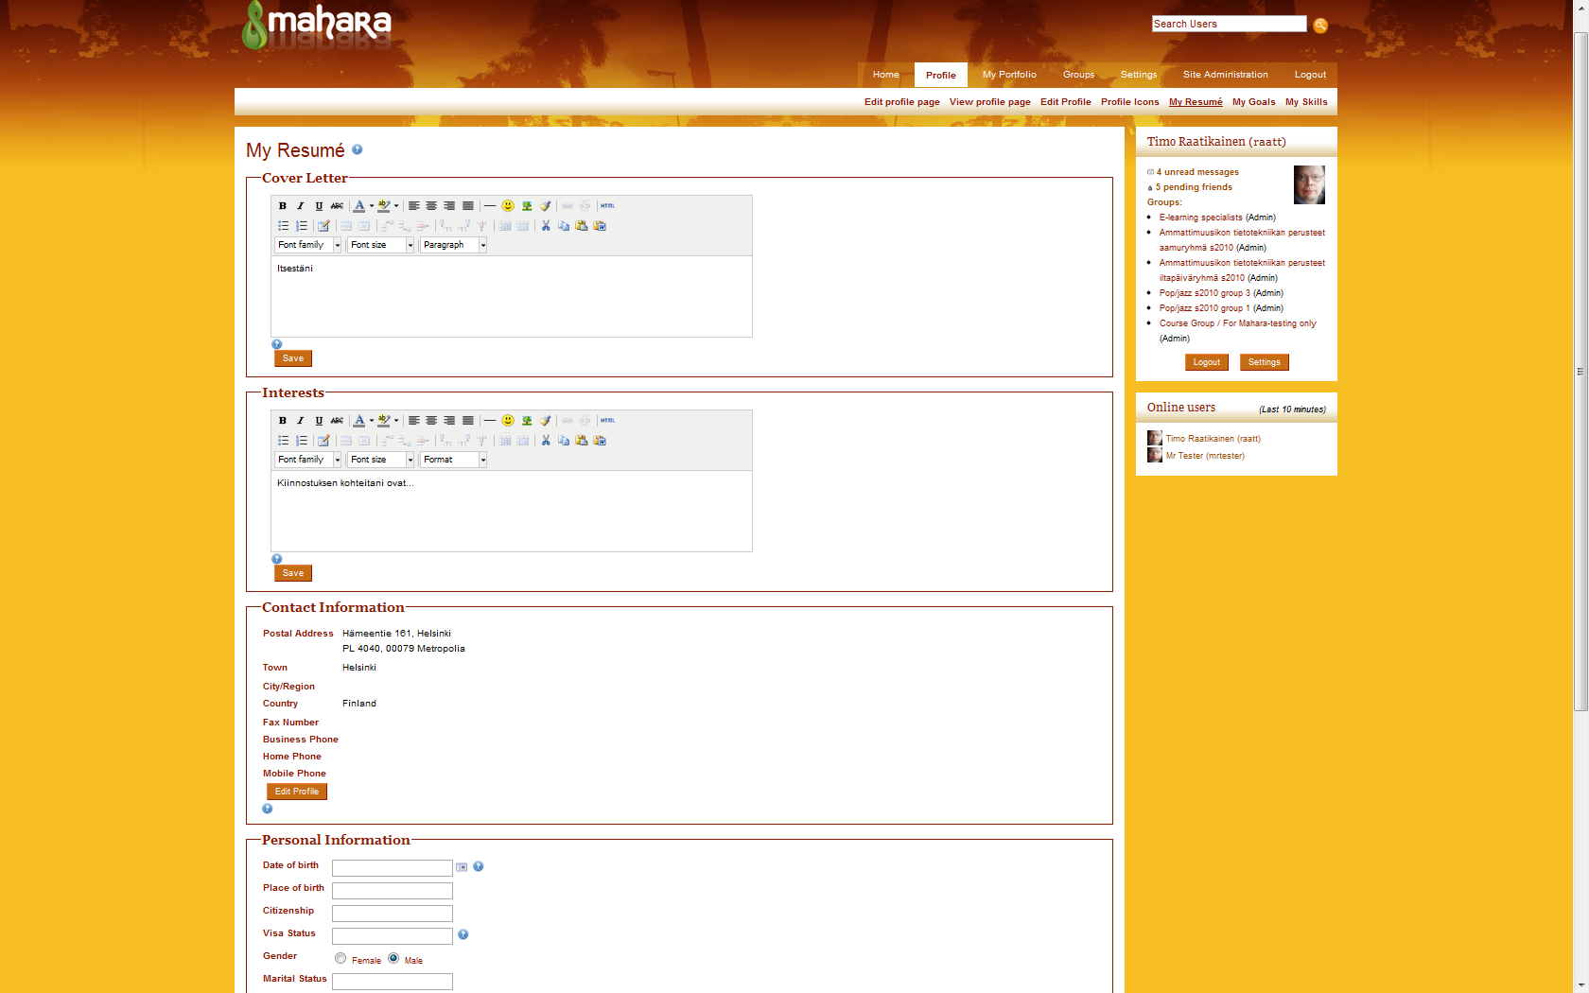
My Resumé

Slide 21
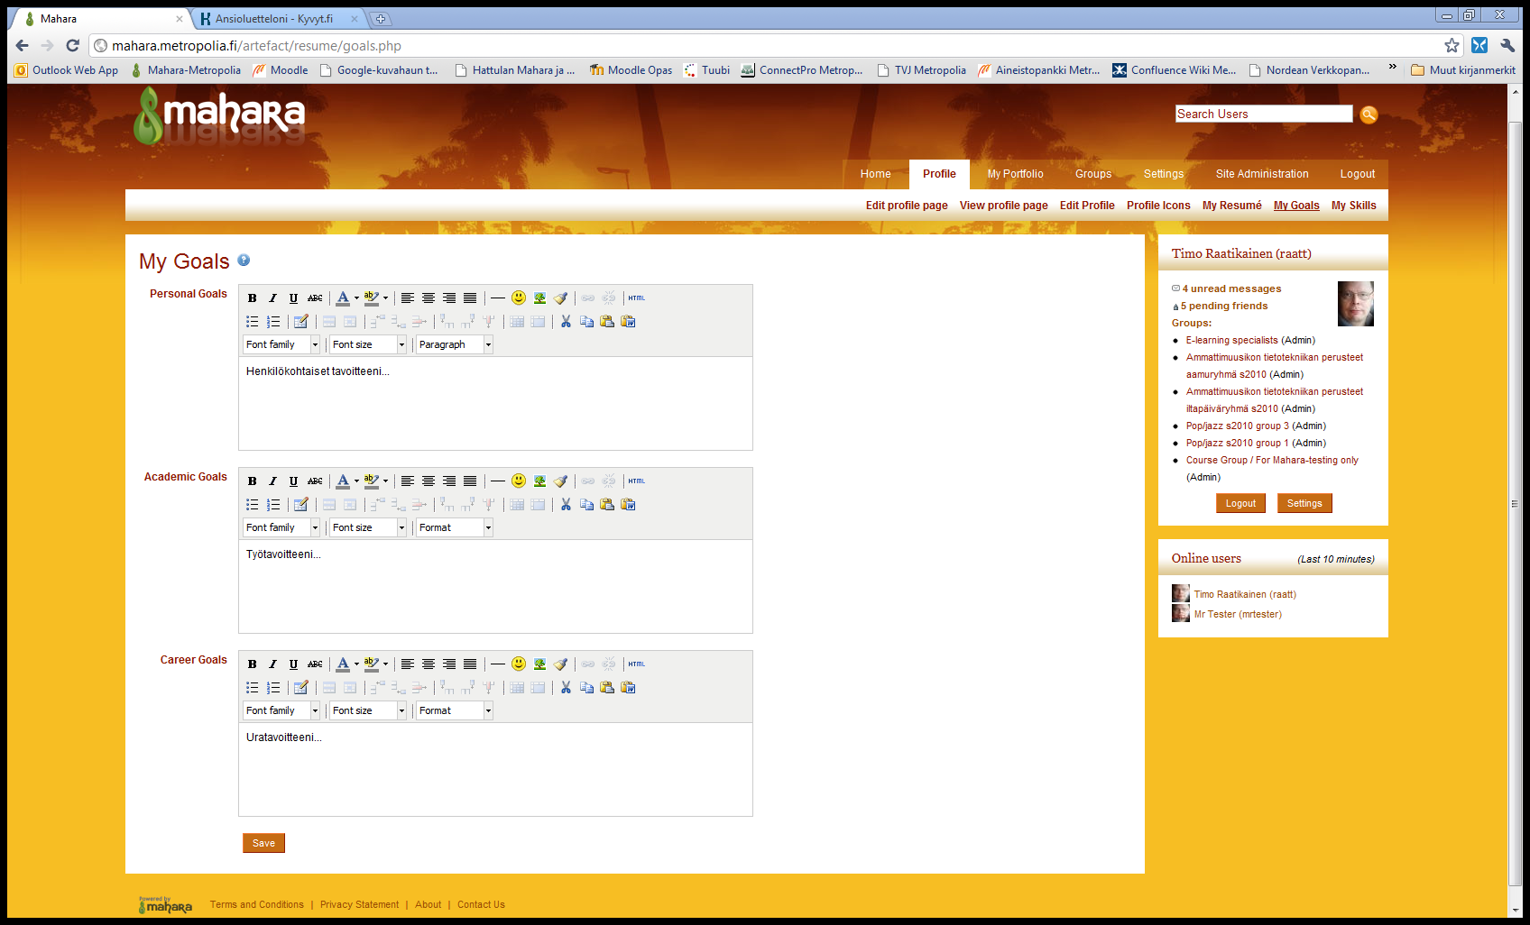
My Goals

Slide 22
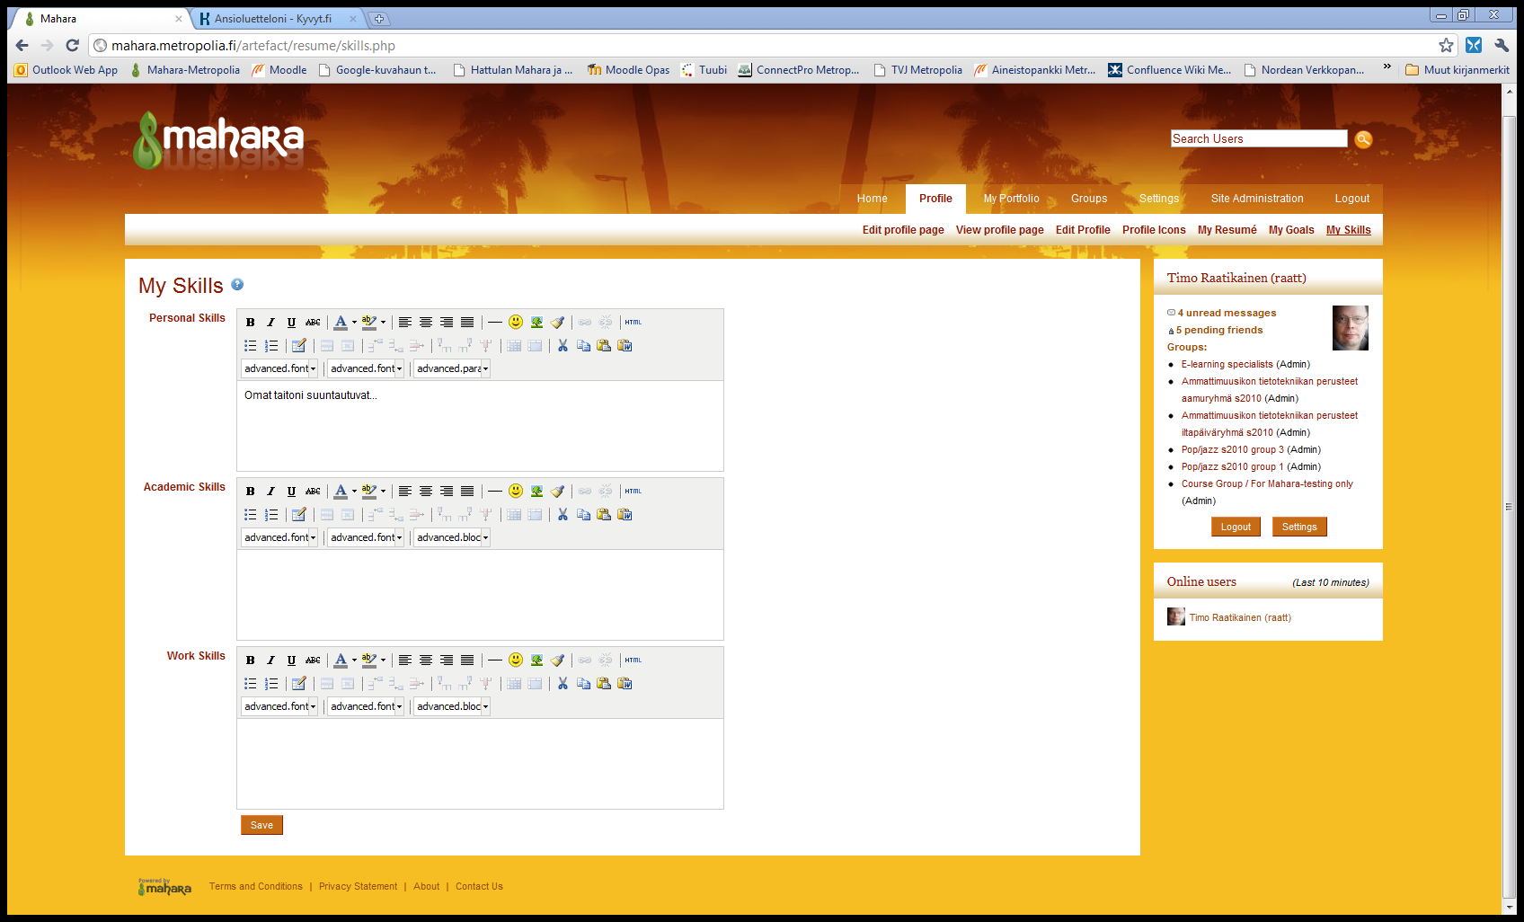

My Skills

Slide 23
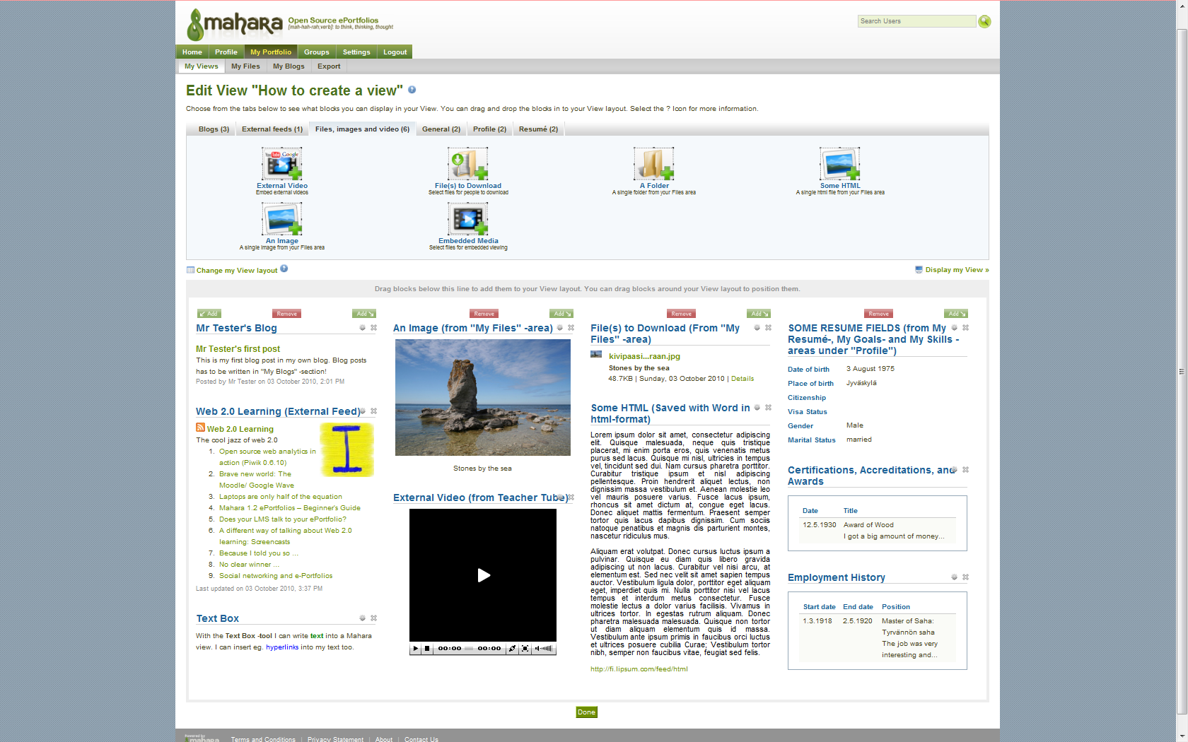
Editing the View

Slide 24
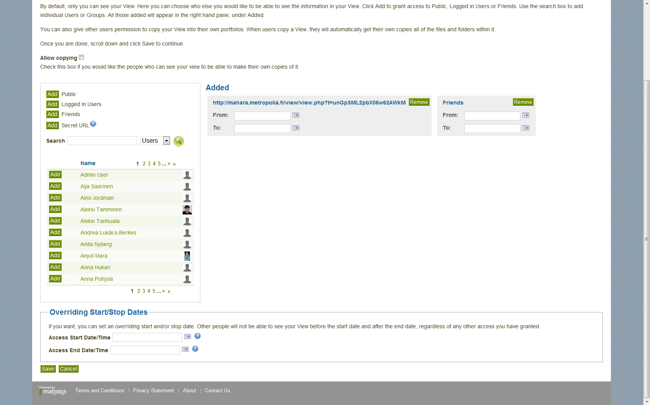
Editing View Access

Slide 25
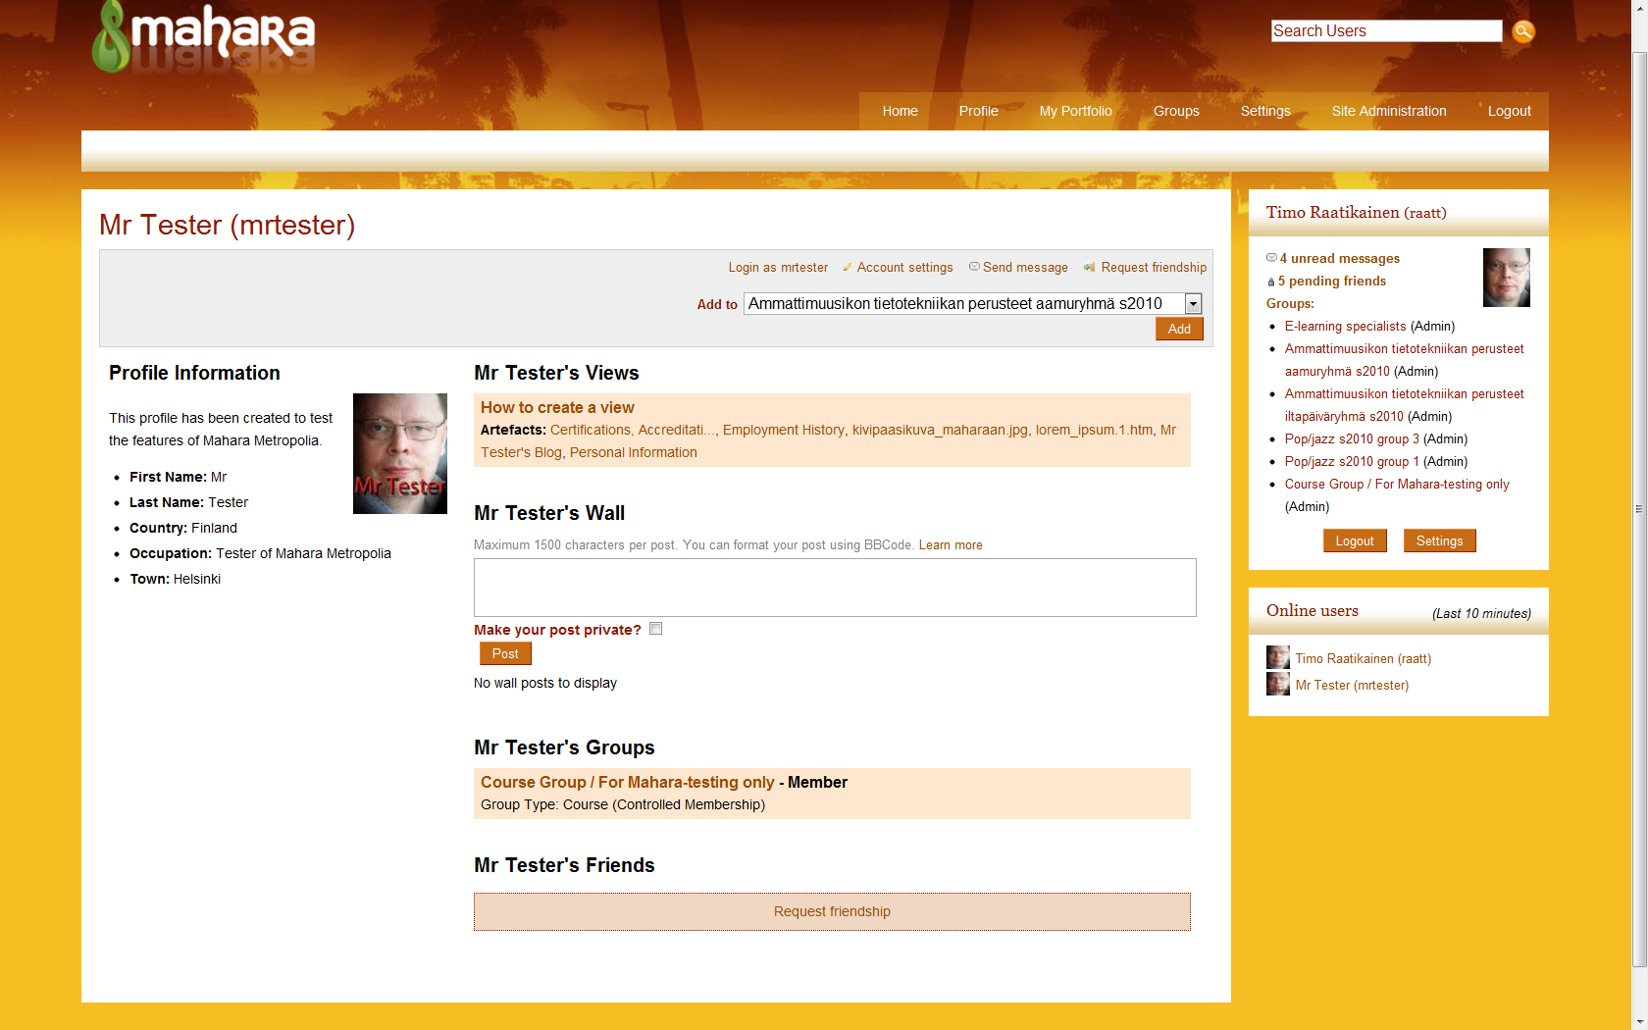
How Others View Your Page

Slide 26
Groups
Users can create their own groups for studying, interests etc.
Staff right owners
(e.g. teachers) can create course type groups as well.

Slide 27
Different Kinds of Groups
Join by entering (open groups).
Join by sending a request.
Join by accepting an invitation.
A group: the teacher can add students to the course.

Slide 28
Students’ Experiences
Mahara Metropolia piloting 2010-2011

Slide 29
Students’ Experiences 1
”Mahara was quite easy to use, even though I have never used Facebook and I didn’t know what a blog is either”
”Our Mahara-group was handy, because it made possible to return assignments so that not only the teacher could see or comment on them”

Slide 30
Students’ Experiences 2
”Idea of Mahara is fine, but it should have been available already at the beginning of my studies… I don’t bother moving everything into Mahara any longer”
”I am a little suspicious about Mahara, because I don’t know much about modern communication technologies”

Slide 31
Students’ Experiences 3
”If an employer is a modern one, it is possible to show a CV through Mahara”
”More difficult to use than Facebook”
”It was great to get to know Mahara…I believe that the use of it will increase in the future”

Slide 32
Students’ Experiences 4
”Mahara is really easy to use and it can be used to produce simple web-pages”
”The look of Mahara is not especially attractive and you can’t affect the look of your pages very much”
”Editing the profile page is very flexible and you don’t have to show anything to others if you don’t want to”

Slide 33

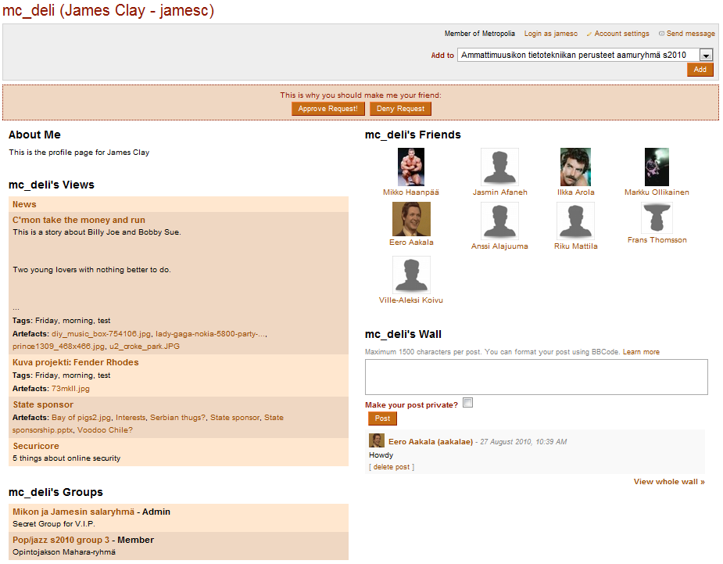
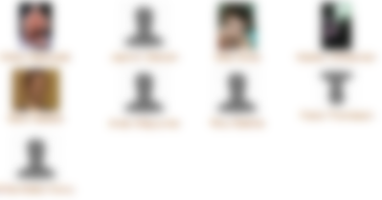
Student’s Profile Page

Slide 34
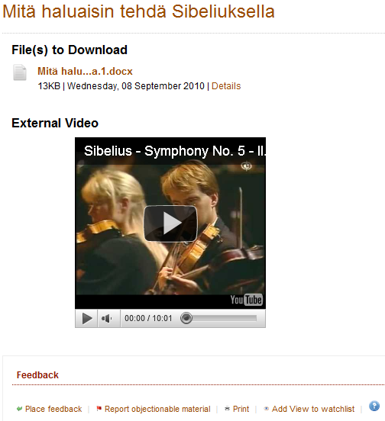
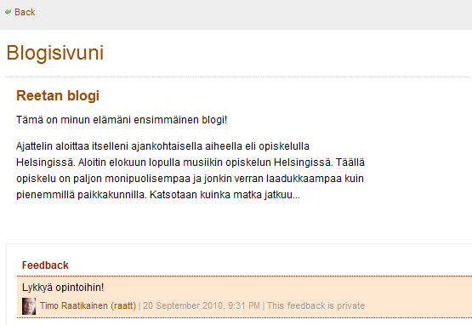
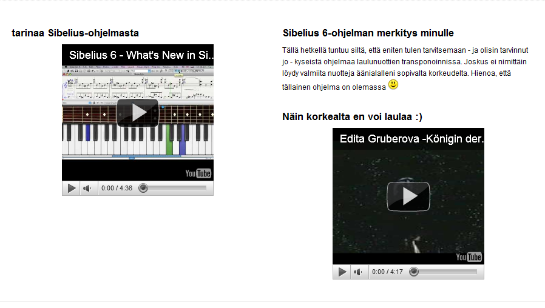
Student’s Views on Mahara

Slide 35
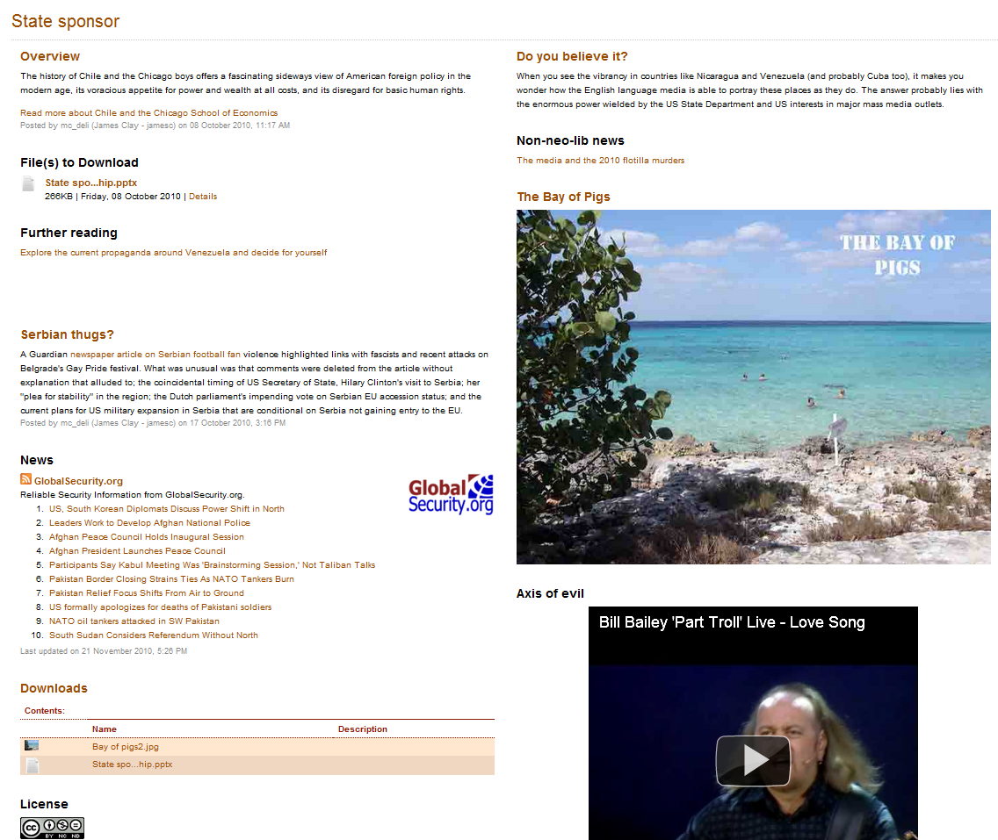
Student’s Views on Mahara

Slide 36
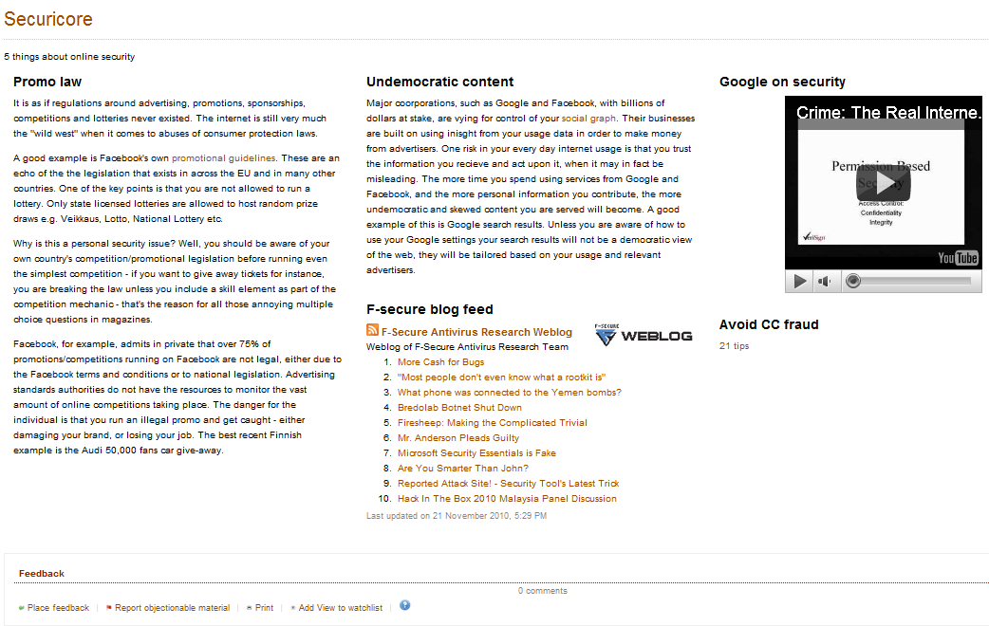
Student’s Views on Mahara

Slide 37
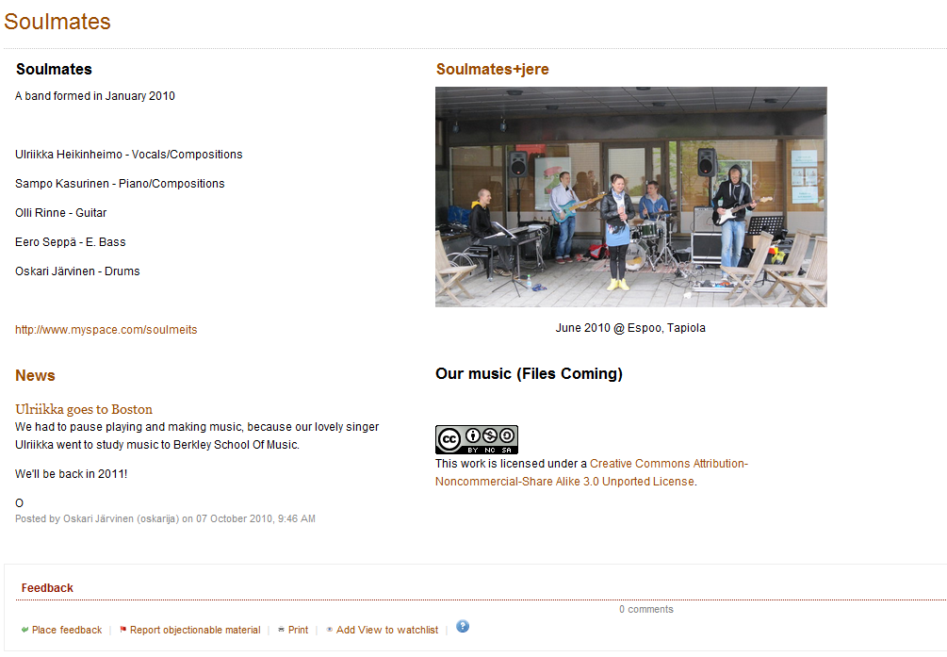
Student’s Views on Mahara

Slide 38
Present Thoughts about Piloting
Mahara is a great tool for educators and employers to get to know the person they are dealing with.
To really use Mahara as a tool in RPL, the users should be strongly advised to gather the material into Mahara during their all life long. How to support life long learning?
Teachers were also interested in using the e portfolio for networking and showing their experience.

Slide 39
Solutions for the Life Long Learning
  Cooperation with Helsinki City department of education started in spring 2011. Mahara will be used in high schools and vocational education of Helsinki Metropolitan area.
  Students have free access to Metropolia’s Mahara after their graduation. All members of Metropolia’s alumni association are offered the access. The membership is free of charge.

Slide 40
Tool for teacher’s professional development
Form for teacher’s personal curriculum was created in order to help teachers in start
Form for teacher’s teaching portfolio was created in order to help teachers to express their skills
Piloting Mahara as a tool for teacher’s professional development will start in autumn 2011
Teachers will be encouraged to use Mahara to express their skills and to create groups and communities

Slide 41

Thank you! timo.raatikainen@metropolia.fi terhi-maija.itkonen-isakov@metropolia.fi

