Slide 1
Mahara Piloting Project in Helsinki Metropolia UAS - Finland
Mrs.Dr. Terhi-Maija Itkonen-Isakov, Senior Advisor
Mr. Timo Raatikainen, Senior Lecturer

Slide 2
Structure of the Presentation
What RPL means
Various types of aspects to be evaluated
Requirements for the RPL-platform
Mahara
How Mahara works
Students’ thoughts and examples of Metropolia UAS Mahara-pilot, autumn 2010
General thoughts about Mahara

Slide 3
Recognizing Prior Learning (RPL)
Learning does not always take place in the classroom: it also happens on the job, at home, and in the community. The recognition of prior learning is a reliable process that takes into consideration ALL learning by examining what a person knows and can do. http://www.aeei.gov.sk.ca/rpl

Slide 4



Education & Employment History
How to recognize?

Slide 5


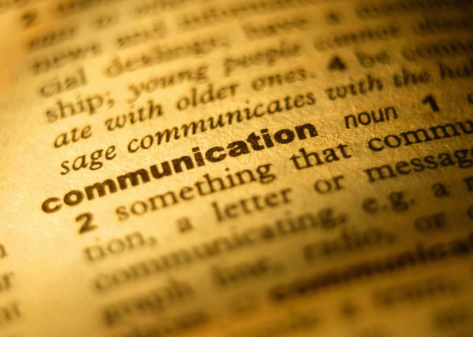





Skills, publications, certificates
How to recognize?

Slide 6

Where to Collect, Select & Share?
Safety & ownership of data?
Usability?
Social networking functionality?
Flexible control of the visibility?
Is everything lost, if I quit?

Slide 7
Mahara Te Reo Māori for ‘think’ or ‘thought’

Slide 8
Mahara
New Zealand 2006
Electronic portfolio, weblog, resume builder and social networking system
Piloted at Helsinki Metropolia UAS since August 2010
  About 500 users until now.

Slide 9
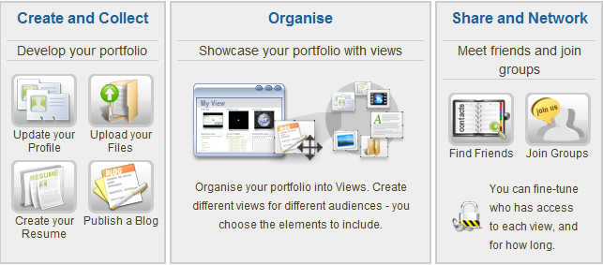
The Main Point of Mahara
http://demo.mahara.org/

Slide 10
Mahara to Collect, Select & Share
Safe platform, on its’ own server
Open source, free of charge
Users own their data
Social networking functionality
Different views for different audiences
Exportation of data at any time

Slide 11

Mahara PLE & Moodle VLE
Educational Videos
made with
Connect Pro
-Jing
-Camtasia Studio
Catch everything into
M O O D L E
Teacher’s
Blog
and
Course’s
Wiki
on
some platform
Linked by weblinks
Linked
by feeds
Linked by weblink
Linked by feeds
Linked by feeds
Students
Wikis
on
different platforms
Mahara
E-portfolio and
Networking
platform
Students
Blogs
on
different platforms

Slide 12
Mahara-Moodle Integration (=Mahoodle)
E.g. single-sign on between both systems
E.g. users' profile information is ported across
E.g. possible to submit Mahara Views to Moodle for assessment

Slide 13





Moodle VLE, Mahara PLE & WWW

Slide 14
Mahara Metropolia in practice

Slide 15
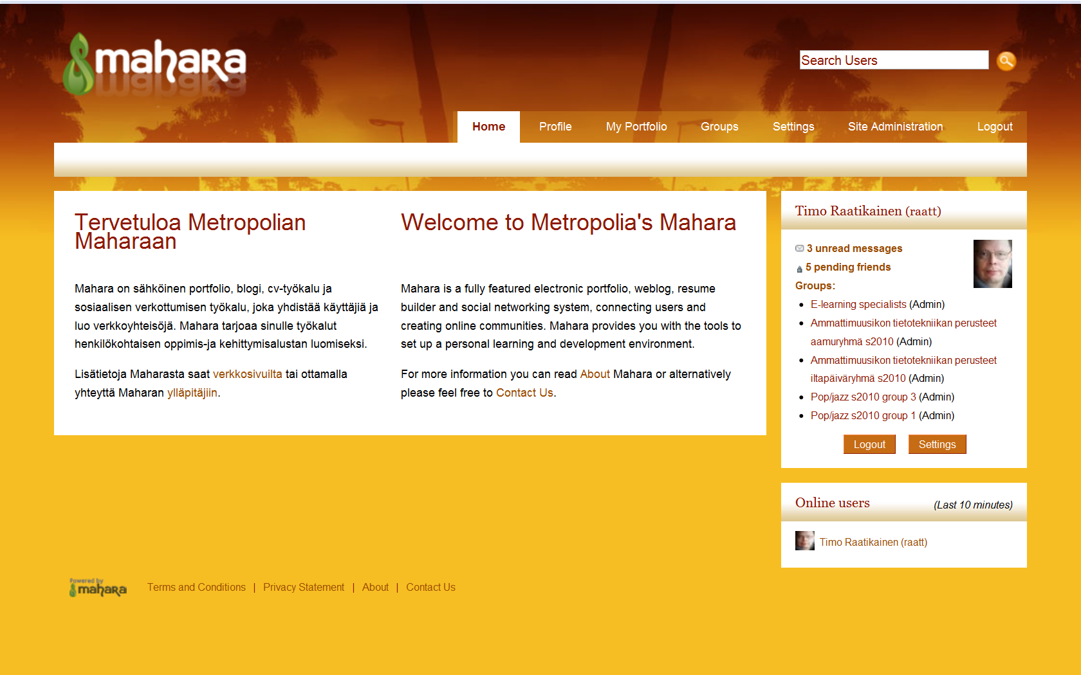
Entering

Slide 16
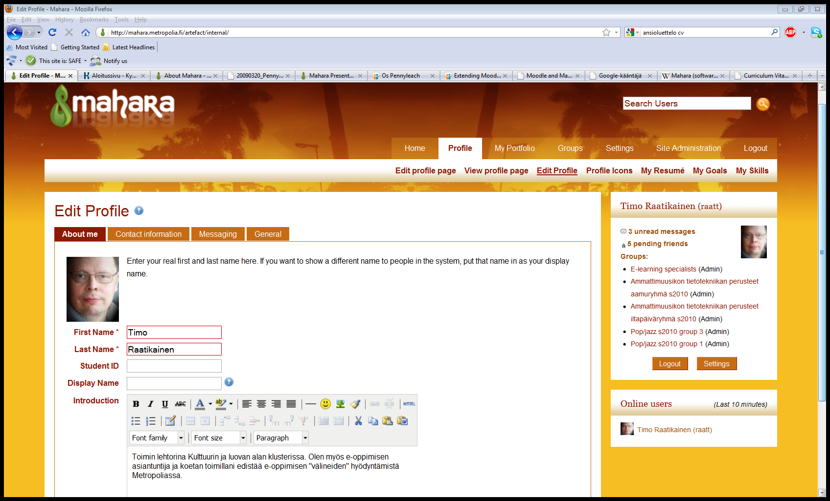
Editing Profile

Slide 17
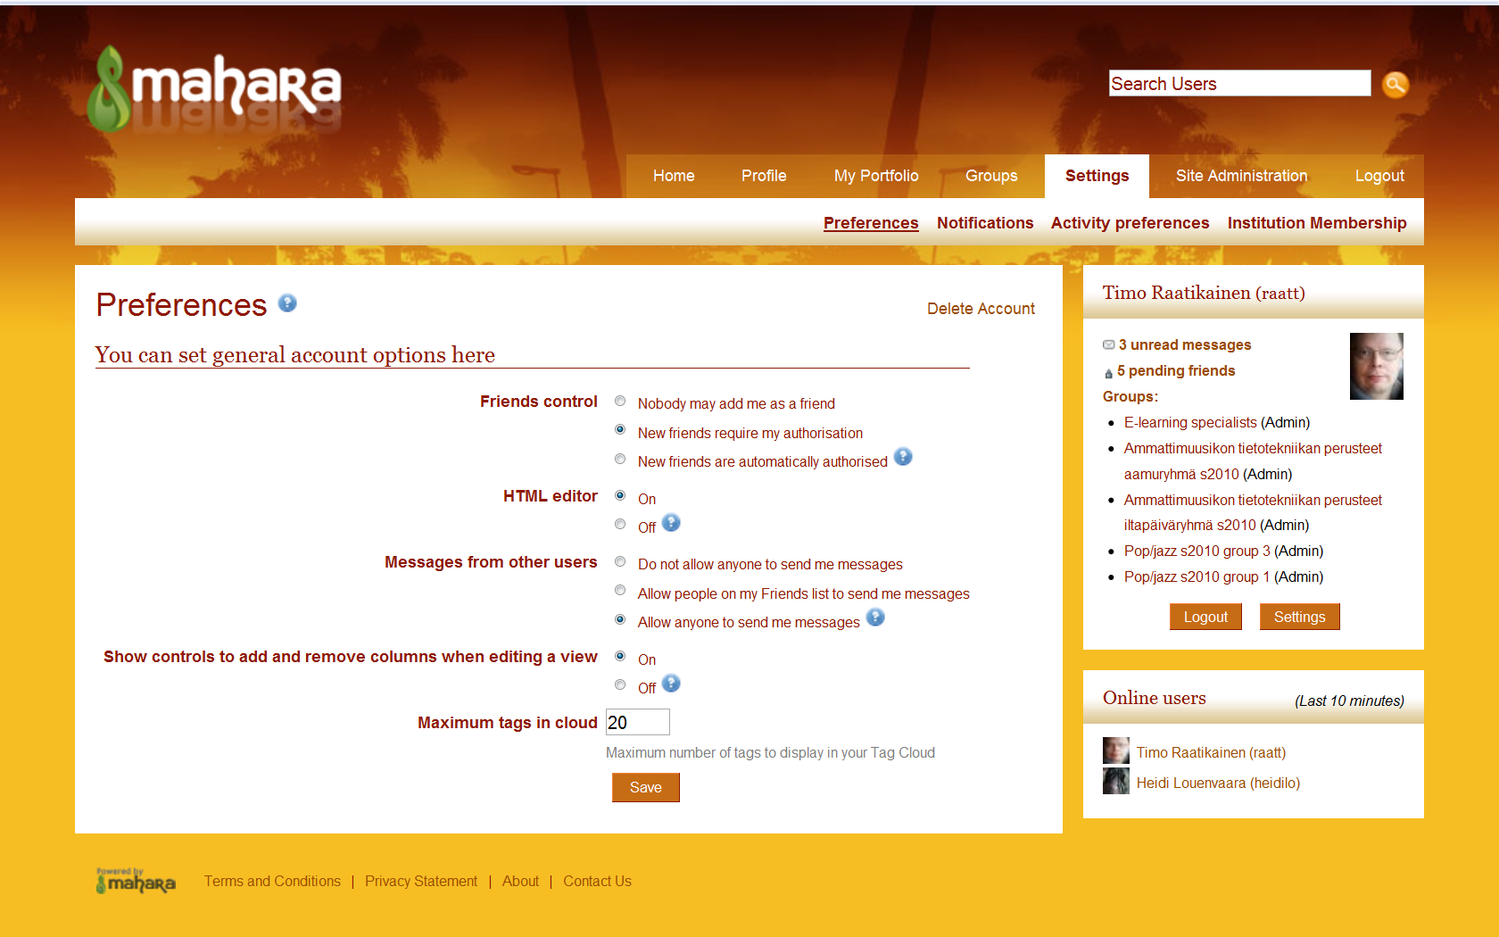
Setting Options

Slide 18
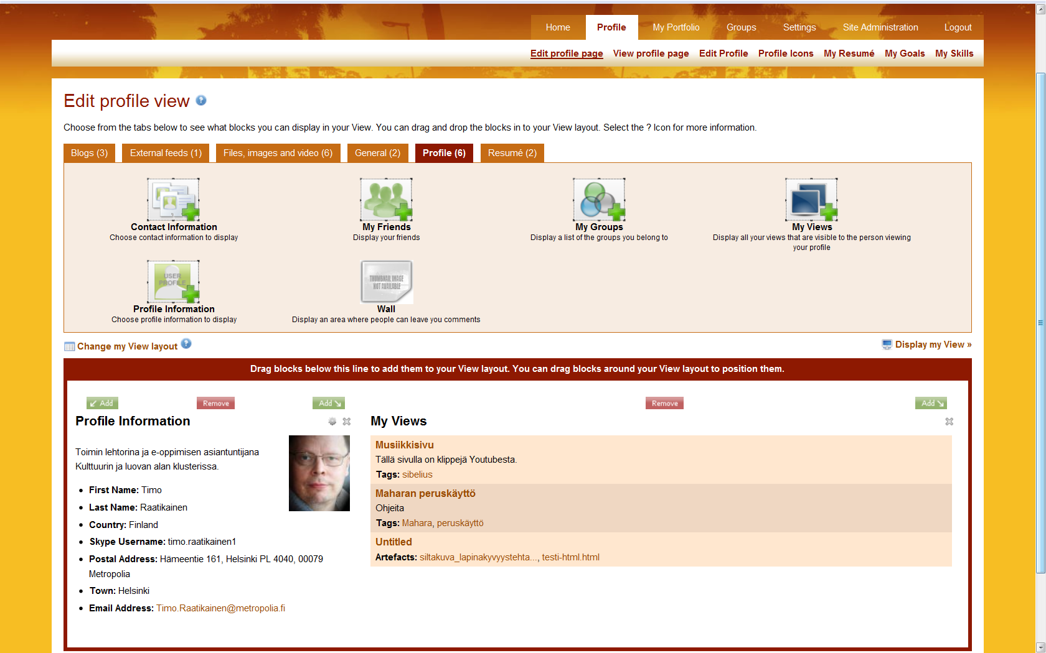
Others see your profile page
My Friends
My Groups
My Views
Wall
available
only on the profile page

Slide 19
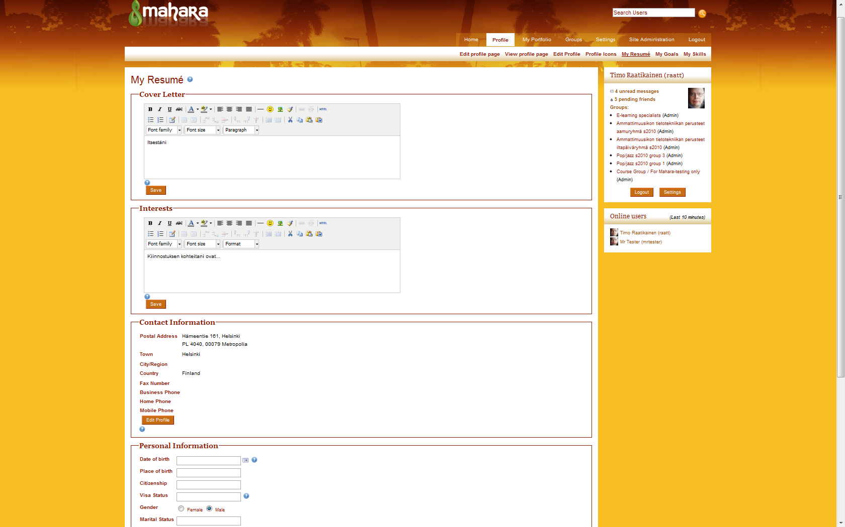
My Resumé

Slide 20
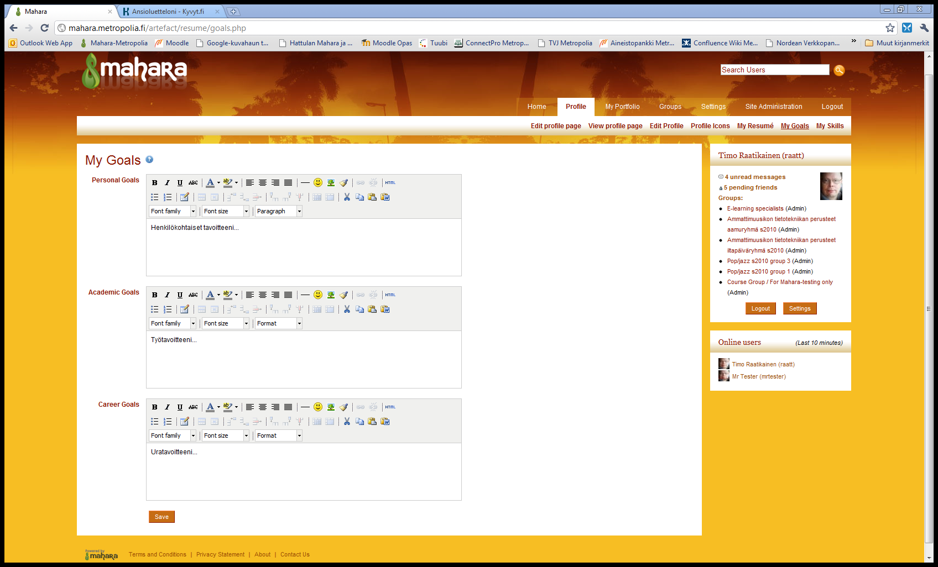
My Goals

Slide 21
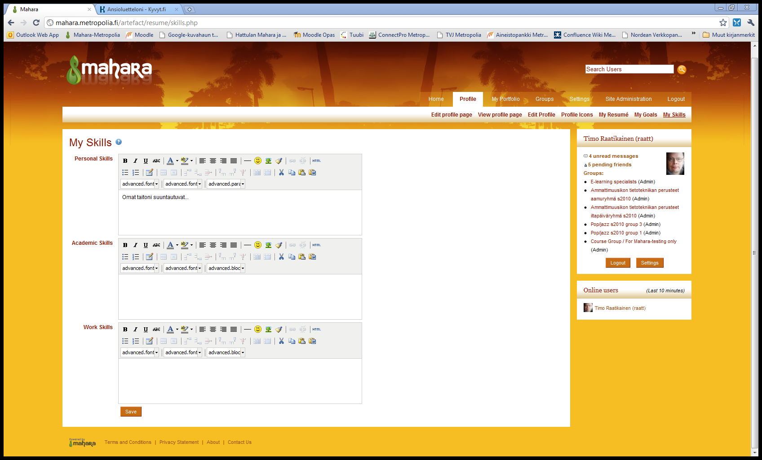

My Skills

Slide 22
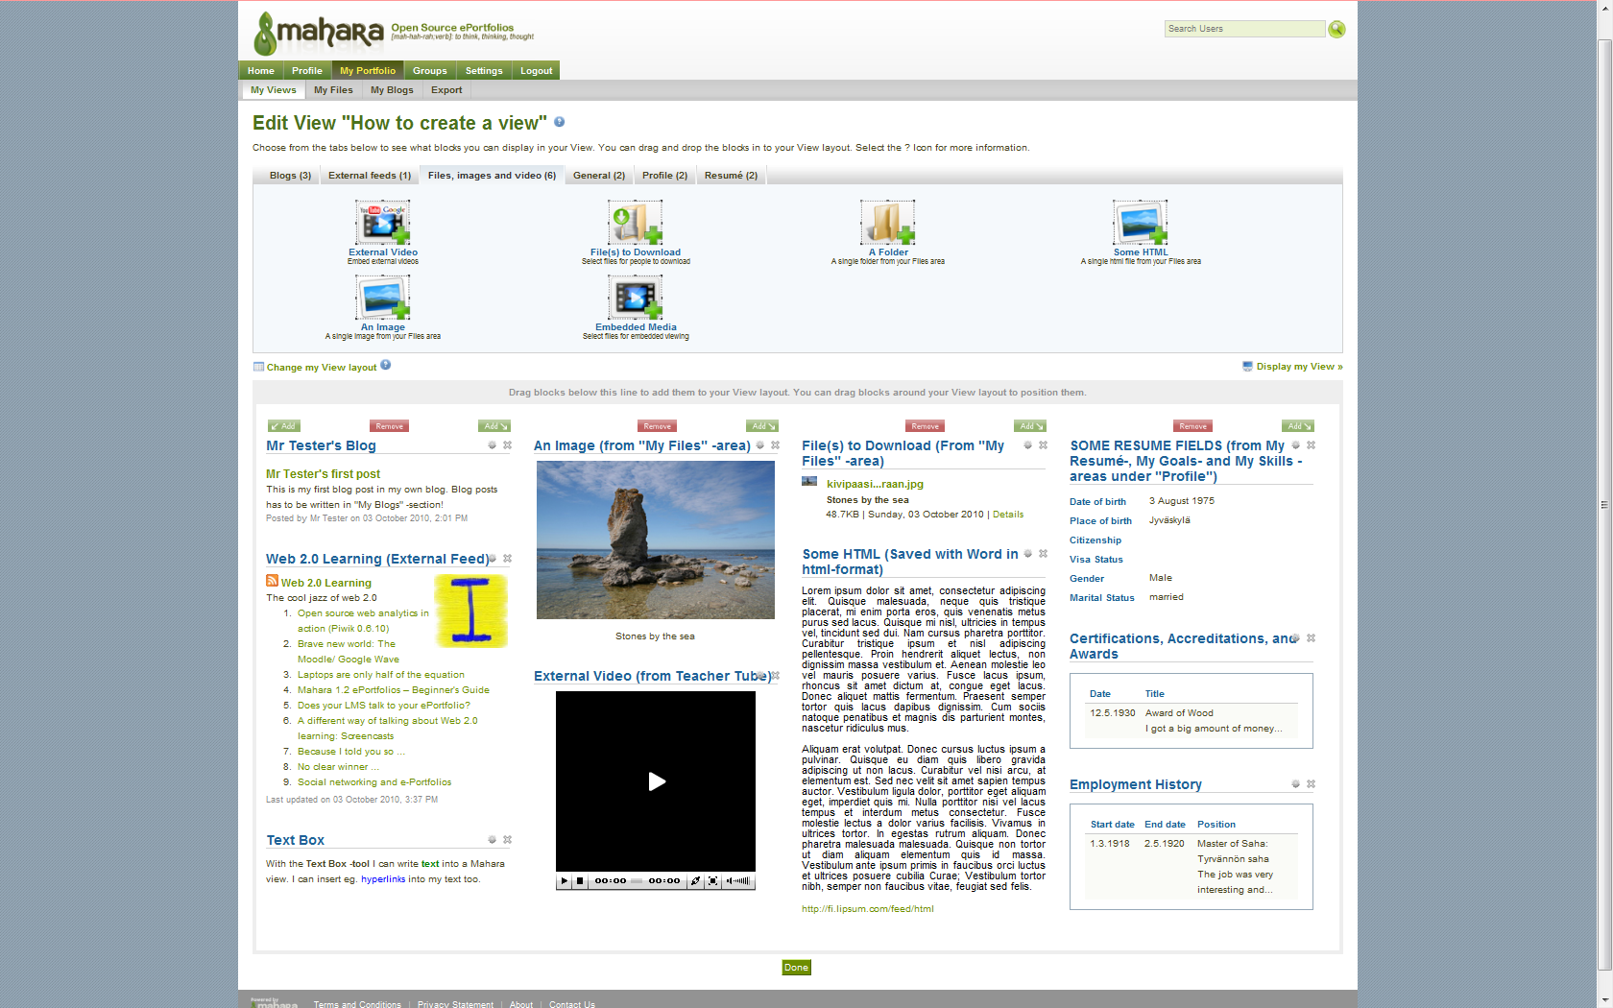
Editing the View

Slide 23
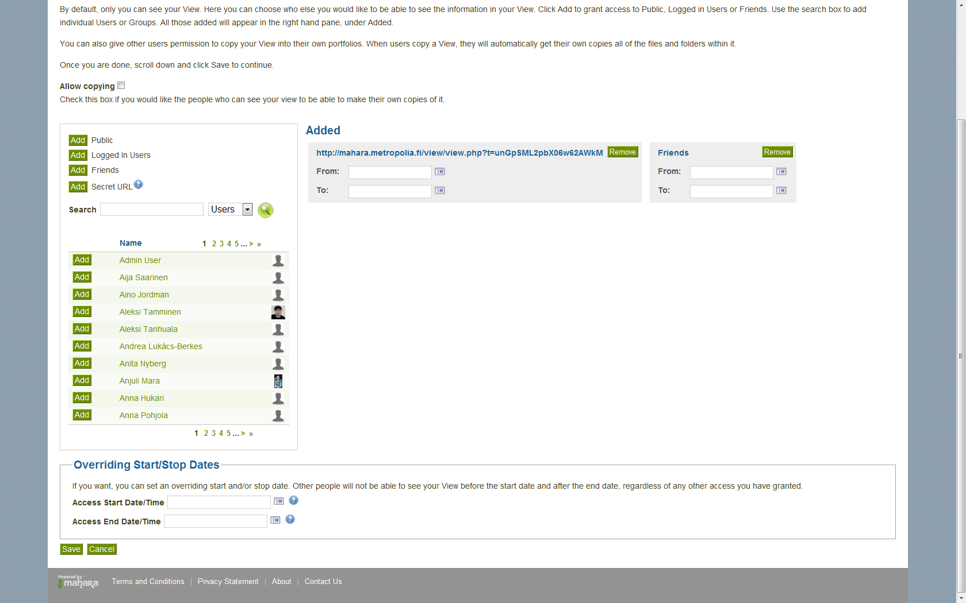
Editing View Access

Slide 24
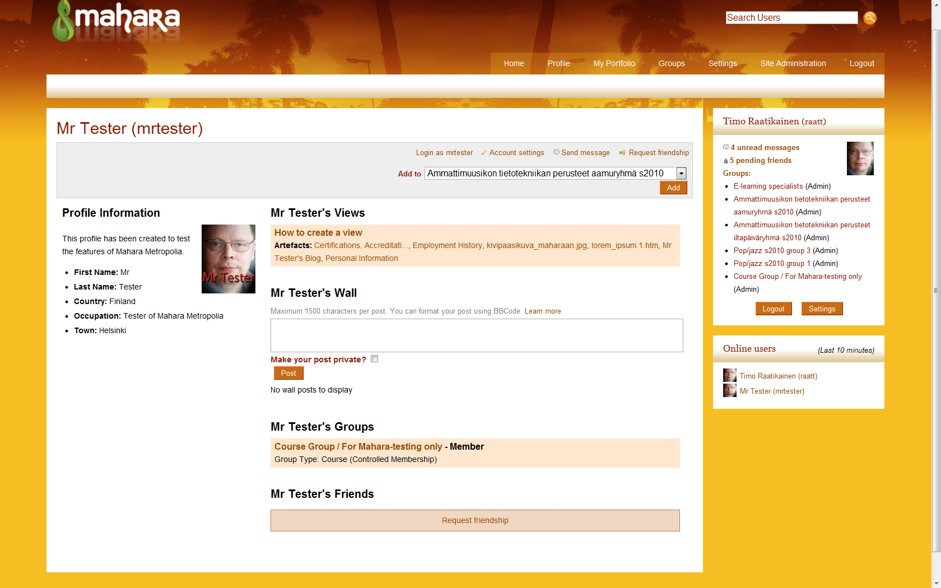
How Others View Your Page

Slide 25
Groups
Users can create their own groups for studying, interests etc.
Staff right owners
(e.g. teachers) can create course type groups as well.

Slide 26
Different Kinds of Groups
Join by entering (open groups).
Join by sending a request.
Join by accepting an invitation.
A group: the teacher can add students to the course.

Slide 27
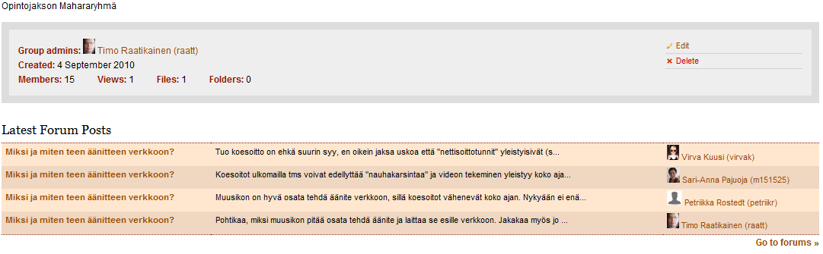

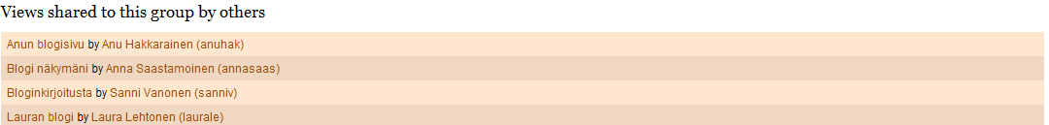
Example: A Group of a Course

Slide 28
Students’ Experiences
Mahara Metropolia –piloting 2010-2011

Slide 29
Students’ Experiences 1
”Mahara was quite easy to use, even though I have never used Facebook and I didn’t know what a blog is either”
”Our Mahara-group was handy, because it made possible to return assignments so that not only the teacher could see or comment on them”

Slide 30
Students’ Experiences 2
”Idea of Mahara is fine, but it should have been available already at the beginning of my studies… I don’t bother moving everything into Mahara any longer”
”I am a little suspicious about Mahara, because I don’t know much about modern communication technologies”

Slide 31
Students’ Experiences 3
”If an employer is a modern one, it is possible to show a CV through Mahara”
”More difficult to use than Facebook”
”It was great to get to know Mahara…I believe that the use of it will increase in the future”

Slide 32
Students’ Experiences 4
”Mahara is really easy to use and it can be used to produce simple web-pages”
”The look of Mahara is not especially attractive and you can’t affect the look of your pages very much”
”Editing the profile page is very flexible and you don’t have to show anything to others if you don’t want to”

Slide 33

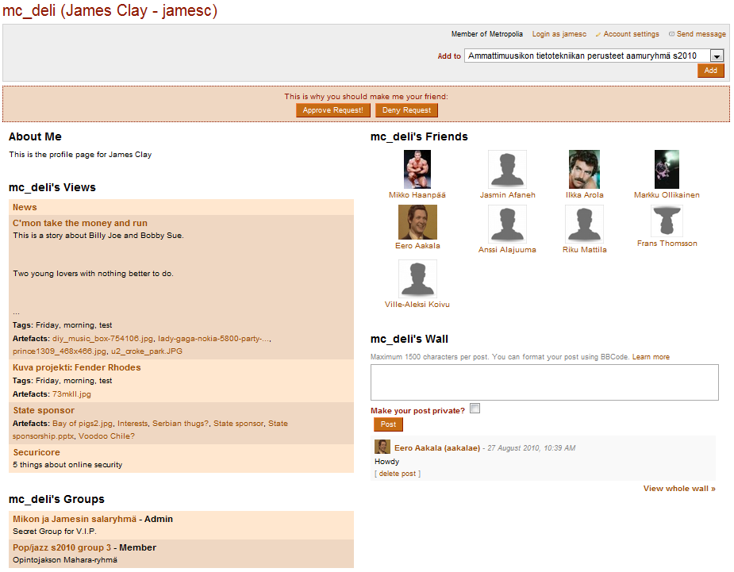
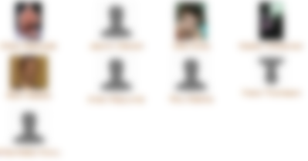
Student’s Profile Page

Slide 34
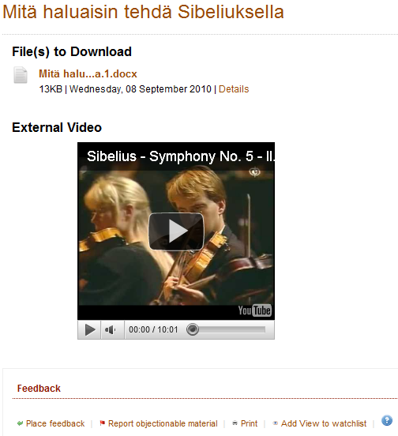
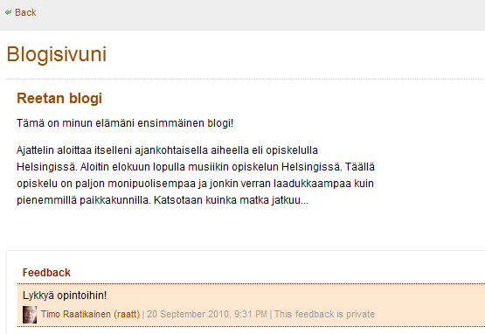
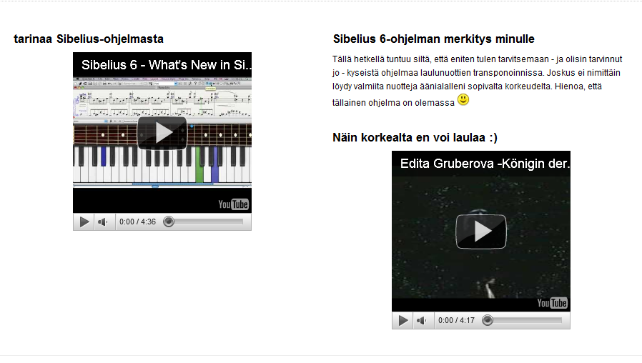
Student’s Views on Mahara

Slide 35
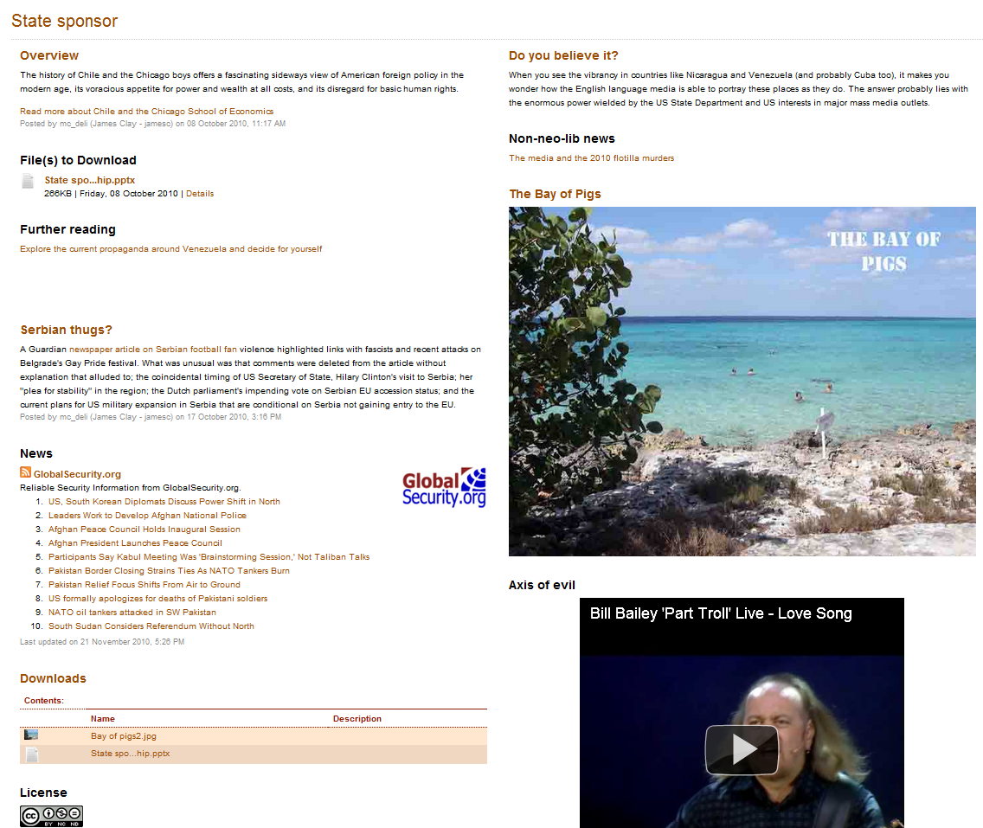
Student’s Views on Mahara

Slide 36
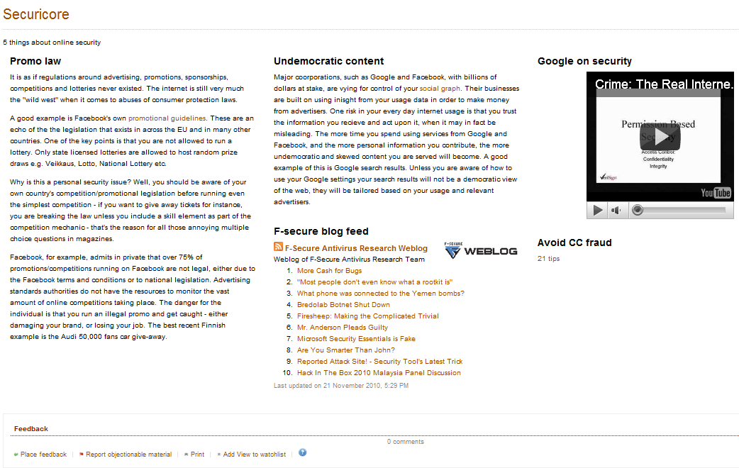
Student’s Views on Mahara

Slide 37
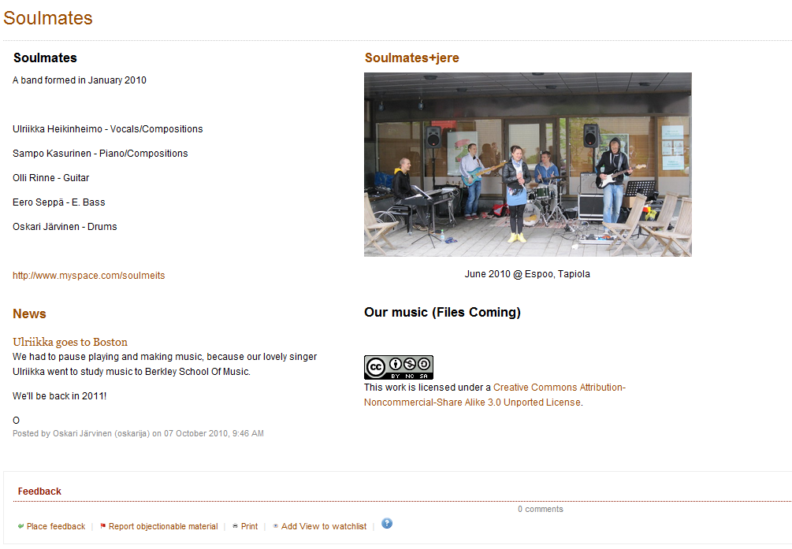
Student’s Views on Mahara

Slide 38
Present Thoughts about Piloting
Mahara is a great tool for educators and employers to get to know the person they are dealing with.
Mahara can also be used as a tool for teacher’s professional development.
To really use Mahara as a tool in RPL, the users should be strongly advised to gather the material into Mahara during their all life long.

Slide 39

Thank you! timo.raatikainen@metropolia.fi terhi-maija.itkonen-isakov@metropolia.fi

