Slide 1
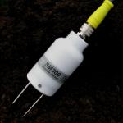
Sensor Technology
Soil moisture sensor sm-300

Slide 2
Contents
Introduction
Features
SM300 working procedure
Installation
Calibration
Specification

Slide 3
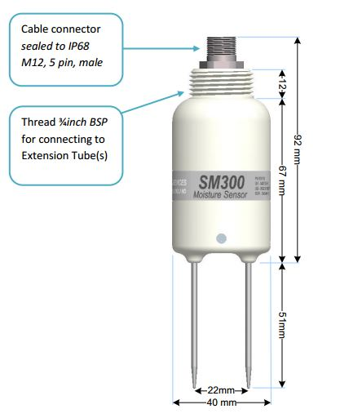
Introduction
SM300 as a soil moisture sensor
Extension cable & tubes
Waterproof
Output signal is a differential analogue dc voltage.
Use of supplied general soil calibration
Dimension

Slide 4
Features
Soil moisture accuracy
Salinity sensitivity
Stability
Minimal soil disturbance
Easy installation
Waterproof connector
Electrical Immunity

Slide 5
SM300 working procedure
Power supply
1000MHz waveform
Transmission of electromagnetic field
Permittivity
Vout
Result

Slide 6
Installation
1. Spot measurement
2. Depth
3. Alternative

Slide 7
Calibration
1. Soil calibration
2. Sensor calibration
3. Soil moisture reading

Slide 8
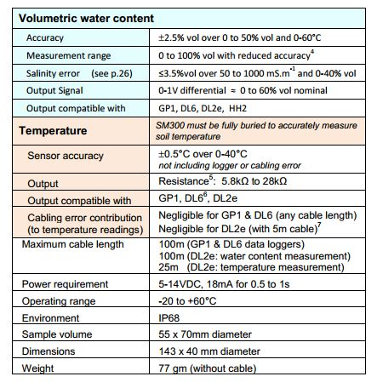
Specification

Slide 9


