Slide 1
Sensor Technology
Soil Moisture Sensor
A soil water sensor is an instrument which, when placed in a soil for period of time, provides information related to the soil water status of the soil (Cape 1997).
By Amrit Gautam (TI13S1)

Slide 2
Outline of the Presentation:
Introduction
  What is soil moisture sensor ?
  Impact of Soil moisture sensor in Agriculture production and Irrigation water management
Technology for measuring soil status
  Soil Moistures Sensors
    Working Principle
Study on Dielectric Capacitive Soil moisture sensor
Capacitive sensor in the Market
  SM300

Slide 3
Introduction:
The sensors which are used to measures the water content of soil are called Soil moisture sensors.
With increasing number of population but limited land resource, the demand for food is constantly increasing. Now, better production of crop is essential to fulfill the demand.
Water plays an active role in the development of the crops. Better crops leads to the high yields.
It is important to know when to water and how much to water constantly for the better production of corps.
Use of correct Soil moisture sensors helps to ease out the pain which can monitors and keep records about the changes in soil moisture starting form cultivation to harvesting period of crops.
Proper water management is possible through the use of this sensor technology.

Slide 4
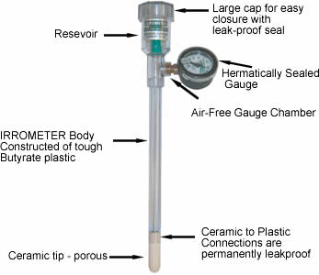
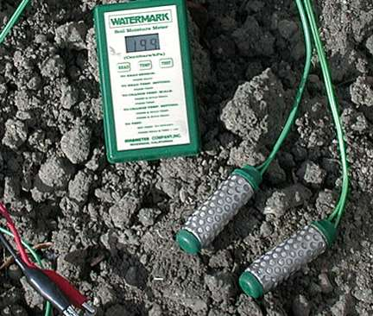
Technology for measuring soil status
Porous media instruments
These instruments are made from materials that are porous to water i.e. materials through which water can move and be stored in the pores. Water is drawn out of the porous medium in a dry soil, and from the soil into the medium in a dry soil. For example: Tensiometer, wetting-front detectors, electrical resistance blocks.
Tensiometer
img src: http://www.calafrica-sa.co.za/soil_moisture_measurement.htm
Electrical resistance blocks
img src:http://www.ndsu.edu/pubweb/chiwonlee/plsc211/student%20papers/articles08/tyrelcale/Irrigation.html

Slide 5
2) Neutron Moderation:
Based on technique on measuring fast-moving neutrons that are slowed ( thermalised ) by an elastic collision with existing hydrogen particles in the soil.
Hydrogen is present in the soil as a constituent of soil organic matter, soil clay minerals and water. Water is the only form of hydrogen that will change from the measurement to measurement. Therefore, any change in the counts recorded by the Neutron moderation is due to change in water.
3) Heat dissipation
Sensors working with this principle, measure the heat dissipated in a ceramic medium.
The amount of heat dissipated is directly proportional to the amount of water contained within the ceramic's void spaces. The more water that is contained in the ceramic, the more heat is dissipated and lower the sensor reading.
This type of sensor has no effect of soil type or salinity since they are completely based on thermal conductivity.

Slide 6
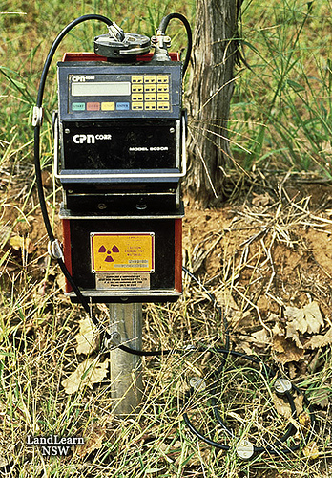
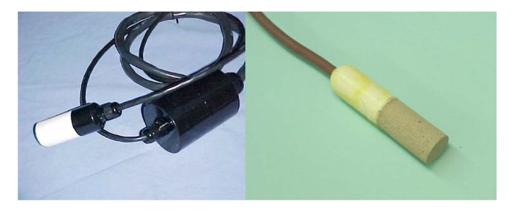
Neutron Moderation
Img src :https://www.flickr.com/photos/landlearnnsw/4076514556/
Heat Dissipation
Img src: http://vfd.ifas.ufl.edu/water-nutrient-management.shtml

Slide 7
Study on Dielectric Capacitive Soil moisture sensor
4) Dielectric Methods
Capacitance Sensors using Frequency-reflectometry (FDR)
Working Principle:
  The dielectric constant is a measure of the capacity of a non-conducting material to transmit electromagnetic waves or pulses.
  It contains two electrodes separated by a dielectric. The two electrodes are inserted into the soil and becomes the part of dielectric.
  A vey high oscillating frequency is applied to the electrodes, which results in a resonant frequency, the value of whose depends upon the dielectric constant of the soil.
  The moisture content of the soil will change the value of dielectric constant of the soil.
  The greater the soil moisture content the smaller the resonant frequency.
  This change is converted into a soil moisture measurement.

Slide 8
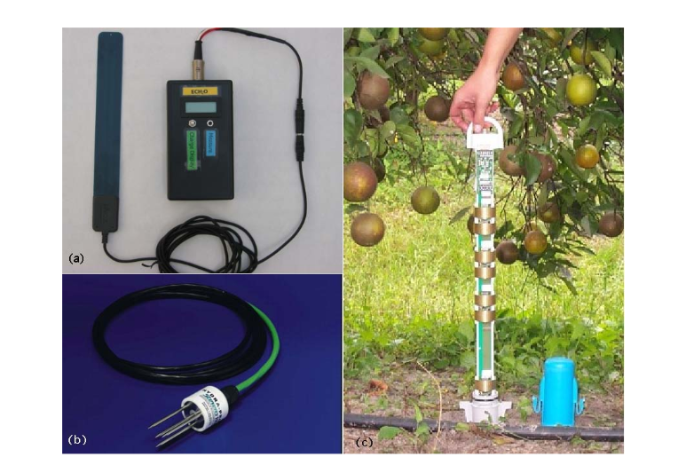
Frequency domain (FD) probes: a) capacitance (platesembedded in a silicon board); b) capacitance (rods); and c) FDR (rings)
Img src: https://www.bae.ncsu.edu/topic/go_irrigation/docs/Field-devices-monitoring-.pdf

Slide 9
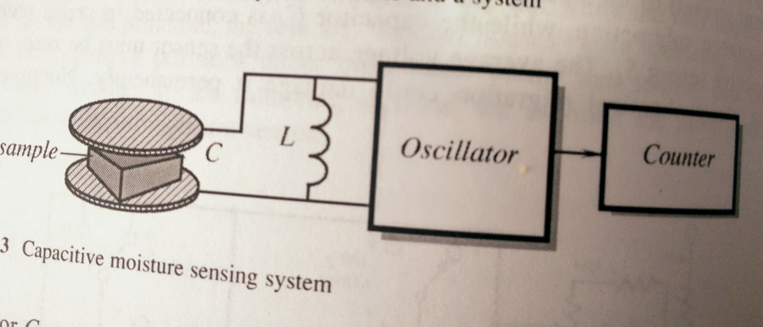
Capacitive Moisture Sensing System
Img src: Handbook of Modern Sensors (Page 450)

Slide 10
Advantages:
Accurate after soil-specific calibration (±1%)
Can be used with high soil salinity where TDR fails
Can be connected to conventional dataloggers (DC output signal)
More flexibility in probe design
Disadvantages:
For reliable measurements, it is critical to have good contact between the sensor (or access tube) and soil. Careful installationis necessary to avoid air gaps.
Tends to have larger sensitivity to temperature, bulk density, clay content and air gaps than TDR.
Needs soil-specific calibration.

Slide 11
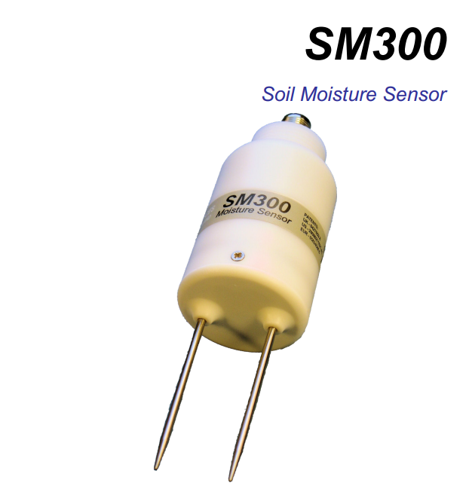
SM300 (Commercially Available FDR sensor)
This device is capable of measuring the soil moisture content and temperature of soil. It has two sensing rods which is directly inserted into the soil for taking the readings and sealed plastic body.
The reading is logged to the data logger through use of waterproof cables which carries output analogue DC voltage.
It can be calibrated for specific soils.
The measurement accuracy of this model of sensor is 2.5% . The temperature measurement of the soil is from 0.5 C to 0-40 C .It is rugged, waterproof and can be buried inside the soil.

Slide 12
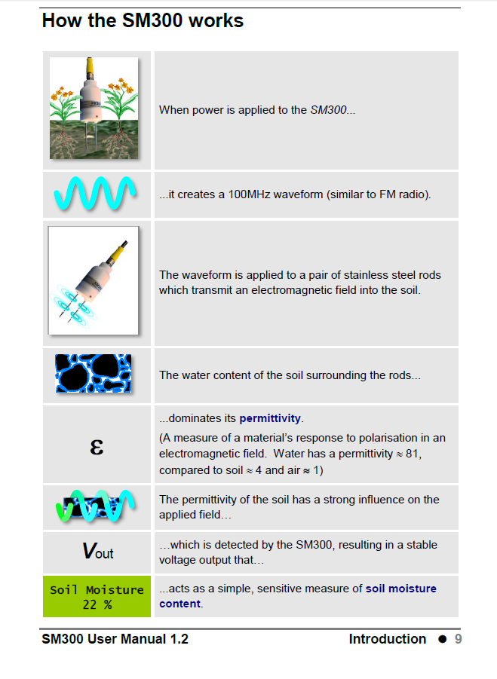
How SM300 works ?

Slide 13
References:
User manual for the SM300, Soil Moisture [ONLINE] Available at: http://www.delta-t.co.uk/product-downloads.asp?$=Product%20Manuals
Accessed on: 12.5.2015
2. Field Devices for Monitoring Soil Water Content [ONLINE] Available at : https://www.bae.ncsu.edu/topic/go_irrigation/docs/Field-devices-monitoring-.pdf
Accessed on: 12.5.2015
3. Irrigation needs and how to test for them [ONLINE] Available at: http://www.ndsu.edu/pubweb/chiwonlee/plsc211/student%20papers/articles08/tyrelcale/Irrigation.html
Accessed on: 12.05.2015
Soil Water Monitoring [ONLINE] Available at: http://www.irrigationfutures.org.au/imagesDB/news/soilwatermonitoring2ed.pdf
Accessed on: 12.05.2015
Thank you ! ☺

