Slide 1
Sustainable Business Models class 1 Introduction
Lecturer:
Menno de Lind van Wijngaarden

Slide 2
Program
Class 1 Introduction
Class 2 Ethical consumerism
Class 3 Social Entrepreneurship
Class 4 Circular Economy

Slide 3
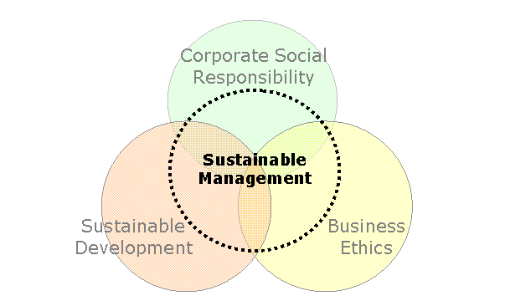
 | Sustainable development | Corporate Social Responsibility | Business Ethics
Level | Society | Business | Individual
Context | Communities, Countries, Regions, Global Organizations | Industries, small, medium to large, multinational enterprises | Citizenship, Employee, Manager, Consumer
Issues | Environment, Populations, Effects of Globalization, Treaties, Protocols | Stakeholders management, Fair trade, Chain responsibility, Code of conduct | Human Behavior, Ethical decision making, do the right thing. World view.
Notes:
Sustainable Management is about integrating the 3 levels into sound decision making.

Slide 4
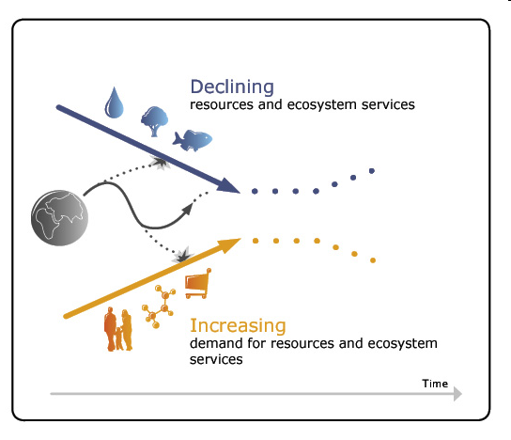
Funnel Theory
Business needs to be innovative, stakeholder oriented, and long term oriented to find its way into the funnel.
Notes:
From The Natural Step
www.naturalstep.org

Slide 5
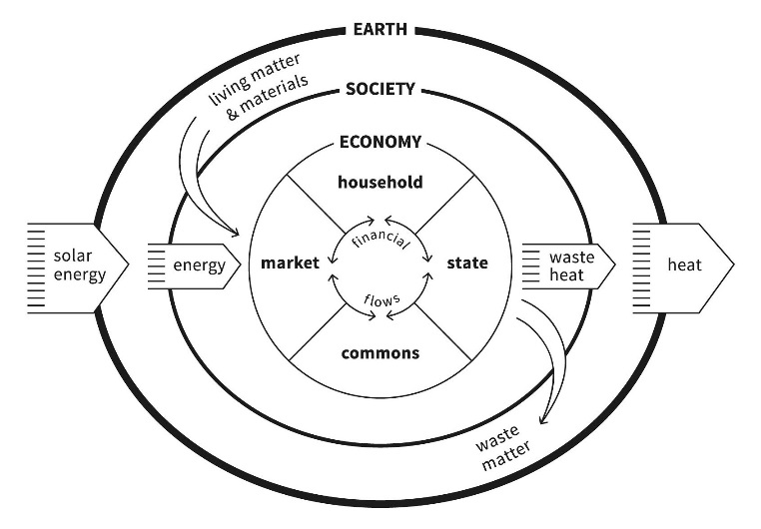

Slide 6
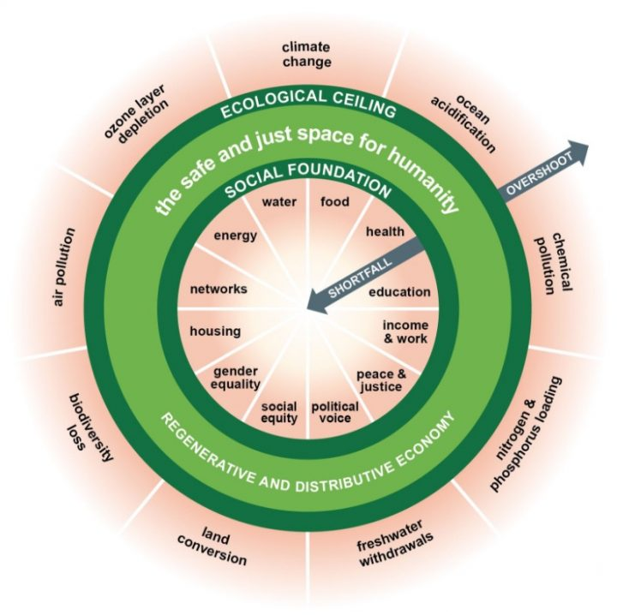
Notes:
From: https://www.kateraworth.com/doughnut/
From: Rockström, J., Steffen, W., Noone, K., Persson, |[Aring]|sa, Chapin, F. S., Lambin, E. F., … Foley, J. A. (2009). A safe operating space for humanity. Nature, 461(7263), 472–475. https://doi.org/10.1038/461472a

Slide 7
Proposed solution:
Sustainable limits throughput
Renewable resources
  Rate of use no greater than rate of regeneration
Non-renewable resources
  Rate of use no greater than substitution rate of non- into renewable resource
Pollutant
  Rate of emission no greater than rate at which it’s recycled, absorbed or rendered harmless
Source: Herman Daly, World Bank Economist
Notes:
Herman Daly, "Toward Some Operational Principles for Sustainable Development", Ecological Economics 2, 1-6 (Amsterdam) 1990

Slide 8
Assignment 1
Ecological footprint. What is it and what does it measure? How big is your footprint. Is it according to the ‘fair share’? How does it compare to others (countries footprint)? What are some strategies to lower your footprint? What could you do to lower your footprint?
Ethical and sustainable thinking: Assess the consequences of ideas on the target community, society and the natural environment. Reflect on how sustainable long-term social, cultural and economic goals are.

Slide 9
Assignment 1
Ecological Footprint: Go to: http://wwf.panda.org/how_you_can_help/live_green/footprint_calculator/
Or http://web.stanford.edu/group/inquiry2insight/cgi-bin/i2sea-r2b/i2s.php?page=fpcalc#
And do the test.
What is your score in planets?
What are the most important factors contributing to the ecological footprint?
How does your score compare to the national average?

