Slide 1
Sustainable Business Models class 2 Ethical Consumerism
Lecturer:
Menno de Lind van Wijngaarden

Slide 2
Sustainable Production and Consumption
"The emphasis of sustainable production is on the supply side of the equation, focusing on improving environmental performance in key economic sectors, such as agriculture, energy, industry, tourism and transport. Sustainable consumption addresses the demand side, looking at how the goods and services required to meet basic needs and improve quality of life - such as food and health, shelter, clothing, leisure and mobility - can be delivered in ways that reduce the burden on the Earth's carrying capacity."
Notes:
Nick Robins and Sarah Roberts, Changing Consumption and Production Patterns: Unlocking Trade Opportunities. International Institute for Environment and Development and UN Department of Policy Coordination and Sustainable Development, 1997.

Slide 3
Assignment
Consumer attitudes towards CSR
In order to benefit from their CSR policies, business want consumers to prefer their more sustainable products over non-sustainable products. But a majority of consumers do not consider sustainability in their purchases. Give sources for this assumption.
What are some good strategies to change the consumer attitudes?

Slide 4

LOHAS
Lifestyles of Health and Sustainability
Certain customer market segment of consumers willing to adapt their consumption towards more sustainable and healthier lifestyles
Notes:
See Internet publications

Slide 5
LOHAS profile
Higher income, higher educated
Early adopters, influencers
40% according to WRI in USA and 44 % (Allianz study) in Germany, 36% of Australian shoppers, China: LOHAS alludes strongly to traditional Confucian principle of harmonious coexistence of humanity.
But only around 15% are really devoted to sustainable consumption

Slide 6
Cultural Creatives
“The Cultural Creatives: How 50 Million People Are Changing The World.” Paul H. Ray and Sherry Ruth Anderson, 2000
Similar to LOHAS concept
Do the test

Slide 7
Does LOHAS and CC trust business?
One OECD study found that Marketing language and competing claims on what makes a product green have caused low market penetration for some eco-labels.
How can business communicate it’s good intentions, sustainability quality of product/service?

Slide 8
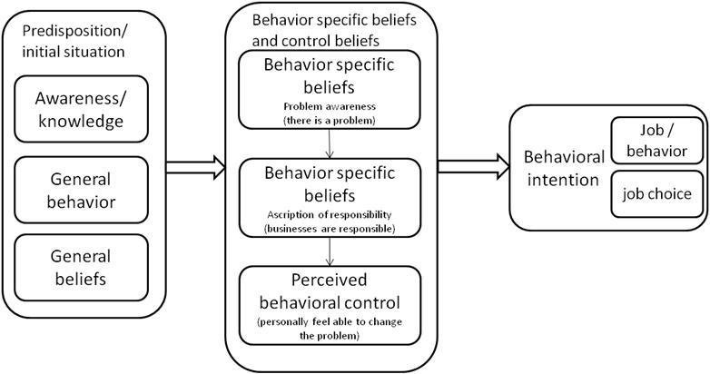
Behavioral intention research
Notes:
From: de Lind van Wijngaarden, M., & Planko, J. (2012). Impacts of sustainability courses on the behavior of business school students. In W. Leal Filho (Ed.), Sustainable Development at Universities: New Horizons (pp. 303–309). Frankfurt: Peter Lang Scientific Publishers.

Slide 9
Ethical consumption
“Conscious and deliberate choice to make consumption choices due to personal moral believes and values
Favoring of ethical products
Boycotting of unethical products
Difficulties with this concept:
  Consumption as moral value?
  Research shows different buying decision making process.
  Little effect in the market

Slide 10
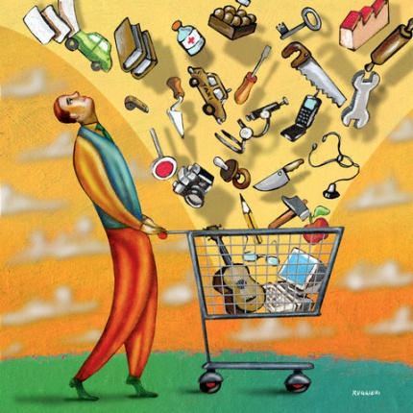
“Myth of the ethical consumer”
Little commercial reward for ethical marketing
Some ethical topics more important to consumers than others.
  Rainforest and working conditions low, animal cruelty high ranked.
Price, value, brand image, and fashion trends are most important factors
Consumers not fully informed
  Only some brands are known for
  ethical issues
Notes:
From: Carrigan, M., & Attalla, A. (2001). The myth of the ethical consumer – do ethics matter in purchase behaviour? Journal of Consumer Marketing, 18 (7), 560–578. doi:10.1108/07363760110410263

Slide 11
“Myth of the ethical consumer”
Consumers don’t want to be inconvenienced
Reality is that ethical abuses are left unpunished by consumers
  Perhaps only if the impact is on the buyer
Group with little interest in ethical behavior
Time pressure reduces consumers search activity

Slide 12
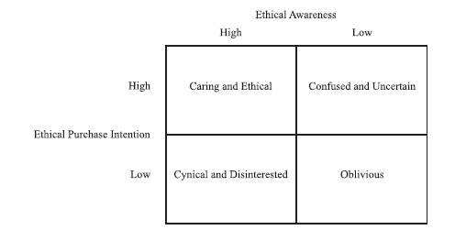
Consumer attitudes
Consumer attitudes to ethical purchasing
From: Carrigan, M., & Attalla, A. (2001). The myth of the ethical consumer – do ethics matter in purchase behaviour? Journal of Consumer Marketing, 18(7), 560–578. https://doi.org/10.1108/07363760110410263

Slide 13








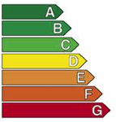








Labeling
Notes:
Consumers have a low awareness of labels

Slide 14
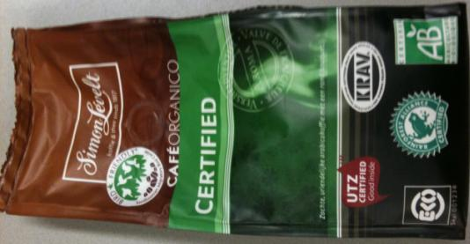
Communication of CSR
 | Own Responsibility | External control
Product | Product info on package (ingredients, production method) | Certification Label (EKO, Fair trade)
Company | Identity (CSR reporting, communications) | Certification standards (ISO 14000, SA 8000 etc)
Notes:
Source: Chapter 5 Ketenverantwoordelijkheid of Johan Wempe in book: Moratis, L. (ed.) (2006). Basisboek MVO : maatschappelijk verantwoord ondernemen. Assen: Koninklijke Van Gorcum.

Slide 15
Managerial implications
Consumers:
  value ethics, but purchase behavior may remain unaffected, don’t expect return on investment
  Most remain uninformed, so ethical marketing information needs to be conveyed in a manner that is not confusing and alienating
  do not want to be inconvenienced, don’t ask for extra effort
  are cynical, so find ways to convince them about ethical integrity
  need to be convinced that their purchase behavior makes a difference in order to change it.

Slide 16
Assignment
Work in a team
Look at the case of Kontii
How would you increase market share?
Describe how you could target the different consumer segments.
Give a pitch presentation

