Slide 1
Sustainable Business Models class 3 Social Entrepreneurship
Lecturer:
Menno de Lind van Wijngaarden

Slide 2
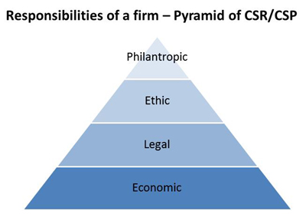
Corporate philanthropy
(Carroll, 1991)
Notes:
Carroll, A. B. (1991). The pyramid of corporate social responsibility: Toward the moral management of organizational stakeholders. Business horizons, 34(4), 39-48.

Slide 3

Heveadorp

Slide 4
Why charity?
Believe: ‘companies can only thrive in affluent societies’
Heveadorp, Ford Motor Company, Cadbury, etc. etc.
Charles Wilson: ‘What is good for the USA, is good for General Motors’’
Consequential or deontological?

Slide 5
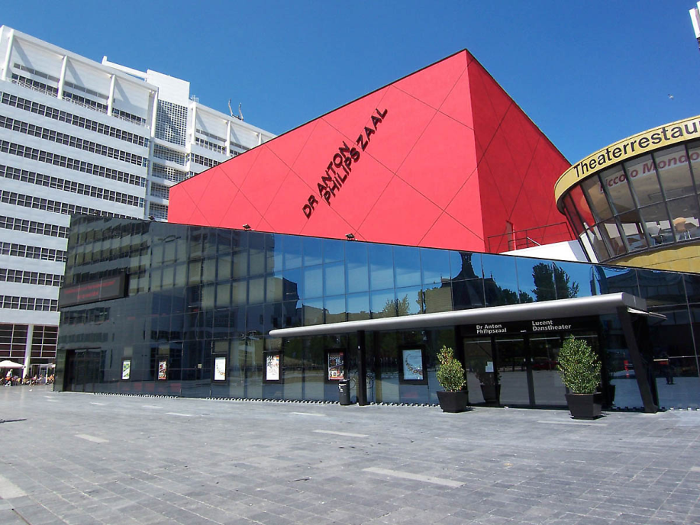

Who pays?
Should donations be made by private individuals?
Or come from company resources?

Slide 6
To think about….
Should payments be in line with corporate activities, or disconnected?
  Expect a return for donation (buying goodwill, establish brand name)?
  Or be really independent (no strings attached)?

Slide 7
Strategic Philanthropy
Philanthropy refers to behavior motivated by concern for others and society at large
Strategic Philanthropy is contradictory (oxymoron), because strategic is egoistic pursuit of self interest, instead of altruistic.
Or mix of motives and altruism is just one of them?

Slide 8
Business benefits
Increase name recognition
Boost employees morale and productivity
Improve cooperation between business units
Porter and Kramer (2002) argue that business should make use of their distinctive strengths to maximize the value of their philanthropic contributions.
    “the more closely a company’s philanthropy is linked to its competitive con-text, the greater the company’s contribution to society will be.”
Notes:
Porter, M. E., & Kramer, M. R. (2002). The competitive advantage of corporate philanthropy. Harvard business review, 80(12), 56-68.

Slide 9
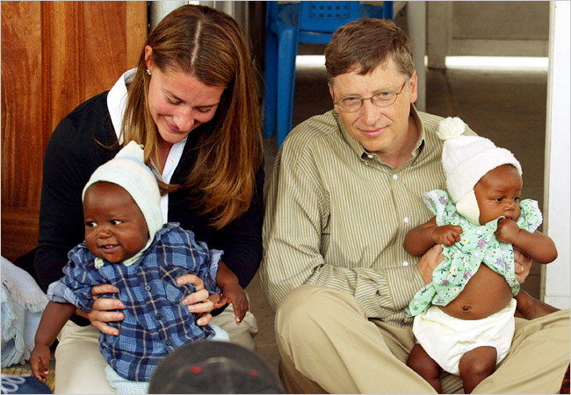
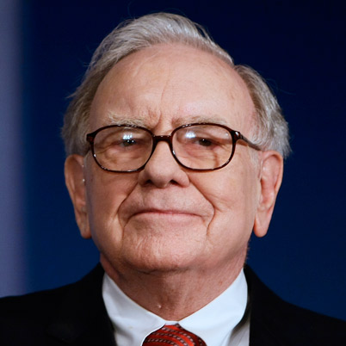
Bill & Melinda Gates Foundation
Bill Gates donated US$28 billion to the foundation.
Foundation endowment of US$38.3 billion
Warren Buffet pledged to give 99% of his wealth (mainly to Gates Foundation)

Slide 10
The concept
What are we looking for?
Adds Value
Sustainable Business Model
Meets demand
Generates Profits
Scalable
Notes:
Adds value to society; positive impact not just minimizing negative impact; creates social or natural capital.
Meets demand; like any product or service there should be a market for it and demand can be sustained
Generates profits; it should generate sufficient profits in order to maintain the business and even grow. The business model becomes scalable.

Slide 11
Sustainable Entrepreneurship
Harnessing the innovative power of entrepreneurship to solve global, social and environmental challenges
  New business models
  New technologies
  New economic systems
it’s about engaging economic incentive systems to drive ecologically and socially sustainable behaviors and outcomes
Notes:
Dean, T. (2013). Sustainable Venturing: Entrepreneurial Opportunity in the Transition to a Sustainable Economy (1 edition.). Boston: Prentice Hall.

Slide 12
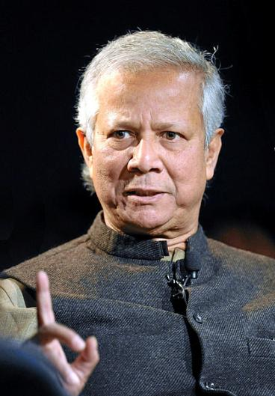
Example of Social Entrepreneur
Muhammad Yunus
Founder of the Grameen bank, it’s model of microfinance inspired hundreds of banks to develop similar business models
Received the Nobel peace price in 2006

Slide 13
What is Soc. Entrepreneurship?
Relative new research field therefore broad definition.
‘a process involving the innovative use and combination of resources to pursue opportunities to catalyse social change and/or address social needs.’ (Mair and Marti, 2006)
Often a focus on the entrepreneur (the change agent); personality, qualities, values and visions.
Characterized by
  Social impact (Social return on investment)
  Innovation (business model)
  Market orientation (performance-driven, competitive, co-operation across sectors.)
(Pless, 2012).
Notes:
From: Pless, N. M. (2012). Social Entrepreneurship in Theory and Practice—An Introduction. Journal of Business Ethics, 1–4. doi:10.1007/s10551-012-1533-x

Slide 14

Social entrepreneurship
Growing phenomena, because…
  Growing inequity
  Weak institutions, retrieving governments
  Scandals in corporate world
  Need for inspiration!
(Pless, 2012).
Notes:
From: Pless, N. M. (2012). Social Entrepreneurship in Theory and Practice—An Introduction. Journal of Business Ethics, 1–4. doi:10.1007/s10551-012-1533-x

Slide 15
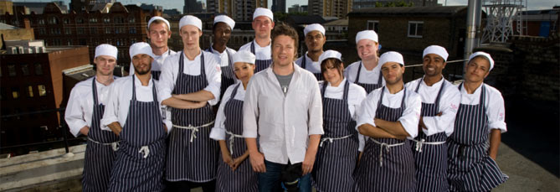
Example
Restaurant chain ‘Fifteen’
Founded by Jamie Oliver in 2002
Each restaurant recruits unemployed and under-qualified young people, aged between 18 and 24, from the local area and trains them to become qualified chefs through an Apprentice Program.
220 have graduated since the start and more than 90 per cent of apprentices stay in the business.
The profit of the restaurants goes into the chef apprenticeship scheme
Notes:
From: http://www.fifteen.net/about

Slide 16
Philanthropy v.s. SE
Philanthropy | Social Entrepreneurship
Spontaneous charity | Reasoning about social return
Honoring sacrifice and justifying weak results | Need for talent and expertise to address challenges
Pure giving | Business like approaches
Relieving suffering | Solving the problem and its cause
Caring for people | Empowering people
(Dees, 2012)
But not just a bipolar strategy;
  Some problems ask for philanthropy, others for SE
  Most SE start with charity
  The two different cultures can also be aligned.
Notes:
From: Dees, J. G. (2012). A Tale of Two Cultures: Charity, Problem Solving, and the Future of Social Entrepreneurship. Journal of Business Ethics, 1–14. doi:10.1007/s10551-012-1412-5

Slide 17
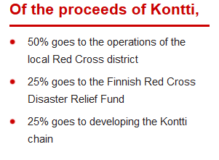
Assignment
In the Kontti case: Are the aspects that could be covered by Philanthropy and/or by Social Entrepreneurship

