Slide 1
Sustainable Business Models class 4 Circular Economy
Lecturer:
Menno de Lind van Wijngaarden

Slide 2
Program
Innovation for sustainability
  Circular economy
    Natural capital
    Cradle to Cradle
  Sharing economy
    Collaborative consumption

Slide 3

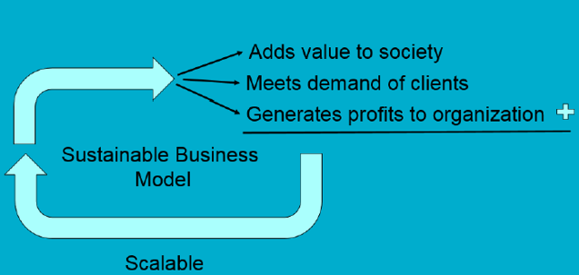
Sundrop farms
http://www.sundropfarms.com/facilities/
Innovative
Let’s consider the factors of the Sustainable Business Model:

Slide 4
Natural Capitalism 3 principles
Buy the time to deal with the growing challenges facing the planet by using all resources far more
productively. (=eco-efficiency)
• Redesign how we make all products and
provide services, using such approaches as
biomimicry and cradle to cradle.
• Manage all institutions to be restorative of
human and natural capital
Notes:
See article Lovins, A. B., Lovins, L. H., & Hawken, P. (1999). A Road Map for Natural Capitalism. Harvard Business Review
4

Slide 5
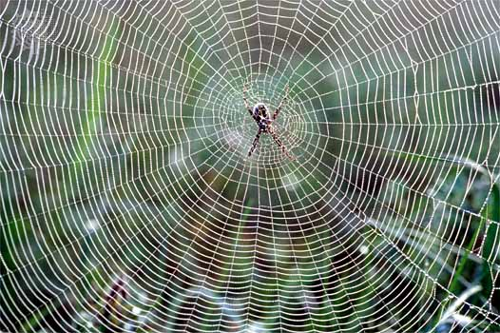
Biomimicry
Spider silk, stronger than steel (not as strong as Kevlar, but tougher than Kevlar)

Slide 6
Natural Capitalism
Increase productivity of natural resources
  Whole system design
  Adopting innovative techniques
Redesign production according to biological models
  Closed loop systems
  Zero waste
Change the business model
  Not selling lifts/elevators, but “leasing vertical transportation”

Slide 7
Innovation of Business Models
From waste as a cost to a waste as an asset
  Recycling factory in Kampala, Uganda pays cash p. kilo plastics, has lead to numerous local initiatives, 43 people working in the factory, hundreds make a living collecting. The clean end products are sold to China for fibers of fleece and carpets. The environment benefits too.
From car lease to mobility services
  Athlon car lease, the biggest lease company of the Netherlands closed a deal with the Dutch Railway, NS. It offers now clients a car lease plus NS Business Card. Athlon wants to become a mobility broker in 2020.
Notes:
Source Waste management: http://www.peopleplanetprofit.be/artikel.php?IK=1223
Car lease to mobility source: www.athloncarlease.com

Slide 8
Program
Innovation for sustainability
  Circular economy
    Natural capital
    Cradle to Cradle
  Sharing economy
    Collaborative consumption

Slide 9
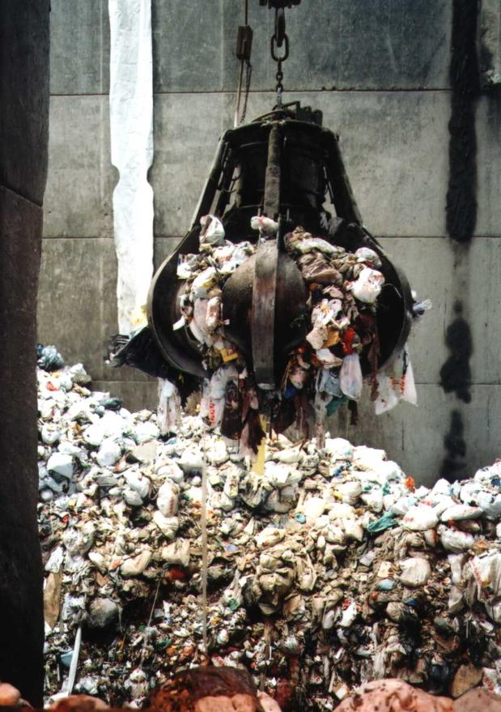
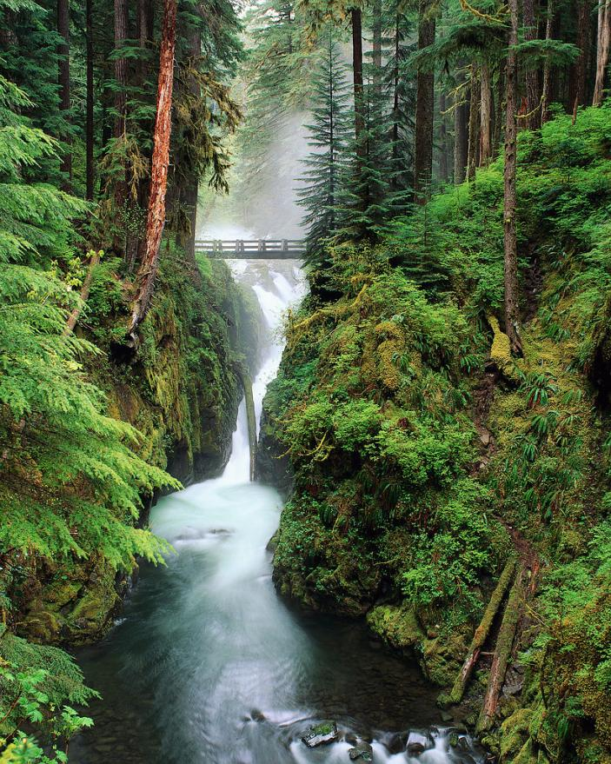






Waste = Food Principle

Slide 10
Waste = Food
Design producs and processes in such a way:
  that resources remain available for human use or the natural environment
  That they are save for the environment and can be reused: Waste = Food
Non renewables are valuable resource for technosphere (food for process)
Non reusables are decomposable in the biosphere (food for organisms)

Slide 11

Cradle to cradle book
Cradle to cradle: remaking the way we make things
Written by Architect McDonough and chemist Braungart
Published in 2002

Slide 12

Cradle to Grave Cradle to Cradle
resource
raw material
component
assembly
consumption
disposal
resource
raw material
component
assembly
consumption
disposal

Slide 13
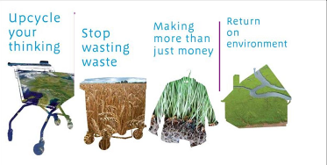
Cradle to Cradle
In contrast to Cradle to Grave concept
  Reduce, reuse, recycling (3 R’s)
Reducing: ‘poisoning’ at a slower rate
Reuse: products are not designed for this purpose
Recycling: down cycling and potentially dangerous

Slide 14
Cradle to Cradle
Focus on:
  Design, start from the root of the problem
  Biological processes, like ecological systems
  Not Eco-efficiency (3 R’s) but Eco-effectiveness
  Waste = Food principle
    Biological nutrients and technical nutrients

Slide 15
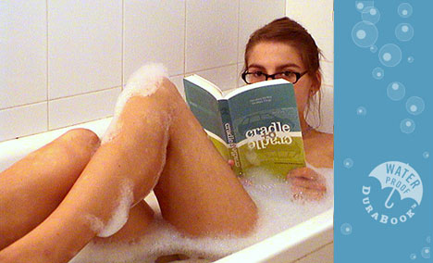
The Book itself
No Paper, but synthetic resins
Non toxic, recyclable (up cycle)
Superior durability and performance
Waterproof
Ink can be washed of
As an example of their concept: the book is a ‘technical nutrient’

Slide 16
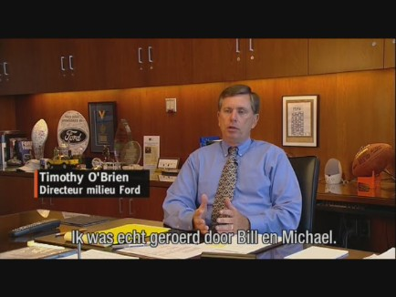
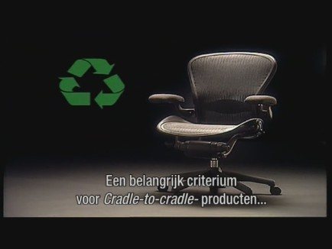
C2C in Business
Ideas has followers among “big business”:
Nike, Ford Motor Company, Herman Miller
2 documentaries in NL attracted attention of business

Slide 17

Example of certified C2C
Diapers fully recyclable, compostable and flushable
No use of chlorine, plastics, latex, perfumes, inks and dyes.
It takes up 500 years to biodegrade for a normal disposable diaper in a landfill

Slide 18
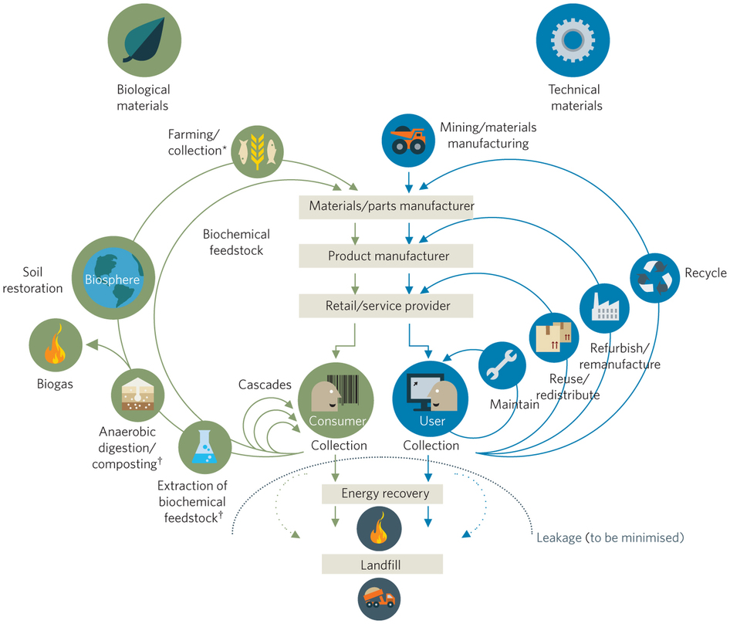

Slide 19
Program
Innovation for sustainability
  Circular economy
    Natural capital
    Cradle to Cradle
  Sharing economy
    Collaborative consumption

Slide 20
Collaborative Consumption
systems of organized sharing, bartering, lending, trading, renting, gifting, and swapping.
  Product service systems Goods that are privately owned can be shared or rented peer-to-peer.
  Redistribution markets Used or preowned goods are moved from somewhere they are not needed to somewhere they are.
  Collaborative lifestyles People with similar needs or interests band together to share and exchange less-tangible assets such as time, space, skills, and money.
Notes:
Botsman, R., & Rogers, R. (z.d.). Beyond Zipcar: Collaborative Consumption. hbr.org/2010/10/beyond-zipcar-collaborative-consumption

Slide 21
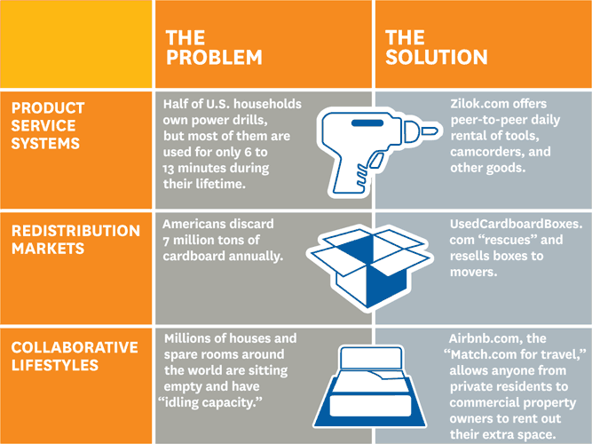
Collaborative Consumption
(Botsman and Rogers, 2014)
Notes:
Botsman, R., & Rogers, R. (z.d.). Beyond Zipcar: Collaborative Consumption. Geraadpleegd 3 december 2014, van https://hbr.org/2010/10/beyond-zipcar-collaborative-consumption

