Slide 1
IPW 2017
Managing Data Risks in the Digital Age
The Digital Age-
Implications for Business Ethics Lecture 1
Dr Tony O’Brien

Slide 2


Slide 3
Learning Outcomes
Managing Data Risk in the Digital Age
Identify the inherent ethical risks in managing an organisation’s data assets
Understand the impacts of the new and emerging technologies
Gain an appreciation of the vulnerabilities risks and impact of Cybercrime on individuals and organisations
Identify potential protective mechanisms that organisations and individuals can employ to ‘mitigate’ against data/digital risk
Understand how business process improvement initiatives can be implemented and sustained
Link the lecture content to the Finnish Red Cross and the Kontti Case Study

Slide 4
Lecture Structure
Lecture 1- The Digital Age- Implications for Business Ethics
The ever increasing difficulties in managing data assets in today’s (and tomorrow’s) volatile environments
The effects of poor data quality and the consequential impacts on all stakeholders’ values
The complexities of managing national and international integrated supply chains and stakeholder connectivity
Lecture 2- Cyber Crime- Vulnerabilities, Risks and Impact
The globalisation of the digital world and the ‘real’ threat of Cybercrime for everyone
The increasing risks relating to the protection of personal data both around social media and within organisational information systems

Slide 5
Lecture Structure
Lecture 3- Mitigating Data Risks
The potential protective mechanisms that organisations and individuals can employ to ‘mitigate’ against these ever-more sophisticated ethical and social risks and threats
Lecture 4- Managing Change for Sustainable Improvements
Methods of embedding business process changes to achieve sustainable organisational improvement initiatives

Slide 6
Our key topics for discussion
IS within the organisational and global context
Awareness of enabling technologies we need to drive and/or support information and knowledge management
Data/Information as an enterprise-wide asset as important as any physical, financial or human asset that organisations manage
Managing information, knowledge, systems, processes and technology as strategic resources to enable organisation to achieve their objectives
Data/Information Quality risks

Slide 7
Emerging(ed) Technology
The expanding use of the internet and the growth of E-Business & E-Commerce
The explosion in social media
The proliferation of mobile devices, inc. BYOD
Cloud Computing & SAAS- (Software as a Service)
The evolution of 'Big Data‘, Analytics & IoT
Data Risk & Security issues, including……… Cybercrime

Slide 8
Systems- Definitions
System:
  An array of components that work together to achieve a common goal or multiple goals
Business System:
  A methodical procedure or process that is used as a delivery mechanism for providing specific goods or services to customers
Information System:
  Computer-based set of applications supported by People and Processes to process Data and turn it into Information
Oz, Jones and Gowthorpe (2012)

Slide 9
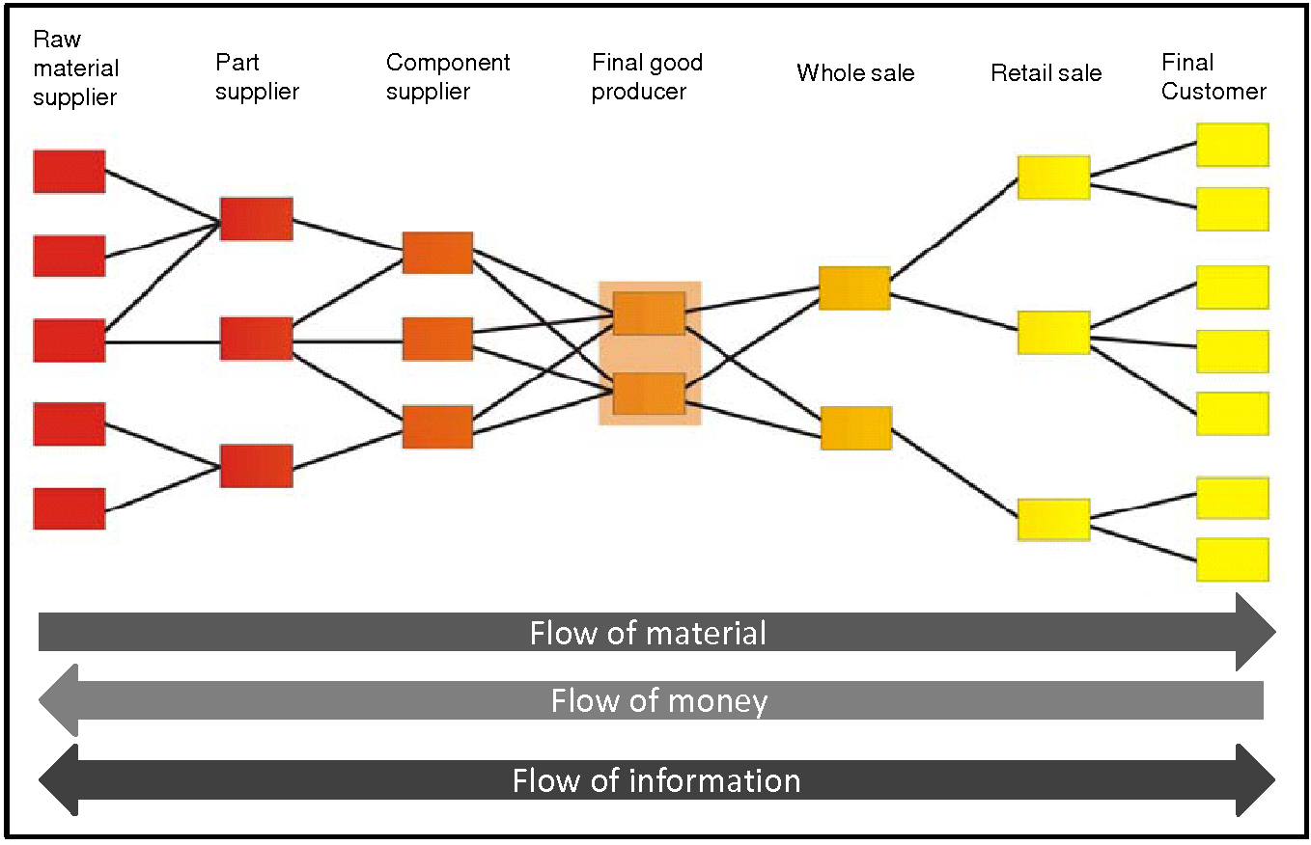
Supply Chain Management
Universidad Politécnica de Valencia Logistic

Slide 10
Information Systems: Definitions
“A set of interrelated components working together to collect, retrieve, process, store and disseminate information for the purpose of facilitating, planning, controlling, co-ordinating, analysing and decision making in business and other organisations” Laudon and Laudon (2016)
This definition suggests all elements of an information system are required to operate together in order to facilitate management operations
“A combination of working practices, information, people and information technologies, organised to accomplish goals in an organisation” Alter (1998)
Plumbing analogy
NOTE- IT is not always an essential element of IS

Slide 11
Levels of Management Decision Making and IS support
Type of IS
Groups Served
Strategic
Level
Decisions
Executive
Information System
Senior
Managers
External/Internal data
Decision
Support System
Middle Managers
Management
Information System
Tactical Level
Decisions
Internal/External data
Operational
Managers & Staff
Transaction
Processing
System
Operational Level
Decisions
Functional systems
Corporate Database
ERP/CRM

Slide 12
Data to Wisdom
What the heck are ‘data’ and information’ anyway?
Answer:
Do we really know?
There are a lot of opinions and it gets worse if we throw in ‘knowledge’ and ‘wisdom’.”

Slide 13
Data and Wisdom
For now:
Data can be structured to fit a database,
Information is what you didn’t know before,
Knowledge can get you out of trouble and
Wisdom can help you avoid trouble in the first place”
(Redman 2005: 22).

Slide 14
Data and Information
Are seen as inter-changeable in every-day terminology (both in practice and elements of academic theory) but we will try to make a clearer distinction
Data:
  Raw facts which are capable of being processed to form information i.e. data is an Input
Information:
  Data which has been processed in such a way as to be meaningful to the audience and in context hence information is the Output
Creating Information from Data requires Processes or a System whether they are supported with Technology or not
Information only becomes truly useful when it can be translated into Intelligence & Knowledge

Slide 15
Data/Information/Knowledge Process Model
Generic System
Input Process Output Recipient
Manufacturing System
Raw Production Finished
Materials Line Products Customer
Information System
Raw Process/ Information Information
Data Database Products Consumer
Knowledge
Decision Making
(Strategic, Tactical, Operational)
Based upon: Strong, Lee and Wang (1997: 104); Wang (1998: 59) and Orna (1996)
Notes:
Check this slide

Slide 16
  Following on
  Checkland and Howell (1997) Mutch (2008)
Traditional thinking
Data Information Knowledge
We may be better reversing the direction
Knowledge Information Data
Rather than information somehow emerging out of data and creating knowledge, it is knowledge that suggests the data that we need and the information that we can draw from it
Data is not simply waiting to be found, but is created by the questions which we ask, questions which can change with changing conditions
We can view information as both a process and a product, although one helpful way of viewing its would be as packaged knowledge

Slide 17
Enterprise Data
Relationships and Complexity

Slide 18
Enterprise Resource Planning
ERP’s allow companies to replace their existing information systems, with a single integrated system.
They promise the seamless integration of all the information flowing throughout a company.
They integrate production, finance, sales and distribution, human resources etc.

Slide 19
Anatomy of an Enterprise System (ERP)

Slide 20
Supply Chain (Information) Management
Universidad Politécnica de Valencia Logistic

Slide 21
Strategies for delivering Information and Knowledge
Evaluating emerging and alternative approaches and strategies for delivering organisational information and knowledge
  Traditional approaches- Client-server, VPN
  Outsourcing
  Cloud Computing
  SaaS, IaaS, PaaS
  Other approaches?

Slide 22
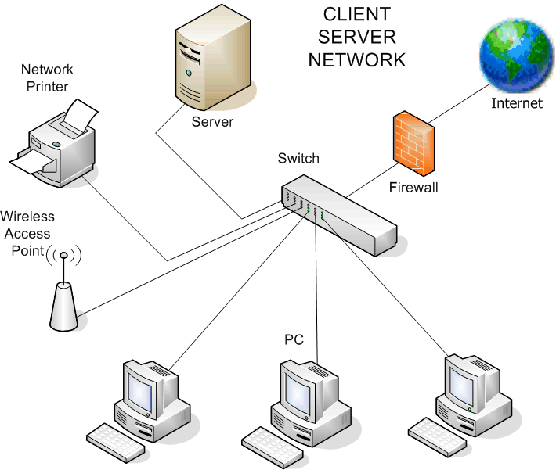
Direct Assists Computer Logics LLP

Slide 23
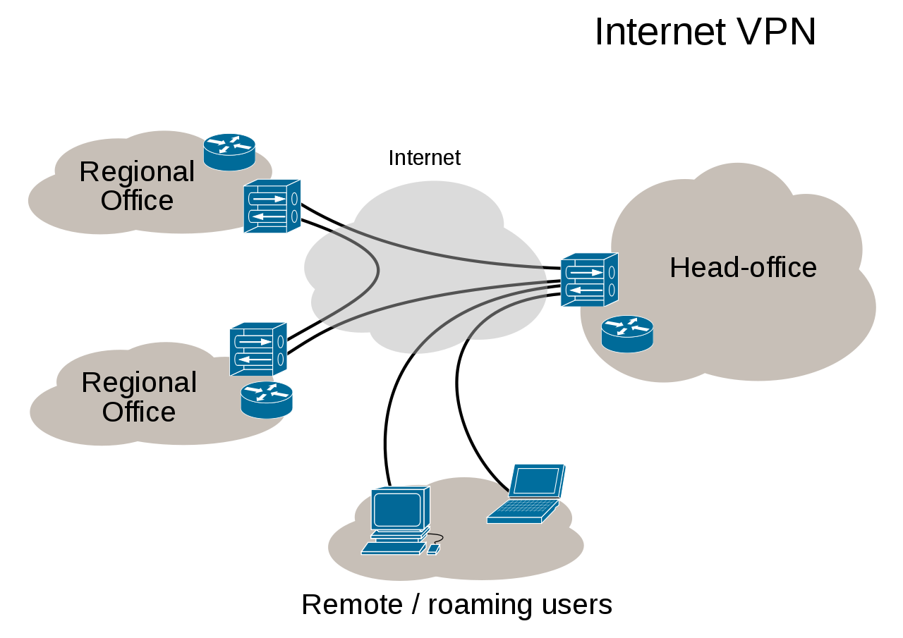

Slide 24
Cloud Computing
A style of computing in which scalable and elastic IT-enabled capabilities are delivered as a service using Internet technologies.
A style of computing in which dynamic, scalable and virtual resources are provided over the Internet. Cloud computing refers to services that provide common business applications online, which are accessed from a Web browser, while the software and data are stored on the servers

Slide 25
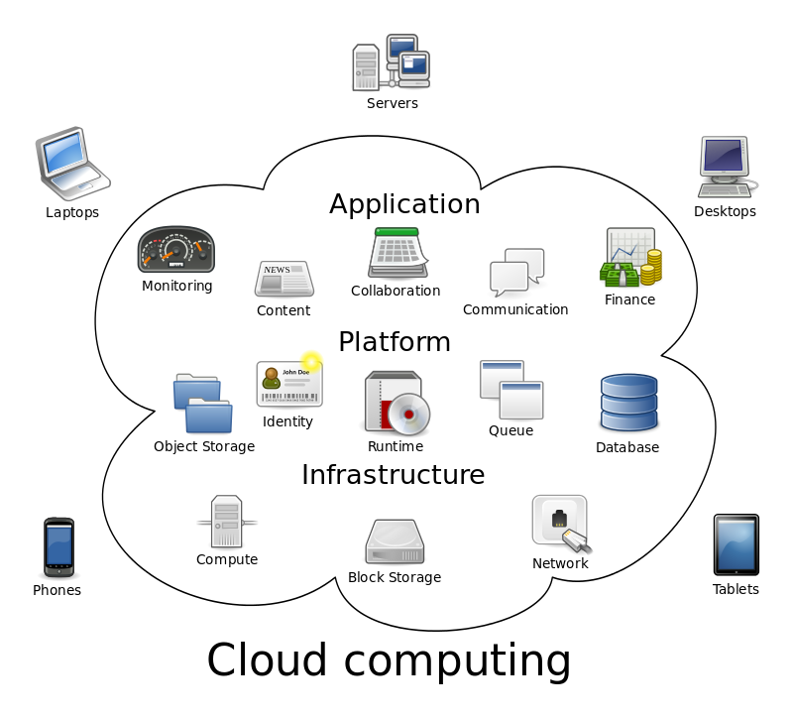

Slide 26
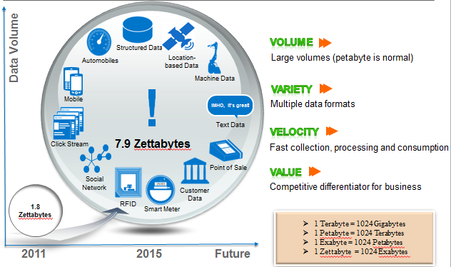
The Growth of Data
Zettabytes = I billion terabytes or 1 trillion gigabytes
Structured & Unstructured

Slide 27
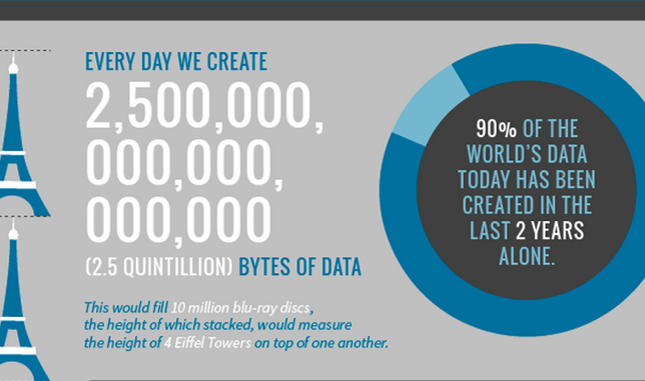
The Growth of Big Data

Slide 28
Big Data
Estimation by 2020 45-50 zettabytes
Data production will be 50 times greater in 2020 than in 2010.
The size of the digital universe will double every two years at least (AKA Moore’s Law in 1965)
Wal-Mart processes one million customer transactions per hour, stored in databases estimated to contain more than 2.5 petabytes of data.
The enormous data influx is straining IT infrastructures. In a recent survey, 55 percent of executives said data is slowing down their IT systems.
Business Ethics and Big Data
https://handouts-live.s3.amazonaws.com/e29d19d363994f6b8e5cb84a62ddb00d?sessionId=2008882885985492492&participantId=300017

Slide 29
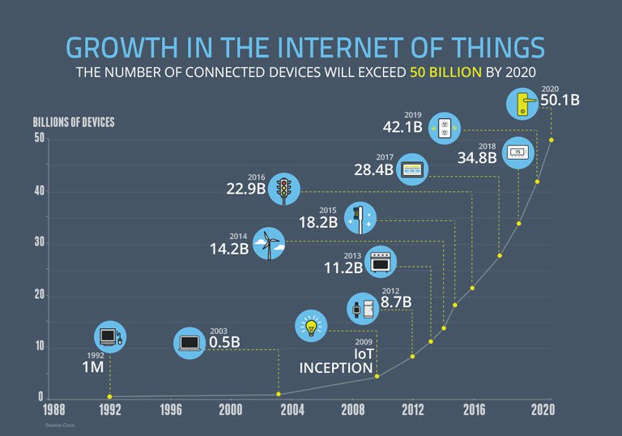
The Internet of Things
Louis Columbus

Slide 30
The Internet of Things (Everything)
https://www.youtube.com/watch?v=LVlT4sX6uVs
https://www.youtube.com/watch?v=Q3ur8wzzhBU
https://www.youtube.com/watch?v=QaTIt1C5R-M
https://www.enterpriseirregulars.com/104084/roundup-internet-things-forecasts-market-estimates-2015/

Slide 31
Data Quality
What is meant by data quality?
What are the disadvantages poor quality data?
What are advantages of having quality data?

Slide 32
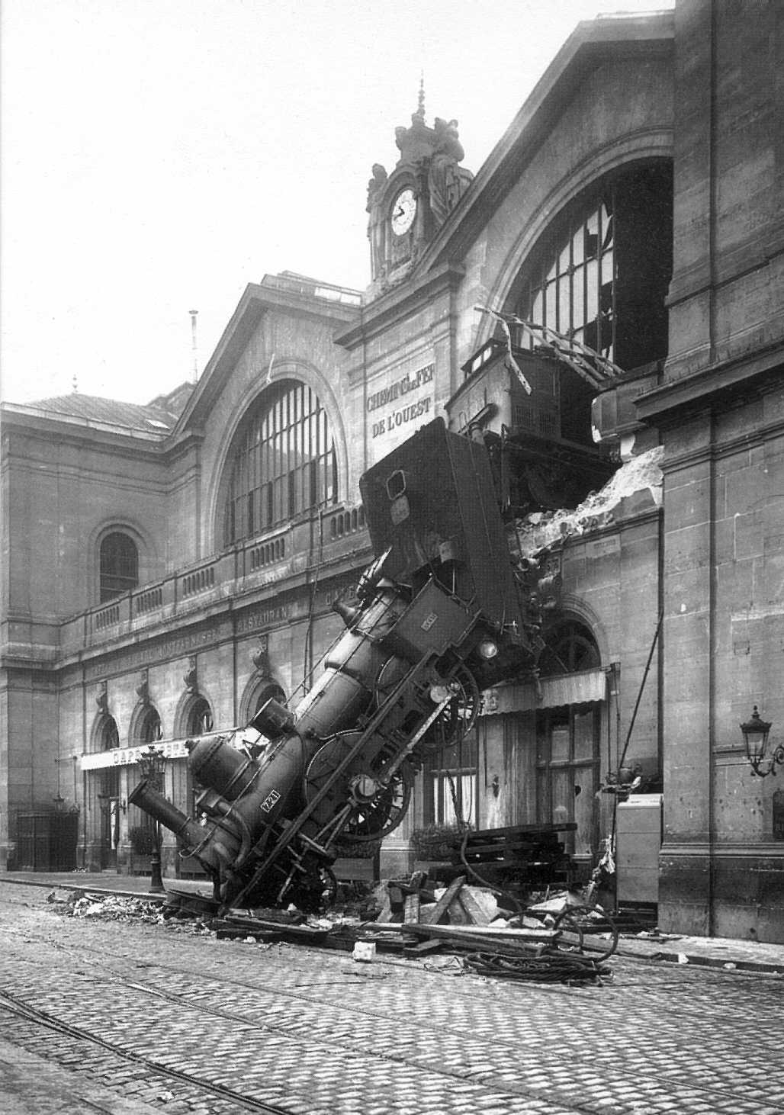
http://www.iqtrainwrecks.com/
Data Disasters

Slide 33
Data Disasters
  A problem that affects real people in the real world that has, at its heart, poor quality information
  A failure to manage the quality of data/information.
  Can range from poor customer service to the loss of life or limb that might arise if there is a failure to manage data/information appropriately.
  Overarching theme: Data Quality

Slide 34


News
Red-faced Tesco feels the pain of the business cycle
Date: 25-Nov-09
Tesco managed to pay a supplier almost £1m for six bikes.
Someone's getting a rocket in accounts...
The finance department managed to overpay by a factor of thousand –
meaning the bikes cost a rather steep £984,000, or £164,000 each.
But the £164,000 question is:
what’s happened to the poor soul in accounts who managed to put an extra three noughts on the cheque?
Why is it an accounts issue?…Its about DATA and CONTROLS

Slide 35
Data Quality
Personal definition
“Having the right and correct data in the right format, in the right place at the right time, by having one single version of the truth across the enterprise” (O'Brien 2011)
Cost of Poor Data Quality
Companies can lose up to 10% of their revenues as a result of poor operational data, together with other serious consequential effects relating to tactical decision making and strategy generation.
(Redman 2001:)
Tom Redman's lake...

Slide 36
Costs of Poor Data Quality
TDWI: Data quality problems costs US business $600 billion a year (5% of US GDP) (Eckerson 2002)
PWC Report: 75% of those surveyed reported major problems resulting from faulty data, (Informatica. 2005:).
“Every business function will have direct costs associated with poor data quality” (Dun and Bradstreet (2006).
A Survey of 193 organisations sponsored, 39% of which had revenues in excess of US $1 billion: 33% rated their data quality as poor at best, whilst only 4% reported it as excellent (Information Difference 2009).
33% of Fortune 100 organisations will experience a data crisis by 2017 arising from their inability to value, govern or trust their enterprise data (Gartner 2014)
On average global companies feel that 26% of their data is inaccurate (up 25% on last year) and 80% do not have a sophisticated approach to data quality . (Experian 2015)
Nearly 60% of organisations do not measure the cost of poor data quality (Gartner 2017)

Slide 37
Data Disaster to Competitive Advantage

Slide 38
Data Seen as an Asset?
Data itself remains one of our most abundant yet under-utilised resources” (Davenport, Harris, De Long and Jacobson 2001: 1)
Many organisations will readily agree that their data is an important asset, but fail to take any action (Hewlett Packard 2007: 3)
Less than one third of organisations regularly monitor data quality (Hayler 2010: 22).
BUT
Companies who are able to gain a better understanding of their customers through improved information may be in a position to enhance their operating margins by up to six percent (Davenport and Harris 2002: 30).

Slide 39
Bringing everything together
Data is both an organisational resource and an enterprise-wide asset, as valuable as any of physical, financial or personal assets and therefore must be managed appropriately.
Its sole purpose is to serve the organisation to enable the it to attain its objectives and goals whilst conforming to the requirements of overall corporate governance

Slide 40
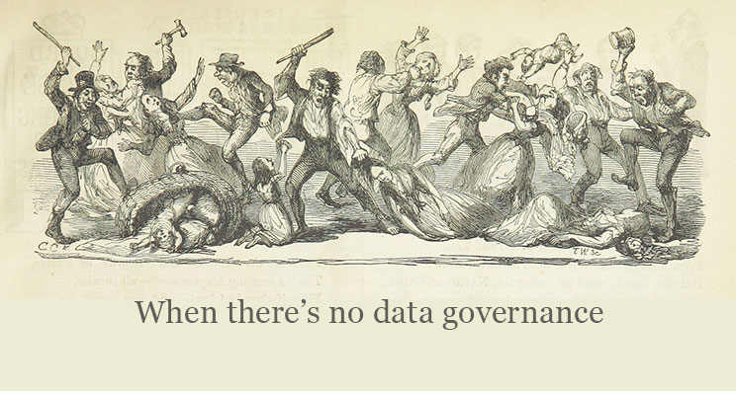
Do you recognise this?

Slide 41
Implications?
Finnish Red Cross
Kontti

Slide 42
References
Alter, S. (1998) Information Systems. Longman Publishing. Boston MA
Checkland, P. and Howell, S. (1997) Information, systems and information systems: making sense of the field. Chichester: John Wiley & Sons
Choo, C.W. (1996) The Knowing Organisation: How Organisations Use Information to Construct Meaning, Create Knowledge and Make Decisions. International Journal of Information Management 16(5) 329-340
Choo, C.W. (2001) The Knowing Organisation as Learning Organisation. Education and Training 43(4/5) 197-205
Davenport, T. H. (1998) Putting the Enterprise into the Enterprise System. Harvard Business Review, July-August 1998: 121-131.
Davenport, T. H. (2006) Competing on Analytics. Harvard Business Review, January 2006: 99-107.
Davenport, T. H. (2009) Make Better Decisions. Harvard Business Review, November 2009.
Davenport, T. H. and Prusak, L (1998) Working knowledge: how organisations manage what they know. Boston MA: Harvard Business School Press

Slide 43
References
Davenport, T. H., De Long, D. W. and Beers, M. C. (1998) Successful Knowledge Management Projects. Sloan Management Review, Winter 43-57.
Davenport, T. H. and Harris, J. G. (2007) Competing on Analytics: The New Science of Winning. Cambridge MA: Harvard Business School Press: 225.
Davenport, T. H., Harris, J. G., De Long, D. W. and Jacobson, A. L. (2001b) Data to Knowledge to Results: Building an Analytic Capability: 1-26: Accenture.
Davenport, T. H., Harris, J. G. and Morison, R. (2010) Overcoming Sticking Points to Embedding Analytics, Information Management Magazine, Vol. May/June: 1-2.
Edvinsson, Leif and Michael S. Malone (1997), Intellectual Capital: Realizing Your Company’s True Value by Finding Its Hidden Roots, HarperCollins Publishers inc., New York
Gartner (2014) Gartner press release Egham http://www.gartner.com/newsroom/id/2672515
Harris, J. G. (2005a) Insight-to-Action Loop: Theory to Practice: Accenture.
Harris, J. G. (2005b). The Insight-to-Action Loop: Transforming Information into Business Performance: Accenture

Slide 44
References
Harris, J. G. (2007) Forget the toys- It's the guy with the best data who wins: Accenture.
Hlupic, V,(2003) Knowledge and business process management, IDEA Group Publishing
IBM (2012) Analytics: The rea-world use of big data
Intel IT Centre (2013) Planning Guide- Getting Started with Big Data
Laudon, K.C., Laudon, J, (2014) Management Information Systems - Managing the digital firm, 13th Edition, Pearson publishers
Marchand, M. A. (2000) Competing with Information: a manager's guide to creating value with information content. Chichester: John Wiley & Sons: 342.
Mutch, A. (2008) Managing Information and Knowledge in Organizations. London: Routledge: 272.
Nonaka, I. and Takeuchi, H. (1995) The Knowledge-Creating Company. Oxford: Oxford University Press: 284
Orna, E. (1996) Information Products and Presentation in Organisations: Accident or Design? International Journal of Information Management, 16(5): 341-351.

Slide 45
References
Oz, Jones and Gowthorpe. (2012) Financial and Management Information. Cengage Learning: 636
Porter, M.E. (1985) Competitive Advantage, Free Press, New York,
Redman, T. C. (2005) Data: A Sea Change Ahead. Wall Street Technology, September
Robison, L. (2010) Correcting the Misconceptions About the Nature of Data that Thwart Information Quality. MIT Information Quality Industry Symposium. Massachusetts Institute of Technology, Cambridge, MA, USA
Strong, D. M., Lee, Y. W. and Wang, R. Y. (1997) Data Quality in Context. Communications of the ACM, 40(5): 103-11
Universidad Politenica de Valencia Logistic. sedislogistic.wordpress.com 2011/03/28
Wang, R. Y. (1998) A Product Perspective on Total Data. Communications of the ACM, 41(2): 58-65.
Wenger, E. (2002) Cultivating Communities of Practice: A Guide to Managing Knowledge: Harvard Business School Books.

