Slide 1
IPW 2017
Managing Data Risks in the Digital Age
Cyber Crime-
Vulnerabilities, Risks and Impact
Lecture 2
Dr Tony O’Brien

Slide 2
Aims of today’s session
The globalisation of the digital world and the ‘real’ threat of Cybercrime for everyone
The increasing risks relating to the protection of personal data both around social media and within organisational information systems

Slide 3
Why are we not surprised?
https://www.theguardian.com/society/2017/may/12/hospitals-across-england-hit-by-large-scale-cyber-attack?CMP=Share_AndroidApp_Email
NHS cyber-attack: Experts strive to restore NHS computers - http://www.bbc.co.uk/news/health-39906019
Massive ransomware infection hits computers in 99 countries - http://www.bbc.co.uk/news/technology-39901382
The ransomware causing chaos globally - http://www.bbc.co.uk/news/technology-39896393
Global cyber-attack: How roots can be traced to the US - http://www.bbc.co.uk/news/technology-39905509
http://www.bbc.co.uk/news/health-39906019

Slide 4
Cybercrime
What is cybercrime?
How does it effect All of us?
What can be the impact?
What is the greatest source of Risk?
What can we do about it? Or
Can we do anything about it?

Slide 5
Electronic Crime, Cybercrime, Computer Crime
“We could be facing cyber warfare….a Cybergeddon"
  ITV Tonight Programme 'Electronic Crime' 2011
“This will be the number one criminal activity in the world….A more serious threat than a nuclear attack"
  Keith Vaz- Chairman of The House of Commons, Home Affairs Select Committee
  http://www.bbc.co.uk/news/uk-politics-23495121

Slide 6
Cybercrime
“Any illegal act for which knowledge of computer technology is essential for its perpetration, investigation or prosecution”
                US Department of Justice
“Criminal actions accomplished through the use of computer systems, especially with intent to defraud, destroy or make unauthorised use of computer systems resources"
                National Hi-Tech Crime Unit UK;

Slide 7
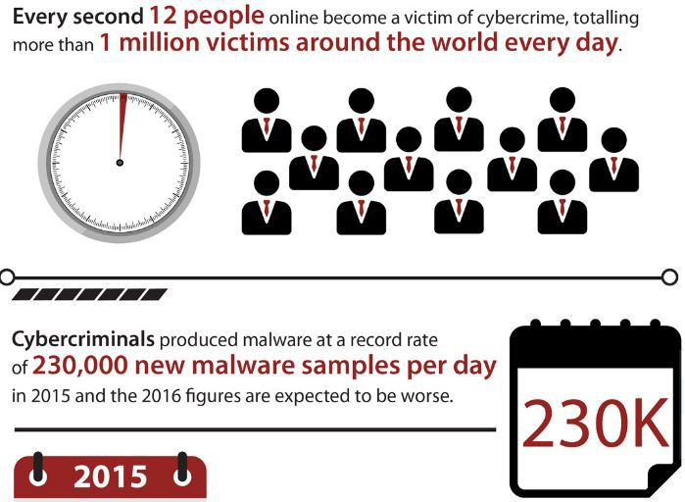
Cost of Cybercrime
Security Affairs 2016
Global cost of cybercrime will grow from $3 trillion in 2015 to $6 trillion annually by 2021

Slide 8
Cybercrime Recent Examples
Yahoo
http://www.bbc.co.uk/news/world-us-canada-38324527
Google Docs
http://www.bbc.co.uk/news/business-39798022
Identity fraud gang tried to sell man's home - http://www.bbc.co.uk/news/uk-38083601
Identity fraud reached record levels in 2016 - http://www.bbc.co.uk/news/uk-39268542
FBI and CIA launch criminal investigation into 'malware leaks' -
http://www.bbc.co.uk/news/world-us-canada-39210628

Slide 9
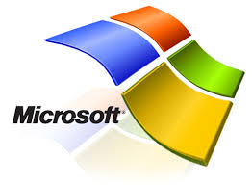
An example of rogue security software that's disguised as a Microsoft alert but that doesn't come from Microsoft
Dear user,
You have reached the storage limit for your Mailbox.
Please visit the following link to your e-mail access restore.
Click Restore
System Administrator.
Windows Live Team

Slide 10
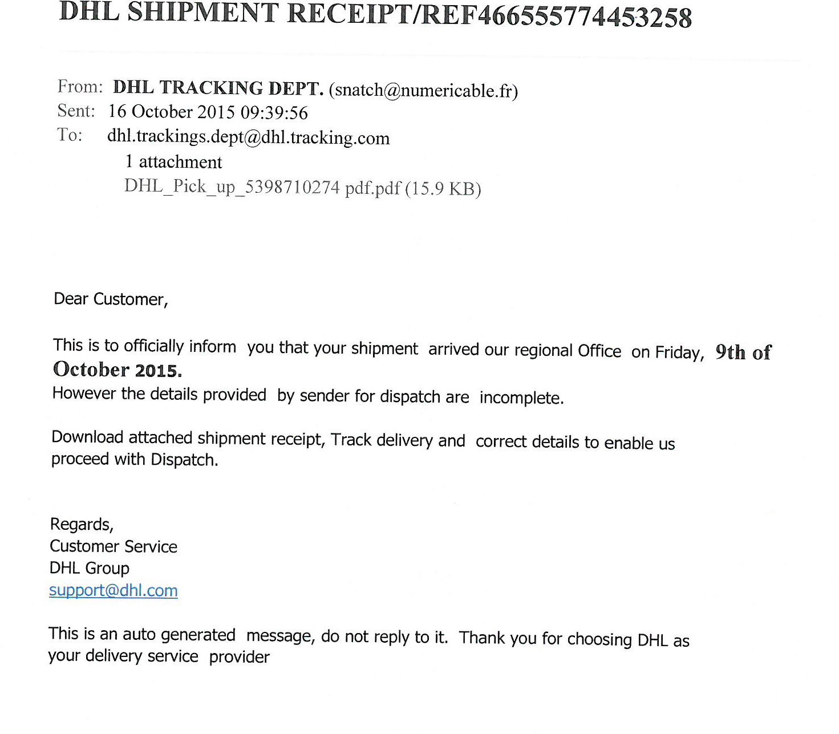

Slide 11


Dear customer,
Customers are strongly advised to lookout for a new phishing scam. If you get an email with the subject, “Your 2016 Tax Report”, with an attachment, do not open it. Please forward it to phishing@hmrc.gsi.gov.uk and then delete it. For more advice, please visit GOV.‌UK and search “phishing”.
Alison Walsh Head of Digital Support for Business and Agents

Slide 12
Vulnerabilities, Threats and Risks
Vulnerabilities
  A weakness in the organization, IT Systems, or network that can be exploited by a threat (a window)
Threats
  Something that can potentially cause damage to the organisation, IT Systems or network
Risk
  A possibility that a threat exploits a vulnerability in an asset and causes damage or loss to the asset

Slide 13
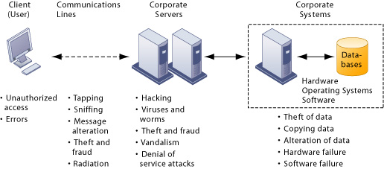
Management Information Systems
Why Systems Are Vulnerable
Contemporary Security Challenges and Vulnerabilities

Slide 14
Origin of the Intrusion or Threat
External
- malware, hackers, script kiddies, former employees, espionage, adversaries, terrorists.
Internal
- management, employees, consultants, contract workers, maintenance crew, temporary staff.

Slide 15
Types of Cybercrime
External and Internal Attacks
Malware, Spam and Phishing (inc. Spear & Whale)
Viruses, worms, trojans, spyware, ransomware
Identity theft
Denial of service- DDoS & Botnets
Social engineering
Cyber terrorism
Hacking
Personal attacks- bullying, stalking, abuse etc.
Theft of digital assets
Theft of loss of personal data- intentional or accidental

Slide 16
Intent or Motive of the Attacker
Political or military objectives- cyber terrorism
Retaliation or vengeance
Ideological objectives
Financial gain, extortion, or blackmail
Curiosity or the thrill of vandalism
Competitive advantage
Focused attack against security companies for trophy hunting

Slide 17
What is Hacking?
Hacking is a way of thinking
Breaking through a computer or a network’s security defences to view or alter information that the intruder does not have access to.
Increasingly, hacking is used to perpetrate many crimes – theft, blackmail, terrorism, etc.
https://www.youtube.com/watch?v=nnKh6SFEaLg

Slide 18
Types of Hackers
Black Hats- Bad Guys
  Subverts computer/electronic equipment behaviour without authorisation- Bad Guys
White Hats- Good Guys
  Work with or in organisations:
    to identify or to get rid of weaknesses
    to design more secure systems
Grey Hats
  The ‘in-betweeners’, ambiguous motives?

Slide 19
Social Engineering
Psychological manipulation of people into performing actions or divulging confidential information
A tactic used by cyber criminals that uses lies and manipulation to trick people into revealing their personal information.
Social engineering attacks frequently involve very convincing fake stories to lure victims into their trap.
Can be in the digital or physical world
https://www.youtube.com/watch?v=HIwqcYwNWh4

Slide 20
Malware
Malware is short for "malicious software." Malware is any kind of unwanted software that is installed without your adequate consent.
Viruses, worms, and Trojan horses are examples of malicious software that are often grouped together and referred to as malware
Destructive malware will utilize popular communication tools to spread, including worms sent through email and instant messages
Trojan horses dropped from web sites, and virus-infected files downloaded from peer-to-peer connections.
Malware will also seek to exploit existing vulnerabilities on systems making their entry quiet and easy
  https://www.youtube.com/watch?v=PgR3WxSo3ho

Slide 21
Types of Malware
Viruses
Trojans
Worms
Rogue software or Scareware
Ransomware
Phishing scams
Adware
Spyware
Key loggers
And Botnets & DDOS

Slide 22
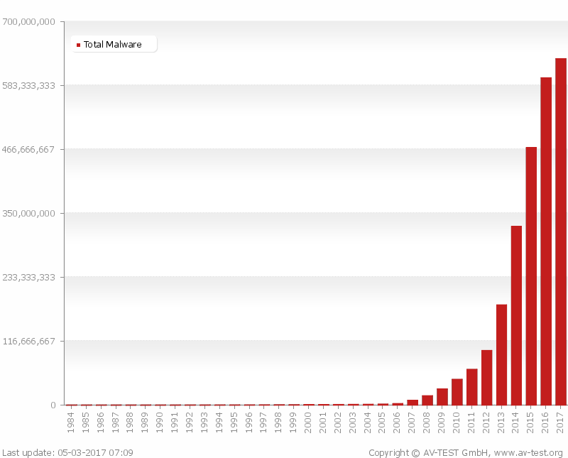
Growth of Malware
AV Test

Slide 23
DoS & DDoS
Denial of Service attack (DoS)
    A single computer flooding a website with useless traffic to inundate and overwhelm the network
Distributed Denial of Service (DDoS)
  Using numerous computers to attack the target network from numerous launch points
  Laudon and Travor 2014
What is a DDoS attack?
  http://www.digitalattackmap.com/understanding-ddos/

Slide 24
Botnets roBOTic NETworks
Hackers create these botnets by infecting other people’s computers with bot malware
    Hundreds, thousands, hundreds of thousands
The infected computers become slaves or zombies serving a master computer belonging to someone else
Botnets deliver:
  90% of the world’s spam
  80% of the world’s malware

Slide 25
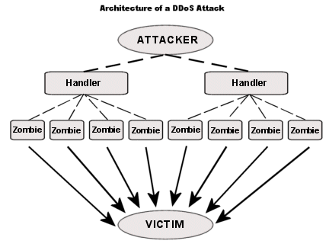
Botnet = roBOT NETwork a Zombie Army

Slide 26
Ransomware
2016- The Year of Extortion
Encrypts your device or claims to
Claim you have done something illegal with your device, and that you are being fined by a police force or government agency.
Demand you pay money.
Many of these claims may be false, a scare tactic designed to make you pay the money without telling anyone who might be able to restore your PC.
There is no guarantee that paying the fine or doing what the ransomware tells you will give access to your device or files again.

Slide 27
A Final thought
https://www.youtube.com/watch?v=Lhe0PbDfaCM
  David Emm from Kaspersky
Don’t forget the
Deep Web
500 times larger than the (Surface) web we know
AND
Dark Web!!!!

Slide 28
Implications?
Finnish Red Cross
Kontti

