Slide 1
IPW 2017
Managing Data Risks in the Digital Age
Managing Data Risks
Lecture 3
Dr Tony O’Brien

Slide 2
Aims of the session
Review the potential protective mechanisms that organisations and individuals can employ to ‘mitigate’ against these ever-more sophisticated ethical and social risks and threats
Presented by
Emerging(ed) technologies within the Digital Age

Slide 3
Emerging(ed) Technology
The expanding use of the internet and the growth of E-Business & E-Commerce
The explosion in social media
The proliferation of mobile devices, inc. BYOD
Cloud Computing & SAAS- (Software as a Service)
The evolution of 'Big Data‘, Analytics & IoT
Data Risk & Security issues, including……… Cybercrime

Slide 4
Safeguarding Your System
“Establish controls which provide adequate protection in a cost effective manner” (Peppard)
“Provide security and resilience that meets their needs at reasonable cost and without shackling the users” (Hinton)
However
The internet was not designed with security in mind!!
Virtually impossible to make systems totally secure!
More effort is needed to protect a system than to hack into it!!!!!

Slide 5
Managing Digital Risk
Risk Management
  "The process of identifying, assessing and developing strategies to manage risk"
  Queensland Government
An IT security risk assessment is absolutely critical to the overall security position of any organization.
An effective security risk assessment can
  Prevent breaches, reduce the impact of realized breaches
  Keep a company's name from appearing in the spotlight for all the wrong reasons
Regular IT security risk assessments also enable organizations to
  Build up a cache of historical data that can be used to effectively gauge and communicate monetary impact related to risks
There are basically three risk management components:
  Evaluation and assessment, to identify assets and evaluate their properties and characteristics.
  Risk assessment, to discover threats and vulnerabilities that pose risk to assets.
  Risk mitigation, to address risk by transferring, eliminating or accepting it.

Slide 6
Real World example of
Data Quality Risk Management Analysis
We examined the experiences gained from collaboration with a large organisation in improving data quality and reducing the risk of Information failures.
Comprised six groups were asked to investigate an area where there were actual information risks and issues, and suggest potential solutions
Risks have been analysed and evaluated within a three-by-three matrix The initial positioning was viewed in terms of:
  Potential organisational risk
  Organisational level impact

Slide 7
Decision/Risk Level Matrix
(each Case Study)
Decisions/ Risk Level | High | Medium | Low
Strategic | 1b New MDM system 5a Regular service interruption causing public embarrassment | 2a Data quality problems 2b Migration issues 3b Lack of data ownership 4a Data accuracy in doubt 4c Information quality issues 4d Lack of data ownership 5b Master data issues 5c Multiple systems and data formats 5d process changes not managed
Tactical | 1b Data download failure | 1b Customer dissatisfaction 2a Increased costs 2a Lost revenues 3c Users losing confidence 4b Procedures not always followed 6a Data inconsistences- manual intervention 6b Asset records inaccurate | 1a Existing data problems
Operational | 1b Non-availability of system | 1a Existing data problems 2a Manual intervention 2a Integration issues 3a Data inconsistencies 3a Manual corrections | 1a Existing data problems

Slide 8
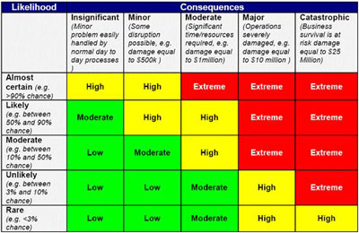
Cyber Security Risk Matrix

Slide 9
Governance
Personal & Organisational
Recognition of the twin Ethical and Social Responsibilities- linked to
Data & Information and IT Governance- with
User training/education, awareness- allied to
Strong policies & procedures- together with a
A policy of enforcement- based upon
Self-Governance- and
Corporate Governance

Slide 10
Organisational Governance
  Data Governance- perceived as an umbrella to also encompass:
    Information Governance
    Knowledge Governance
    IT Governance .................
    And in addition…
    Digital/Cyber Governance
    All underpinned by......................
Corporate Governance

Slide 11
Ethics
Ethics- "refers to the principles of right and wrong that individuals use to make behavioural choices" Rainer and Cegielski (2012)
Ethical standards- "practice or behaviour which is morally acceptable to society" Chaffey and White (2011)
Business Ethics- "moral principles concerning acceptable and unacceptable behaviour by corporations and individual business people" Chaffey and White (2011)

Slide 12
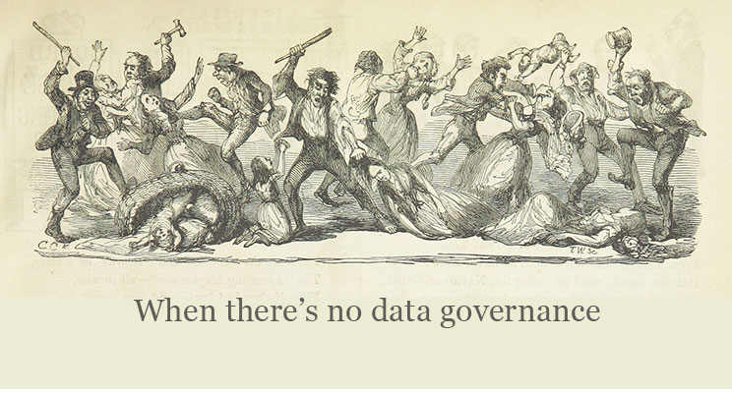
Taming the Data Beast with Governance http://athena-solutions.com/taming-the-data-beast-with-governance/

Slide 13
Data Governance
    Data governance is “how an organisation uses data to benefit and protect itself” www.ibm.com
    Data governance can relate to the “overall management of availability, usability, integrity, and security of data in an enterprise” techtarget.com
    According to SAP, “data governance is the practice of organising and implementing policies, procedures and standards for the effective use of structured/unstructured information assets”
    “Data governance is the orchestration of people, processes, technology to enable an organisation to leverage data and mitigate risk” TDN data

Slide 14
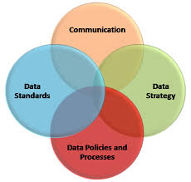
Coordination, Cooperation

Slide 15
The Management of Data-
A Data Governance Policy
        Guiding Principles
Ownership: Who has actual ‘ownership’ or ‘custody’ of the data on behalf of the organisation as a whole and thereby has responsible for the ‘quality’
Responsibility: Those persons who are directly involved in any way with the entry, extraction, manipulation of any part of the data (as data suppliers, processors or consumers)
Management: Ensuring operational availability, security and business continuity- IS/IT Department
Accountability: Everyone within the organisation
Data Policies: To be set by the organisation together with the 'owner' or 'custodians'

Slide 16
Data Governance Frameworks
Data Governance Institute’s DGI –Framework
ISACA’s CoBiT- IT Governance framework
Data Flux’s Governance framework
IBM Data Governance and Data Governance Maturity Model
Sukumar and O'Brien Data Governance Framework

Slide 17
DGI’s Data Governance Framework

Slide 18
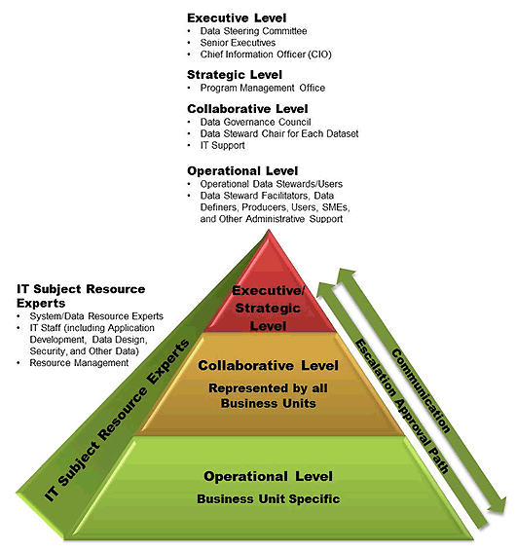
DG- Structure, Roles and Responsibilities

Slide 19
Cybercrime Protective Mechanisms
Security Policies, Processes and Procedures
Technology Solutions
Legislative and Non-legislative

Slide 20

Cybercrime Prevention?
Corporate policies and procedures
Training /awareness/enforcement
Encryption on devices- pcs, laptops, tablets, phones, USBs
Back up data
Be social media savvy
Protect your data/e-identity
Avoid being scammed
Activate firewalls
Use strong passwords
Use anti-virus/malware software
Install the latest operating system updates
Patch/update non-Microsoft software
Legislation and international co-operation
Common sense!!!

Slide 21
Technology Solutions
Protecting Internet communications
  Encryption- Transforms data into cipher text readable only by sender and receiver
Securing channels of communication
  SSL, VPNs
Protecting networks
  Firewalls
Protecting servers and clients
  Enhanced operating systems
  Anti-virus software

Slide 22
UK Legislation
The main statute
Computer Misuse Act 1990
Modified by:
Police and Criminal Justice Act 2006
Serious Crime Act 2015
In reality..
  "Rising Cyber crime suggests that criminal law does not deter criminals and that a better legal solution is required to prevent further rises" Computer Weekly

Slide 23
UK Data Protection Act 1998
Eight major principles
The data controller’s duties
The data subject’s rights
Subject Access requests
Audits
Offences
Fines

Slide 24
Finland- Cyber Legislation
Act on the Processing of Personal Data by the Police
http://www.cyberlawdb.com/docs/finland/data-police.pdf
Personal Data Act
http://www.cyberlawdb.com/docs/finland/personal-data.pdf
Criminal Procedure Act
http://www.cyberlawdb.com/docs/finland/criminal.pdf
The Criminal Code of Finland
http://www.cyberlawdb.com/docs/finland/crcode.pdf
Act on Electronic Signatures
http://www.cyberlawdb.com/docs/finland/esign.pdf
Act on Electronic Services and Communication in the Public Sector
http://www.cyberlawdb.com/docs/finland/public.pdf
Act on the Protection of Privacy in Electronic Communications
http://www.cyberlawdb.com/docs/finland/privacy.pdf

Slide 25
General Data Protection Regulation (2016/679)
European Union regulation intended to strengthen and unify data protection for individuals in the EU
Comes into force on 25th May 2018
Does not require enabling legislation to be passed by national governments
Will replace the UK Data Protection Act 1998
Far greater powers and penalties:
  All breaches must be notified no later than 72hrs
  Fines of up to €20m, or 4% of their annual global turnover whichever is higher (UK max £400k)

Slide 26
Local Laws for a Global Issue?
It is difficult to tackle Cybercrime with local laws
    The attacks can originate from anywhere in the world
    Victims can be based outside the country where the attack originates
    Victims can be located in different countries
    Attackers can work together from different countries to carry out attacks
    Some incidents can be illegal in one country and not in another

Slide 27
International Initiatives
Convention on Cybercrime- (Budapest Convention) 2001
European Cybercrime Centre- Europol
International Criminal Tribunal for Cybercrime- 2012
Geneva Declaration for Cybercrime- 2016
Tallinn Manual Process- 2011
Commonwealth Cybercrime Initiative- 2015

Slide 28
The Future of Cybercrime
THE EVOLUTION OF CYBERCRIME: THEN, NOW AND WHAT'S COMING NEXT
      https://www.youtube.com/watch?v=3APFQ6Y3E64
Top 10 predictions for low-level cybercrime in 2017
  http://www.information-age.com/top-10-predictions-low-level-cybercrime-2017-123463494/
2017 Cyber-crime predictions
  https://www.scmagazineuk.com/2017-cyber-crime-predictions/article/579281/
Security Predictions- The Next Tier
  https://www.trendmicro.com/vinfo/us/security/research-and-analysis/predictions/2017

Slide 29
Common Themes
Lack of XXXXXX Governance
'Governance': Latin 'gubernare‘
'to steer'

Slide 30
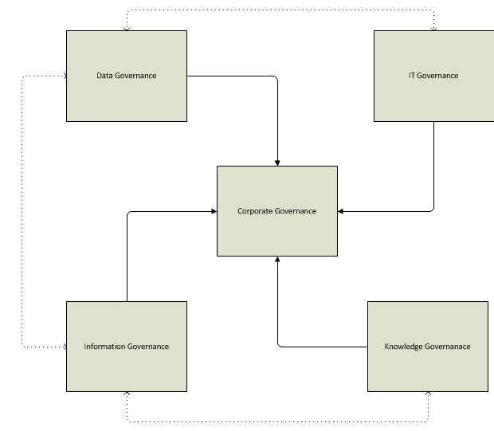
Inter-relationships

Slide 31
Corporate Governance
The ways in which the suppliers of finance to corporations assure themselves of getting a return on their investment
It is the relationship among various participants in determining the direction and performance of corporations
The way in which companies are directed and controlled
The system of checks and balances, both internal and external to companies, which ensures that companies discharge their accountability to all their stakeholders and act in a socially responsible way in all areas of their business activity
Corporate Governance is the system by which companies are directed and controlled

Slide 32
Implications?
Finnish Red Cross
Kontti

