Slide 1
IPW 2017
Managing Data Risks in the Digital Age
Managing Change for Sustainable Improvements
Lecture 4
DR Tony O’Brien

Slide 2
Aims of today’s session
Methods of embedding business process changes to achieve sustainable organisational improvement initiatives
via
  People, Culture and Politics
  Managing the Change
  and then
  Embedding the Change to achieve
  Sustainability

Slide 3
People
Information Producers, Processors, Consumers, 'Users'.. also
'Knowledge Workers' - Peter Drucker/Stephen Covey, English (2009)
Knowledge Management is as much about ‘People’ as Information. Davenport and Marchand (2000)
People are essentially unpredictable unlike the more controlled process flows Whitehead (2006)
Deloitte survey: 99 corporations of which 90% had revenues > $1bn Deloitte (1999)
  57% of IT issues and problems are people related
  Change management, Quality of staff and education and training, resistance to change
Education is the single most essential factor in successful projects Goodfellow (1994)
People who are trained and work together as a team are the key to success or failure Wallace and Kremzar (2001)
The importance of 'soft skills', change management, performance measures, rewards employee morale Mohamed and McLaren (2009)

Slide 4
Culture
Organisational Culture- ‘The way we do things around here’- allied to:
The importance of Corporate Values upon:
  Information Culture: Davenport and Prusak (1997)
  The attitudes and patterns of behaviour that identifies an organisation’s approach to information
  An important influence on how it views and uses information

Slide 5
Information Politics and Culture
Managing the politics of information, together with changes in organisational culture, is difficult, complex and time consuming.
Five models of information politics were identified in order of increasing effectiveness. Davenport Eccles and Prusak (1992: 56) Davenport and Prusak (1997: 69)
Technocratic Utopianism: A heavily technical approach to information management stressing categorisation and modelling of an organisation’s full information assets, with heavy reliance on emerging technologies
Anarchy: The absence of any overall information management policy, leaving individuals to obtain and manage their own information.
Feudalism: The management of information by individual business units or functions, which define their own information needs and report only limited information to the overall corporation.
Monarchy: The definition of information categories and reporting structures by the firm’s leaders, who may or may not share the information willingly after collecting it.
Federalism: An approach to information management based on consensus and negotiation on the organisation’s key information elements and reporting structures.

Slide 6
Organisational Culture and Change
Easier to get the hard components right
  Can be developed in-house or get external help
Difficult to get the soft components right
  Resistance to change,
  Not enough impetus to change
  Vested interests
  Changing existing beliefs, view points and assumptions, touching on organisational culture
  We all like our 'comfort zone'

Slide 7
Managing Change
Implementing any change or improvement involves changing human behaviour
  A study identified that communication plays a fundamental role in the success or failure of such programmes Lewis (2000)
Four key themes emerged:
  Creating, sharing and communicating a vision to everyone
  Sense making around the vision with the provision of feedback opportunities
  Establishing legitimacy for change around the stakeholders (getting ‘buy in’)
  Communicating goal achievements- publicising successes, providing evidence of continued progress towards targets, milestones, etc

Slide 8
Henley Management College research- £25bn is wasted annually on UK improvement processes
Upwards of 80% of such programmes fail to meet expectations
Eaton and Phillips (2006)
Poor communication
Fractures stakeholder commitment
Poor diagnosis of
change problem
Wrong diagnosis
= wrong change remedy
Lack of collaboration
Prevents
team cohesiveness

Slide 9
Managing change
Three scenarios
  Turnaround: emphasis on speed and cost reduction the aim is to achieve immediate results (financial)
  Revolutionary: fast change AND cultural change, often characterised by strategic drift
  Evolutionary: creating an organisation capable of continual change (the learning organisation)

Slide 10
Diagnosing change
Managers need to understand the situation: what types of change are required, the context in which change occurring , the blockages to change and how to encourage change
Types
Importance of context
Blockages to change
Communicating the change process

Slide 11
Styles of Managing Change
Educate: explain
Collaborate: involve
Intervene: delegate through change agent
Direct: top down vision
Coerce: explicit use of power to impose

Slide 12
Theoretical Models for Managing Change
Formula for Change
Stages of Change Model
Kotter’s Eight-Step Change Model

Slide 13
Formula for Change Model
D x V x F >R
If the combined elements of:
D= Dissatisfaction with the current situation
V= Vision of what can be achieved
F= First steps that can be taken to commence the change
Is greater than the initial
R= Resistance to change
Then there is a possibility that change can be implemented
Based upon the work of Richard Beckhard and David Gleicher Jacobs(1994:122)

Slide 14
Stages of Change Model
‘Transtheoretical’ Model
Six to Seven Stages:
Pre-contemplation- no awareness or intention to change
Contemplation- awareness but no firm commitment
Preparation- action intended
Action- some change initiated
Maintenance- initial enthusiasm gives way to normality which can lead to:
Reversion to type/Relapse then return to ‘Action’
Termination- change fully inculcated
Prochaska and DiCelemente (1982)

Slide 15
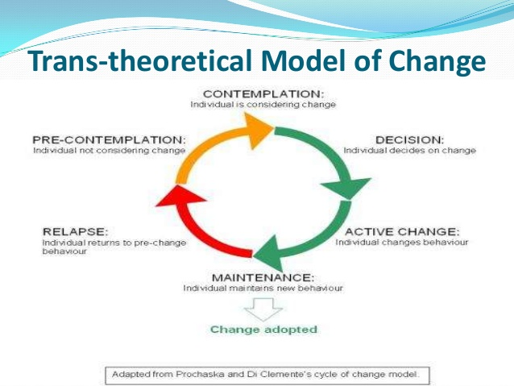
Managing this Change

Slide 16
Kotter’s Eight-Step Change Model
Establishing a sense or urgency
Creating the guiding coalition
Developing a vision and strategy
Communicating the change vision
Empowering employees for action
Generating short-term wins
Consolidating gains
Anchoring and embedding change in culture
Kotter (1996)

Slide 17
Overcoming user resistance
Kotter and Schlesinger (1979) identified six approaches to change
  Education and communication
  Participation
  Facilitation and support
  Negotiation
  Manipulation and co-optation
  Power / coercion
Notes:
Education – see the logic and need for the change – one to one groups, cascades
Participation – potential resistors involved in change
Facilitation and support – training in new skills, time off for a demanding period!!!
Negotiation and agreement – provide incentives (but very expensive and sets precedents)
Manipulation and Cooptation – coopt a influential resistor not for that person to participate but to endorse the new way.
Explicit and implicit coercion – where speed is essential and initiator has power. Long term game?

Slide 18
Real World Example
Data Quality Improvement Project
Remploy
  Largest provider of employment opportunities for disabled people in the UK
  Employing 6,000 disabled people across 65 factories and business offices
Project
  DQ was seen as ‘key’ to a number of important corporate projects
  Recognition of the need for quality data at source
  Data Quality Improvement Project launched in 2005 with executive sponsorship (Director of Finance)

Slide 19
Overall Project Improvement

Slide 20
Managing Change
Personal reflection
Change processes attempt to affect human behaviour
Recognition that setbacks can occur at all times and are the norm
A long term positive solution-focussed approach should be employed
No big bang- but a step by step; action upon action; decision upon decision process
Continuous measurement, reporting and communicating
Change Leaders/Champions at all levels
Involving and developing everyone

Slide 21
Deciding Factors
Sell the concept up and down the organisation
Attitude & willingness at all levels to embrace something new
Senior management sponsorship & involvement
Measurement of progress & the publication of the results
Attempt to address cultural issues
System & structural changes can prevent a return to type
Have a ‘internal champions’ who has the respect of the audience
  Personal experience

Slide 22
Lessons Learnt
Take things slowly to ensure everyone is on-board
Identify who has ownership/custody and responsibility. The businesses ‘own’ the data- culture change/paradigm shift
Provide regular visible measures and monitor progress
Build data quality targets into peoples’ objectives
Ascertain root causes of issues and resolve problems at source
Identify how the process will improve the quality of the data and thereby support the corporate mission to make a difference to the lives of disadvantaged individuals
22

Slide 23
Managing Change
https://www.youtube.com/watch?v=k69i_yAhEcQ
https://www.youtube.com/watch?v=owU5aTNPJbs
https://www.youtube.com/watch?v=vPhM8lxibSU
https://www.youtube.com/watch?v=2ssUnbrhf_U
https://www.youtube.com/watch?v=f60dheI4ARg
https://www.youtube.com/watch?v=hcz1aZ60k7w

Slide 24
Implications?
Finnish Red Cross
Kontti

Slide 25
References/Sources
Austin and Macfarlan (2007) Corporate Information Strategy and Management , 7th Edition, McGraw Hill, 2007)
Eaton, M. and Phillips, S. (2006) Sustaining Improvement: Is It a Pipe Dream: ezinearticles.
Jacobs, R. W. (1994) Real-time strategic change: How to involve an entire organization in fast and far-reaching change. San Francisco: Berrett-Koehler: 335.
Kotter JP, Schlesinger LA. Choosing strategies for change. Harv Bus Rev 1979; 57(2):106-14.
Kotter, J. (1996) Leading Change. Cambridge: Harvard Business School Press: 203.
Lewis, L. K. (2000) Communicating Change: Four Cases of Quality Programs. Journal of Business Communication, 37(2): 128-155.
Marchand, D. (1998) ‘Competing with Intellectual Capital.’ in G. von Krogh, G. Roos and D. Kleine Knowing I Firms. London, Sage: 253-268
Mutch, A. (2008) Managing Information and Knowledge in Organizations. London: Routledge: 272.
Prochaska, J. O. and DiClementie, C. C. (1982) Trans-theoretical therapy- towards a more integrated model of change. Psychotherapy: Theory, Research and Practice, 19(3): 276-288.

