Slide 1
Integrated Reporting
Business reporting in the 21st century

Slide 2
Integrated Reporting <IR>
is supported by the International Integrated Reporting Council (IIRC)
Increasingly used around the world (2015 data).
  60 FTSE listed companies (UK)
  130 Japanese companies (Japan)
“innovations in reporting coming out of New Zealand are among the best examples of integrated reporting”
(<IR> newsletter April 2016)

Slide 3
IR process – the six capitals that create value
1.Financial
2. Manufactured
3. Intellectual
4. Social & relationship
5. Human
6. Natural
Increases? Decreases? Transformations?

Slide 4
NZ POST - capitals
http://annualreview2016.nzpost.co.nz/reporting.html

Slide 5
The six capitals in detail. . .
1. Financial
  Cash, equity, debt.
2. Manufactured
  Infrastructure (roads, rail, bridges, power grid etc) buildings, equipment.
3. Intellectual
  IP (patents, copyright, software, licenses).
  Institutional capital (tacit knowledge, processes, protocols, systems).
4. Social & relationship
  Key stakeholder relationships, social license to operate, shared values & norms etc.
5. Human
  People’s competencies, capabilities and experience, motivations, loyalties.
6. Natural
  Air, water, land, minerals and forests, fisheries, farming, biodiversity and eco-system health.

Slide 6
IR process – internal and external focus
What value has been created?
Who has benefited from it?
  “financial reporting entity”(internal)($)
  others (external)
    +ve & -ve externalities

Slide 7
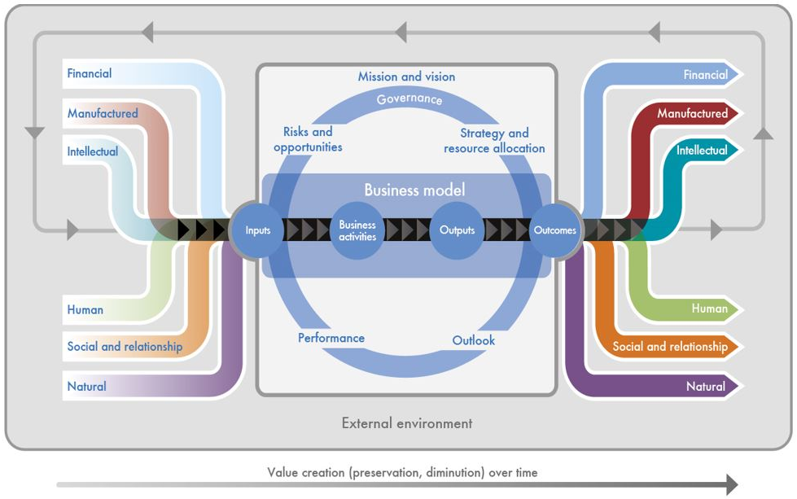
IR process – value creation.

Slide 8
IR process – overview
Increases, decreases, transformations in capitals

Slide 9
IR –Approach (guiding principles)
1. Strategic focus and future orientation
  Past & present learnings, risks & opportunities now and future.
2. Connectivity of information
  Holistic view, showing relationships and dependencies among value creators.
3. Stakeholder relationships
  Nature & quality of key stakeholder relationships
4. Materiality
  Matters that substantively affect the ‘financial reporting entity’s’ to create value over the short, medium and long term.
5. Conciseness
  Short, plain language, link to other info as needed.
6. Reliability and completeness
  All material matters, both positive and negative, in a balanced way and without error.
7. Consistency and comparability
  Consistent over time (vertical); comparable to other organisations (horizontal).

Slide 10
Sanfords - materiality
http://www.sanford.co.nz/investors/reports-1/company-reports/2015/2015-annual-report/
Pp 18 - 20

Slide 11
IR – output (report content)
1. Organizational overview and external environment
  Purpose and societal/economic context.
2. Governance
  Structures and processes connected to SML value creation.
3. Business model
  Costs, revenue, core processes (BMC (?))
4. Risks and opportunities
  SWOT re SML value creation.
5. Strategy and resource allocation
  Forward journey: where and how?
6. Performance
  Historical journey: progress and status? (link to capitals).
7. Outlook
  More SWOT re SML value creation
8. Basis of preparation and presentation (General reporting guidance).
  What is in this report, and why?

Slide 12
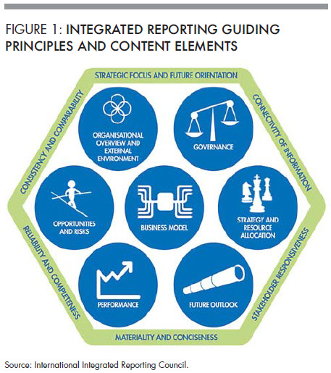
IR – guiding principles & content combined

Slide 13
<IR>
Six capitals.
Seven guiding principles.
Eight content sections.
“Its a whole thing”
(Bojack Horseman)

Slide 14

Kontti and <IR>
“Begin with the end in mind” (Stephen Covey)
<IR> is based on integrated thinking.
consideration . . . of the relationships between its . . . . functional units and the capitals that the organization uses or affects.
Integrated thinking leads to integrated decision making and actions that consider the creation of value over the short, medium and long term.

Slide 15
Kontti & the six capitals
What capitals are used to create value?
How are they increased, decreased, transformed?

Slide 16
Kontti & materiality
What are the ‘relevant matters’ that most affect Kontti ability to create value?
  Within the Kontti organisation (reporting entity)?
  Risks, opportunities and outcomes from other entities/stakeholders outside Kontti that have a significant effect on Kontti?
Which of those issues is most important to Kontti strategy?

Slide 17
Kontti & business model
Structure
  Governance, divisions & department, locations, stakeholders?
Function
  Activities that add value, cost, etc?
  Core competencies?
Strategy
  Progress so far
  SWOT

Slide 18


Reference links
http://integratedreporting.org/resources/
  Integrated reporting guidelines.
Two New Zealand examples
http://annualreview2016.nzpost.co.nz/reporting.html
  NZpost 2016 integrated report
http://www.sanford.co.nz/investors/reports-1/company-reports/2015/2015-annual-report/
  Sanford 2015 integrated report

