Slide 2
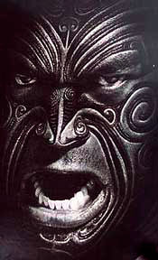
(a ‘mihi’ or introduction in Te Reo Maori)
Ko Rolleston te maunga
Mt Rolleston is my mountain
Ko Waimakariri te awa
Waimakariri is my river
Ko Ngati Wiremu, Ngati MacLean, Ngati O’Keiran te iwi
Williams, Maclean, Kearns, are my tribes
Ko Peter Drucker te rangatira
Peter Drucker is my leader (chief)
Ko Kearns te hapū
Kearns is my family
Ko Te Noho Kotahitanga te marae
Te Noho Kotahitanga is my marae
Ko Kaiako Nick ahau
My name is Nick

Slide 3
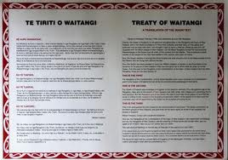
Aotearoa : New Zealand
Treaty of Waitangi (signed 1840)
  established Aotearoa-New Zealand a bicultural nation – one land with two people.
    Tangata whenua (people of the land)
    Tangata tiriti (people of the treaty)

Slide 4
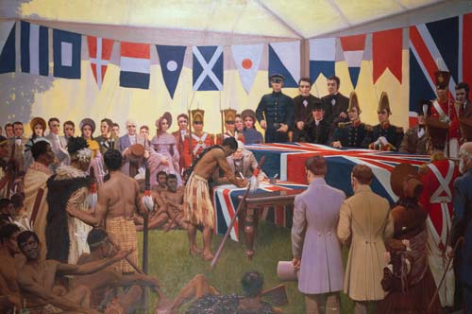
Treaty of Waitangi 1840
Between 40 Maori chiefs and the (English) Crown
  Gave Tino Rangatiratanga over Taonga Katoa to Māori
  (chiefly power) (treasures)
  Gave right to govern and enact laws to Crown.
  Gave Tangata whenua protection of the Crown.

Slide 5
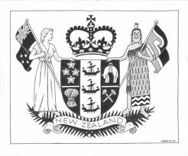
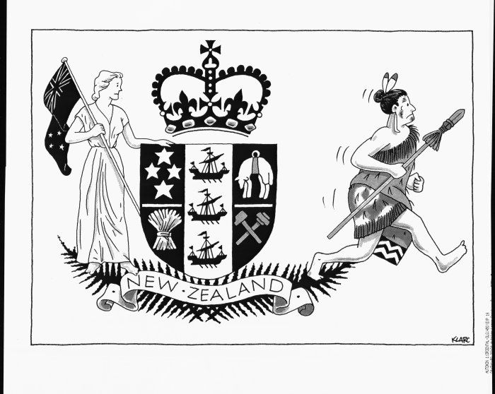
Plan . . . . . . . . . and . . . . . . . . . . . reality

Slide 6
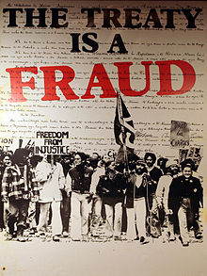
The Waitangi Tribunal 1975
A permanent commission of inquiry into Crown
breaches of the Treaty of Waitangi was set up in 1975.
Has the role of making recommendations on claims
by Maori for redress of wrongs by the crown in the past,
  usually including;
    an apology
    possible return of suitable lands
    cash in lieu of other unavailable assets

Slide 7
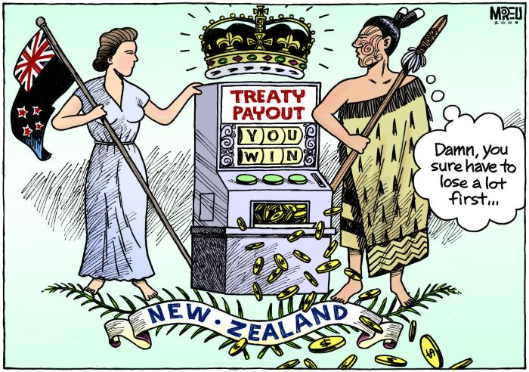

Slide 8
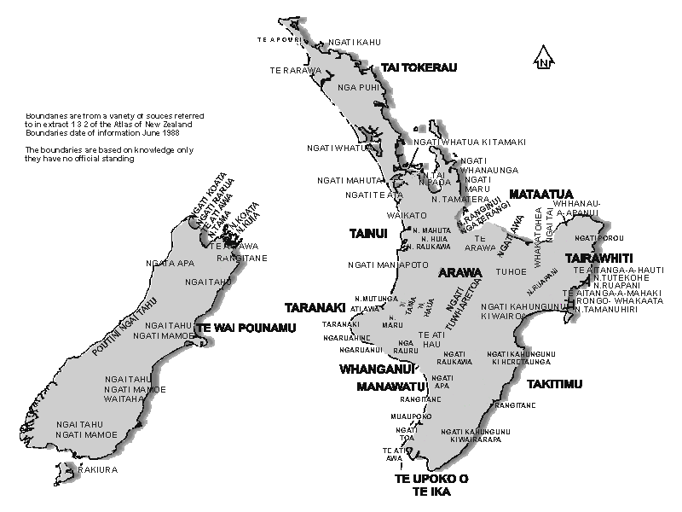
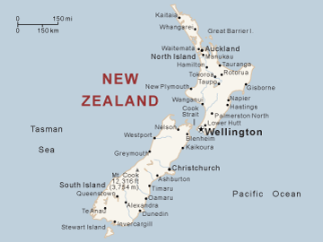
Aotearoa - New Zealand (tribal nation)

Slide 9
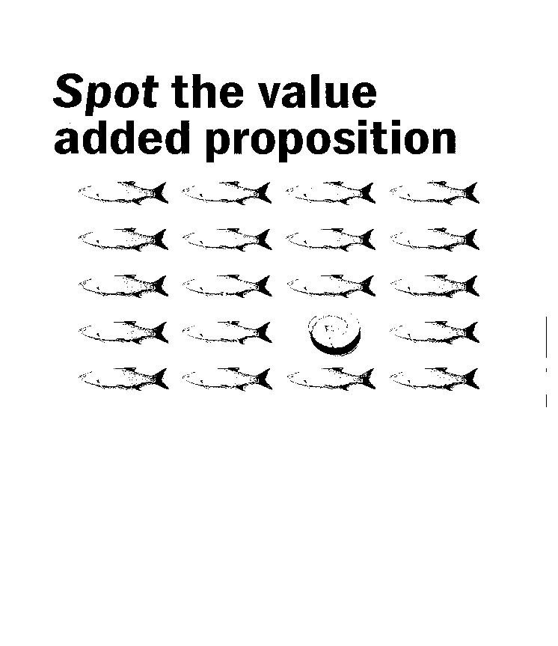
Māori Business in Aotearoa : New Zealand In 2017
- NZ$45 billion in Maori controlled businesses
- 75% primary sector (farm, fishing, forestry)
- Significant property holders.
Ngati Whatua Orakei $1.5Bn of Auckland CBD)
- Significant export earners (commodities, tourism)
- SMEs into
prof services
tourism
. . everything

Slide 10
So what’s it all about?
Maori businesses have an approach to business informed by their tradition (Kaupapa or Tikanga).
Western business philosophy approaches the same position through the multiple bottom line measuring of success.
Question: What are the touchpoints between the western and the Maori traditions?
“What do they know? Do they know anything ? Let find out!”

Slide 11
Tikanga: (ways of doing business)
“express their identity as Māori in connection with business”
1. Kotahitanga: Māori unity, shared sense of belonging
2. Tino rangatiratanga: Self-determination, ownership, control
3. Whanaungatanga: An ethic of belonging, kinship, family
4. Kaitiakitanga: Guardianship of natural resources
5. Wairuatanga: Spirituality
6. Manaakitanga: Hospitality, generosity, care, and giving
7. Tuhono: Cross-sectoral alignment of Māori aspirations on all dimensions
8. Puawaitanga: The best possible return is sought on integrated goals
9. Purotu: Multiple responsibilities and levels of accountability

Slide 12

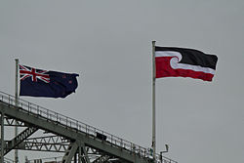
Rangatiratanga: Leadership
  1. Management for current and future requirements,
  2. Strategic development and oversight,
  3. Relationship development and maintenance,
  4. Problem-solving, conflict resolution and peace-making,
  5. Adaptation, risk analysis and management.

Slide 13
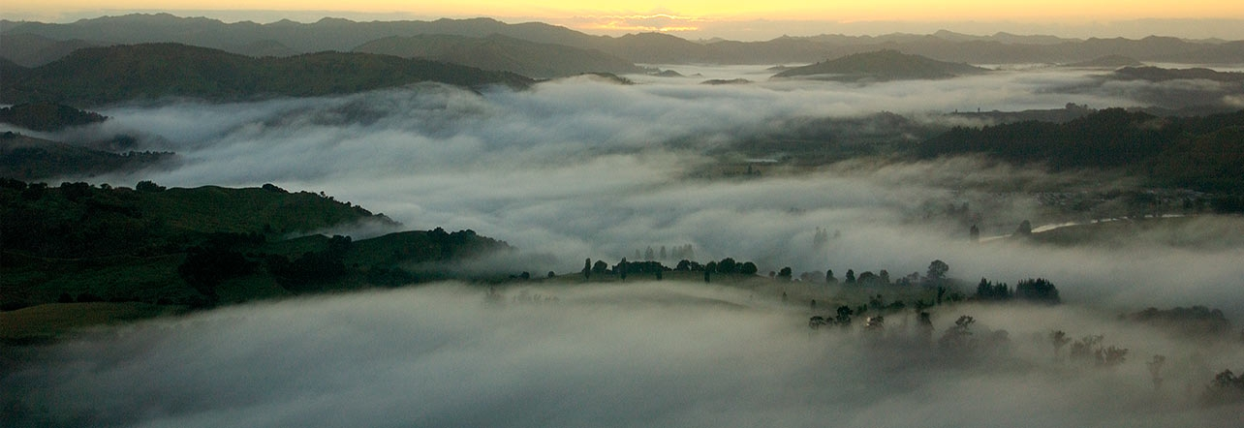
Kaitiakitanga (guardianship)
1.Expressed in strong and conservative governance.
2.Emphasis on wealth protection as well as wealth creation.
3. Intergenerational responsibilities recognised.
Maori are “walking backwards into the future, embracing the past”

Slide 14
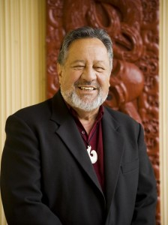
Privatisation of NZ Govt assets
Rt Hon Sir Pita Sharples (Government Minister 2008-2014)
The Rt. Hon. Pita Sharples was once asked why the Maori Party (junior coalition partner) supported the National Party (senior coalition partner) policy of state asset sales –
His reply “ Sell them to Maori, then they’ll never leave NZ ownership”.
A response that reflects the long term and conservative perspective of Maori business philosophy.

Slide 15
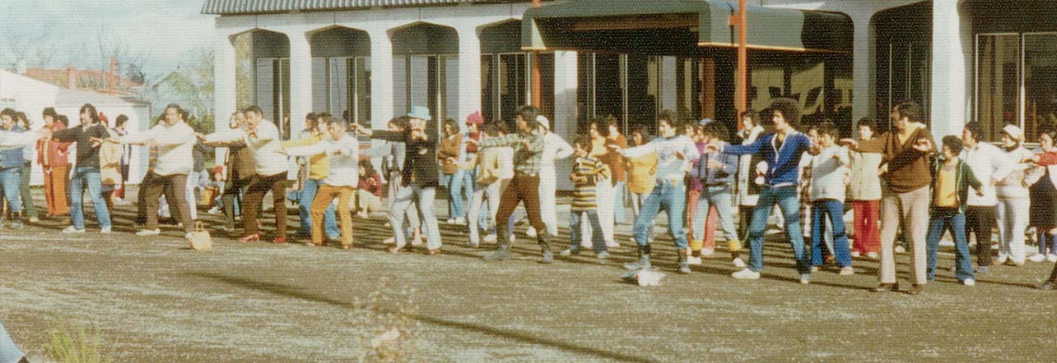
Puwhaitanga– best possible returns on integrated goals
'multiple bottom line’ of social, cultural, environmental, spiritual, economic goals.
1. Hold, manage, develop, Māori resources such as people, land, water.
2. An avenue for cultural expression and/or to foster pride.
3. Maintain Māori culture, language, and arts.

Slide 16
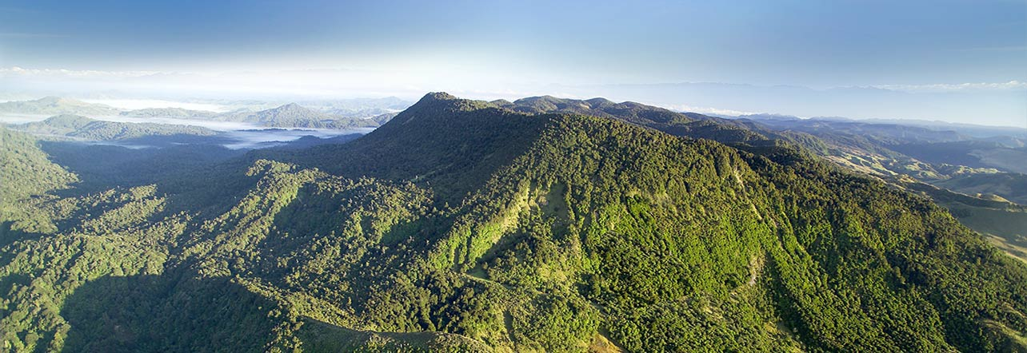
Tūranga: (positioning/anchor of the business)
“ what is the intended purpose for an organisation”
1. Legal structures to manage collectively owned assets.
2. Recognition of some assets as Taonga (as well as asset).
3. Specific legislation (eg. Te Ture Whenua Māori Act (1993))

Slide 17

Manaakitanga: Relationships
1. Enhance the integrity, status / prestige, and power of guests (mana).
2. Build unity through humility and the act of giving.
3. Care for themselves and each other as well as for their visitors.

Slide 18
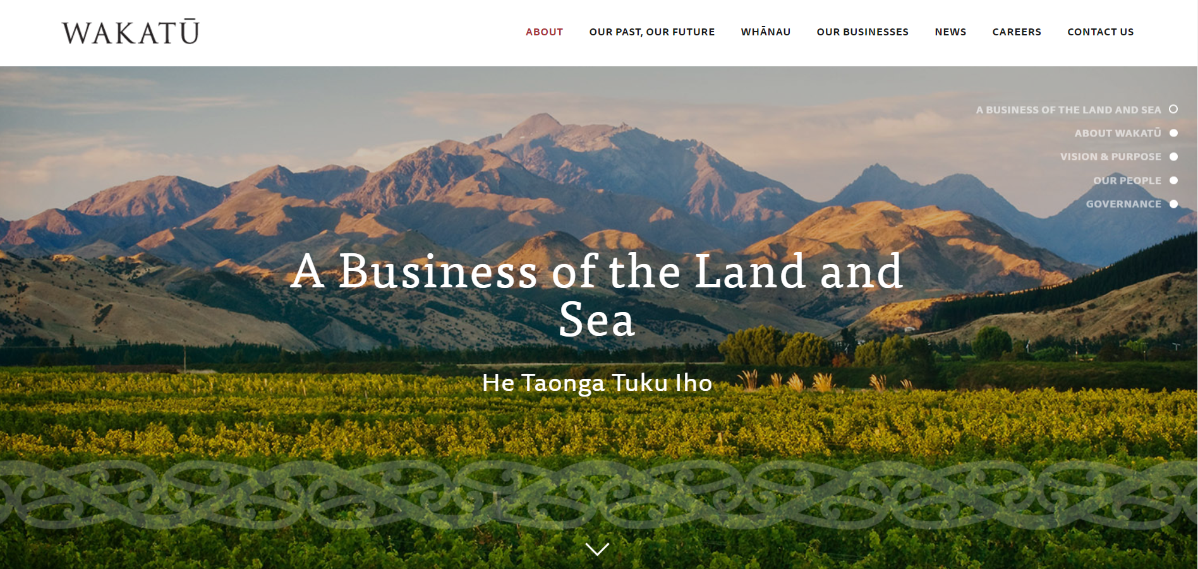
http://www.wakatu.org/#welcome

Slide 19


Tohu wines
https://www.tohuwines.co.nz/pages/identity

Slide 20
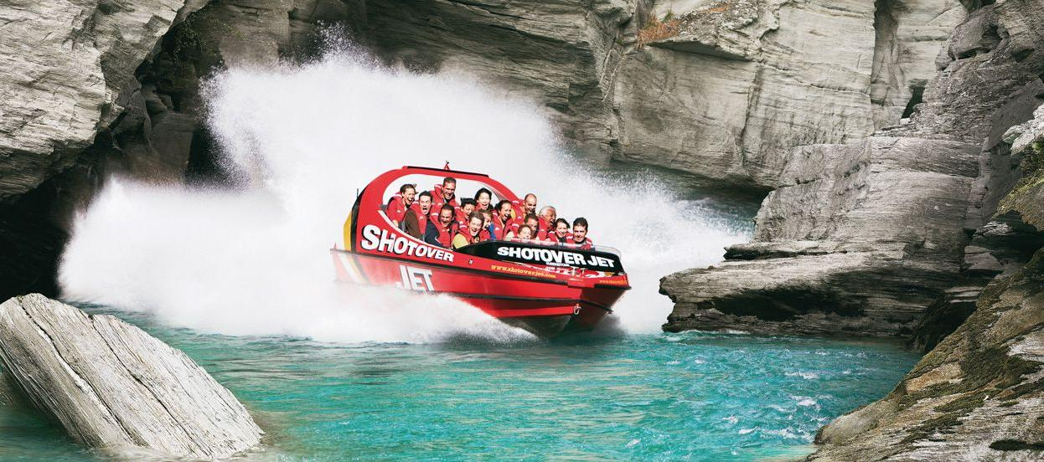
Shotover Jet (part of Ngai Tahu tourism
      http://www.shotoverjet.com/

Slide 21
Māori Business - Western Business
Key Differences
Property rights
Western view - based on ownership and exclusive use
Maori view - based on customary use and inclusive use
Profit motive
Western view – companies required to maximise shareholder return
Maori view - multiple bottom line – optimisation thinking.
Risk profile
Western view - risk commensurate with returns and leveraging of assets
Maori view – risk averse due to intergenerational focus (asset protection).

