Slide 1
People and nature
Conservation – Do not develop
Sustainability – develop but do no damage
Resilience – surviving with damaged systems

Slide 2
Resilience Thinking
Resilience is a system property. It refers to the amount of change or disturbance that a system can experience without shifting into an alternate state that has different structural and functional properties.
System = You, me, the economy, society, the biosphere.

Slide 3
Panarchy – systems thinking for resilience.
The adaptive cycle concept, taken from ecological systems
A front loop (blue) (r → K) of growth
A back loop (green)(Ω →α) of death/rebirth
Which give rise to a figure-8 path which complex social-ecological systems may follow.

Slide 4
Forest example. . .
REORGANISATION
Following a fire, some plant seeds will be on open ground.
(burnt over land)
CONSERVATION
The plant community is large, mature, complex. Affects conditions.
Complex networks.
(forest trees)
EXPLOITATION
Some plants will establish and grow. Affected by conditions.
Simple networks.
(weeds, shrubs)
RELEASE
An event disrupts the complex system, releasing the built up capital.
(forest fire)

Slide 5
Business example. . .
REORGANISATION
Capital available for new opportunities.
(cars)
CONSERVATION
Business grows to be market leader, with significant networks.
Market driver.
(taxi industry)
EXPLOITATION
Successful startup business grows rapidly.
Market driven.
Simple networks.
(taxi business)
RELEASE
Creative destruction. Market leader slow to react to change.
Networks disrupted.
(uber, zipcar)

Slide 6
What is happening in the loops?
Front loop (blue).
Long time frames, slow steady growth.
Exploitation of resources & Conservation of the system.
Planned progress.
Back loop (green)
Short time frames, rapid changes.
Release of the resources & reorganisation of the system.
Unplanned crisis.

Slide 7
Systems within systems
Economy
Industry
Business
The adaptive cycle pattern repeats at different scales.

Slide 8
Drivers of change
The adaptive cycle is driven by processes which are either;
  Big & Slow – large scale, long-term change.
    Industrial age – steam /electricity / electronics / cyber-bio.
    GDP growth – OECD 3% / EU 2%
    Demographic changes – aging western societies
  Small & Fast– small scale, short-term change.
    Election cycles (Fiscal policy)
    Inflation shocks (oil prices in 1970’s, credit shocks in 1987, 1998, 2008)

Slide 9
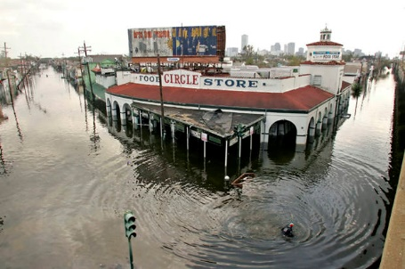
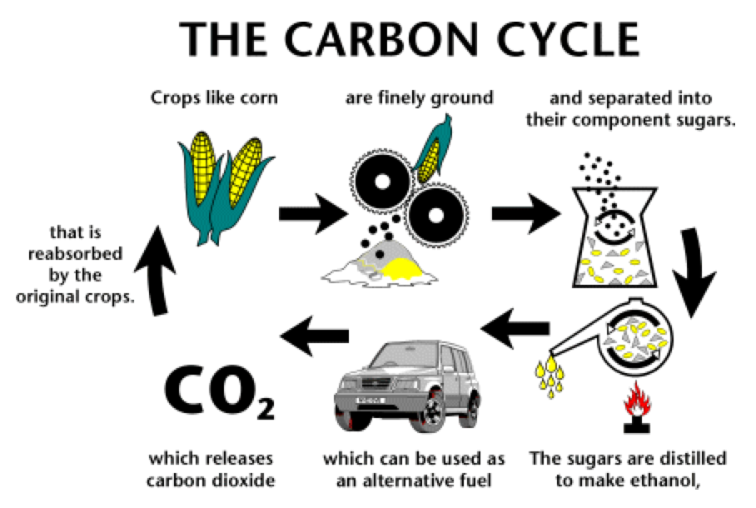
Disturbances.
All systems are subject to disturbances which may be a
  Pulse disturbance – one-off event
  which shocks the system.
    E.g. weather event.
  Press disturbance – continuing pressure
  applied to the system.
    E.g. CO2 release into atmosphere

Slide 10
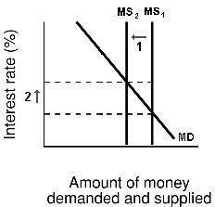
Adaptation or Transformation
In response to a driver or a disturbance the system will either;
Adapt-
  adaptation refers to actions that sustain development on current pathways.
    Usually a negative feedback loop
      E.g Monetary Policy - interest rates to control inflation by affecting money supply/aggregate demand.

Slide 11
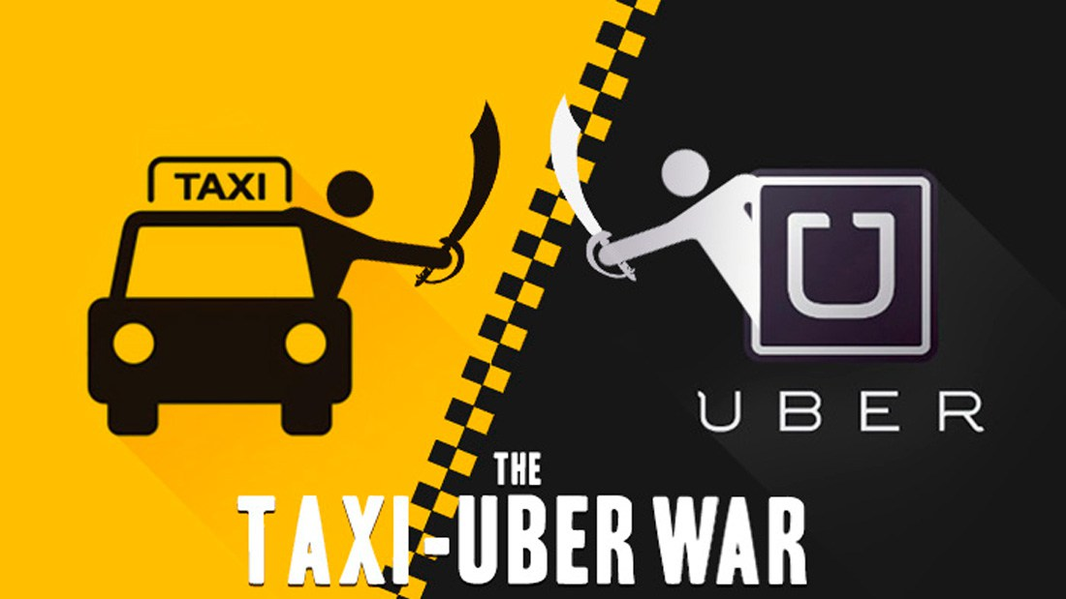
Adaptation or Transformation
(or) in response to a driver or a disturbance a system will;
Transform
  transformation is shifting development into other emergent pathways and even creating new ones.
    E.g. Disruptive Innovation – itunes / amazon.com /uber.

Slide 12
Cusps / Tipping Points / Crises
The change from ‘front loop’ to ‘back loop’ will often happen at a crisis.
The system gets to this point through a long period of sustained growth.
The cumulative effect of drivers & disturbances push the system
out-of-control.

Slide 13
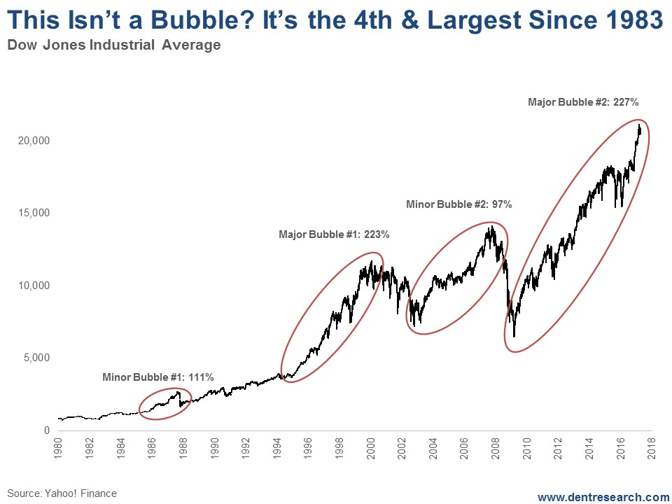
Breaking waves of change = tipping point
Short term / fast moving drivers (red)
Long term /slow moving drivers (blue)

Slide 14
To summarise. . .
Simple systems are a reorganisation in response to resource availability.
Systems exploit the resources and grow in response to drivers (fast & slow) and become…
  Increasingly complex.
  Increasingly self regulating (adapting & conserving).
The drivers/disturbances exceed the system’s capacity to adapt, causing
  Transformation (release of resources)
  Loss of system complexity / high level of function.

Slide 16
20th century consumerism as a panarchy
A long period of strong growth in economic output, standard of living, increasing disposability and waste, etc based on . . .
Mass production and mass consumption, fuelled by credit industry.
Large centralised media businesses.
Culture of materialism = happiness.
(All big & slow processes)

Slide 17
Brief review of consumerism drivers
Power of advertising
  “engineering of consent” “buy not what they need, but what they want”.
  “waste not, want not” to “beware of thrift and unwise economy”.
Buy now - pay later culture
  Purchasing on credit increases demand and changes purchasing decisions.
Life cycle shortening
  “ending the depression through planned obsolescence”.
  Mobile phones.

Slide 18
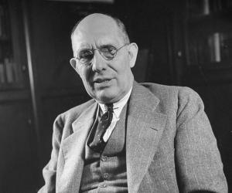
Brief review of consumerism drivers
“just one more”
  Gadgets for every purpose in the home.
  Buying your happiness / keeping up with Jones.
“choice as new value”
  More types of everything –paradox of choice.
. just because you’re not paranoid. . .
  “the key to economic prosperity is the organised creation of dissatisfaction . . . If everyone were satisfied, no-one would want to buy the new thing”.
    (Charles Kettering, Research Director, Chevrolet, 1929)

Slide 19
But now . . . 21st century . . . Tipping point?
Increasing instability in economies from digital connectivity leading to new purchasing patterns, distrust of centralised media. . .
Credit industry under stress.
Environmental damage from consumerism (throwaway) living.
Inequality rising rapidly.
Materialism ≠ happiness.

Slide 20
Brief review of symptoms.
Rising inequality.
  Wealth being concentrated. Richest 8 people = poorest 3.0 billion.
Plastic rubbish in oceans.
  Linear production systems generating waste / atmosphere & oceans are sinks.
Climate change.
  Reduction of ecosystem services through human habitat and resource extraction.
Political & civil unrest.
  Global political elite losing contact with people they represent.

Slide 21

20th century systems are now / nearly failing.
Linear production systems.
Fossil fuel as energy source.
Disposable products.
Traditional media outlets.
Credit industry.
Political representation.

Slide 22
Early signs of the release are emerging
Rise of alternate media.
Disintermediation of traditional business models.
Fragmentation of mass markets.
Access - not ownership driving economy.

Slide 24

One of these is collaborative consumption.
What is collaborative consumption ?
  Redistribution.
    Freecycle, Swaptrader, Kontti.
    (unwanted products still have value –to others).
  Product service systems.
      peer-to-peer renting
      (reduced need for ownership / income for owners)
  Collaborative Lifestyles.
        Co-sharing, couchsurfing, carpooling.
        (new business models / long tail internet opportunities)

Slide 25
Principles of collaborative consumption
Critical mass
  Size and scale of collaboration is important to have enough choices.
  Critical mass also provides social proof to convince people it is safe.
Power of Idling Capacity
  Many possessions are not being used – most of the time.
Belief in the commons
  Understanding of communal resources concept.
Trust between strangers
  Self governing social systems through peer-to-peer feedback.

Slide 26

Kontti is (already) part of collaborative consumption
Buying & selling second hand goods is Redistribution.
Other possibilities for more collaborative consumption activities exist.
  Running peer to peer exchanges
  Hiring as well as selling goods
  Barter economies (alternate currency)

Slide 27
Kontti is at positioned the point of
transformation and release.
Kontti could be important as part of
managing materialism into collaborative consumption.

Slide 28
Social capital is important
  Materialism has resulted in a cumulative loss of social capital.
  Preservation of capital in release phase of panarchy is crucial to next phase.

Slide 29
. . . suggestions for Kontti . . .
Kontti is positioned within a social-ecological system which is undergoing / about to undergo rapid change.
Collaborative consumption provides a useful strategic window.
Where possible, decisions should be optimised to increase the social capital of Kontti and its stakeholder community.

Slide 30
Final thought. . . Future crunch
“scientific and optimistic thinking about the future”
The world can be daunting overloading negative pessimistic depressing etc
This is partly due to media operating using amygdyla hijack tactics.
  If it bleeds, it leads / good news is no news
http://www.futurecrunch.com.au/

Slide 31
Reference links
http://www.resalliance.org/workbook/
  Resilience assessment workbook
http://www.collaborativeconsumption.com/
  Website on which you can find the Botsman & Rogers book

