Slide 1


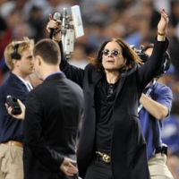
Terve Helsinki !

Slide 2

Decision-making heuristics in resource allocation in the Finnish Red Cross: rational irrationality in deciding who gets what
An interactive lecture exploring how Fisher's (1998) six values concerning priority setting might affect resource allocation in an international aid effort. An interactive lecture building on Rokeach's (1973) work on terminal and instrumental values and Lindfelt's (2004) examination of ethics in Finnish business.
Dr. Rob Baker, Sheffield Business School, Sheffield Hallam University, United Kingdom.
r.baker@shu.ac.uk

Slide 3
Sheffield Hallam University

Slide 4

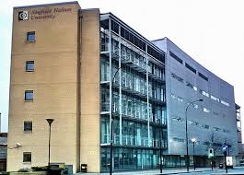


Sheffield Hallam University

Slide 5
Assertion:
"People use heuristics to ease the process of […] taking a decision, and to simplify the mass of competing views and information that surround any issue" (Fisher & Lovell 2006, p180).

Slide 6
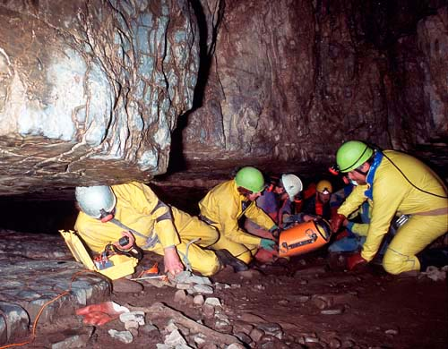
Values as heuristics in ethical reasoning
The Cave Rescue Mission
Helen Richardson, Female, Age 34
Tozo Nalkoe, Female, age 19
John Simpson, Male, Age 41
Owen Smith, Male, Age 40
Suni Vapar, Male, Age 47
Edward Palmerston, Male, Age 59
15 mins - individual decisions
15 mins – small group discussion

Slide 7
Unpacking the
Cave Rescue ‘game’

Slide 8
People do not use a comprehensively rational process when they come to a view on moral matters.

Slide 9
One answer to this exercise is that the people involved (i.e. those in the cave) should make their own decisions.
You might have pushed back and told them they had to decide.
This exercise demonstrates that all too often we believe that we are at ease with change, but in fact, we tend to fall back into our old ways of doing things. It is not easy to change our beliefs.
Your personal beliefs will always sway your decisions.

Slide 10

Heuristic thinking
When we choose a car to buy: process is 'subjective expected utility'
Identify available cars
identify my important factors
Rank those factors by weights
Research each car and compare to factors
Choose car with highest score

Slide 11

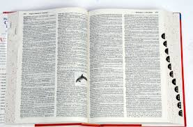
adjective
enabling a person to discover or learn something for themselves.
"a ‘hands-on’ or interactive heuristic approach to learning"
German heuristisch, from New Latin heuristicus,
from Greek heuriskein to discover;
First known use: 1821
Notes:
Heuristics are a means of discovering or finding out something. They are mental tricks of the trade or rules of thumb that are used, almost unconsciously, to simplify the process of decision making. They are cognitive devices that limit the need to search for, and evaluate, further options. The term also carries with it the idea of discovering things by trial and error rather than by systematic analysis of all appropriate information.

Slide 12
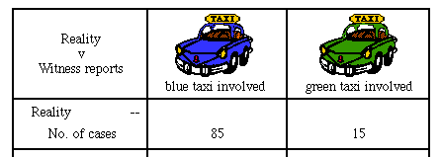
Decision-making heuristics
85% taxis are blue, 15% green
Witness testified cab as being green
Given that witness identifies correctly 80% of time, incorrectly 20% of time.
Probability of green = 0.15
Prob blue if it is blue = 0.85 * 0.8 (=0.68)
Prob green if it is green 0.15 * 0.8 (=0.12)
Prob of green = 0.41 ’Base-rate neglect’ = more attention to immediate sources of information.
Notes:
https://plus.maths.org/content/solution-taxi-problem

Slide 13
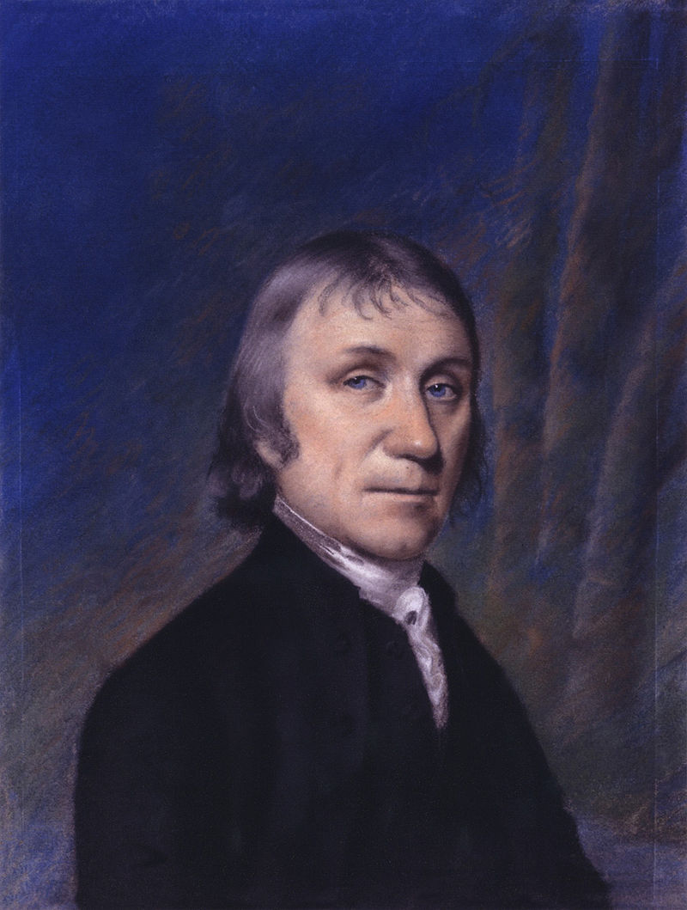
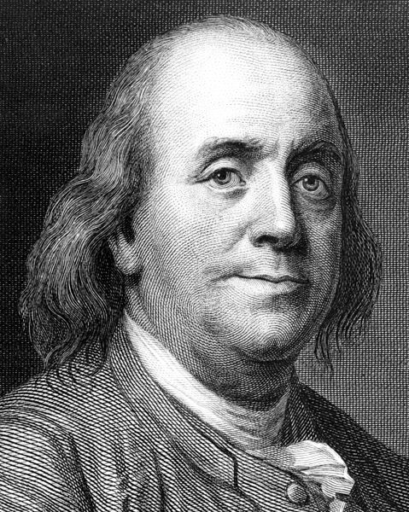
Decision-making heuristics
In 1772 a man named Joseph Priestley wrote a letter to Benjamin Franklin asking for his advice on a decision he was trying to make.
Benjamin Franklin wrote back indicating that he couldn’t tell Priestley what to do, since he didn’t have enough information about Priestley’s problem. However, he could tell Priestley how to make his decision.
Benjamin Franklin's Moral Algebra ('Franklin's Rule', really multiple regression)
(Gigenrenzer et al. 1999 p76).

Slide 14
Decision-making heuristics
A similar & well known is given the name Dawes' Rule. This is the simple "let's make a list" decision method everyone knows. You know, "divide a piece of paper into two columns and write Option 1 on one side and Option 2 on the other and then write down all the pros and cons of each." Dawes' Rule simply adds up all the pros (and cons) and picks the one with the highest score.
Notes:
https://plus.maths.org/content/solution-taxi-problem

Slide 15
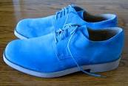
Decision-making heuristics
The ‘recency effect’ more weight to recent information than past learning
The ‘halo and horns’ heuristic: latch onto one – perhaps insignificant - thing biasing judgment.
Can we really employ an interviewee wearing blue shoes?
Notes:
https://plus.maths.org/content/solution-taxi-problem

Slide 16
Values as heuristics in ethical reasoning
Maximise number: 1st likely to panic
Maximise happiness to society: those who can make the greatest contribution to society (‘utilitarianism’)
Rescuing first those who have dependents
Rescuing youngest first
Rescuing the morally worthy before the morally unworthy

Slide 17
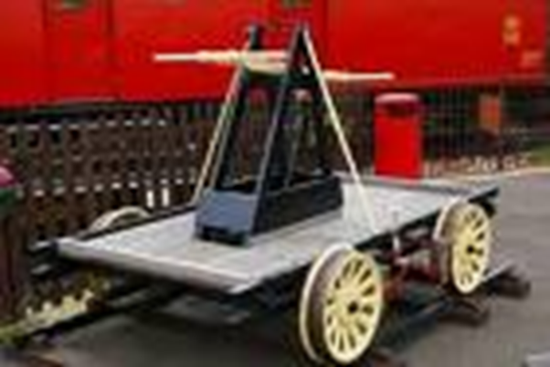
Values as heuristics in ethical reasoning
Utilitarianism
  A trolley is running out of control down a track. In its path are 5 people who have been tied to the track by the mad philosopher.
  Fortunately, you can flip a switch, which will lead the trolley down a different track to safety. Unfortunately, there is a single person tied to that track.
  Should you flip the switch?
  Your decision
Notes:
Show of hands

Slide 18
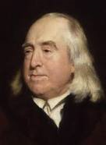
Values as heuristics in ethical reasoning
Utilitarianism
Jeremy Bentham
English philosopher,
1742-1832
  A trolley is running out of control down a track. In its path are 5 people who have been tied to the track by the mad philosopher.
  Fortunately, you can flip a switch, which will lead the trolley down a different track to safety. Unfortunately, there is a single person tied to that track.
  Should you flip the switch?
  Your decision
Notes:
Show of hands

Slide 19

Utilitarianism
Jeremy Bentham
English philosopher,
1742-1832
University College London

Slide 20
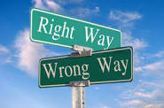
Values as heuristics in ethical reasoning
Emotions and social norms act as heuristics (Gigerenzer et al 1999:30)
Emotions: love for one’s child prevents ethical dithering
Social norms: do as you peers do
Links to values:
hard to give rational account (like emotions)
Values are acquired in the socialisation process (Rokeach 1973:17)

Slide 21
Values heuristics, priority setting & resource allocation
Utility
Individual need
Deservingness
Ecology
Fairness
Personal competence and gain

Slide 22
Values heuristics, priority setting & resource allocation
Utility
Allocating resources to maximise the quantity of good done.
For instance in health policy studies, QALYs (Quality Adjusted Life Years).
Measure of the benefit to the average patient of a treatment in additional years of life.
Treatment A: cost per QALY = £9,075
Treatment B: cost per QALY = £194
See Pereira (1989) and Baldwin et al (1990)

Slide 23
Values heuristics, priority setting & resource allocation
Individual need
Allocation by expert in field.
Need can be assessed objectively and ranked.
Problem: wills expenditure without regard for availability.

Slide 24
Values heuristics, priority setting & resource allocation
Deservingness
UK sceario:
compensation to HIV+ haemophiliacs through contaminated blood products
V.
homosexual AIDS patients who had ‘brought it on themselves’
(Mihil, 1990)

Slide 25
Values heuristics, priority setting & resource allocation
Ecology
Voices of all parties should be heard
Identify the different perceptions
Try to create a consistent policy from that plurality
But, subject to powerful influences in group

Slide 26
Values heuristics, priority setting & resource allocation
Fairness
= impartiality between individuals
Concerned only with equality of access and opportunity, not with equality of outcomes.

Slide 27
Values heuristics, priority setting & resource allocation
Personal competence and gain
an heuristic when applied causes decisions to be made to the decision-maker's benefit

Slide 28
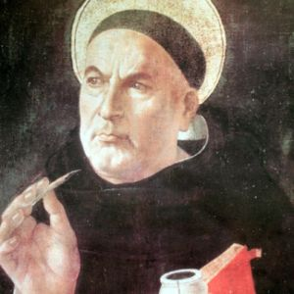
Integrity and loyalty as value heuristics
Integrity: basing action on sound judgement and seeking a unity of thought and action.
Aquinas: virtue requires people to act knowingly, voluntarily and according to a fixed principle or habit
(D'Entreves 1965: 147-8)
St. Thomas Aquinas
Theologian, Philosopher, Priest, Saint (c. 1225–1274)

Slide 29

Integrity and loyalty as value heuristics
Loyalty is an unthinking faithfulness to a person, group or purpose. If a loyal person were to reflect: question being loyal to the right thing.
But there is a tension between
integrity and loyalty:
'whistleblowing'
Booz Allen Hamilton contractor Edward Snowden released classified material on top-secret NSA programs including the PRISM surveillance program to The Guardian and The Washington Post in June 2013.

Slide 30

Integrity and loyalty as value heuristics
Ethical horizons:
limits of loyalty:
to self, family
to groups
to employing organisation
to society
limits of integrity:
personal & private arena
of networks
of organisational arena
wider society, polity & economy

Slide 31
Loyalty vs integrity when an organisational malpractice is discovered
Ethical horizons:
limits of loyalty:
to self, family
to groups
to employing organisation
to society
limits of integrity:
personal & private arena
of networks
of organisational arena
wider society, polity & economy

Slide 32
Ethical horizon
Loyalty
Integrity
Society
Sacrifice of self for another’s benefit
Civil
associations
Sacrifice to show membership and
commitment
Organisations Acting as a scapegoat
Self Sacrifice to maintain or increase personal
benefit or status

Slide 33
Loyalty and integrity
Two themes that often appear in organisational codes of ethics:
  ‘expected to maintain the highest levels of honesty and integrity, both inside and outside working hours’
  ‘maintain confidentiality’
  ‘devoting their best efforts to the business of the firm’
  ‘civil servants owe their loyalty to the duly constituted government’
  ‘civil servants should conduct themselves with integrity, impartiality and honesty’.

Slide 34
What do organisations expect?
If they have codes of ethics then: these provide guidelines for integrity
    have a positive tone
    use vague words
    often have no disciplinary teeth
    are shorter (mean of 16.5 items in one study)
If they have codes of conduct then:
  these provide rules to be loyally followed
    have a negative tone
    are specific and explicit
    detail mechanisms for corrective action
    are longer (mean of 30.1 items)

Slide 35
The limits of managers’ ethics
Organisations expect employees to be loyal and say they expect them to show integrity at work.
How do managers respond to these expectations?
  Where do they place their loyalty?
  Where do they seek to show integrity and where do they not?

Slide 36
Whistleblowing
An interview survey of 45 managers:
15 examples of serious ethical breaches by the organisations they worked in.
In all cases they chose to do nothing – and became cynical –
  because of loyalty to the organisation?
The limit of their loyalty was the organisation.

Slide 37
Principled resignations
A number of interviewees reported that when they saw or experienced ethical wrongs at work:
        harassment and bullying
        employment discrimination.
They resigned as a matter of principle, to maintain their personal integrity.
But they did not whistleblow internally or externally.

Slide 38
Setting ethical horizons
David: ‘All right, for the sake of argument, imagine we set up a business to murder people.’
Colin: ‘Murder Incorporated.’
David: ‘OK; it’s been done. But say we did this and we followed all the culture and empowerment stuff. We could have democratic management, lots of trust and all that. There’s good pay for everybody, welfare arrangements, good pensions. Christmas parties for the kiddies. There’s a moral code – just like the Mafia – that holds everything together. Everything we have said so far makes this a moral business. But we know it’s not. Murder isn’t moral is it?’
Watson (1998)

Slide 39
Limits of loyalty and integrity
Loyalty
Being faithful to:
  self and family
  groups and associations one has chosen to join
  the employing organisation
  society at large.
Integrity
Thinking honestly and soundly, and acting accordingly, in:
  the personal and private arena
  the personal and public arena
  the organisation
  society at large.

Slide 40
The limits of integrity
I only need to show integrity in my personal life and with my own family. I bracket my working life as an area in which it may not be possible to show integrity.
      ‘But he was ever so good to his mother’
I should show integrity in dealings with friends and associates.
      E.M. Forster on friends
I should act with integrity within the organisation. If I see something wrong I must report it to management.
      Nursing code of ethics
I should act with integrity within society at large.
      Graham Pink and whistleblowing

Slide 41
Loyalty and integrity may conflict
‘Loyalty to people or institutions is a fine quality, which arouses admiration and respect. But it is part and not the whole of morality. In order to understand and exercise it aright we have to set our loyalties to our persons and organisations within the framework of a much larger framework of ethics. It is adherence to this framework which both expresses and creates integrity’.
Adair, J. (1980) Management and Morality, Gower, p.178

Slide 42
Sacrifice
Loyalty and integrity both demand sacrifices.
  Integrity demands the sacrifice of things – money, status, power – for its maintenance.
  Loyalty is the sacrificing of integrity to obtain things – money, status, power – for oneself or for some other body such as an organisation.

Slide 43
Decision-making heuristics in resource allocation in the Finnish Red Cross: rational irrationality in deciding who gets what
Dr. Rob Baker, Sheffield Business School, Sheffield Hallam University, United Kingdom. r.baker@shu.ac.uk
Kiitos paljon!

Slide 44
Decision-making heuristics in resource allocation in the Finnish Red Cross: rational irrationality in deciding who gets what
References
Adair, J., (1980) Management and Morality, London: Gower, p.178.
Fisher, C. and Lovell, A., (2006). Business Ethics and Values: individual, corporate and international perspectives. 2nd edn. Harlow: Pearson Education Ltd. Ch. 5.
Gigrenzer, G., Todd, P., and the ABC Research Group (1999) Simple heuristics that make us smart. Oxford: OUP.
Mihil, C., (1990) “Thatcher shuns out of court deal for haemophiliacs with HIV”, Guardian, 9 November: 2.
Rokeach, M.,(1973) The Nature of Human Values. New York: The Free Press.
Watson, T.J., (1998) ‘Ethical codes and moral communities: the Gunlaw Temptation, the Simon Solution and the David Dilemma’ in Parker, M., (ed.) Ethhics and Organisations, London: Sage. pp253-69.

Slide 45
A practical example: buying a car: subjective expected utility.
Definition of 'heuristics'.
Benjamin Franklin's Moral Algebra ('Franklin's Rule', really multiple regression) (Gigenrenzer et al. 1999 p76). “Nothing but money is sweeter than honey.”
Dawes' Rule.
The exercise of judgement (Kahneman et al. 1982 p156-7) & base-rate neglect.
The recency effect.
The halo and horns heuristic.
The recognition heuristic.
Emotions and social norms: other condemning; self-conscious; other suffering; other praising

