Slide 1
Welcome to International Project Week
Nicky Adams
Senior Lecturer in HR and Leadership

Slide 2
Business Ethics and CSR
Lecture 1

Slide 3
Ethics
Oxford Dictionary online defines Ethics in the following ways
  moral principles that govern a person’s behaviour or the conducting of an activity
  the branch of knowledge that deals with moral principles
https://en.oxforddictionaries.com/definition/ethics

Slide 4
Ethics
Crane and Matten (2010, p.8) provide the following definitions
“Morality is concerned with the norms, values and beliefs embedded in social processes which define right and wrong for an individual or a community.”
“Ethics is concerned with the study of morality and the application of reason to elucidate specific rules and principles that determine right and wrong for a given situation. These rules and principles are called ethical theories.”
So morality is the starting point, ethics is our attempt to rationalise this and this leads to ethical rules (theories)
Notes:
Crane, A and Matten, D. (2010) Business Ethics. 3rd ed. Oxford: Oxford University Press

Slide 5
Business Ethics
Cambridge online dictionary defines business ethics as
  rules, principles, and standards for deciding what is morally right or wrong when doing business
http://dictionary.cambridge.org/dictionary/business-english/business-ethics
Crane and Matten (2010, p.5) state
“business ethics is the study of business situations, activities and decisions where issues of right and wrong are addressed”

Slide 6
Business ethics and social responsibility
Chryssides & Kaler (p. 12, 1993) note
“Business ethics, like ethics in general, is centrally concerned with conduct.
“…essentially questions about whether we ought or ought not to perform certain kinds of actions; about whether those actions are good or bad, right or wrong, virtuous or vicious, worthy of praise or blame, reward or punishment
Consequently…the point of the exercise is to resolve questions of conduct.”
Notes:
Chryssides, G. & Kaler, J. (1993) An Introduction to Business Ethics. London: International Thompson Business Press

Slide 7
Corporate Social Responsibility
Crane and Matten (2010, p.53) provide the following definition:
  “Corporate Social Responsibility includes the economic, legal, ethical and philanthropic expectations placed on organisations by society at a given point in time.”
Griseri and Seppala (2010, p.7) give a broader definition
  “the accommodation of corporate behaviour to society’s values and expectations”
They note there is a wide variety of meaning included within the term
Notes:
Griseri, P. and Seppala, N. (2010) Business Ethics and Corporate Social Responsibility. Andover: Cengage Learning

Slide 8
Corporate Social Responsibility (CSR)
“Companies’ integrating social and environmental concerns in their daily business operations and in their interactions with their stakeholders on a daily basis.” (European Commission, 2001 in Robinson and Dowson, 2010, p.210)
“the only social responsibility of business is to maximise profits.”(Friedman, 1970 in Crane and Matten, 2010, p.47)
“Corporate responsibility (CR), also known as corporate social responsibility (CSR) or business sustainability, addresses the ethics of an organisation’s activities and how it operates in a way that is viable over the long term. These two factors are intrinsically linked, as a business that damages the systems on which it depends will ultimately be unsustainable.”
http://www.cipd.co.uk/hr-resources/factsheets/corporate-responsibility.aspx#

Slide 9
A Way of Categorising Ethical Theories
Types of ethical theory
Deontological
Respect for persons
Religious ethics
Teleological/ consequentialist
Utilitarianism
Ethics of character
Ethical relativism
Human rights
Egoism
Virtue ethics
Justice ethics
Deontological:
deon = obligation / duty
logia = speech
telos = end / goal

Slide 10
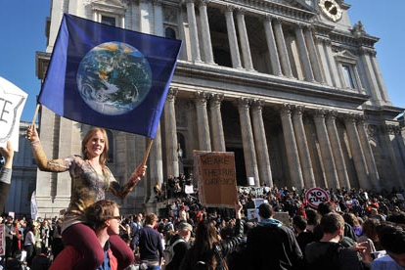
Teleology
Stipulates that acts are morally right or acceptable if they produce some desired result such as realisation of self interest or utility
An example of this may be activism
  The doctrine or practice of vigorous action or involvement as a means of achieving political or other goals, sometimes by demonstrations, protests, etc
  Is this / can this be justified?
Notes:
Source: Ferrell Fraedrich and Fraedrich; Business ethics: ethical decision making and cases 5th edition page 57

Slide 11
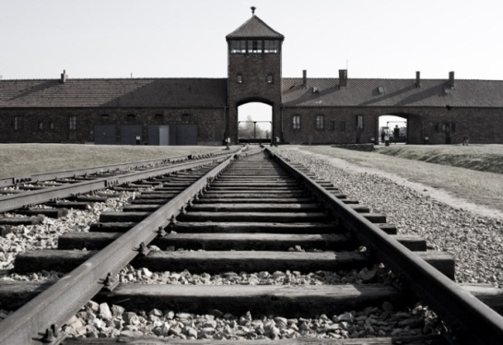
Deontology
Focuses on the preservation of individual rights and on the intentions associated with a particular behaviour rather than on its consequences i.e. following the rules
An example of this may be genocide
  The deliberate and systematic extermination of a national, racial, political, religious or cultural group
  Can this be anything other than abhorrent?

Slide 12
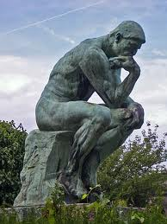
In its simplest form…
Teleology: the end (outcome) justifies the means by which we achieve it
Deontology: we follow rules, no matter what the personal costs might be
How would this apply to ethics in a business environment?

Slide 13
Business ethics
If business ethics addresses issues of right and wrong in decision making, the question is how we decide what is right and what is wrong
And how does this relate to the law, which also tells us what is right and what is wrong?
One view is that the law is the minimum acceptable standard
However some issues are not legislated for – this is where ethics often starts

Slide 14
Why is it important?
Being (seen to be) ethical can be good for business
Business has an increasing influence in society
It has the potential to contribute to society – should it do so ethically or not?
Business malpractice is damaging to individuals, organisations and society
Stakeholders require a more ethical approach
https://www.youtube.com/watch?v=V8U5grZhd1s (3mins, view of CSR)

Slide 15
Some more thoughts…
What are your values?
Where do they come from?
Are you a good or bad person?
Why do you think this?
Do personal values matter?
What might be the challenges applying these in the workplace?

Slide 16
Business Ethics
So, if business ethics addresses issues of right and wrong in decision making, let’s look at how we could decide what is right and what is wrong
Think about how this would apply to the Finnish Red Cross and their work with developing Kontti
This could be in relation to e.g.
  Increasing donations
  Increasing customer footfall
  Appealing to a different demographic group

Slide 17
Other Views
Hartman, DesJardins and MacDonald (2015, p.219) state “social responsibility is what a business should or ought to do for the sake of society, even if this comes with an economic cost”
They identify three levels of responsibility
  A duty NOT to cause harm – not selling a product that causes harm is an example. This is often covered by legislation as well as being an ethical viewpoint
  A duty to prevent harm (even when you are not the cause) – a company providing a drug free to those at risk of disease is an example. Merck provide a drug to prevent river blindness free in some of the poorest parts of the world
  A duty to do good – volunteering is an example of this, where one does not have to do that thing, but chooses to
Notes:
Hartman, L., DesJardins, J., MacDonald, C. (2015) Business Ethics: decision making for personal integrity and social responsibility New York: McGraw-Hill

Slide 18
To Summarise…
There are a range of ethical theories
These underpin business ethics and therefore Corporate Social Responsibility
How we apply CSR in organisations can be a challenge and depend on many things

