Slide 1
Welcome to International Project Week
Nicky Adams
Senior Lecturer in HR and Leadership

Slide 2
Stakeholders
Lecture 2

Slide 3
What is a Stakeholder?
A stakeholder in an organization is . . . any group or individual who can affect, or is affected by, the achievement of the organization’s objectives.
    Crane and Matten, quoting R. E. Freeman (1984).

Slide 4
Who are the stakeholders in Kontti and why?
Discussion

Slide 5

Individual donors
Employees
Customers
Society
Finnish Red Cross Disaster Relief Fund
Kontti
Volunteers
Anyone Else?
Local Red Cross
Government
Management

Slide 6
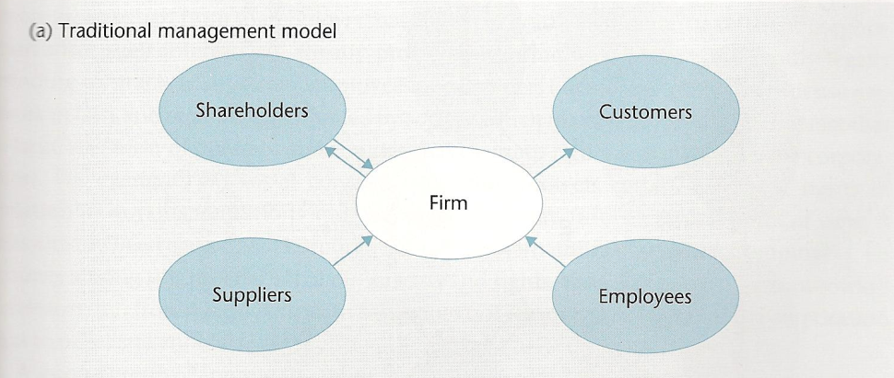
Crane and Matten, 2007: 59

Slide 7
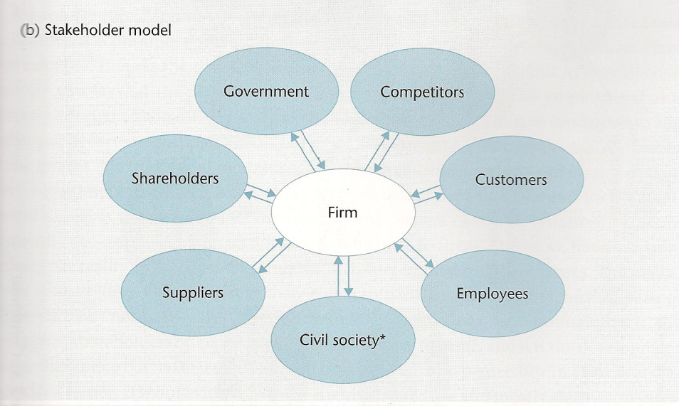
Crane and Matten, 2007: 59

Slide 8
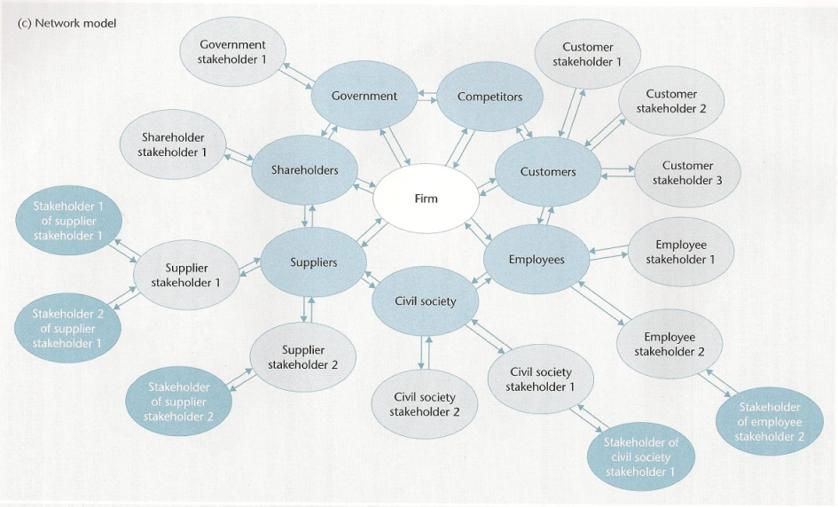
Crane and Matten, 2007: 60

Slide 9
A better definition?
A stakeholder of a corporation is an individual or a group which either: is harmed by, or benefits from, the corporation; or whose rights can be violated, or have to be respected, by the corporation (Crane and Matten, p.58)
directly benefits from / is harmed by . . . ?
substantially benefits from / is harmed by . . . ?

Slide 10
Prioritisation of stakeholders (stakeholder mapping)
Power
C
Keep
satisfied
D
Key
players
A
Minimal
effort
B
Keep
informed
Source: Johnson, Scholes and Whittington,
2005: 182
Level of interest

Slide 11
But who or what really counts
Source: Mitchell, Agle, Wood, 1997, p.872
Power – “a relationship among social actors in which one social actor, A, can get another social actor, B, to do something that B would otherwise not have done” (Dahl, 1981:1), “..to impose its will in the relationship” (Mitchell et al, 1997:865)
Legitimacy – “a generalised perception or assumption that the actions of an entity are desirable, proper, or appropriate within some socially constructed system of norms, values, beliefs and definitions (Suchman, 1995: 574)
Urgency – “the degree to which stakeholder claims call for immediate action” (Mitchell et al, 1997: 867) – compelling, driving imperative
Power
Legitimacy
Urgency

Slide 12
Stakeholder Mapping with Kontti
Consider how you would prioritise the stakeholders for Kontti
What are your reasons?
How might this influence the choices you make in responding to the assignment brief?

Slide 13
To Summarise…
Stakeholders are important to an organisation
How you prioritise them will be influenced by a range of factors
Who your stakeholders are and how you engage with them can influence your business

