Slide 1

Innovaatio 2015
Paula Viertola, Piia Larjomaa ja Johanna Fagerholm

Slide 2

THE PROBLEM
• HOW HELSINKI COULD BE TRANSFORMED MORE ATTRACTIVE AND LIVABLE PLACE ALSO AT WINTER TIME?
• FOR CITIZENS AND VISITORS
• CITY AND SUBURBS
LACK OF LIGHT
DARKNES
NOT ENOUGH EVENTS
LACK OF COMMUNALITY

Slide 3
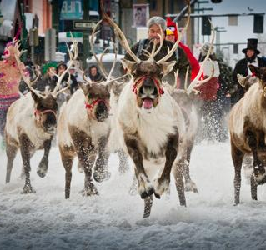
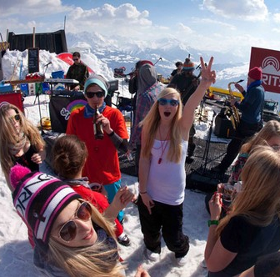
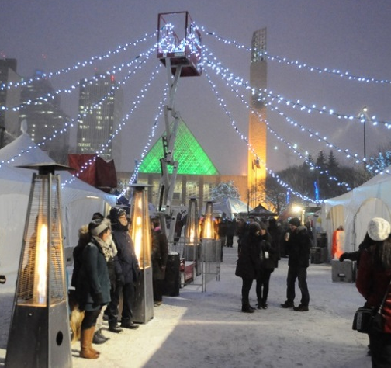
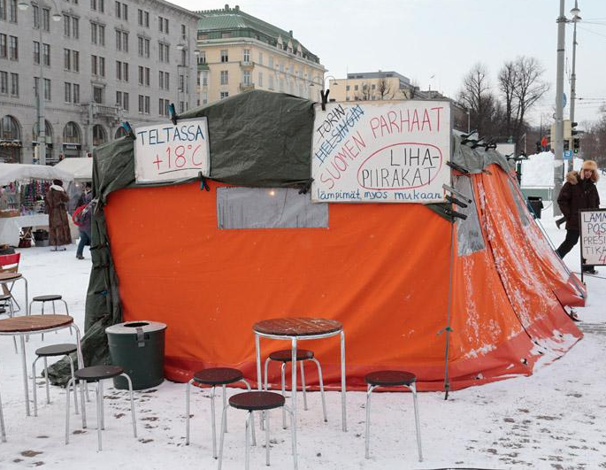
FIRST IDEA…
…WAS TO CREATE BIG WINTER EVENT
PROBLEM :
FINANCIER
UNCOMFORTABLE CONDITIONS FOR SELLERS CUSTOMERS AT MARKET PLACES – UGLY TENTS
(UNATTRACTIVE ATMOSPHERE)

Slide 4
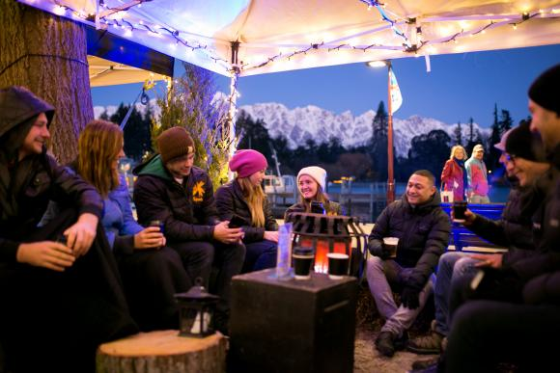
VILLAGE IN CITY
OPTION FOR TENTS- TO MAKE IT EASIER FOR THE SELLERS AND BUSSINESS OWNERS TO GO AND SELL THEIR PRODUCTS ON STREETS ALSO
PERMANENT ”ELEMENTS” FORM ”SPACE IN SPACE”-EFECT WHEN CONNECTED TO EACH OTHER
GET PEOPLE MORE SOCIAL AND ENCOURAGE TO MAKE COMMUNITY SPIRIT STRONGER!

Slide 5

WHAT BRINGS PEOPLE TOGETHER?
FOOD!

Slide 6
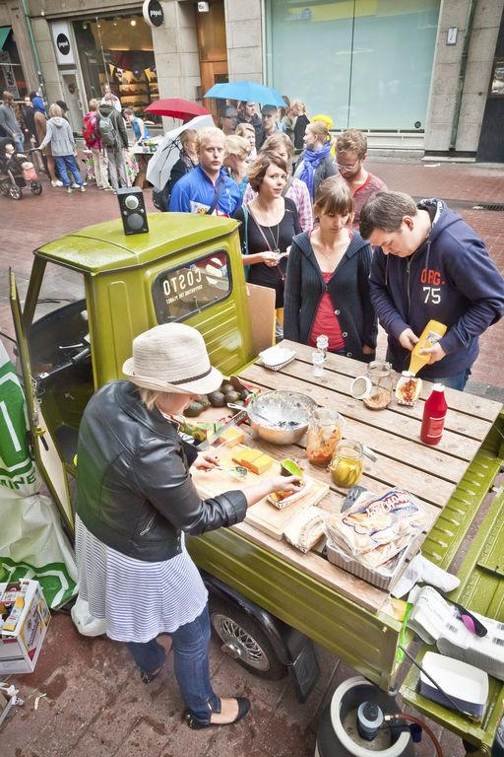
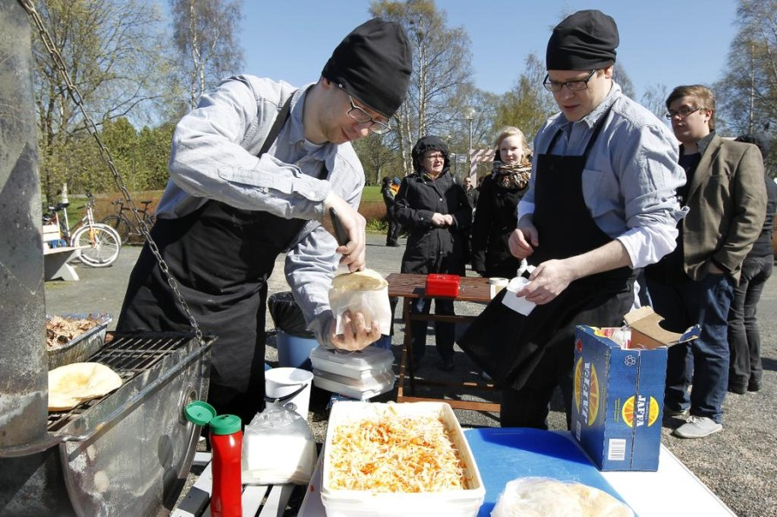
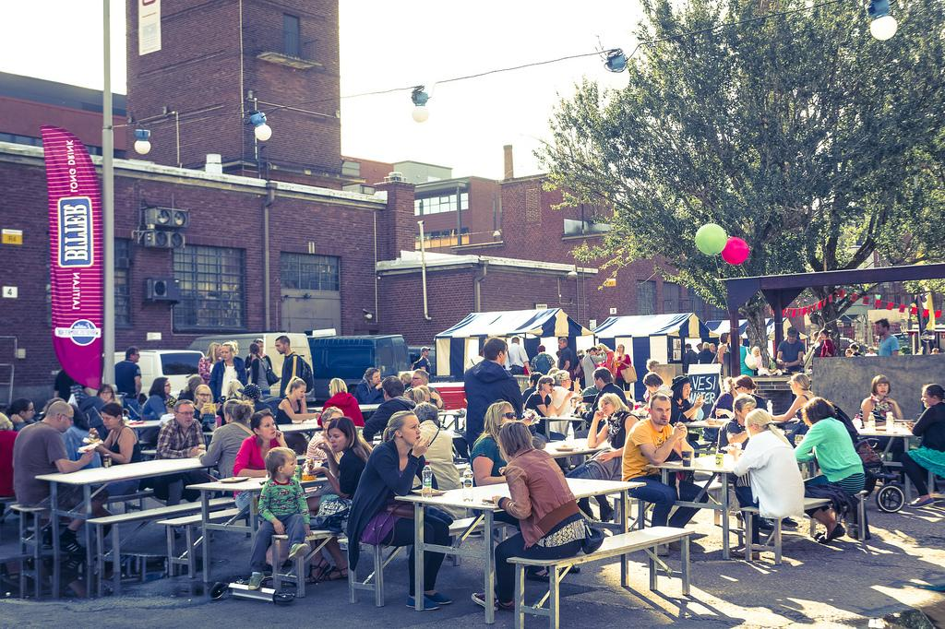
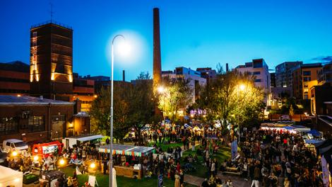

Slide 7
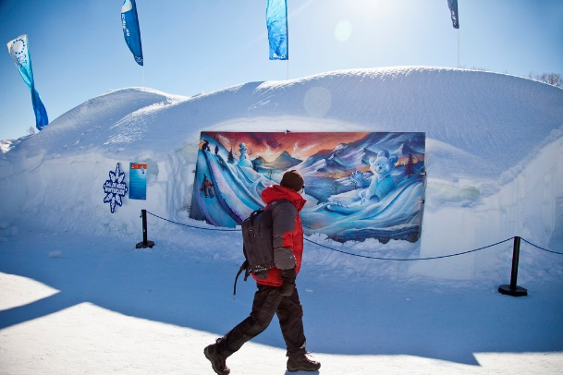
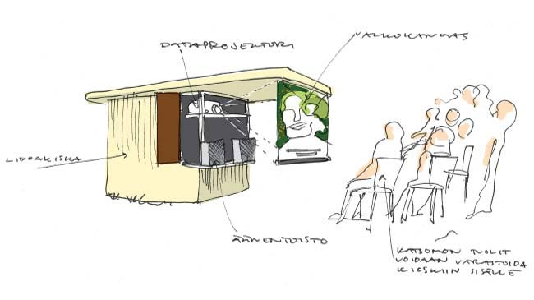
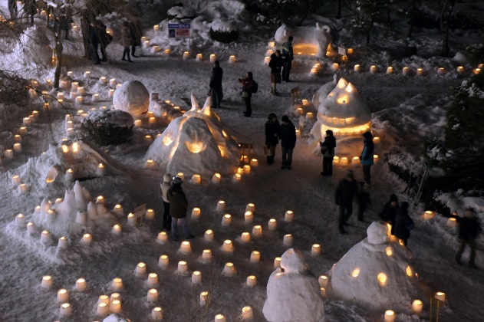
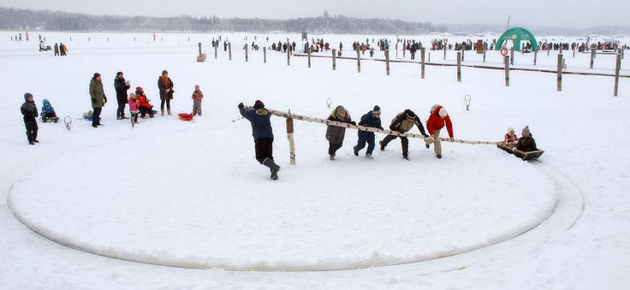
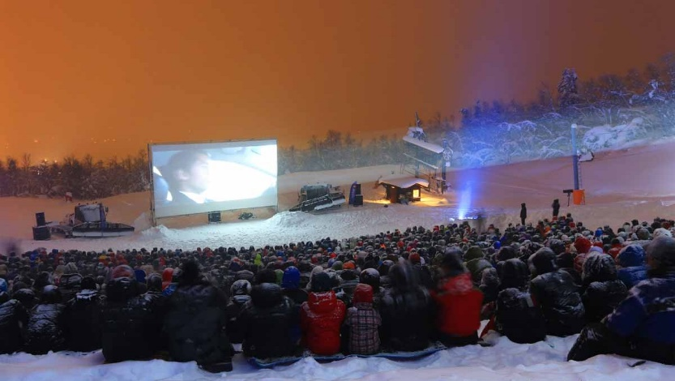
WINTER EVENTS!

Slide 8

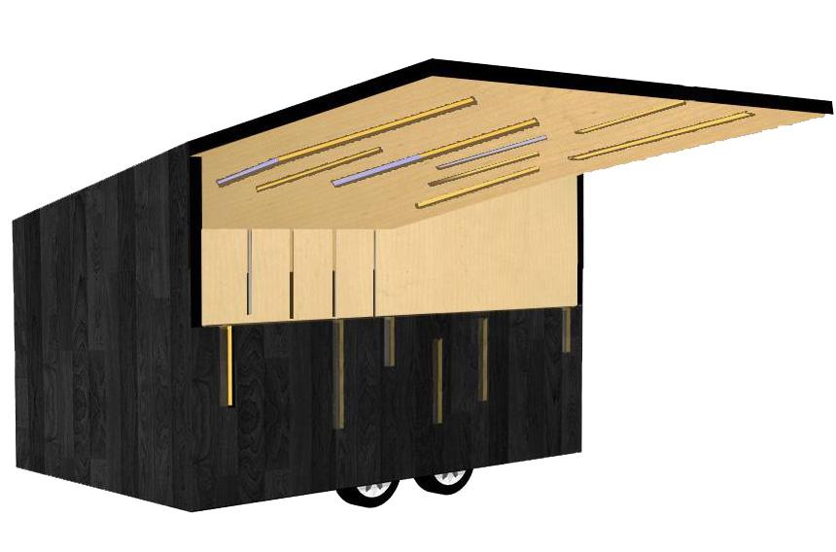
MORE PROOF THAN TENT, EASIER TO MOVE THAN SEACONTAINER

Slide 9
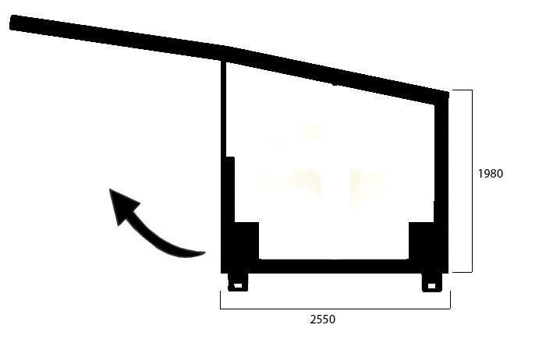
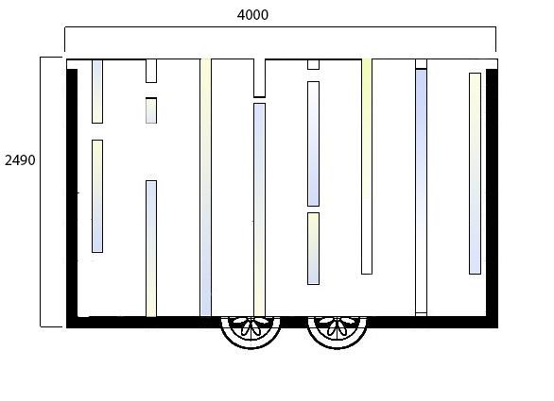




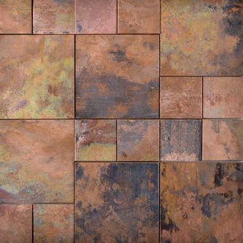
THE FRONT WALL WORKS ALSO AS A SHELTER WHEN YOU FLIP IT UP!
GAS SPRING TO HELP THE LIFTING OF THE SHELTER
WINDOWS WITH LED-LIGHT WHICH COLORS CAN BE CHANGED.

Slide 10
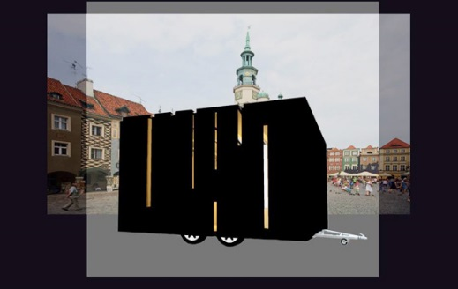
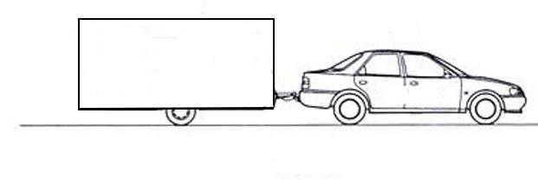
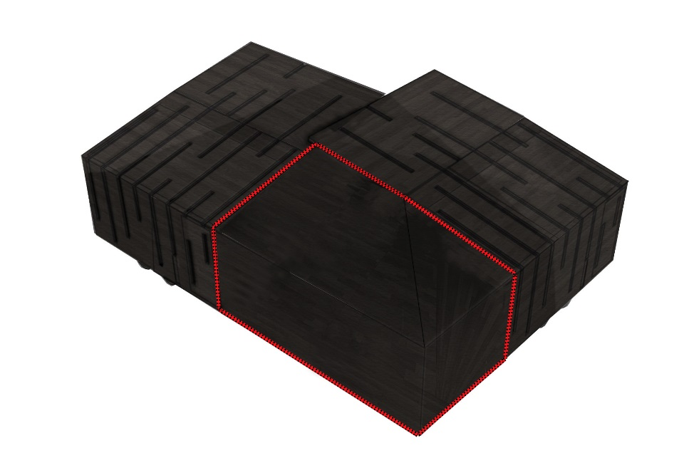
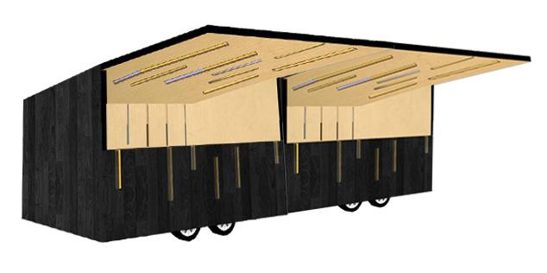
EASY TO MOVE WITH CAR TO PLACE FROM AN OTHER
SAVES TIME
CORNER PIECE
CAN BE COMBINED TO LINE

Slide 11
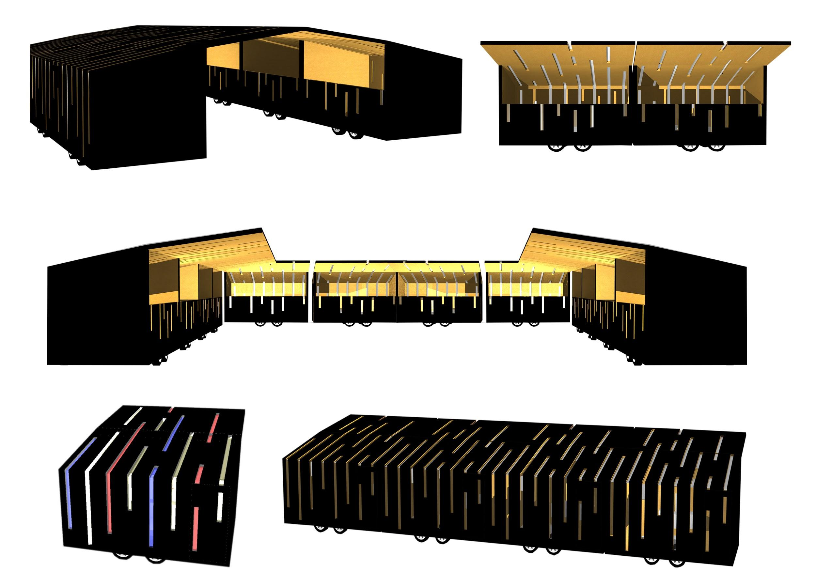
COMBINABLE FOR DIFFERENT SPACES

Slide 12
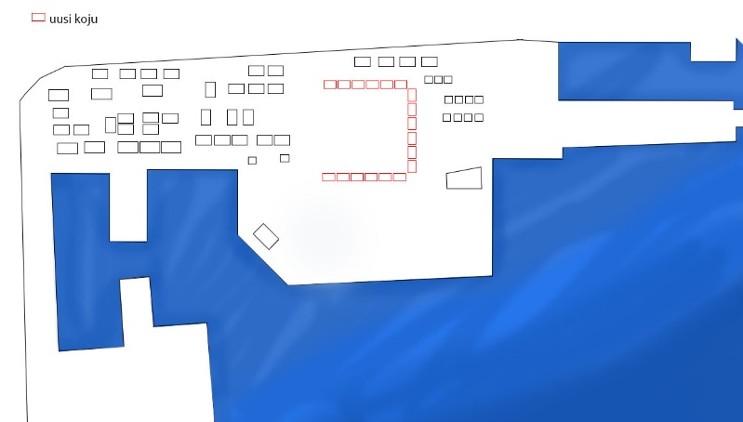
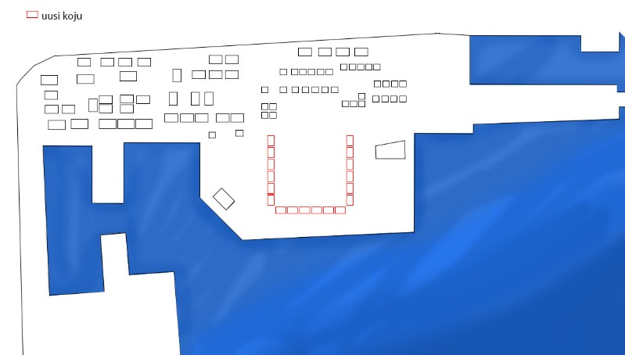
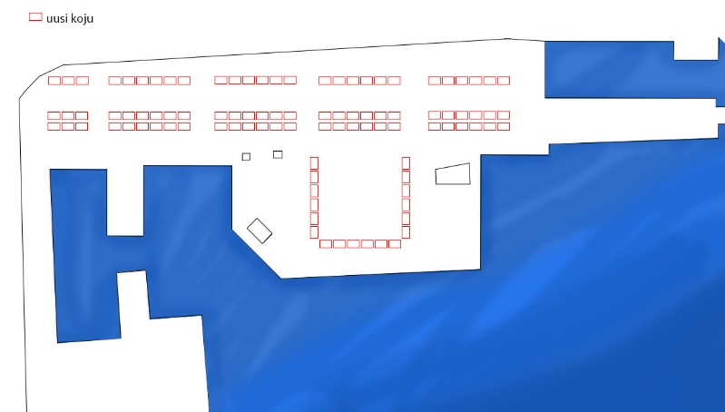
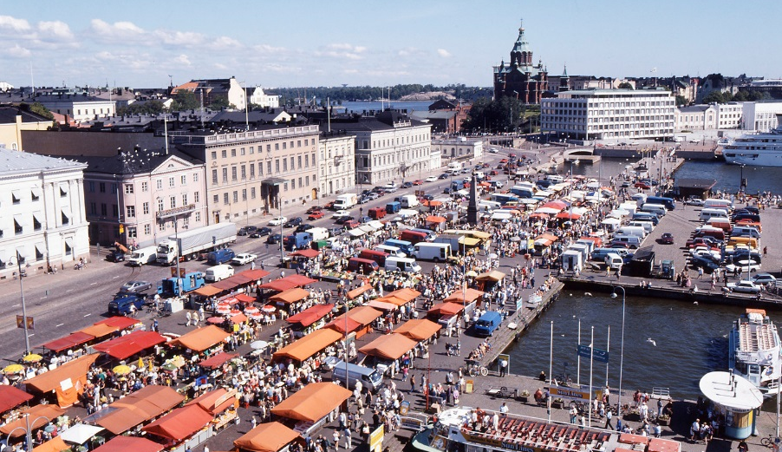
A FEW SUGGESTIONS FOR ORGANIZATION FOR KAUPPATORI…

Slide 13
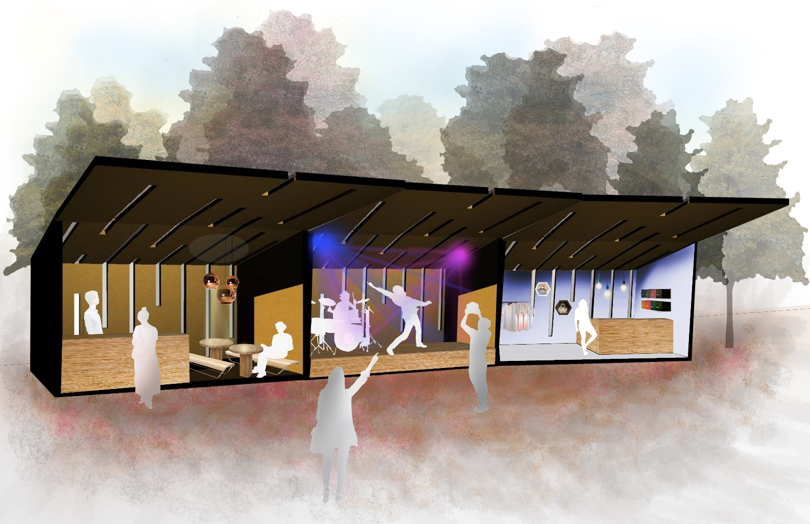
THE IMAGINATION IS THE LIMIT
CAFE, STAGE, SHOP….

Slide 14
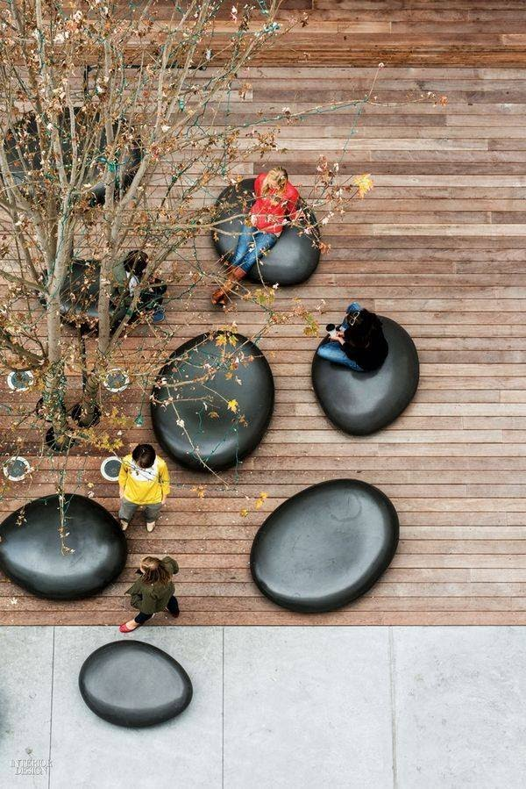
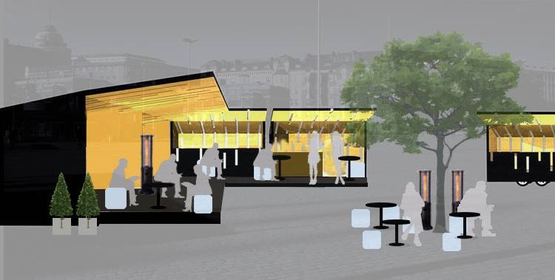
HANGING AREA – ” SPACE IN SPACE”

Slide 15

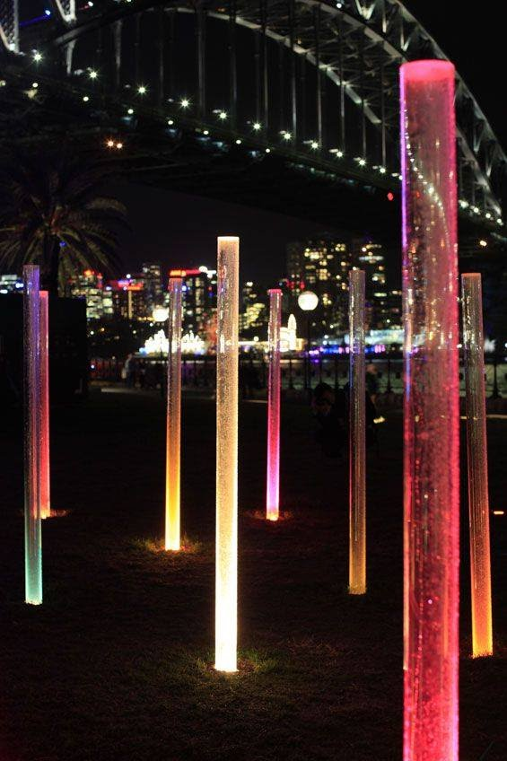
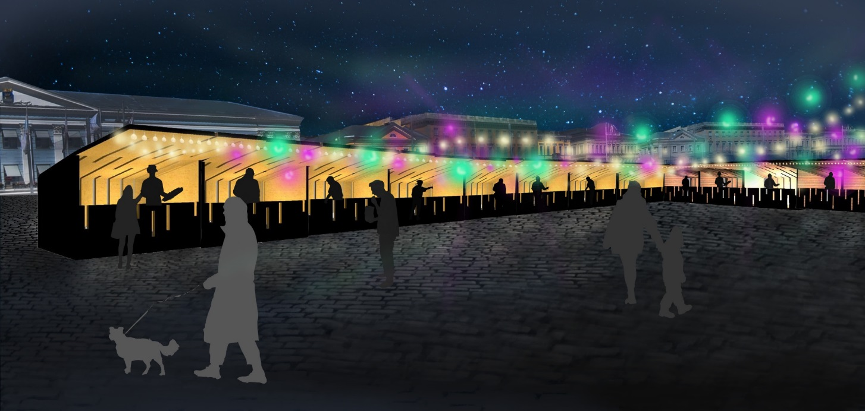
PLENTY OF LIGHTS…

Slide 16
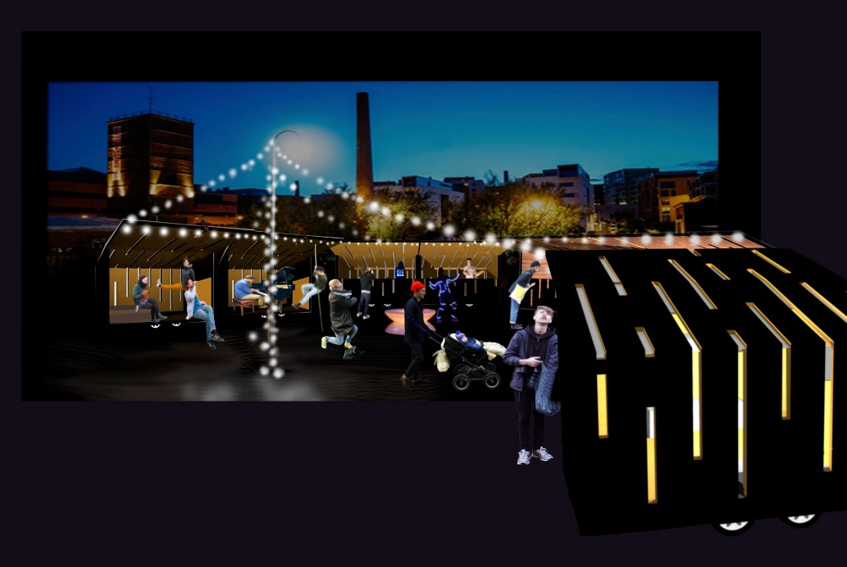
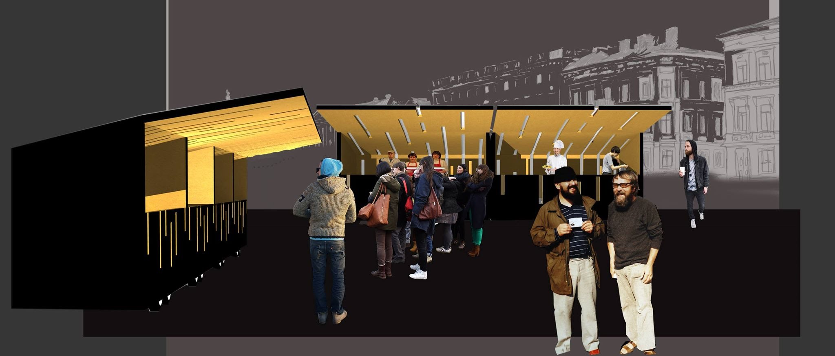
…AND FRIENDLY ATMOSPHERE…

Slide 17
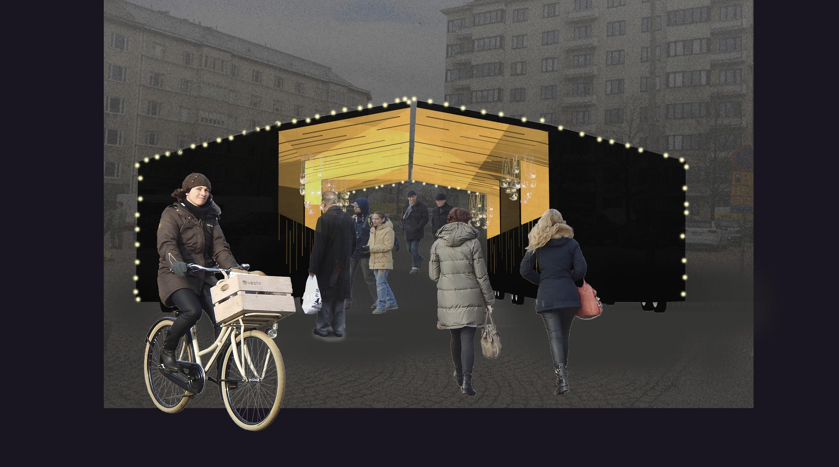

Slide 18
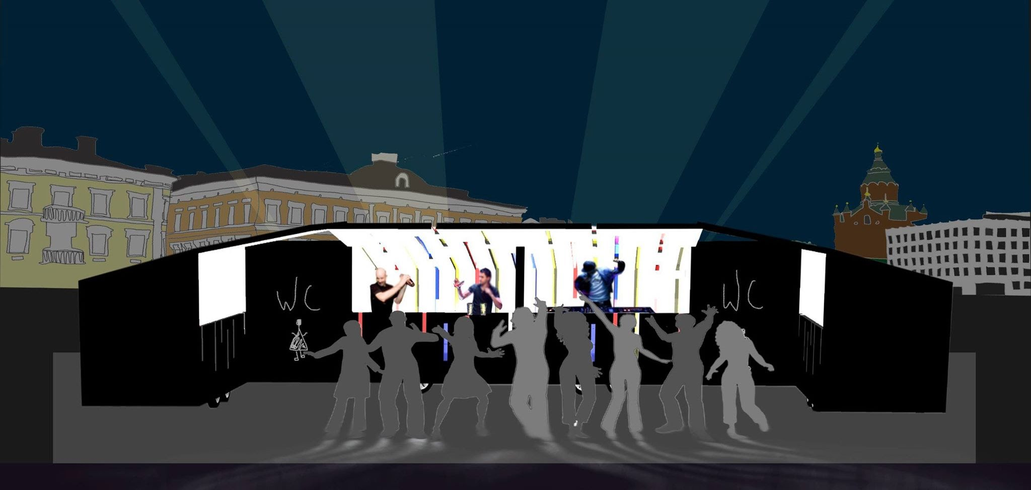
THANK YOU!!!!

