Slide 1
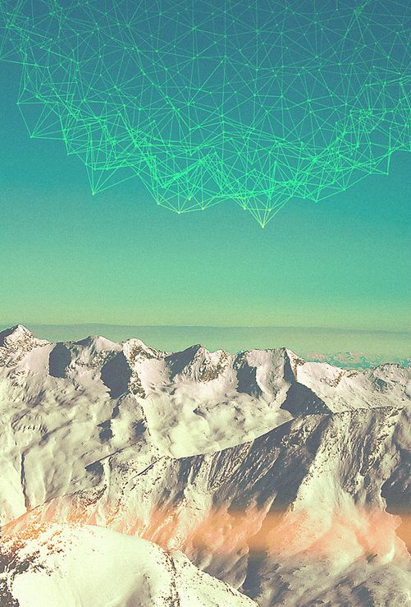
HELSINKI AT WINTER
Piia Larjomaa, Paula Viertola ja Johanna Fagerholm

Slide 2
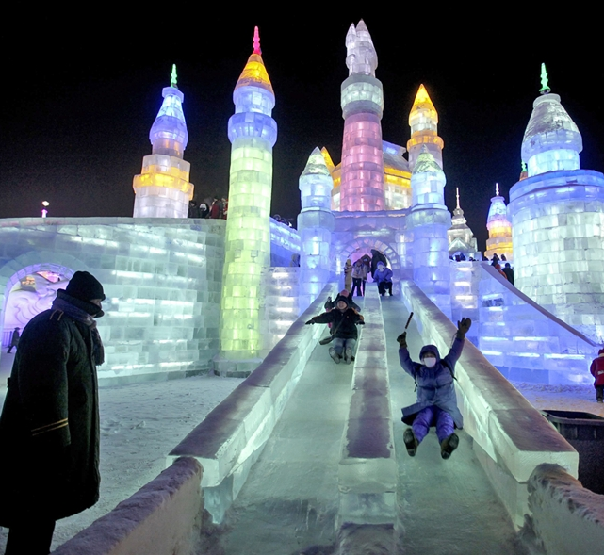
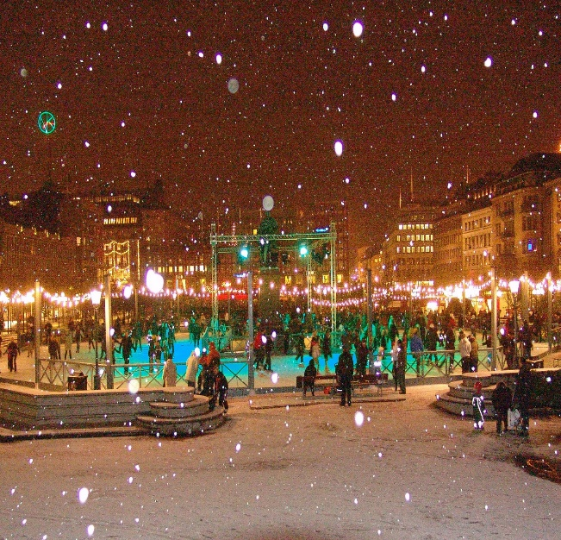
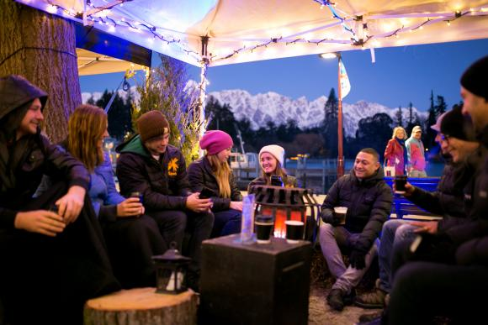
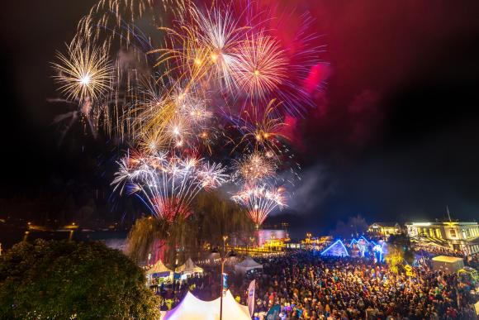
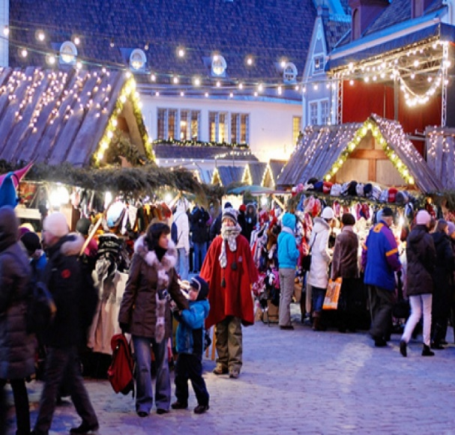
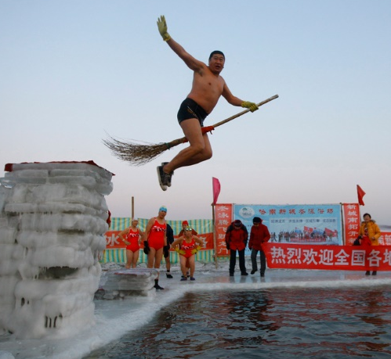
WHAT THEY HAVE THAT WE DON´T ???
In other countries/big cities there are more events and activities in wintertime that brings people together.
Better information servises.
”What, Where, When?”
More Lights

Slide 3
SOME EXAMPLES OF…
EXISTING WINTER EVENTS
IN OTHER COUNTRIES

Slide 4
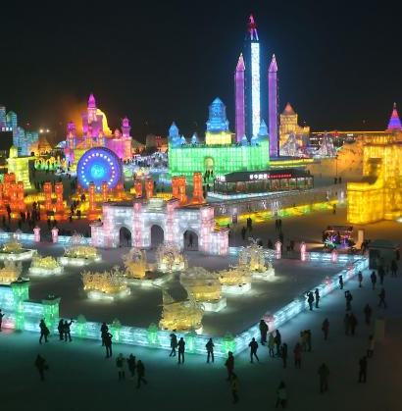
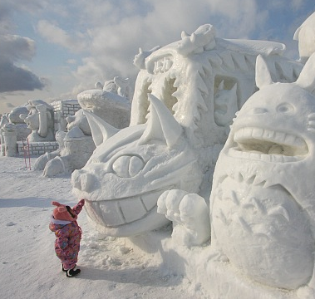
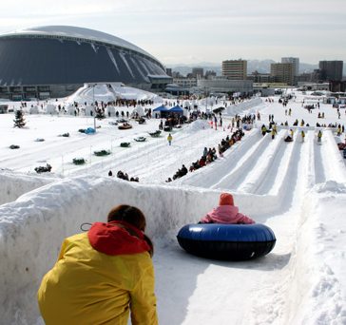
SNOW FESTIVAL, JAPAN
Sapporo Snow Festival
(Sapporo, Japan)
For seven days in February, Sapporo is turned into a winter dreamland of crystal-like ice and white snow.

Slide 5
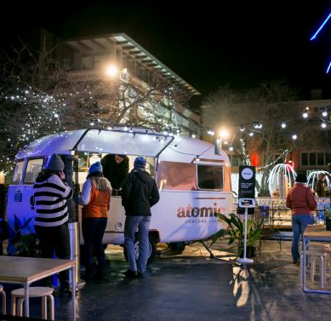
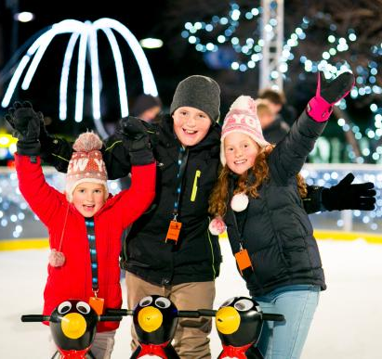
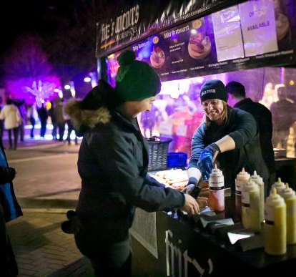
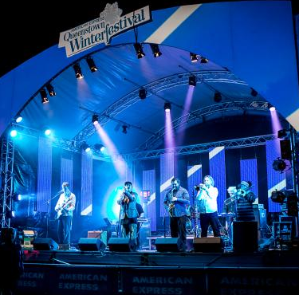
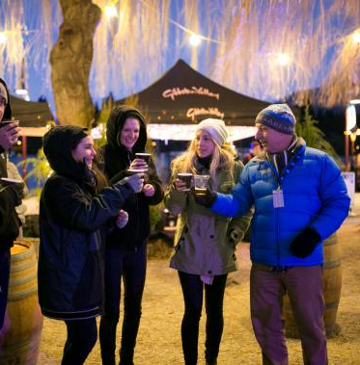
Queenstown Winter Festiva, New Zealand
The Winter festival is a ten day event of Queenstown's unique culture and community with street parties, fireworks, international and local acts, comedy and family fun.

Slide 6
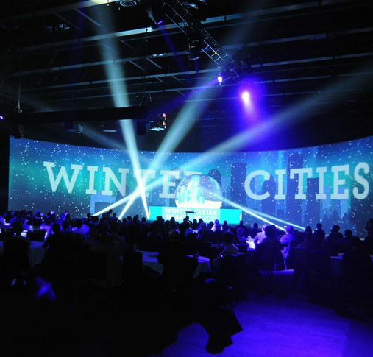
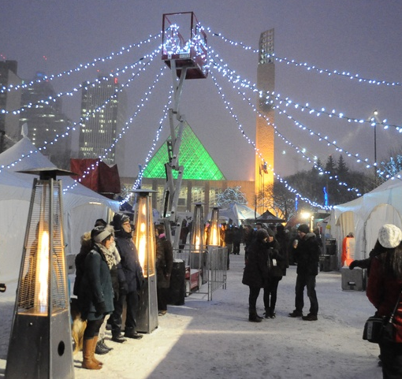
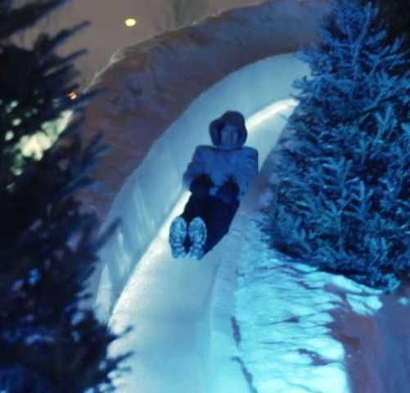
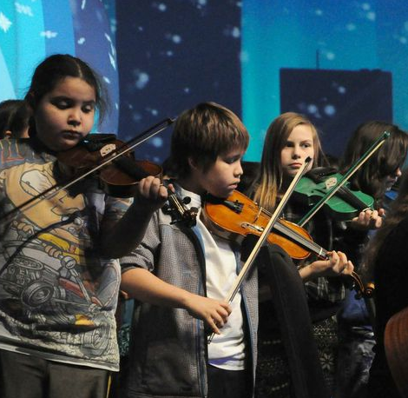
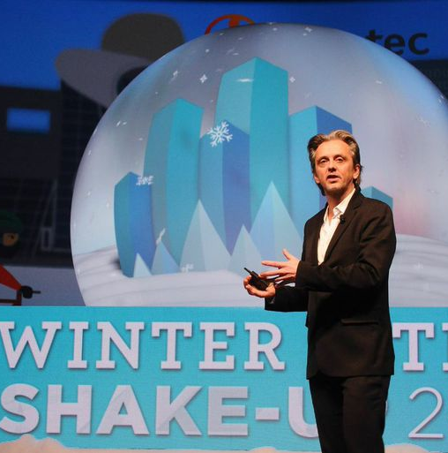
WINTER CITIES SHAKE-UP, FESTIVAL & MARKET,
EDMONTON, CANADA
AN INTERNATIONAL CONFERENCE ON SHAKING UP PRECONCEPTIONS ABOUT HOW TO PLAN, DESIGN, LIVE, WORK, AND PLAY IN WINTER CITIES.
“COLD. YES. DARK. YES. BORING? NEVER”.
http://www.wintercitiesconference.com/#start

Slide 7
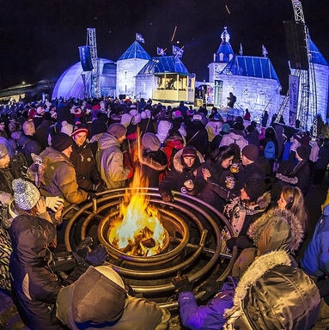
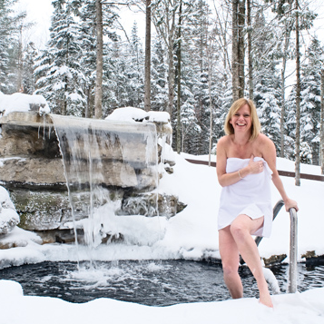
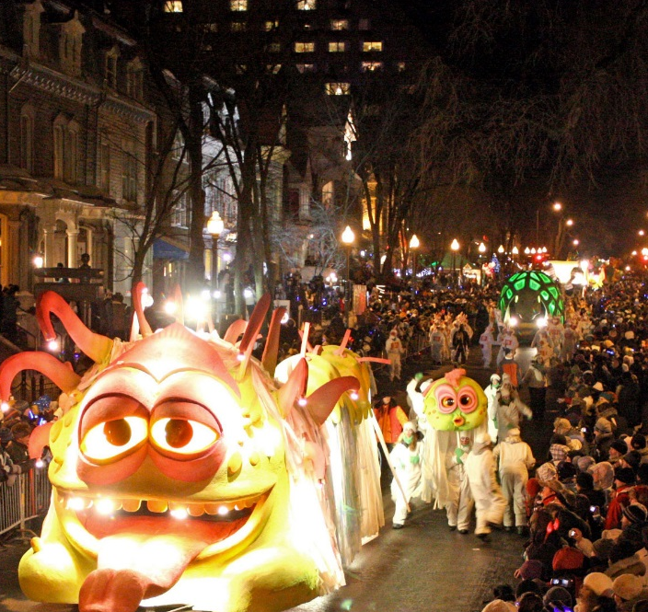
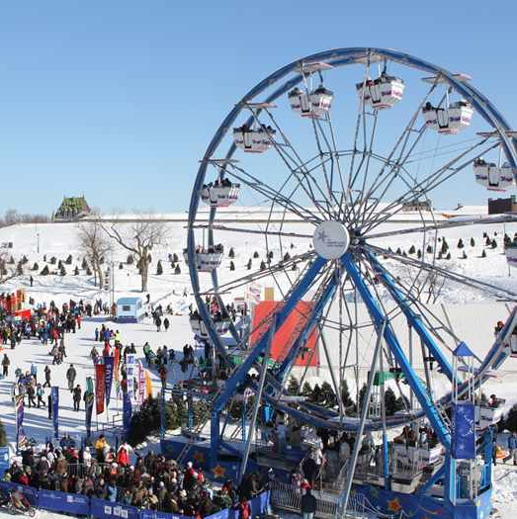
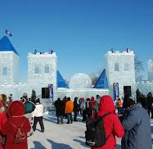
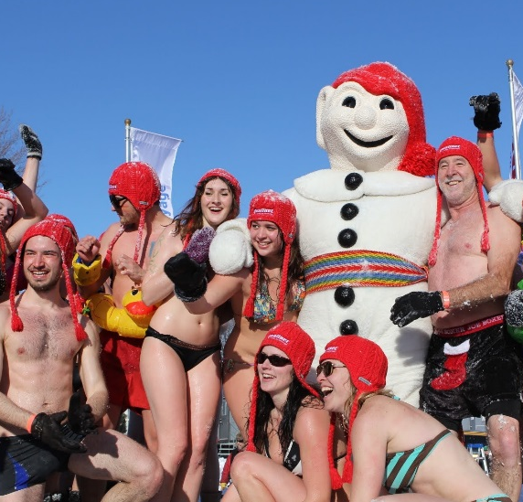
WINTER CARNIVAL, QUEBEC, KANADA
For 60 years, the Québec Winter Carnival has organized the largest and most popular winter celebration in the world.

Slide 8
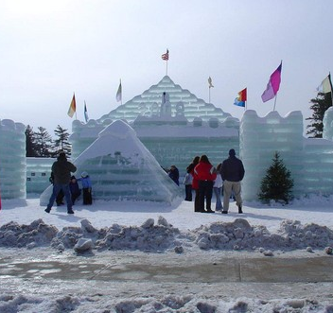
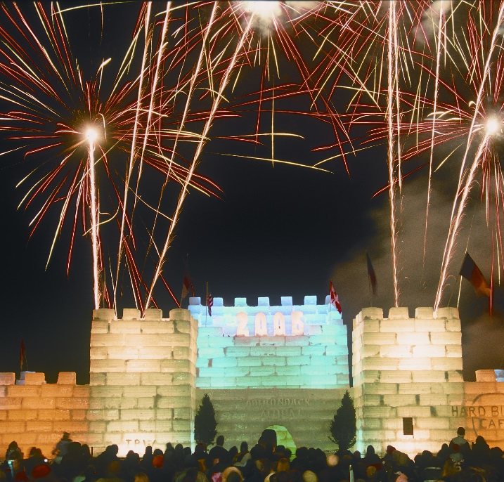
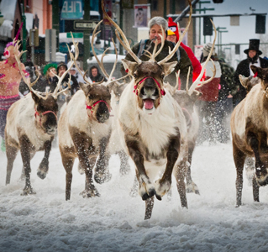
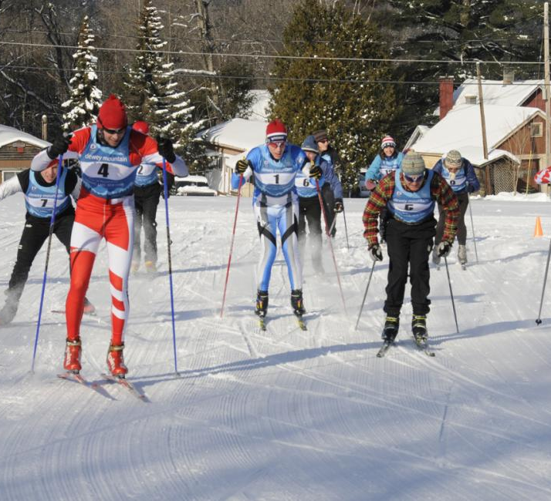
SARANAC LAKE WINTER CARNIVAL, NEW YORK
A union of winter sports competitions as well as offbeat contests, concerts, fireworks, and a parade. But the centerpiece of this 115-year-old fete is an elaborate ice palace built by volunteers with ice blocks from Lake Flower. The festival Scheduled every year from January 31 to February 9.

Slide 9
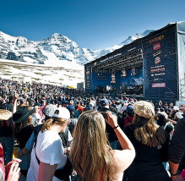
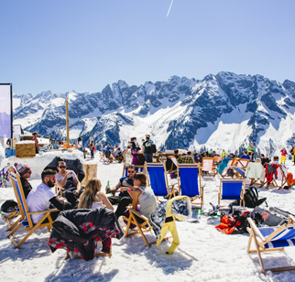
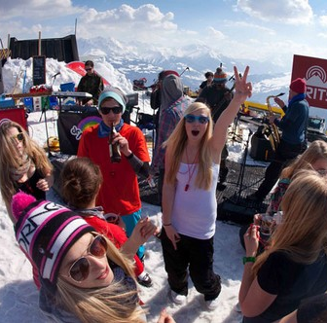
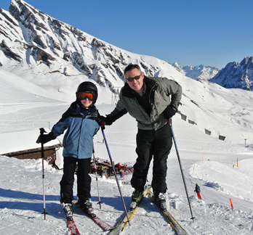
Brits Music and Winter Festival, Switzerland
The Brits Festival provides its visitors with an entire week of music and skiing bonanza for all ages and sizes.

Slide 10
Existing events at wintertime in Helsinki
Ravintolapäivä 17.2
Japan week 21-26.10
Lux-Helsinki 6-10.1
Late night shopping Kallio 17.12
Streat Helsinki 22.3
Winter fun Helsinki 15.1-8.2
Uudenvuoden juhlat senaatilla 30.12
Food carneval 15-16.11
Joulupolku seurasaari 13.12
Joulukadun avajaiset 22.11
Tuomaan markkinat 4-22.11
Jääpuisto
Korjaamon joulumarkkinat 15.12-16.12
Naisten joulumessut 2-6.12
Puotilan kartanon joulumarkkinat 13.12
Kaapelin joulu 11-20.12
Linnanmäki valokarnevaali 10-18.10

Slide 11
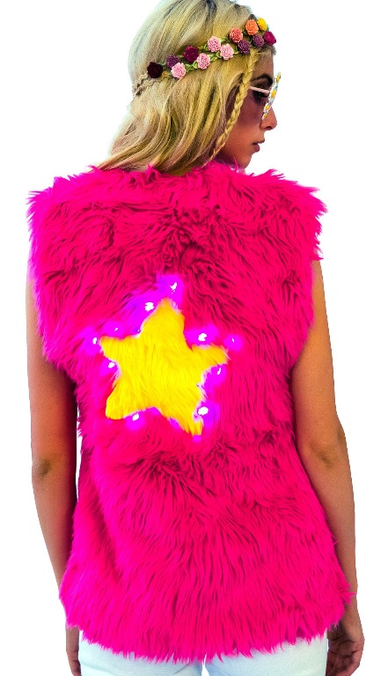
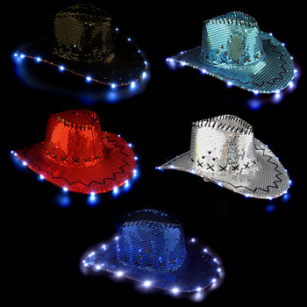
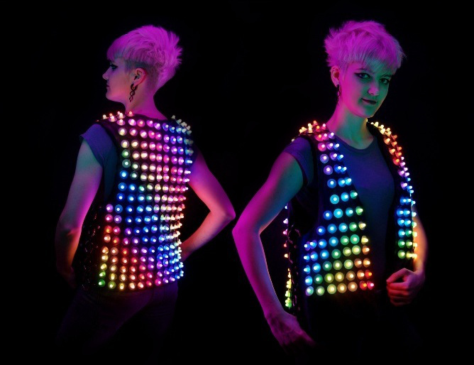
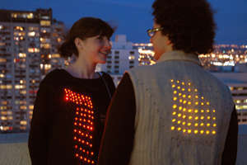
Light parties
RENT/BUY COOL HATS AND VESTS. PIMP YOUR OWN CLOTHES TO LIGHT SURROUNDINGS. ”FREE” MARKETING TO THE EVENT.

Slide 12
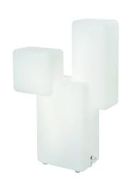
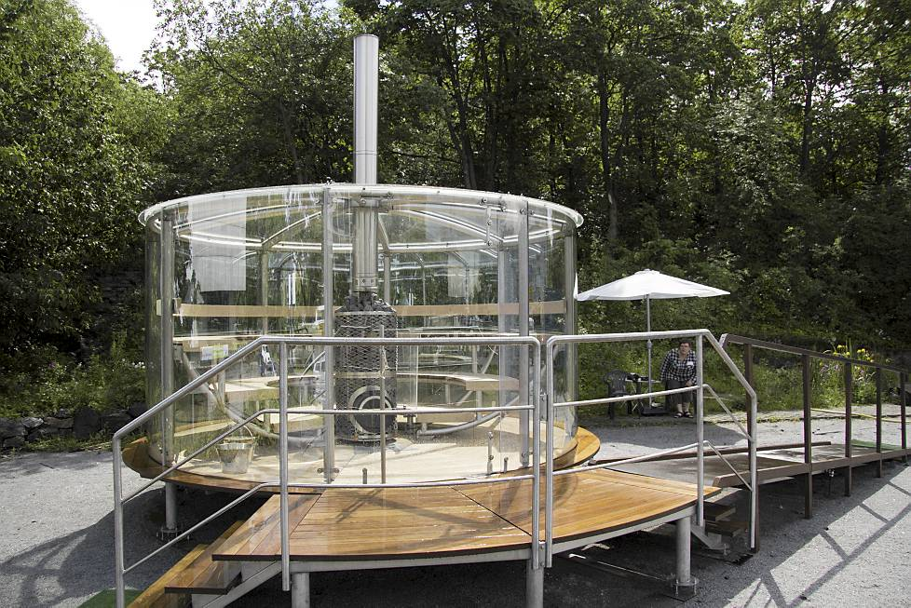
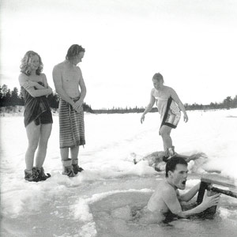
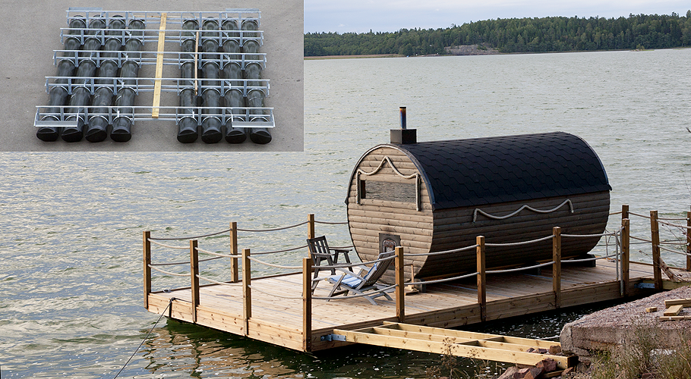
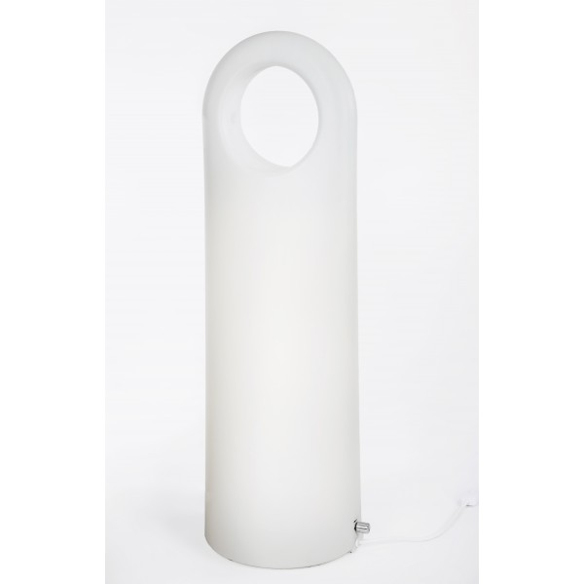
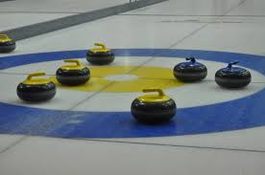
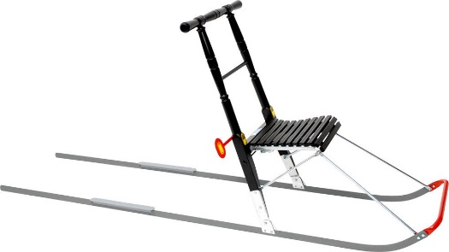
GRAZY FINNS!!
Bright light and light! Sponsor Innolux, Innojok?
Sauna and swimming in hole in the ice (if place located near water).

Slide 13
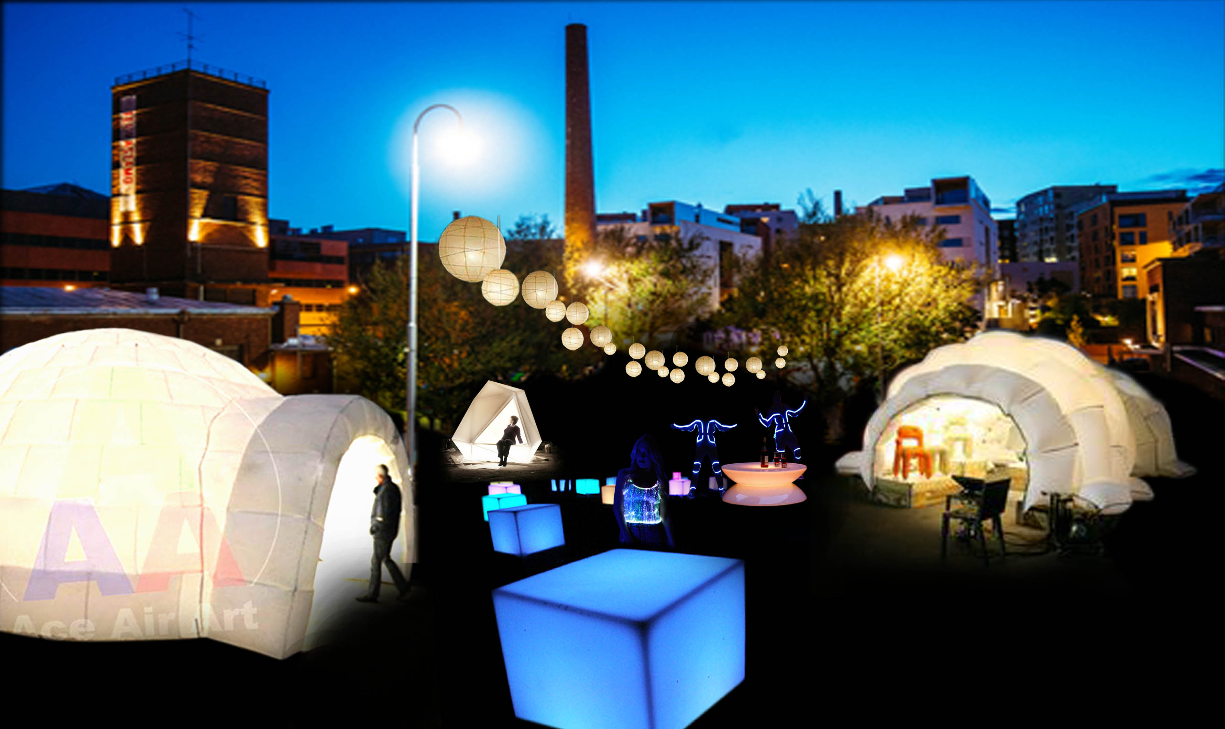

Slide 14
