Slide 1

build the world with pearls

Slide 2

Less than 20% of engineers are women in the whole world
Just wondering . . .
is there any difference how girls and boys are inspired to use their ”engineering skills” when growing up?

Slide 3
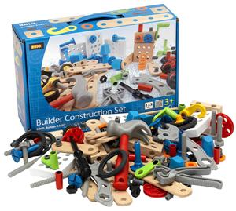
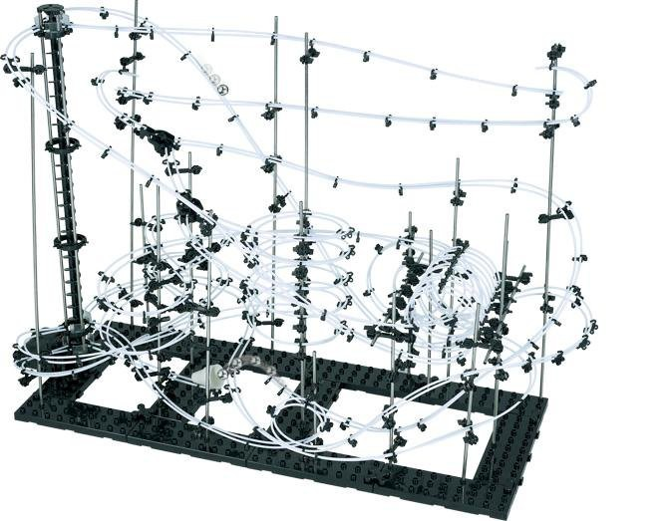
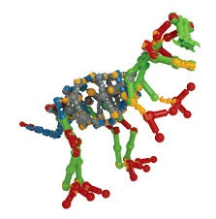
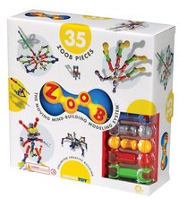
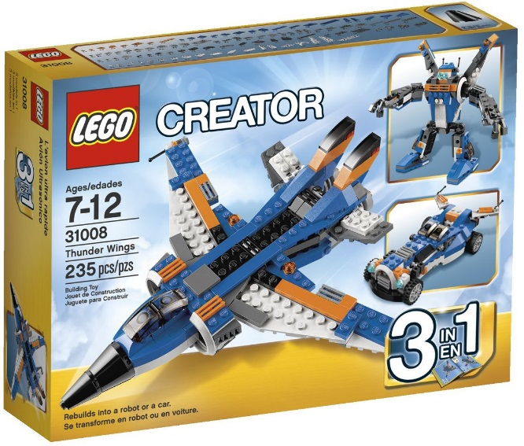
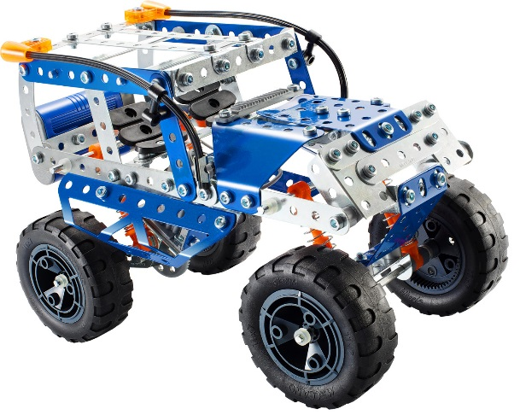
The offering for ”the future boy engineers” is inspirational and massive!
Notes:
¨We all know boys have Legos. In addition there are lot’s of other building series (Brio, Zoob, Meccano, Playmobil) that are designed just MORE for boys than for girls.

Slide 4
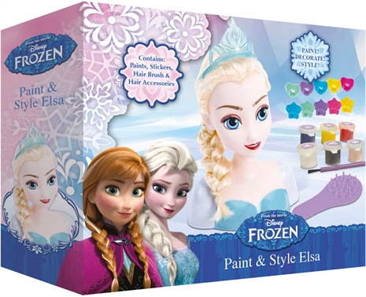
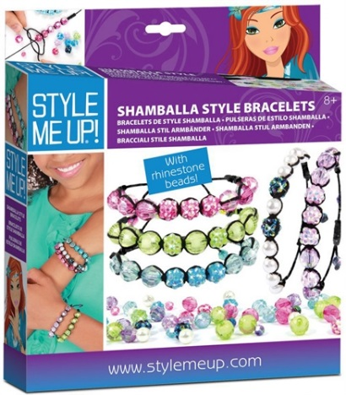
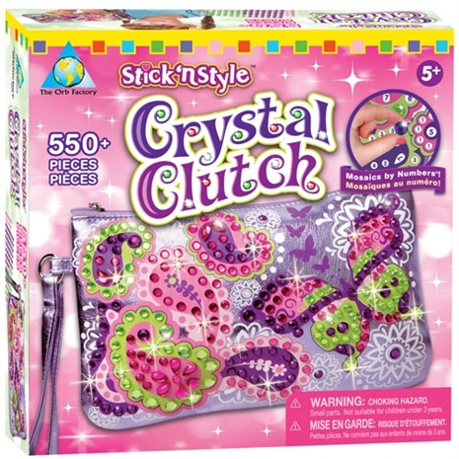
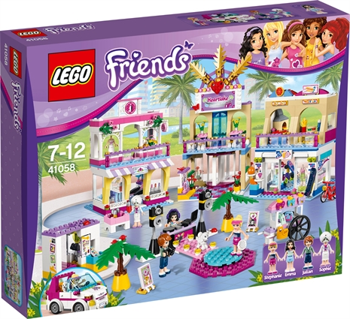
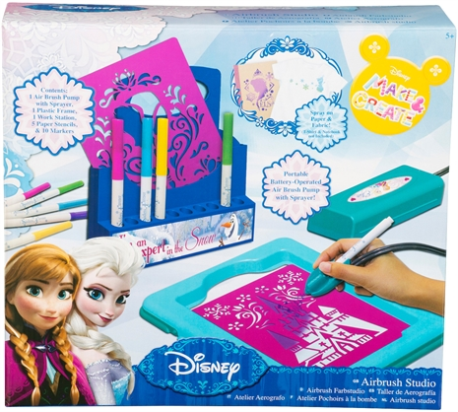
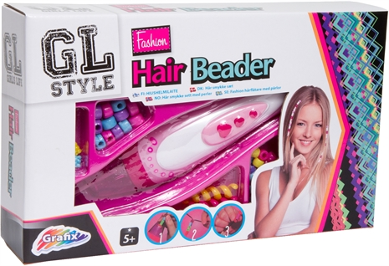
What is found for . . .
Notes:
Is there anything similar available that is targeted especially for the future girl engineers? That is not too girly but yet still allures girls to use their imagination and start building?

Slide 5
. . . ”the future girl engineers”?
  - Styleheads
  - Drawing packages
  - Style me up kits
  - Make decorations toolboxes
  - Lego Friend building series (the only real purpose building serie found?)
  - Lot’s of other ”how to be pretty and cute” toys
  Ultimately, there’s nothing wrong with having this type of toys for girls. Assumingly they also help to build imagination and creativeness.
  But there is still lack of REAL BUILDING SERIE TARGETED FOR GIRLS WHICH LASTS TIME AND TEMPTS TO GIVE WINGS TO GIRLS’ IMAGINATION OVER AND OVER AGAIN!
Notes:
So far (and after countless hours of Google searches) nothing just as described is found.

Slide 6
  . . . With what kind of building serie would girls build and play as intensively as how boys play with Legos and such?
  . . . What kind of building serie would catch girls interest?

Slide 7
Can it be so obvious?
PEARLS, OF COURSE!
”Design and create almost any shape or form you can think of, build it with easy to attach pieces and finish it on the way with beautiful pearls.”
Pegado = pearl building serie for girls at ages approximately from 5 to 12 years
Countless amount of shapes can be build with Pegado
Can be build, dismantled, and build again - no glueing

Slide 8
How to catch girls interest?
  The building serie needs to be…
  fun and inspiring to play with
  beautiful and aesthetic
  easy to learn how to build and easy to make
  lot’s of different variations from
  flexible – easy to personalise designs
  developing – for both physical fine motorics as well as creativity and imagination

Slide 9
Variety of Collections
  Shapes
  Figures
  Buildings and Castles
  Letters
  Flowers
  . . . whatever can be thought of!
  Marketing research will be conduced of girl’s interests.
Notes:
Next 4 slides give a glimpse of what the collections could possibly be

Slide 10
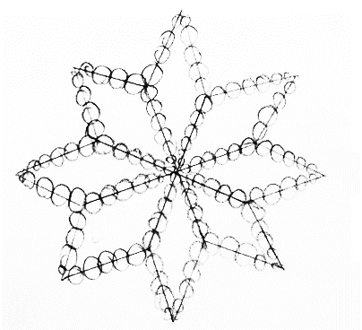
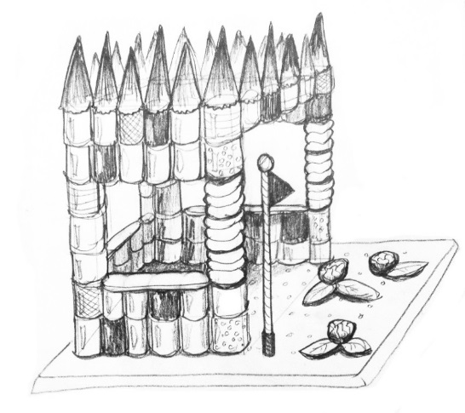
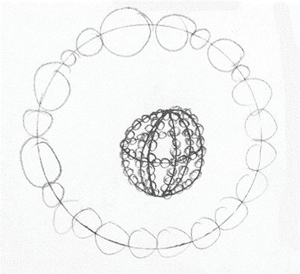
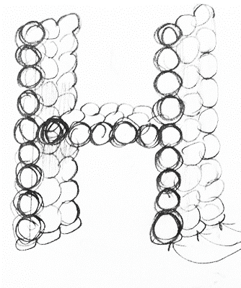
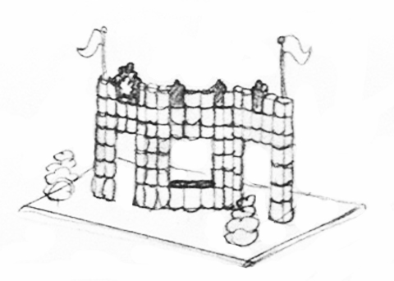
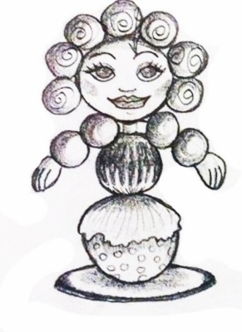
Just to give few simple examples

Slide 11
HOW TO BUILD
Basic 3-step model
Deside the shape and select the right STRING PARTS
Use ATTACHMENT PARTS to build the strings together
Thread the selected PEARLS into the strings along as building
When needed special parts, support parts, bases, etc are used

Slide 12
The need at the moment?
Optimize and design the basic 3-step building model and the construction parts with 3D design (dimensions, sizes, special parts, bases, etc.)
→ produce/print prototypes for real-life testing
Redesign, rework, improve, print again!

Slide 13
Next steps and plans?
STEP 2: Online application to support creativity and to generate a strong social community.
OPPORTUNITY: Innovative people will be needed to the team if the idea is proven functional and the need is endorsed.

Slide 14
Pegado Value Statement
”
  We belive that child’s strong self-esteem is built with the feeling of being good at what she does and when she is able to express herself in creative way. We believe that it is every child’s right to be able to use her endless imagination and she needs to be given opportunities and encouraged to do so.
  Pegado offers solutions for children to endlessly create, experiment and produce something new.

Slide 15
Caught your interest ?
  Reveal your team for further information
  Maria Ulvinen
  0400 436 493
  maria.ulvinen@valo.fi
  Mika Kortelainen
  040 483 5473
  mika.kortelainen@onninen.fi

Slide 16
build the world with pearls

