Slide 1


Superteam tournament

Slide 2






Superteam –tournament is developed in TeenMINNO project, funded by European Social Fund (ESF).
TeenMINNO project….
Develops students innovation competences
Makes the paths from vocational school to higher school or from school to work smoothier
Increases co-operating between different education disciplines and degrees (vocational and higher schools) and co-operating between business and schools
See more: www.metropolia.fi/teiniminno

Slide 3

Superteam tournament
Superteam is a new multiprofessional and multigraduated innovation project: model brings secondary vocational and higher education students together to solve innovation challenges.
Superteam is a tournament based on best develop of innovation competences of students and best solution for the innovation challenge.
The Superteam model is based on MINNO® - the pedagogic innovation process model, developed by Metropolia University of Applied Sciences

Slide 4
Superteam-tournament in a nutshell
The project starts with a business partner’s genuine challenge – a need, a question or a problem that the business has.
2. The students work on solutions to the challenges in groups that consist of students from many different disciplines (multi-professional) and two different schools (multi-graduated). The starting point is to gain an understanding of the business’ needs and then answering those needs.
3. Innovation lecturers coach the groups during the process.
3. The goal is to create a genuine, ready-to-use innovation. Co-creation is the key in this process. The business is not a passive client, but participates by sparring, developing and evolving.
4. The outcome of the process is not only to develop a new product or service or to improve on the existing ones, but also to develop innovation competencies.
The process creates added value for all participants; education, learning and the business.

Slide 5

1st Superteam pilot spring 2017 (1.2.-17.3.)
Superteam model was co-created by Metropolia University of applied sciences, Omnia vocational school and Future Tournaments ltd during year 2016
  Model based on Metropolia´s MINNO® -model and Futuretournaments´ Innovation tournament –model
About 60 students from Metropolia and Omnia was involved (disciplines e.g. business economics, cultural management, landscaping, textile design) in pilot 1.2.-17.3.2017
13 student teams, 9 teacher -coatches
Challenges from 6 enterprises: Novita, Polar, Finnish National Theatre, Fivr, Airo Island, Arctic 15
Grande Finale 16.3.2017 in Espoo Shopping Centre (library) Iso Omena

Slide 6
Students in multidisciplinary teams developed e.g.
Electronic discount card that gives you sport challenges
The more you do sports - the more you get screen time. App for kids.
- Collective knitting game
- Sock knitting app - design your socks
- Augmented reality experience in businesd events

Slide 7
…....
System for projecting holographic image to boost presentations
Virtual reality sauna
Theater box travelling around the country to engage youth
Mascot robot and popup club in shopping centre for the National theatre
- Ghost tour in theatre

Slide 8
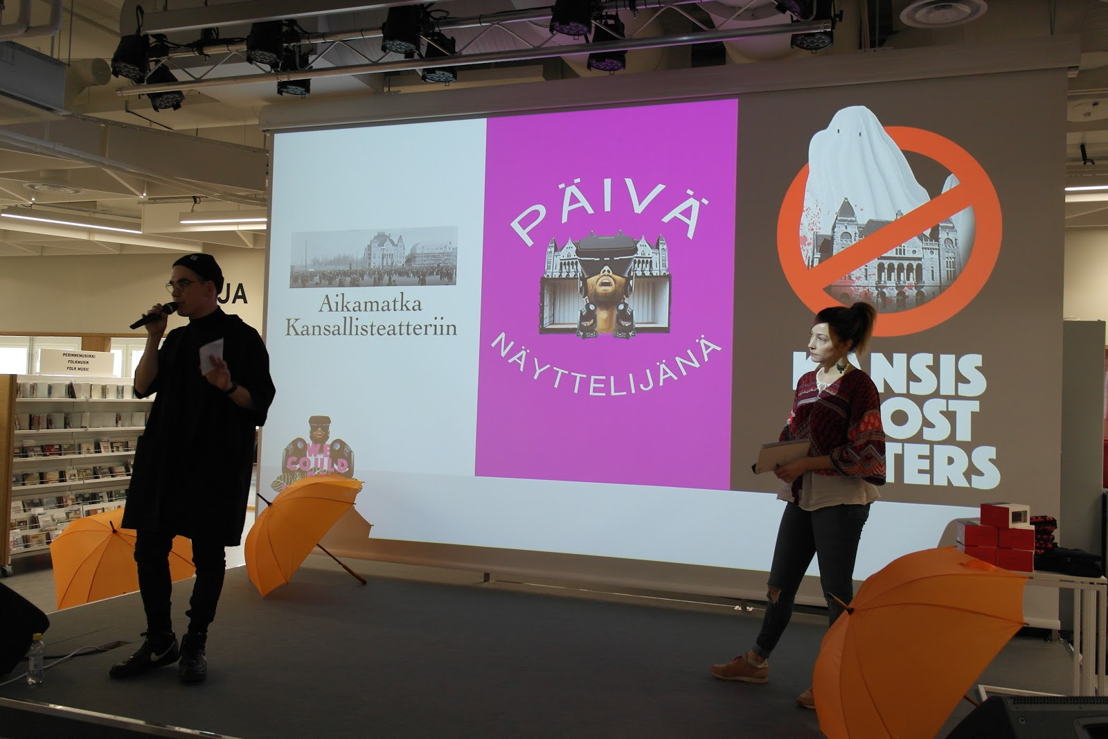

Slide 9
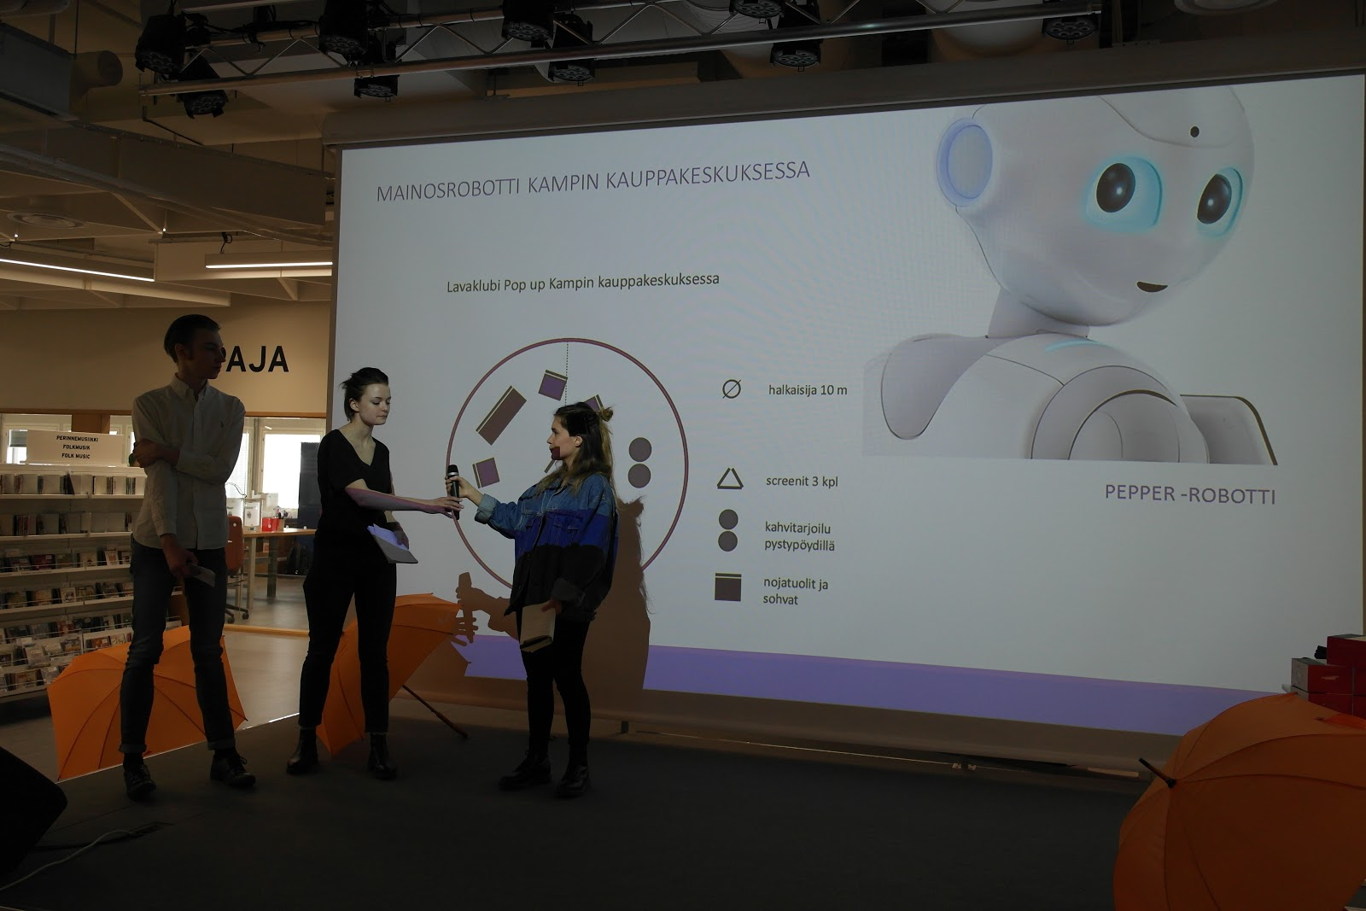

Slide 10
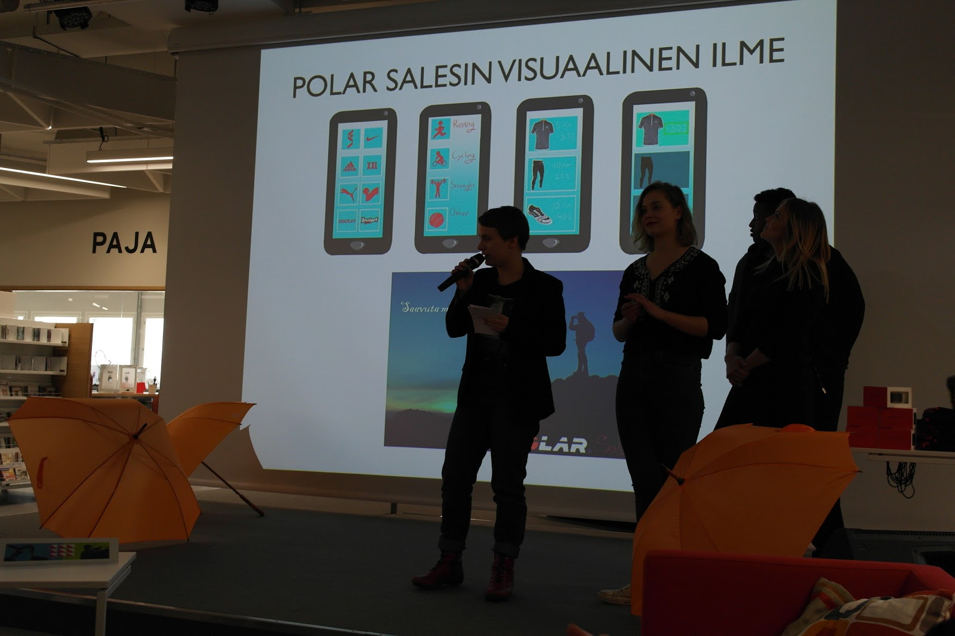

Slide 11
…....
Dual Active won later the Ultrahack hackaton!
…....

Slide 12
Co-creating of the model is to be continued in
2nd Superteam pilot in autumn 2017 (28.8.-13.10.)

Slide 13

Innovation process in Superteam
(6 intensive weeks)
Orientation&Challenge – Future orientation - Ideas - Consepting - Prototyping - Testing – Implementing - assessment

Slide 14

WHY this MODEL?
The process creates added value for all participants; education, learning and the business.
Based on research, tournament model products more elaborate solutions and more motivated participants*
* ACTIVE INNOVATION — CASE STUDY IN SMART EXERCISE ENVIRONMENTS: COMPARING TRADITIONAL AND EXPERIMENTAL INNOVATION METHODS. International Journal of Innovation Management Vol. 14, No. 3 (June 2010) pp. 449–470
Feedback is formalized with steps of process
Tournament model creates the positive pressure to develop the best solution

Slide 15
AIMS of the PROCESS
To develop students´ innovation competences
To learn innovation process
To develop a new innovative solution
To smooth the transition from vocational school to higher education or from school to work
To understand the possibilities of new technologies, also in other areas than technology

Slide 16
Benefits for business partners
Innovation solutions to challenges
Cost-effective way to develop innovations and implement project
Know-how from youth and possibility to get to know potential workers (networking also with other enterprises)
Possibility to carry social responsibility

Slide 17
