Slide 1

What is Ethics in Business ethics?
Corinna Casi
PhD student in Environmental Ethics
Faculty of Social Sciences, University of Helsinki
corinna.casi@helsinki.fi
IPW, Metropolia Business School, Mon. 16th May 2011
1
Notes:
1

Slide 2
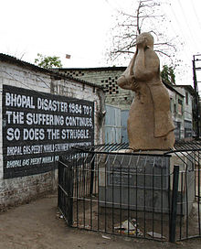
Business and consequences
    The Bhopal disaster (1984)
    is the world's worst industrial catastrophe.
    The Union Carbide India Limited (UCIL) factory produced the pesticide Sevin using MIC (methyl isocyanate).
    water entered the tank containing MIC the temperature increased to over 200 °C and raised the pressure. The tank vented releasing toxic gases into the atmosphere resulted in the exposure of hundreds of thousands of people.
Bhopal memorial
corinna.casi@helsinki.fi
2

Slide 3
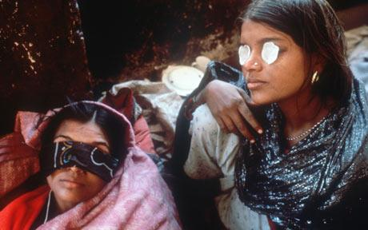
To maximize the profit and reduce expenses:
safety systems were switched off (alarm, tank refrigeration system which could have mitigated the disaster severity).
non-existent emergency
action plans
.
corinna.casi@helsinki.fi
3

Slide 4
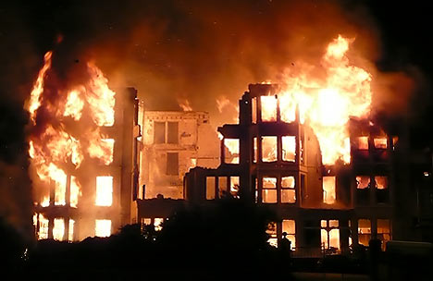
Human losses: - 558,125 injuries
- 3,928 certified deaths (1991)
10,000 - 30,000 dead according to independent organizations
Environmental consequences:
Within a few days: 2,000 buffalo, goats, and other animals were collected and buried; leaves on trees yellowed and fell off; fishing was prohibited.
MIC and the Sevin plants are still there and spreading (1989)
soil and groundwater were still polluted (in 1989).
the Madhya Pradesh High Court decided to incinerate the toxic waste (2008)
corinna.casi@helsinki.fi
4

Slide 5
Summary:
What is ethics?
What is business?
Business ethics
Business ethics as part of Applied ethics
What philosophy can say about Ethics in Business?
Why discussion in business ethics is necessary?
Me and everything is other than me
Ethical businesses
Conclusions
5

Slide 6
What is ethics?
Greek word Ethos (ἦθος) "custom, habit“.
Ethos forms the root of ethikos (ἠθικός), meaning "moral,
showing moral character".
Ethics for a layman is a set of rules and values which should inspire the moral behavior of human beings.
In philosophy, ethics is rather a certain kind of activity of thinking.
Ethics requires a certain independence of mind and practice. It is an attempt to place conduct of individuals on a reflective and created basis rather than on those given of habits, practice and religion.
6

Slide 7

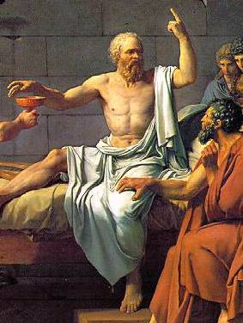
"Know thyself"
(γνῶθι σεαυτόν, gnōthi seauton)
SOCRATES (469 BC–399 BC)
System of ethics, as the critical reflection upon practices and tradition, began with the Greeks, specifically with Socrates.
KNOW THYSELF: who are you? What is good for you, not for the multitude.
7

Slide 8
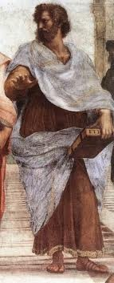
What kind of person one should be to live a fulfilling life? the ethical question of Ancient Greece
Ethics is practical:
aimed at doing good rather than only knowing it.
(Ex. To pollute is bad ≠ do not to pollute)
Everything has a function (plants and animals)
The human purpose is to live up and develop one's full potential (ex. pianist)
live a fulfilling life attaining different virtues (arête) such as courage, justice, wisdom etc. - VIRTUE ETHICS –
realized only in the right community (polis)
ARISTOTLE (384 – 322 BC)
corinna.casi@helsinki.fi
8

Slide 9
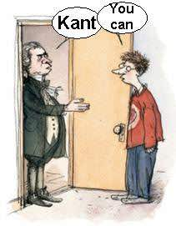
How may I conduct my life?
Immanuel Kant (1724 -1804)
what is right and just comes first than “what is good for me” individually. (universal moral theory)
Deontological theory is ethics of duty (deos) and justice before issues of good.
ethical people create an ethical society
corinna.casi@helsinki.fi
9

Slide 10
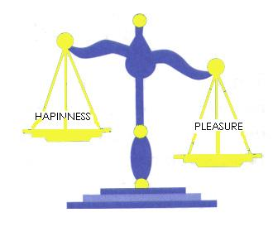
The greatest good (pleasure/ happiness) for the greatest number
Teleological ethics - Utilitarianism
search for what is good.
focuses on the consequences, scope (= telos)
Jeremy Bentham’s (1748 - 1832):
what is morally right are actions which maximize pleasure and reduce pain. (Individualistic theory)
In economic terms, the value of an action depends on the amount of utility generated because individuals seek to maximize utility.
10

Slide 11

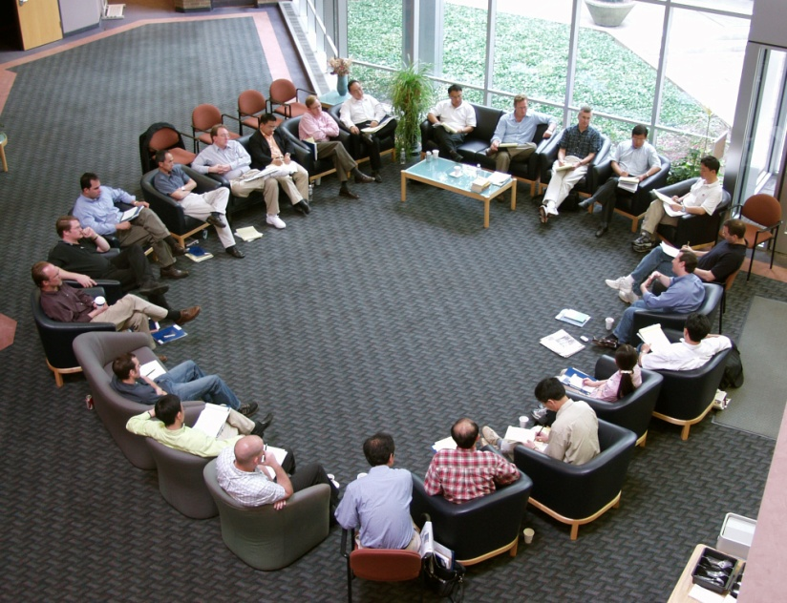
Pluralism
  Alfred Ayer, (1910-1989)
  A moral claim represents just something I like or I do not. (ex. vegetarianism)
  subjectivism.
  Pluralism foster the dialogue.
  possibility of finding one’s own morality.
corinna.casi@helsinki.fi
11

Slide 12



What is business?
refers to engagement or activity;
engagement in a trade or profession from 15th cent.
“While business lives under the discipline of profit, its consequences are often larger than making of profit.”
corinna.casi@helsinki.fi
12

Slide 13
Business ethics is part of Applied ethics
Philosophy
Metaphysics is the study of the nature of reality, including the relationship between mind and body.
Political philosophy
Logic
Epistemology is concerned with the nature and scope of knowledge.
Philosophy of mind mind/body
Philosophy of language
Moral Philosophy or ethics
Business ethics
Applied ethics
International ethics
Environmental ethics
Bioethics
Professional ethics
13

Slide 14

Business ethics
  - Business ethics (BE) emerged as an academic discipline in the 1970s
Many topics fall into BE :
  hiring and firing of the employees;
  Ethics of sales and marketing;
  Emission Trading and carbon credits;
  Corporate ethics policies;
  ethical problems arising out of new technologies: genetically modified food, mobile phone radiation and health;
  distributive consequences of economic actions: who gains and who loses from economic activity? Is the resultant distribution fair or just?
  Product testing ethics: animal rights and animal testing.
corinna.casi@helsinki.fi
14

Slide 15

What can philosophy say in Business Ethics? 1/2
The aid of philosophy in business is underestimated, philosophy is all around!
(ex. utilitarian theory; Nussbaum’s capability approach is a paradigm for policy debates)
Philosophy can show you the theory behind and clarify misunderstandings.
Ex. 4 social styles: Amiable person cares about relationships (humans); analytical (thinking philosophical) driver (fact “anti-philosophical”) and expressive (change idea rapidly; needs person approval not big importance to moral values).
corinna.casi@helsinki.fi
15

Slide 16
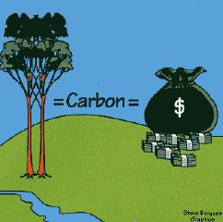
What can philosophy say in Business Ethics? 2/2
shows the issue from another perspective.
(ex. Carbon emission trading)
It can show alternatives:
    Negative sides on “Maximization of the utility of the greatest number” (IPhone & radiations): what about the minority? What if the majority is wrong? (Nazism); and if the the majority destroys the environment? (something that we all need).
    Ex. In business the “maximization of profits” is not the only viable solution. (ex. Deontological approach).
corinna.casi@helsinki.fi
16

Slide 17


Why discussion in business ethics is necessary?
Because we deal, directly or indirectly, with
“what is other from you”, which can be:
people (colleagues, competitors, clients, etc) and we cannot treat people as mere lifeless objects.
or environment (and it turns to influence humans)
In business it is the “silent stakeholder”
corinna.casi@helsinki.fi
17

Slide 18

“Man is by nature a political animal” Aristotle
Individuals are socially embedded beings.
moral behavior takes place within a social context.
“Ethics is the responsibility for the other person” E. Levinas (1906 – 1995)
Ethical theory is connected to actions.
corinna.casi@helsinki.fi
18

Slide 19


Being the other
(other as people)
“Treat yourself and others as an end in themselves and not as a mere means”. (I. Kant)
Tomorrow you can be “that other”, whom you are dealing with today.
    (Ex. A company discharges toxic pollutants into the local river and it can cause skin cancer in humans. Several years later the grandchild of one of the decision-making stakeholders died of skin cancer because he went swimming several times in the sea where that river flows to.)
corinna.casi@helsinki.fi
19

Slide 20

Being the other
(other as environment)
Da-sein is the subject which is in the world.
(M. Heidegger, 1889 – 1976)
we have to take care of the surrounding world if we want to survive.
As for Environmental Pragmatism and Environmental Psychology,
Humans and the environment are interconnected
corinna.casi@helsinki.fi
20

Slide 21

Being the other
(other as environment)
Dilemma of human-environment interaction: a double bind:
(J.W. Bennett )
Thanks to technology we can easier making use of natural resources: humans are more free than before.
On the other hand we are more dependent on nature. In this sense our freedom decreases and it is noticeably bound to nature.
therefore spoiling nature, we spoil ourselves.
corinna.casi@helsinki.fi
21

Slide 22

Ethical businesses
Certified B Corporations are a new type of corporations group which uses the power of business to solve social and environmental problems. They include:
  fair trade
  organic and healthy baby food;
  eco-friendly clothing and footwears;
  Construction of sustainable buildings;
  Green energy solutions;
  Designing and installing rain harvesting systems for indoor and outdoor use is a growing industry;
  legal counselling for sustainable companies.
corinna.casi@helsinki.fi
22

Slide 23

What ethics should NOT be in business:
One of the main critiques on BE is that they are a set of instructions and procedures to be followed by ethics officers.
is not about FIXED READY-MADE ANSWERS because the law prescribes them (like fill in the blank with ready-made answers) .
or an attempt to make things look a lot better than they actually are
it is not about changing normal
business practices overnight.
corinna.casi@helsinki.fi
23

Slide 24
Conclusions:
Ethics can be taught through theory and practice
(Virtue is essential to become an ethical being - Socrates)
“Can you tell me, Socrates, how virtue is acquired […]?”
The answer seems to be this: “Virtue is acquired by teaching and by practice, assuming an honest desire by all parties to seek moral insight.”
(the Meno, Plato's dialogue)
BE is not only about providing contents to be learned (theory) but also case studies and examples where critical inquires will lead to the habit and then to the practice that provide moral insight.
(Kenneth E. Goodpaster)
corinna.casi@helsinki.fi
24

Slide 25

Ethics in business should be about:
2) acquiring a moral attitude in what you are doing;
being concerned about the other and respect it.
accept the existence of diversity and alterity in ethics as in life. To be an individual in a society is not only to have merely a selfish first person perspective (what is good for me or what is wrong in my opinion) but it is also to occupy a third person perspective (the one of the other)
- inseparable viewpoints (ex. Bhopal)
corinna.casi@helsinki.fi
25

Slide 26

Questions or comments?
corinna.casi@helsinki.fi
26

Slide 27
Bibliography
Arendt Hannah, The Human Condition, Chicago: The University of Chicago Press, 1958.
Aristotle, Nicomachean Ethics, translated H. Rackham Cambridge, Mass.: Harvard University Press, 1934.
Barry Clarke, Paul and Linzey, Andrew [edited by], Dictionary of Ethics, Theology and Society, London and New York: Routledge, 1996.
Bennett, J.W., Human Ecology as Human Behavior, New Brunswick, NJ: Transaction Publishers, 1993.
Bentham Jeremy, An introduction to the principles of morals and legislation, an authoritative edition by J. H. Burns and H. L. A. Hart, with a new introduction by F. Rosen, Oxford: Clarendon Press, 1996.
Bhotal disaster: http://www.bhopal.com/
The four styles model: http://www.tracomcorp.com/training-products/model/style-descriptions.html
Goodpaster Kenneth E., ‘Teaching and Learning Ethics by the Case Method’ in The Blackwell Guide to Business Ethics, edited by Norman E. Bowie, Oxford: Blackwell, 2002.
Heidegger Martin, Being and time [Sein und Zeit], translated by John Macquarrie & Edward Robinson, Oxford: Blackwell, 1978.
Jones C., Parker M. et al., For Business Ethics: A Critical Text, London: Routledge, 2005.
Kant Immanuel, Critique of Practical Reason (Kritik der praktischen Vernunft, 1788), translated and edited by Mary Gregor, Cambridge: Cambridge University Press, 1997.
Levinas Emmanuel, Totality and Inﬁnity, Pittsburgh: Duquesne University Press, 1969.
Nussbaum Martha C., Creating capabilities: the human development approach Cambridge, Mass.: The Belknap Press of Harvard University Press, 2011.
Plato, Meno, edited with translation and notes by R. W. Sharples, Warminster: Aris & Phillips, 1985.
Werhane, P. and R.E. Freeman, Blackwell Encyclopedic Dictionary of Business Ethics, Malden, MA: Blackwel, eds. 1997.
corinna.casi@helsinki.fi
27

