Slide 1
Team rules, roles and values
Metropolia ADP course
Sept 9, 2010
Esa Eerola
esa.m.eerola@nokia.com
esa.m.eerola@gmail.com

Slide 2
Contents
How do I give and receive information
  Johari Window
How do I behave in a team environment
  Belbin Team Roles
How to make decisions in tough situations
  Team values

Slide 3
Johari window
Cognitive psychological tool created by Joseph Luft and Harry Ingham in 1955
A widely used model describing the process of human interaction
A simple yet useful tool for illustrating and improving self-awareness, and mutual understanding between individuals within a group

Slide 4
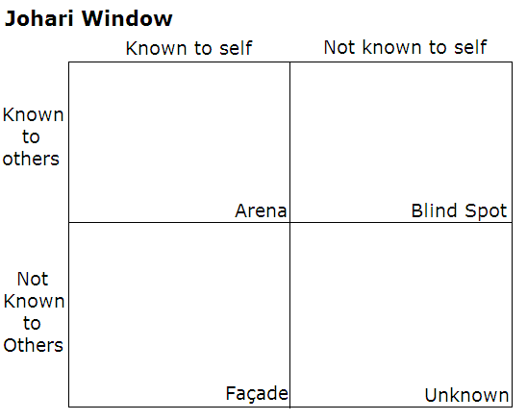

Slide 5
Contents
How do I give and receive information
  Johari Window
How do I behave in a team environment
  Belbin Team Roles
How to make decisions in tough situations
  Team values

Slide 6
Belbin Team Roles
Dr. Meredith Belbin observed that people in teams tend to assume different team roles
Individuals seem to display different team roles to varying degrees

Slide 7
Belbin Team Roles
Belbin identified nine team roles and categorized them into three groups: Action Oriented, People Oriented, and Thought Oriented.
Each team role is associated with typical behavioral and interpersonal strengths.
By understanding your role, you can develop your strengths and manage your weaknesses as a team member, and so improve how you contribute to the team.

Slide 8
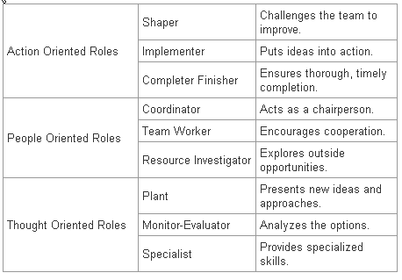
Team role descriptions:

Slide 9
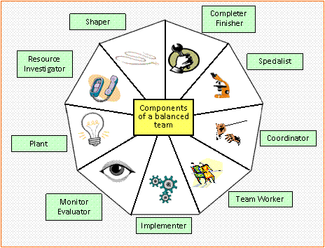

Slide 10
Contents
How do I give and receive information
  Johari Window
How do I behave in a team environment
  Belbin Team Roles
How to make decisions in tough situation
  Team values

Slide 11
Team values
“ the bedrock upon which a high performance culture is driven”
A philosophy describing the ideals the team aspires to fulfill and live up to
Values help in making decisions in tough situations: right or wrong, good or bad, etc
Often, teams (and companies) state their values in public

Slide 12
Examples of values
Reuters
  Passion
  People
  Performance
Virgin
  Value
  Quality
  Innovation
  Fun
  Competitive
  Challenge
Porsche
  Technical
  Human
  Performance
  Perspective
  Environmental
McLaren
  Commitment
  Quality
  Excellence
Source:
http://www.winningteams.co.uk/Team-Values.html

Slide 13
Core values of your team?
Generate some (four or so) most valued words that the team can reach agreement on and become energized by.
Example of creating team values:

Slide 14
Rules…
Everyone participates
Everyone works hard
Everyone has & adds value
Everyone learns
Everyone enjoys
Everyone has fun
Everyone supports each other

