Slide 1
Project Pakistan
Utilizing ”normal” phones for social uplift of people indeveloping contries

Slide 2
Team members:
Anna Lopatenko: Programming
Santeri Sillanpää: Market Research
Teemu Levander: UI design
Antti Mäki-Opas: Sales pitch
Charles Beausse: Project Management
Jukka Rippinen: User experience, design
Tobi Deckert: Project Management, Design

Slide 3
Progress report 9.8.10:
Team members
Roles of the team members
Communication & Contact list
Brainstorming about the Pakistan idea
Development of two main ideas
Wiki page launched

Slide 4
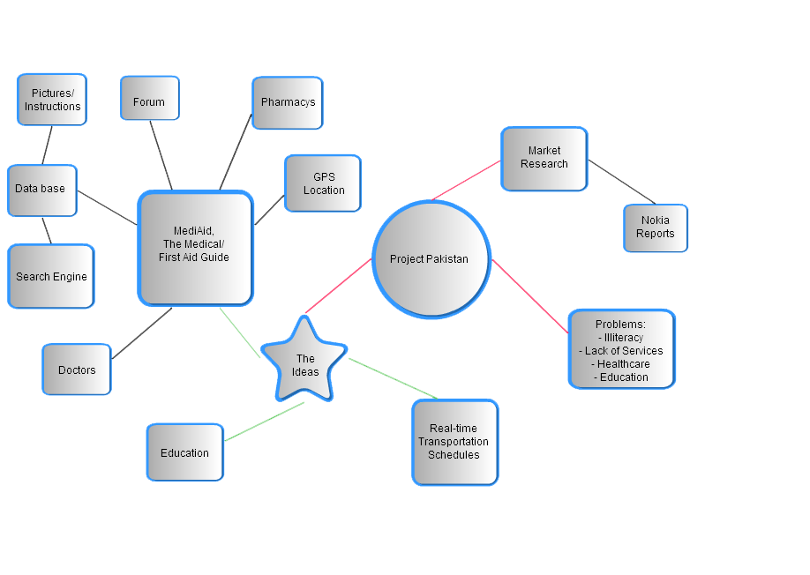

Slide 5
Target: (till December)
→ 2 mobile phone applications (Prototype) ready to launch/test
Future Target:
→ Commercialization of the applications in the rest of the world

Slide 6
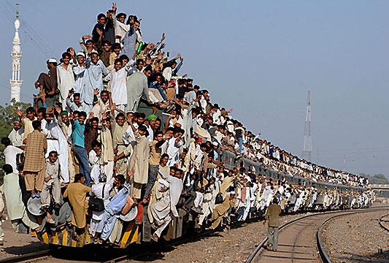
Applications:
“MobiAid”
Real time update for Transportation
(Education application for self studies)

Slide 7
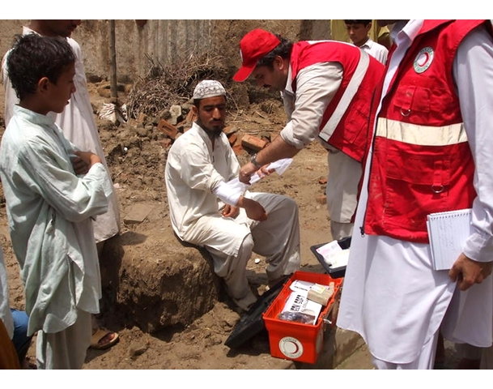
“MobiAid”
Customer(s) problem:
need for healthcare
not enough doctors
rural areas?
bad service and supply for medicals?
Our solution:
Medical library
Forum
Money comes from:
Advertisement (Medicine companies), Health organisations, Government, Companies/Network providers (→ improving their image)

Slide 8
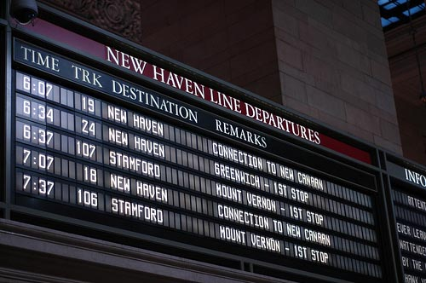
Real time update for Transportation
Customer(s) problem:
No real time Schedule
Our solution:
Real time update (GPS-based)
Money comes from:
Transportation companies (if private)
National Transportation (state funded)

Slide 9
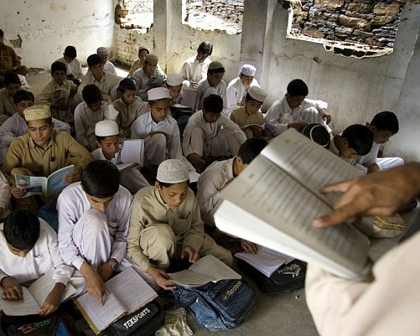
Education application for self studies
Customer(s) problem:
bad education opportunities
(→ high illiteracy rate)
Our solution:
Education application for self studies
Money comes from:
Private investors
Government
foundations

Slide 10
Plans for next week:
Research in the web about Pakistan
Research about competitors

Slide 11
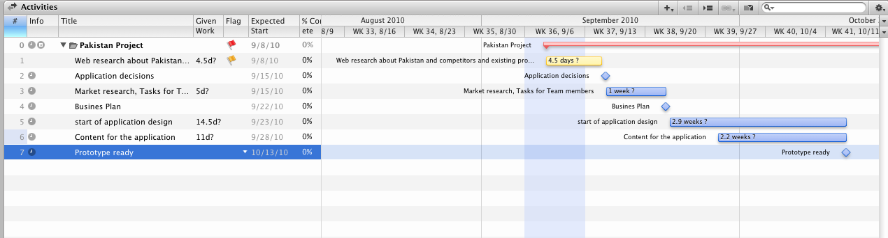
Milestones:

