Slide 1

target audience.
investors.

Slide 2

Sales pitch
Ruben Zoeteweij,
Jong-Hwa Park,
Elisa Wirkkala,
Juha Halme

Slide 3


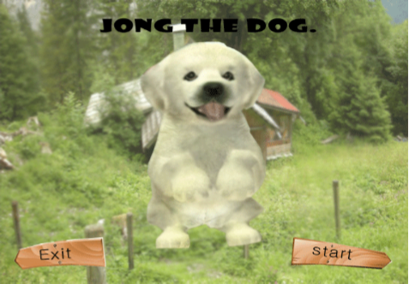

  Imagine how boring it is to wait a bus if you can't see
  Solution: games for visually impaired
    Jong the Dog

Slide 4
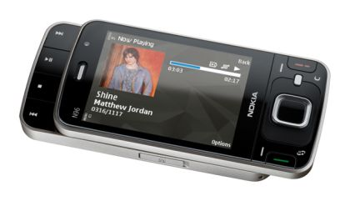
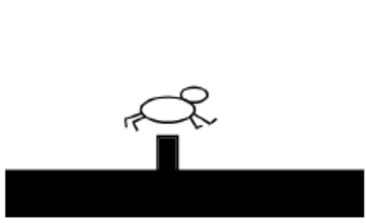
Introduce Jong the dog.
Nokia Series 60 5th version
and above
Developed for Flash Lite 3.0 (ActionScript 2.0)
High contrasting colors

Slide 5
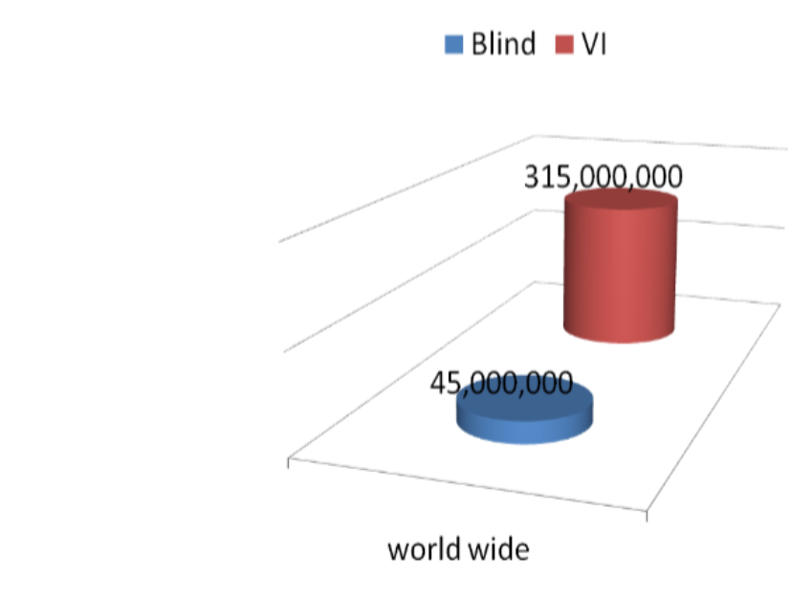
315 Million potential customers !
  Big and growing target group
    Worldwide
      Blind: 45,000,000
      VI: 315,000,000
“I have just one question, when is it coming to the market?"

Slide 6

Make profit:
  No competitors
  Ovi-Store
    Limited edition: free
    Full version: 3,99 €
And also support VI:
  Give more fun
  Teach VI people to use the mobile phone

Slide 7
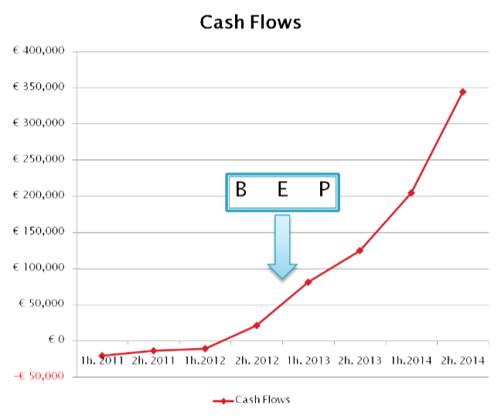
Financials
After four years..
  20 games
  250,000 players
Net Present Value
  € 478K
  Amount of money needed:
  € 53K
ne

Slide 8
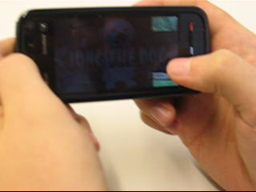
Present demo of Jong the dog

Slide 9
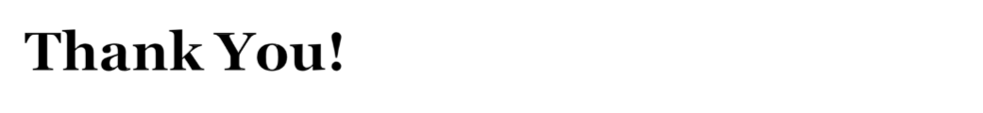
Time for questions

