Slide 1


Final steering group
Application Development Project
What we did and what we learned
Our Difficulties and solved problems

Slide 2
Brainstorming & Team
Gathering a lot of ideas to select the best ones
Behavior in multi cultural team
Present our ideas and give feedback to other teams
over all innovation because of the start from scratch
giving and getting feedback
Lack of Time in the beginning
Lack of knowledge about Pakistan and the market
Maybe the team was too big in the beginning
Skills of each team member
Files sharing and way of communication

Slide 3
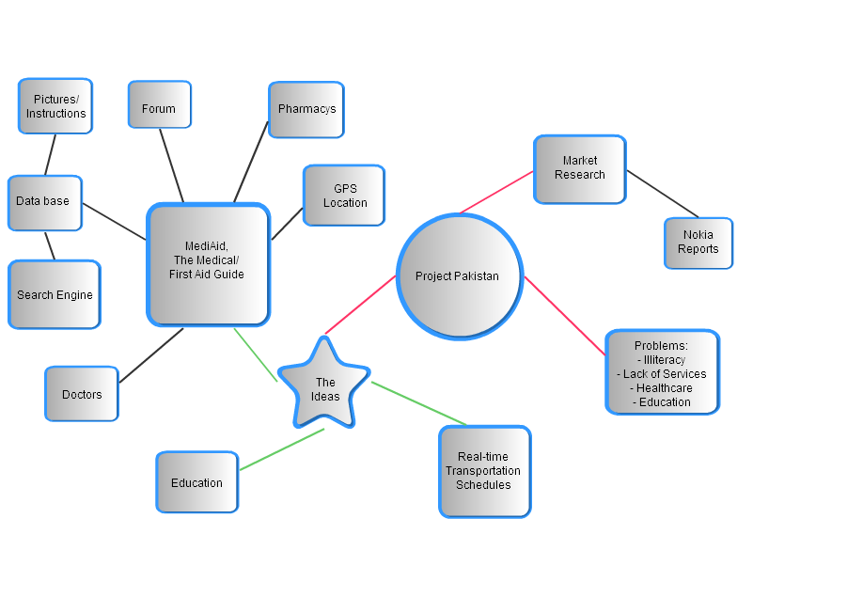
Mindmap with focus on 2 main ideas
Tough Team discussions
first decisions
Filling the first ideas with content
First consultation with Pakistani people
Importance of the feedback of the teachers
do the right decisions
convince and motivate team mates who have not the same opinion

Slide 4

Split up into MobiFun and MobiHealth
more effective team work in smaller groups
role of the different team members
way of communicating fixed
wiki page setup
finding the name
problems with the splitting up of the teams
still a lack of programming resources
our single coder
lack of information about the knowledge of the different team members

Slide 5

Market research
gathering lots of useful information about unknown markets
first information about our target user & customer
finding competitors
looking for first potential investors
real phone calls with business men
reliability of the information or just exaggerated marketing
lack of Pakistani contacts
distance between us and the market

Slide 6
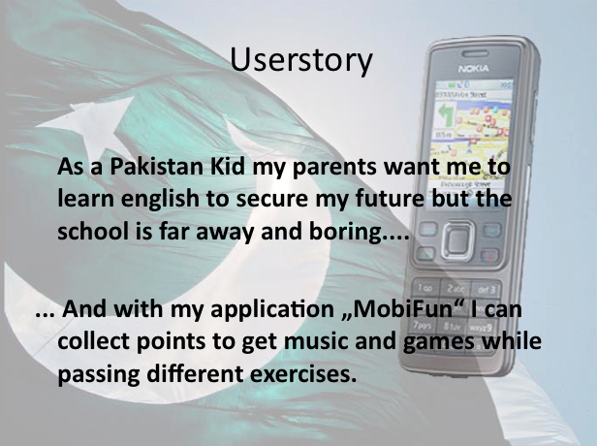
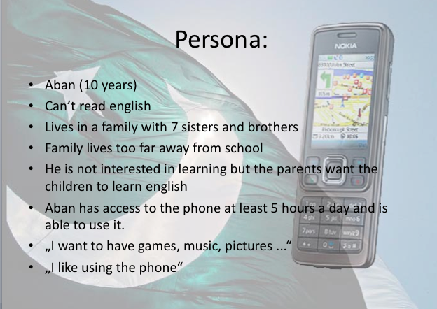
User story
1st time of creating a user story
Seeing it changing while the time goes on
The effect of the Pakistani culture influencing our persona
the role of females in Pakistan
getting enough information about our persona

Slide 7
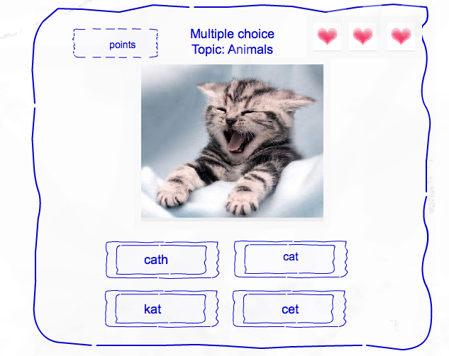
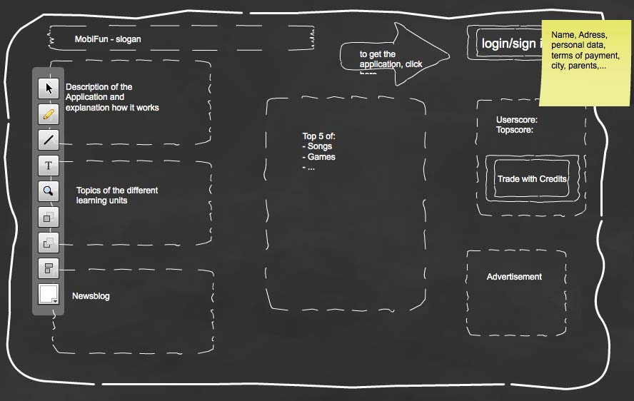
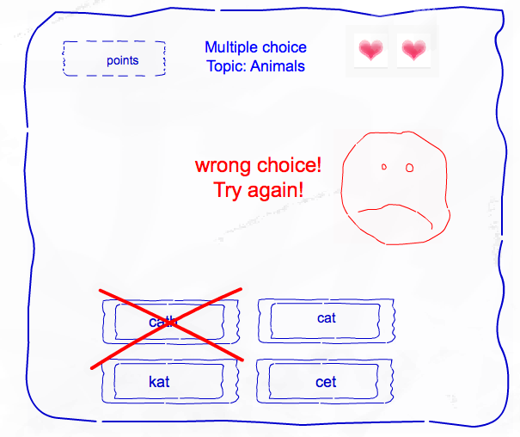
The Mock up
What a Mock up is and what it is used for
Make it easy understandable and convincing
powerpoint slides as a simulation
No professional software
Make it reliable and understandable
Select the diferents features for the app

Slide 8
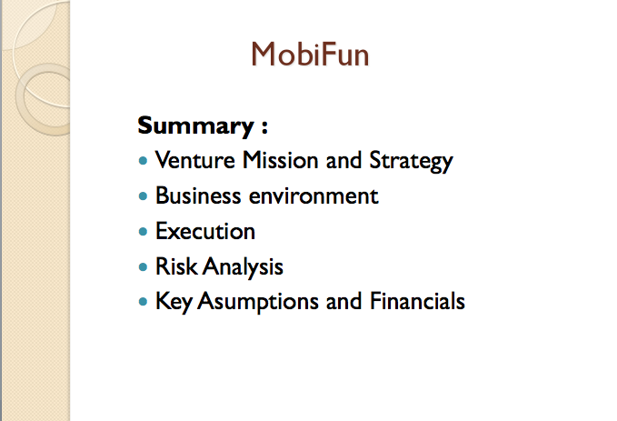
1st row version of the business plan
Content of a business plan (Mission, Strategic intent, Earnings logic, business environment, competition, risk analysis, key assumptions and financials)
divided in 3 parts
update all parts if just one has changed

Slide 9
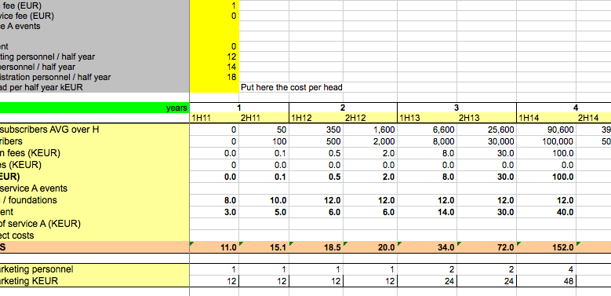
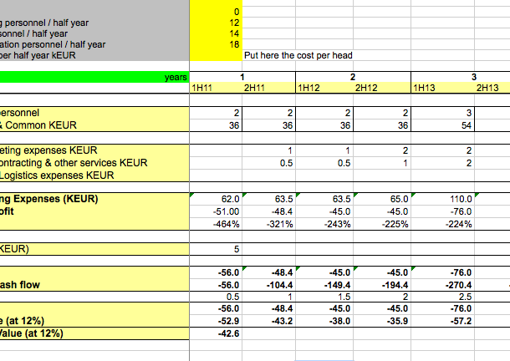
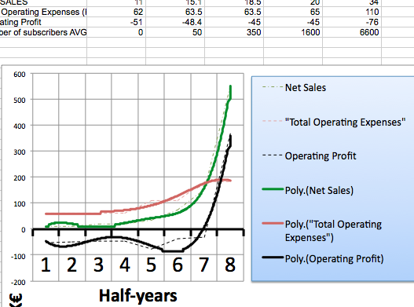
Financial Template
how to manage with the file
the figure net present value
updated after changes and new information
handling with excel in general
try to make real assumptions about the income and outcome
useful for the sales pitch
make it fit for the different business models we had
figure out the right assumptions
make it clear and visible
make it look realistic and convincing

Slide 10
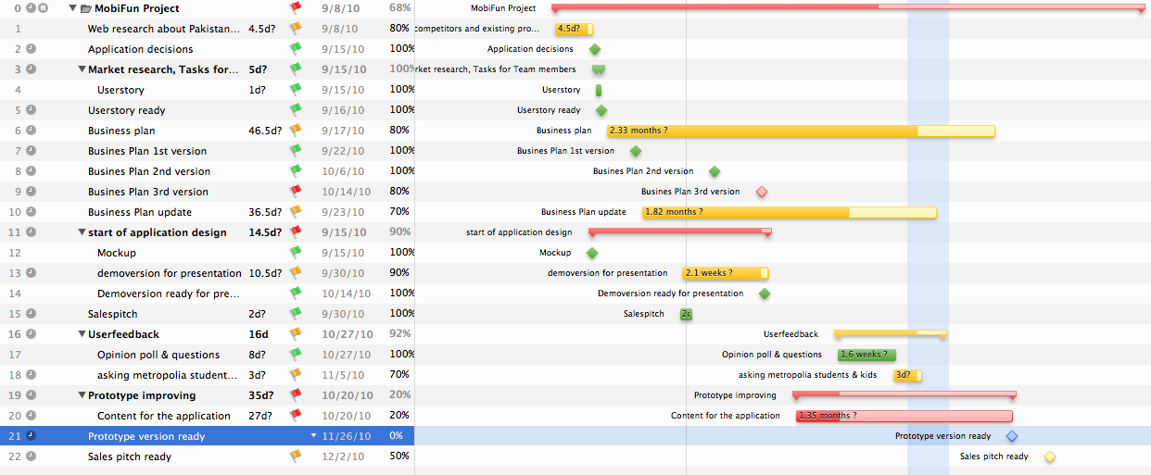
Project plan
learning how to work with project management tools
gives a good overview about deadlines and general progress
made the team work more effective
getting all the information about all team members for the update

Slide 11
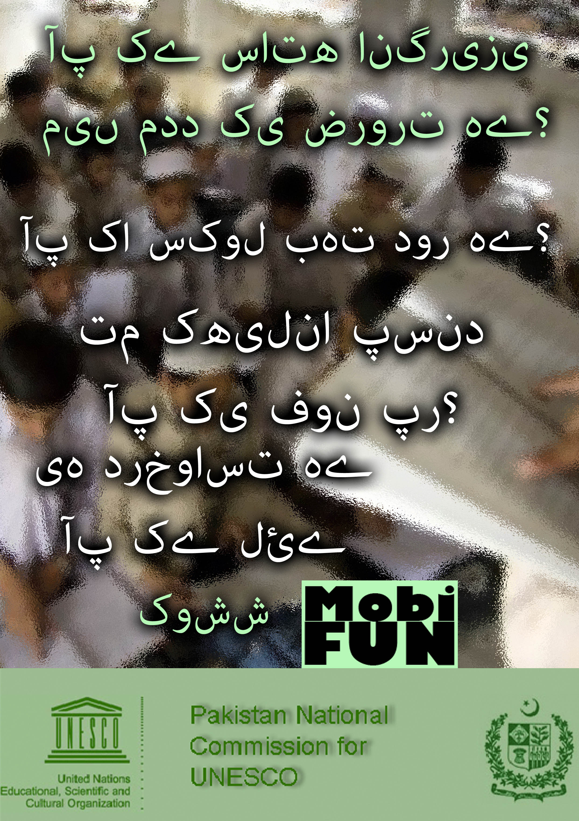

Marketing plan
making the perfect marketing mix fitting to our project (out of place, price, product and promotion)
Flyer & Poster design
10% of our budget and we want to provide the application for free
selecting appropriate information for the flyer

Slide 12
Developing the application.
Developed in relation to the project definition.
- Demo & wire frame
- Improvement on demo: Adding more content
- Testing
- Final version
- Trying to outsource
Difficulties:
- Challenges in implementing some features: e.g. Randomizing.
  - `Unreliable´ outsourcing or collaboration.
  to develop it like the mock-up
  make it fluent and lively

Slide 13
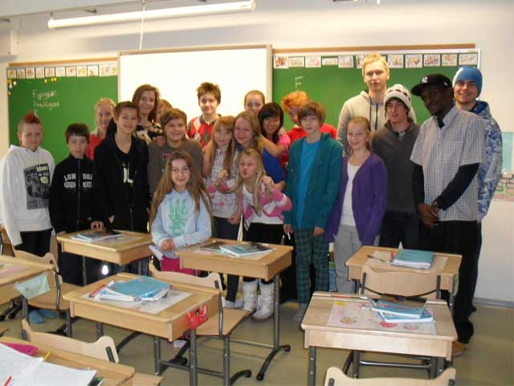
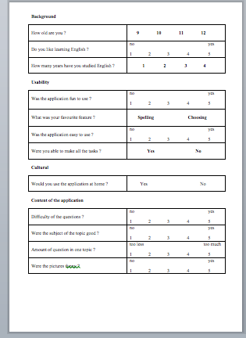
Userfeedback & Contacts
Contacting real persons in business and meetings with them
Gather experience with the handling of the questionnaires
Finding appropriate questions for the kids
Get in touch with contact in general (Babbel & schools)
Delay in getting response
being taken for real

Slide 14
Sales pitch
understanding the meaning of a sales pitch
selecting the right information
devided into 4 equal parts
filming sessions
staying in the timeframe with all the necessary information
being convincible to get investors for a nonprofit project

Slide 15
The Project in general
preparing for the meeting every week (steering group presentation)
progress report
weekly updates (wiki page, plans,…)
Good experiences working together
Professional presentations useful
The future of the application?
different expectations and tasks from Greg and the teachers
public access of Wiki
See the schedule in advance

Slide 16
Thank you !

