Slide 1


LoudDemo
Business plan
Mesfin
Kalle
Artem
Rémy
25/11/2010

Slide 2


Summary
1.
2.
3.
4.
5.
6.
7.
8.
9.
10.
Customer problem
Our solution
The advantages
Strategic intent
Marketing plan
- Market research
- How we reach the customers ?
- Price strategy
- Sales strategy
- Service strategy
11.
12.
13.
14.
Financial plan
- Financial
- Graph
Risks analyse

Slide 3
Customer Problem
Cd’s
Bands send Demo
Record
Labels
E-mail
Only minority of the
demos are actually
matching the interests
of record labels
…
Record labels use lot of time
dealing with incoming demos
25/11/2010
1

Slide 4
Our Solution
Band
SendDemo
Database
Receive demo
Record label
Create an Environment ALL in ONE.
25/11/2010
2

Slide 5
The advantages
The amount of uninteresting received demos by record label decreases
Demos are matching the criteria/filters of record labels
The service gives value both for record labels and bands/artists.
Bands can send demos only to record labels which are potentially
interested of producing their music
Record labels does not need to store the demos physically (cd's)
25/11/2010
3

Slide 6
Strategic intent
➔Be the first company to sell it’s kind of tool in Finland.
➔We want to record label save money but also create a value,
so we can make money with our tool.
➔We want to help new band to get to be known.
25/11/2010
4

Slide 7
Marketing plan
25/11/2010
5

Slide 8
Market Research
    ➔No direct competitor
➔200 Record Labels in Finland
➔8000 Record Labels in Europe
➔Thousands of Bands & Artists
25/11/2010
6

Slide 9






How we reach customers?
➔Direct Visiting to customers
Venues
Music fairs
➔Promotion
25/11/2010
7

Slide 10
Price Strategy
Free Service for Bands/Artists
Monthly fee of 50€ for Record Labels
25/11/2010
8

Slide 11
Sales strategy
➔Available huge data of Bands/Artists
➔ Offer Trial Service
25/11/2010
9

Slide 12
Service Strategy
Efficient and Easy Service
Free services
Customer is our king!
25/11/2010
10

Slide 13
Financial plan
25/11/2010
11

Slide 14
Financial
Net Present value (at 12%): 2.359.000 €
Break-even-point: 1,75 years
25/11/2010
12

Slide 15
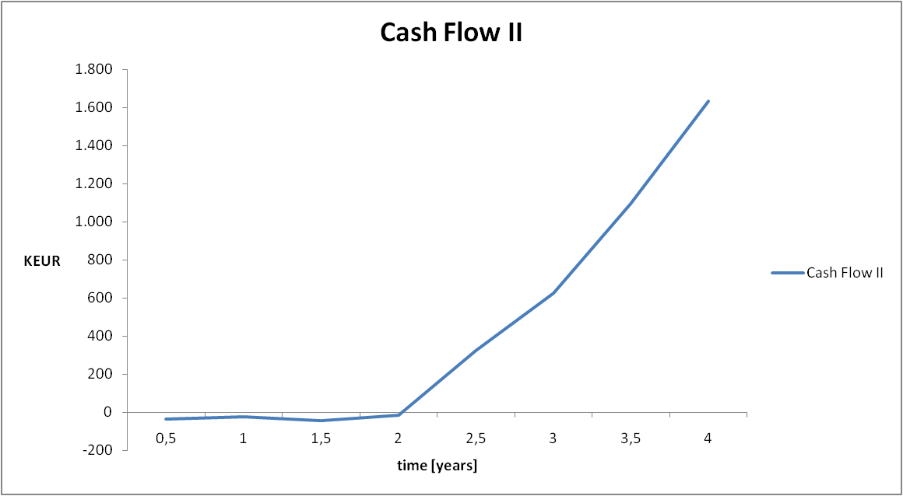
Graph
25/11/2010
13

Slide 16
Risks analyses
Risks
Actions
Market : Sales fail
Create better marketing
Modify the application based on given feedback.
Technology : Users Overflow
Monitor application activity
Competence : lack of technical skills and
business
Ask help to professional / teacher
Learn more about our need
25/11/2010
14

