Slide 1


LoudDemo
Business plan
Mesfin
Kalle
Artem
Rémy
23/09/2010

Slide 2


Summary
Mission and Strategy
Business environment
Execution
Marketing Plan
Key Asumptions and Financials
Risk Analysis

Slide 3
Our mission
Costumer problem :
Record companies use a lot of time :
➔ To go throw incoming sound samples from bands
➔ Answering to phone calls/emails.
€€ Money €€
Band Have to wait lot of time before having answer
Are not sure to be listened

Slide 4
Strategic intent
We want to be the first company to sell it’s kind of tool in Finland.
We want to record label save money but also create a value,
so we can make money with our tool.
We want to help new band to get to be known.

Slide 5
Product/Service concept
Who pays for what and why ?
Record label
By using our service, the sound samples/emails are received only from the bands,
which fits the certain criteria
Criteria are defined as "filters" in our service.
Record labels can choose the filters from our service.
The amount of phone calls/emails to record labels is also reduced.
Making money
Create value
Saving time
Saving money

Slide 6
Market Research
Market size:
Finland:
– ca. 200 Record Labels
- ca. 1000 Artist/ Bands
Europe:
– ca. 8000 Record Labels
- ca. 10000 Artist/Bands

Slide 7
Market Research
Findings:
No direct competitors
Survey:
basic information of handling in record labels
Interview:
Gained information of medium size record label, specially about the filter

Slide 8
Market Research
Significance:
Seems to be that our service might not have much value for medium sized record label
Medium sized record label companies receive only 1-2 demo/day
Potential Market:
In Finland about 30 % of 200 RecordLabels
In Europe about 40 % of 8000 RecordLabels

Slide 9
Offering to customers
Introduce the service by visiting:
the customers
venues
music fairs

Slide 10
Price Strategy
Free Service for Bands/Artists
Monthly fee of 50€ for Record Labels

Slide 11
Sales strategy
to allure Record Labels with a huge offer of Bands & Artists
➔ Testversion: first 4 weeks free!!!

Slide 12
Financial
Net Present value (at 12%): 2.359.000 €
Break-even-point: 2,5 years

Slide 13
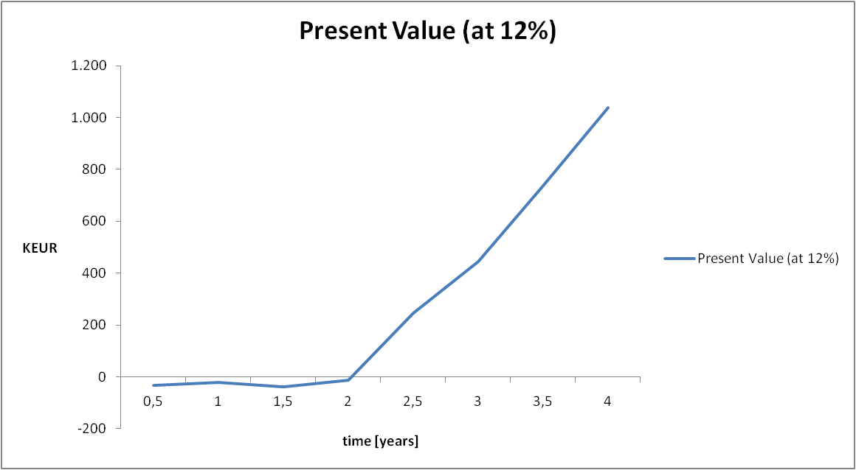
Graph

Slide 14








Promotion
Promotion services using
    Social Medias
    Record Label company web sites
    Band web sites
    Concerts

Slide 15
Risks analyse
Risks
Actions
Market : Sales fail
Create better marketing
Modify the application based on given feedback.
Technology : Users Overflow
Monitor application activity
Competence : lack of technical skills and
business
Ask help to professional / teacher
Learn more about our need

