Slide 1
Marketing Mix - Promotion

Slide 2

MySpace Adds
Different models of adds

Slide 3
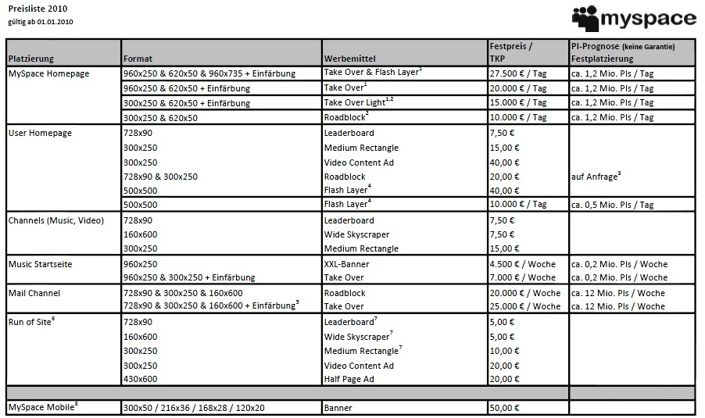

Slide 4
Cost per impression
Def.:
It is used for measuring the worth and cost of a specific e-marketing campaign. This technique is applied with web banners, text links, email, and opt-in e-mail advertising, although opt-in e-mail advertising is more commonly charged on a cost per action (CPA) basis although sometimes CPM is used.
In our case TKP means: Price per thousand banners

Slide 5

USER HOMEPAGE

Slide 6
Channels

Slide 7

Run of Site

Slide 8
Run of Site

Slide 9

Being on the first page of the Google results
If your ad appears on Google or the Search Network, the answer depends on each keyword's Quality Score, which is determined by clickthrough rate, relevance to the search query, account history, and other relevance factors.

Slide 10

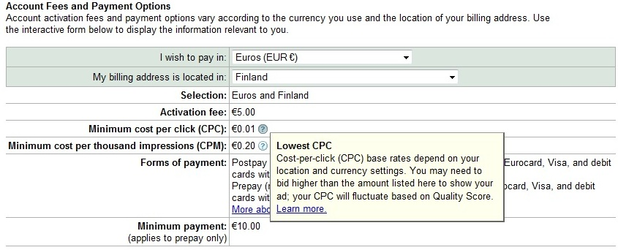
Pricing Google

