Slide 1

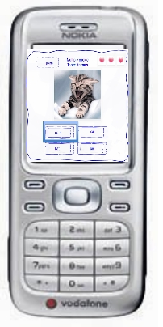
When Learning becomes entertainment.
Charles Beausse
David Kanyari
Teemu Levander
Tobias Deckert

Slide 2

Background
Pakistan : largest number of illiterates
1/3 children have access to education
26 % illteracy rates for girls
Education < 3% of its budget
74% of Pakistan's population < U.S. $ 2 /day.
For a better future English skills

Slide 3
Our solution MobiFun!
English skills for teenagers through Nokia S40 phone
Motivation:
free internet minutes

Slide 4
DEMO

Slide 5
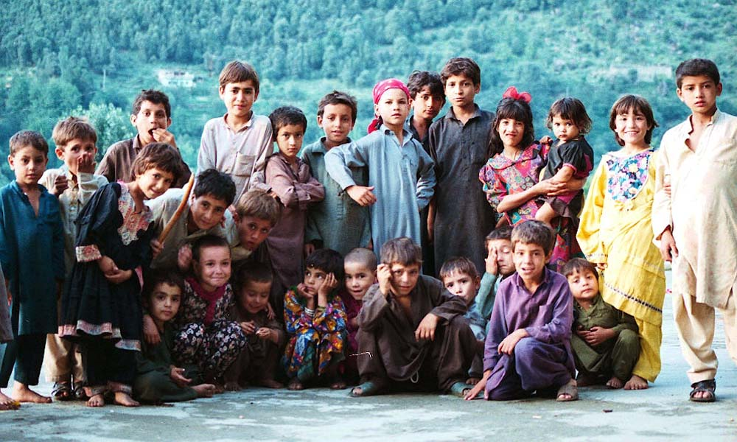
Market Size and Trends
Focus 5-10 years kids.
25 million kids in the target age
91 million mobile phones available

Slide 6
Why us ?
Our user:
Social benefits Real learning effect
Application:
Easy handling & sharing
MobiFun
The market:
1st in Pakistan
Marketing:
Image push of your company

Slide 7
Marketing Mix
  Price
    Free application
    1€ fee when expanding to other markets (US, Europe)
  Promotion
    Website, flyers & posters, events
    Word of Mouth → bluetooth topics sharing

Slide 8
Financials

Slide 9
Thank you for your attention!

Slide 11
User story
As a Pakistan Kid my parents want me to learn english to secure my future but the school is far away and boring....
... And with my application „MobiFun“ I can train myself, going through different exercises.
After successfully passed the levels I win some free minutes of telecommunication or text messages.

