Slide 1

Audience
Investors

Slide 2
LoudDemo
09.12.2010

Slide 3

Our Business Sector
Music Industry

Slide 4
Customer Problem
Cd’s
Bands send Demo
Record
Labels
E-mail
…
Only few of the
demos are actually
matches the interest
of record labels.
Record labels use lots of time
dealing with incoming demos.

Slide 5
Our Solution
Create an Environment ALL in ONE.
Band
SendDemo
Database
Received demo
Record lable

Slide 6
Using our service
Increase the value for both bands and lables
No more unmatched demos are coming
Demos are stored in our database

Slide 7
      Demo
      Band/Artist
      Record Label

Slide 8
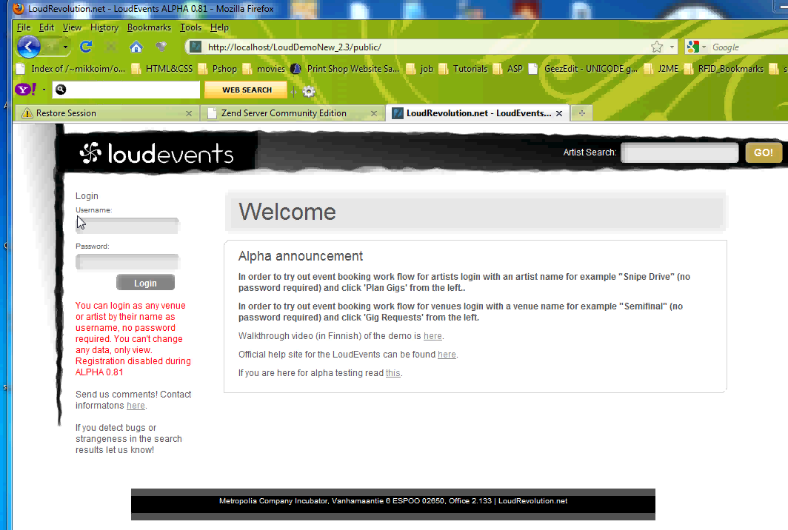
Band/Artist

Slide 9
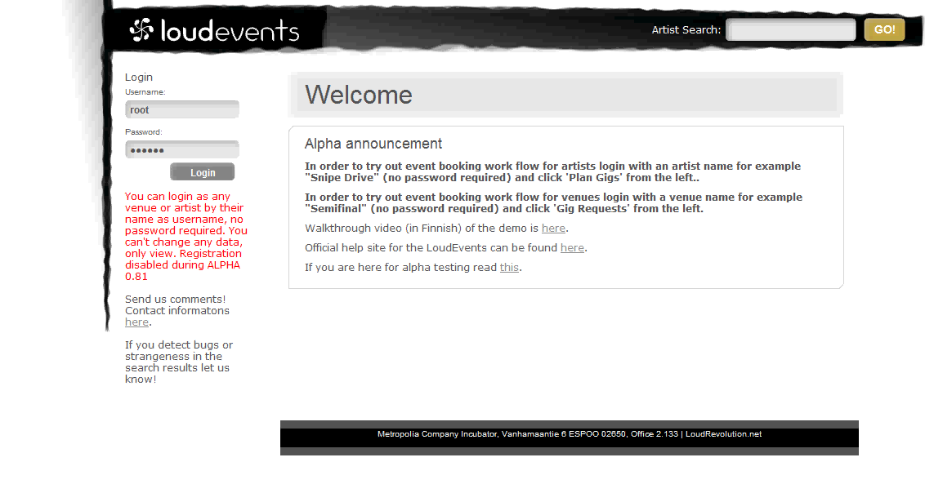
Record Label

Slide 10
Market
Short-term ( 1 year ) ➔ Finland
<>200 Record Lables in Finland
Long -term ( > 1 year ) ➔ Germany, France, UK and Sweden.
<>More than 8,000 Record Labels available

Slide 11
Competitor
    No direct Competitor

Slide 12
Pricing
Free Service for Bands/Artists
Monthly fee of 50€ for Record Labels
➔ Testversion: first 4 weeks free

Slide 13
Investement Opportunity
Company current value = 400,000€
Ready to sell 10% of our share
  ➔40,000€
If you invest on our service you will earn double figures in three years

Slide 14
Summary
Increase the value for both bands and lables
No more unmatched demos are coming
Demos are stored in our database

