Slide 1
Market research
Nutrition supplements
1/11/2010
Iiro Nuutinen
Henri Juutila
Jesse Saharanta

Slide 2
Background
”Hired” by RunToShop
Consultant company for marketing solutions
cooperation companies (Wrange, go4fit.fi and Sportlife)
Idea: Find new and cheap marketing ways, make applications

Slide 3
Main research questions
How to get more customers for the nutrition companies?
Why people don’t use nutritions?
How can we change stereotypes of nutrition supplements?
What are the requirements of customers conserning the products?

Slide 4
Chosen approach to research and sources
Try to find out the customers’ interests and why they buy or not nutritions
Survey(googledocs) via Facebook
Questions about using or not, where from they buy, how often they use
Also fitness expo: What kind of application nutrition companies prefer
Going to do some research in sport teams

Slide 5
Findings
110 answers: men 86%, women 14% of answers
47% of women and 12% of men haven’t used nutrition supplements
People who train in gym are most likely using nutrition supplements
  2nd Ice hockey
  3rd football

Slide 6
Findings
Mostly people use nutrition supplements to improve recovering process after training
    Also gaining mass/muscle mass is one important goal
Protein drinks, recovery drinks, vitamins and creatine are the most used products
People choose product by the price (37%)
  Next is quality of the product (26%)
  Free delivery only 1% !!!

Slide 7
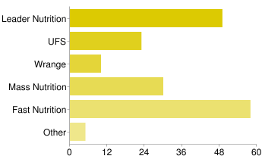
Findings
32% of people order nutrition supplements from a webstore, others buy them from a store
We listed 5 finnish nutrition brands and Wrange was least used brand!!!

Slide 8
Benefits of doing research
Wrange’s product range is too small
    Better to buy all products from one store, right?
Wrange’s store stand in wrong place
We found out that some people are scared of nutrition supplements or they don’t see any needs for use them

Slide 9
Learnings
First market research, so we learned a lot
- Survey, asking the right questions
- Analysing the findings
- Find the best target group for us

