Slide 1

Research of the application

Slide 2
Navigation System for blind
- Loadstone GPS
- Wayfinder Access
- Trekker
- BrailleNote GPS
Currently Researches

Slide 3
Loadstone GPS
-an open source software for satellite navigation for blind and visually impaired users
free and runs currently on many different Nokia devices with the S60 platform
must be connected to the cell phone by Bluetooth.

Slide 4
Wayfinder Access
from the Swedish company Wayfinder Systems AB
work with screen readers like Mobile Speak or Talks from Nuance Communications and text-to-speech technology

Slide 5
Trekker
from HumanWare (previously known as VisuAide, 2003)
a personal digital assistant (PDA) application operating on a Pocket PC

Slide 6
BrailleNote GPS
from Sendero Group, LLC, and Pulse Data International, now called HumanWare, in 2002a personal digital assistant (PDA) application operating on a Pocket PC
- a combination of a personal digital assistant, Map-quest software and a mechanical voice

Slide 7
GPS navigation plan to help blind
From an Italian technology company
: Two keys
A. Tells the user their exact location including the house or building number
B. Call centre that the person needs assistance with navigation
Link : http://news.bbc.co.uk/2/hi/technology/6458005.stm

Slide 8
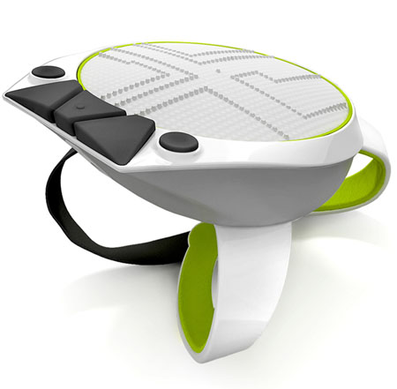
Touch & Go Navigation System
From Natalia Ponomareva (Rusian Designer)
: The Touch & Go is an innovative navigation system that has been designed for the blind people to make them self-directed. The device acts as a wearable navigator comprising a hand gadget along with an earpiece and a tactile display that provides the directions as a map. The device gives direction at 1:1000 scale and remains in the center of the position of the users. An indicating arrow directs the user to move in and supports the user via auditory signals to the earphone, equipped with an ultrasonic transmitter-receiver. Using the device is convenient; it remains tied with the back of the user’s hand with included straps.

Slide 9
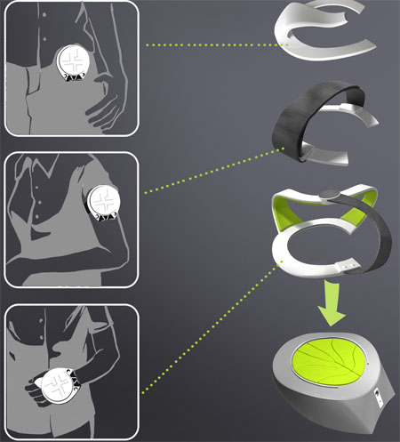
Touch & Go Navigation System
From Natalia Ponomareva (Rusian Designer)

Slide 10
GPS system from Irish firm
From IRISH
: The application uses a phone’s built-in GPS receiver and compass to gauge its location. It then vibrates when the phone is pointed in the correct direction, allowing users to follow a route by touch.
-The tool will let them put it in their breast pocket and follow it quite easily.
-The phones used were provided by O2 and run on Google’s Android system
More : http://www.irishtimes.com/newspaper/finance/2010/0702/1224273791195.html

