Slide 1

Opening data in Higher Education Institution
Tuomas Orama, Jaakko Rannila

Slide 2
Open data
Open data is the idea that certain data should be freely available to everyone to use and republish as they wish, without restrictions from copyright, patents or other mechanisms of control. (source: wikipedia)
Notes:
* Auer, S. R.; Bizer, C.; Kobilarov, G.; Lehmann, J.; Cyganiak, R.; Ives, Z. (2007). "DBpedia: A Nucleus for a Web of Open Data". The Semantic Web. Lecture Notes in Computer Science 4825. p. 722. doi:10.1007/978-3-540-76298-0_52. ISBN 978-3-540-76297-3.

Slide 3
Reasons to open data
Finnish government encourages public sector to open their data for services and new business development, and utilization of information.
Combining with other public data can create new value.
New markets and innovations from and around the data.
Services made by users, user-driven Innovation!
Notes:
Open ecosystem enables people in need of a certain service to start brainstorming,
sketching and creating such a service. This is a great model for developing
services designed to match actual needs. Not only the masses, but small
groups and individual people as well, can create services matching their needs.
On the other hand, it would benefit the provider of open data, if a large number
of people took advantage of the provided data resources.
The responsibility of ideation and the implementation stays in the organisation,
unless the data is open. It is one of the tasks of the actors in the public
administration to produce an overall picture of the most common needs, based
on their data. Special needs, and those of smaller groups, are inevitably ignored
in the process.

Slide 4
Benefits for the organization & end users
New usage for the data
Organizations reputation for opening data to others
Transparency
Democracy
Better services for the users
Notes:
Open ecosystem enables people in need of a certain service to start brainstorming,
sketching and creating such a service. This is a great model for developing
services designed to match actual needs. Not only the masses, but small
groups and individual people as well, can create services matching their needs.
On the other hand, it would benefit the provider of open data, if a large number
of people took advantage of the provided data resources. For example, Amazon,
the Internet bookstore, offers their massive purchase and transaction databases
to programmers to use for free. The programmers can, therefore, utilise actual
databases and get references for their careers, whereas Amazon gets tens of
thousands of programmers to create new, innovative user interfaces for them.
The application promotes the Internet coverage, business transactions and sales
of Amazon.
The responsibility of ideation and the implementation stays in the organisation,
unless the data is open. It is one of the tasks of the actors in the public
administration to produce an overall picture of the most common needs, based
on their data. Special needs, and those of smaller groups, are inevitably ignored
in the process. This happened, for example, in the case of ChicagoCrimes. There
was a clear need for this service but, in all likelihood, it would not have come up
at the meetings held at the police station. Even if someone had come up with the
idea, they probably would have considered crime reporters to be such a minor
group, that the resources of the police would not have been directed to producing
this service.
Taking user-driven product development to the extreme, is when the developers
of the service are the final users of it. For instance, YouTube is said to have
been born out of the users need to share video files (Cloud 2006). Furthermore,
the first Wiki application emerged in 1995 when Ward Cunningham created the
WikiWikiWeb platform for programmers to easily share information related to
the source code with each other. Open public sector data enables people to further
widen and adjust the public services to make them more suitable for them.
For example, Mapumental service visualises both the time spent on commuting
with public transportation and the prizes of apartments in the area. The Mapumental
service was created to meet the needs of people who were looking for
apartments. In Finland, software company Gemilo saw a market niche in companies
wanting to easily track the public competitive biddings in the area.

Slide 5
Benefits for the business
Dispersed development, multiple suppliers
Everyone can create new apps combining schedule info, lecture info, staff info and so on.
Rapid development through multiple independent developers
Competition increases development activity

Slide 6

Architecture

Slide 7
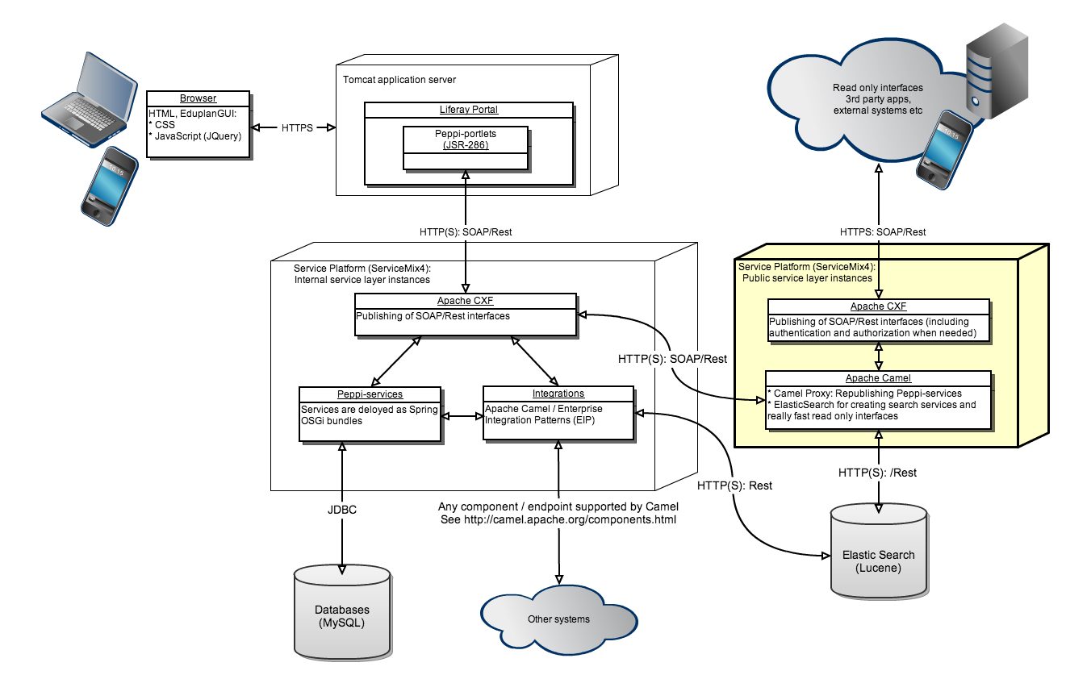
Deployment diagram
Notes:
All core / in-house services and integrations are deployed on the internal service layer
Only trusted internal applications have access to these services directly
No caches, everything is real time
No complex authentication or authorization mechanisms that might be expensive performance-wise
The public service layer is used to republish (proxy) services from the internal service layer to the public Internet and allows us to:
modify the original services: e.g. strip all write methods from the public service interfaces
aggregate services: e.g. providing access to data from a number of internal services as a new simple interface
publish services in a different schema: e.g. for a specific 3rd party integration / data transfer
cache data to minimize load on the internal service layer and databases
authenticate and authorize the users of the services
for identifying users and possibly to provide different interfaces/methods based on authorization
Elastic Search is a flexible and powerful open source search engine base on Apache Lucene
Almost any action can be peformed using a simple RESTful API
perfect for our SOA architecture!
With Elastic Search we create search indexes based on data stored by any number of services
searching is really fast since the search engine index is queried instead of the database(s)
possibility to use facets and other advanced features
Used both by the Internal Service Layer and Public Service Layer
can be used to create extremely fast read only interfaces for open data!

Slide 8
Opening data in Helsinki Metropolia University of Applied Sciences - case examples

Slide 9
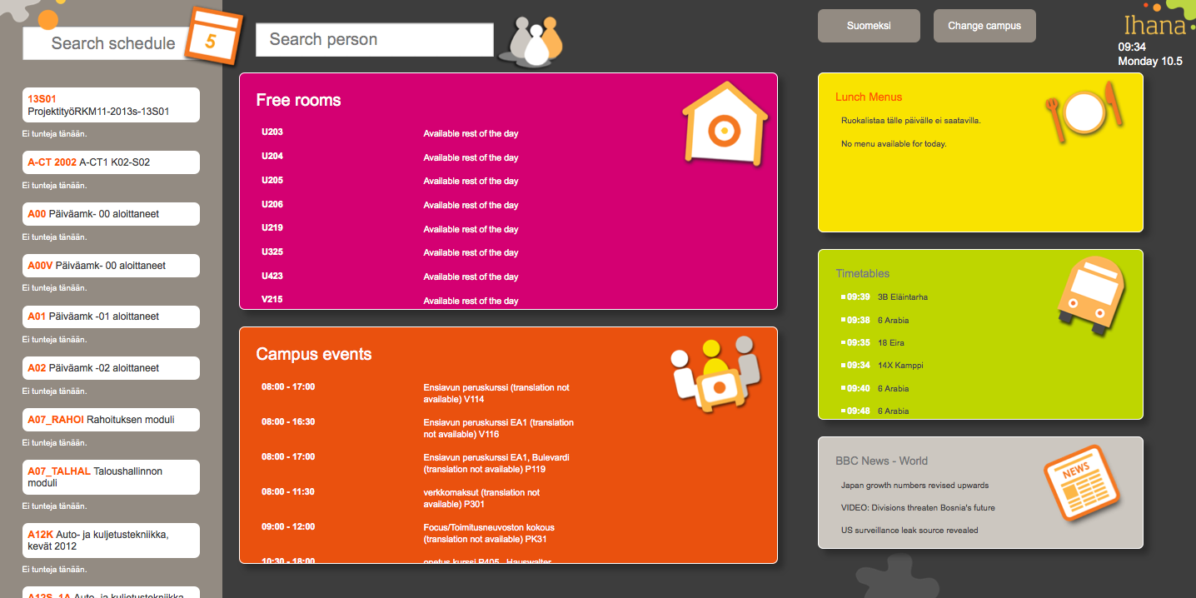
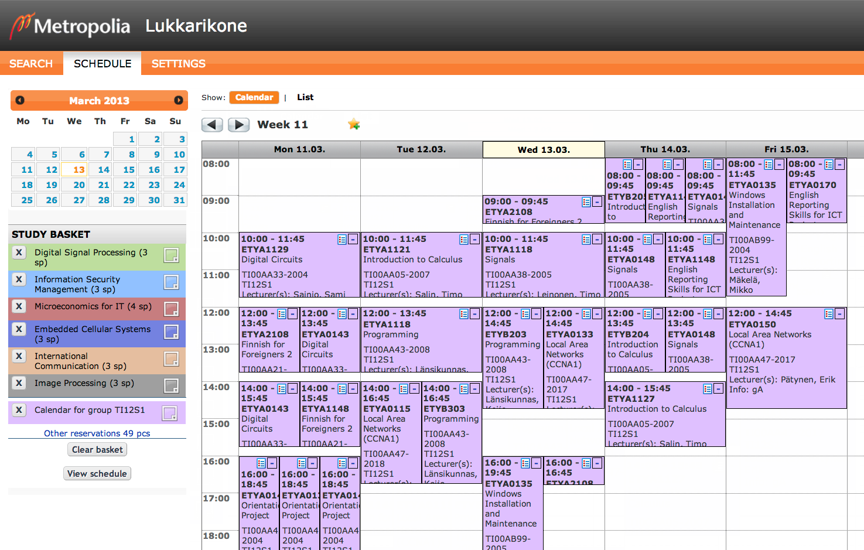

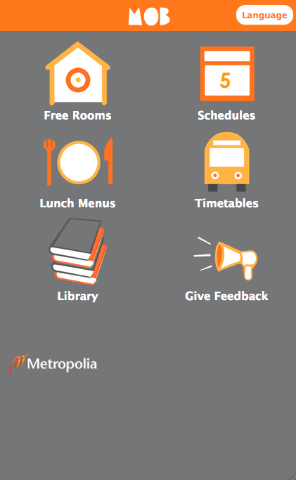
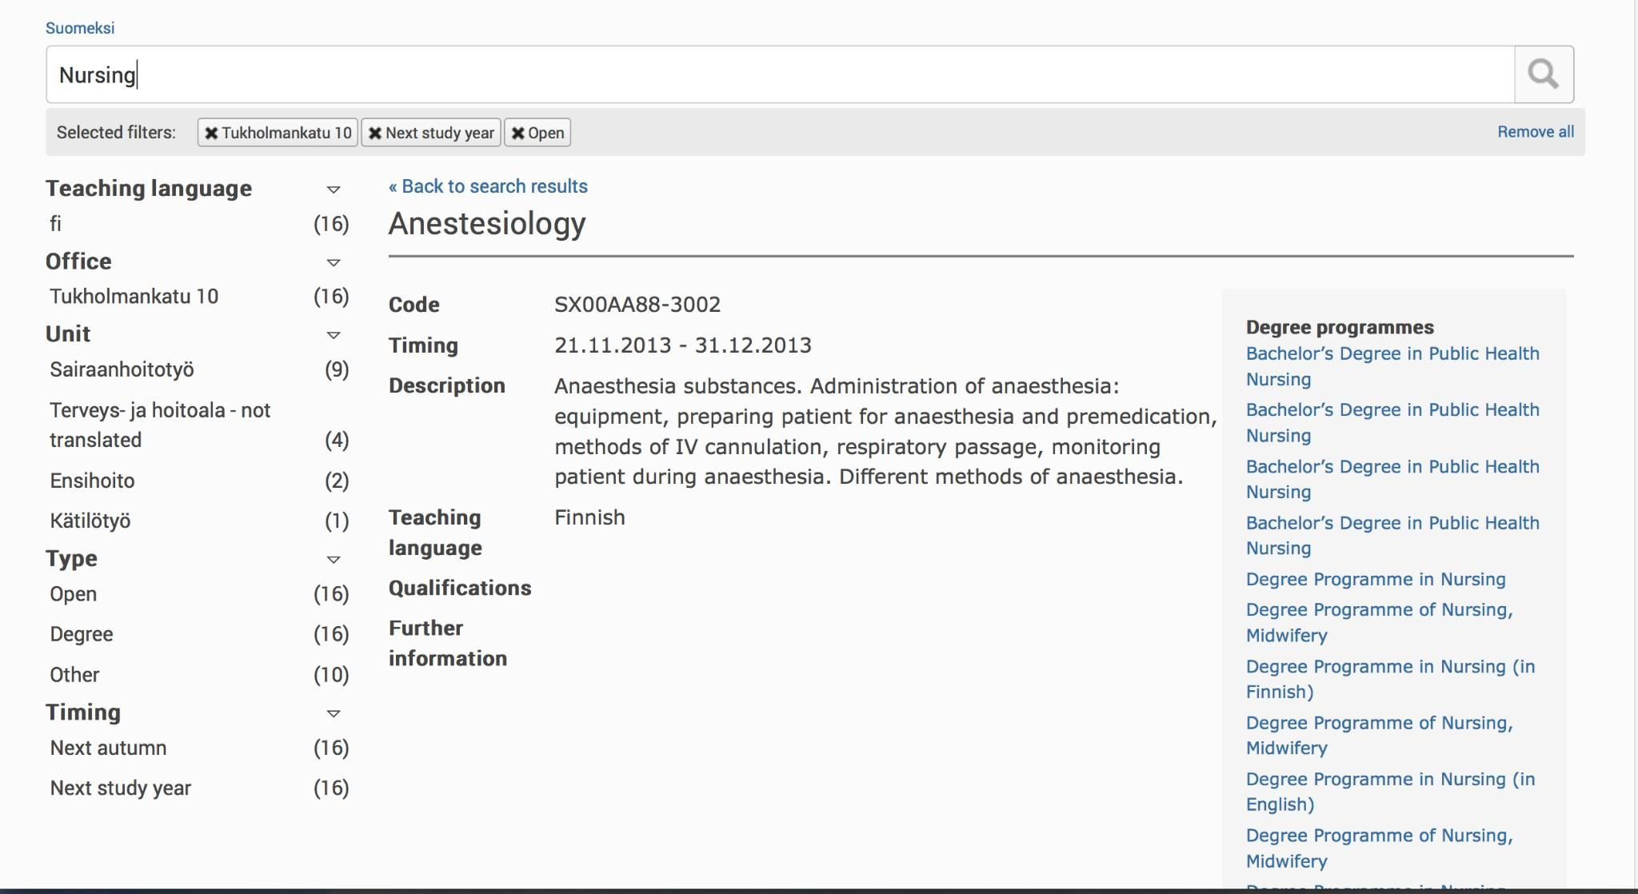
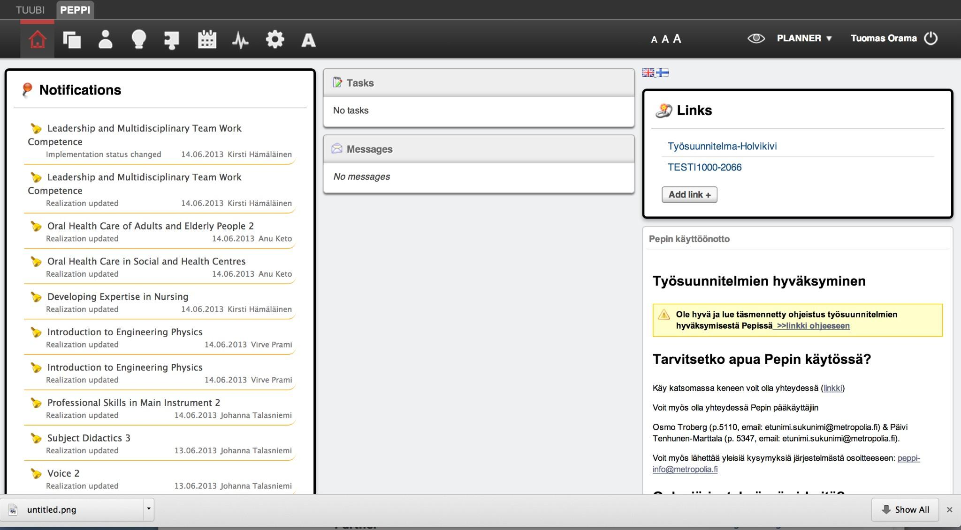
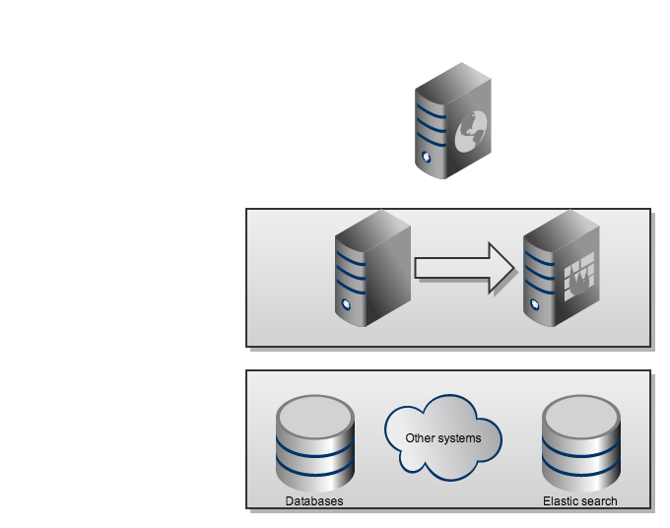
Case examples
Services
Datasources

Slide 10
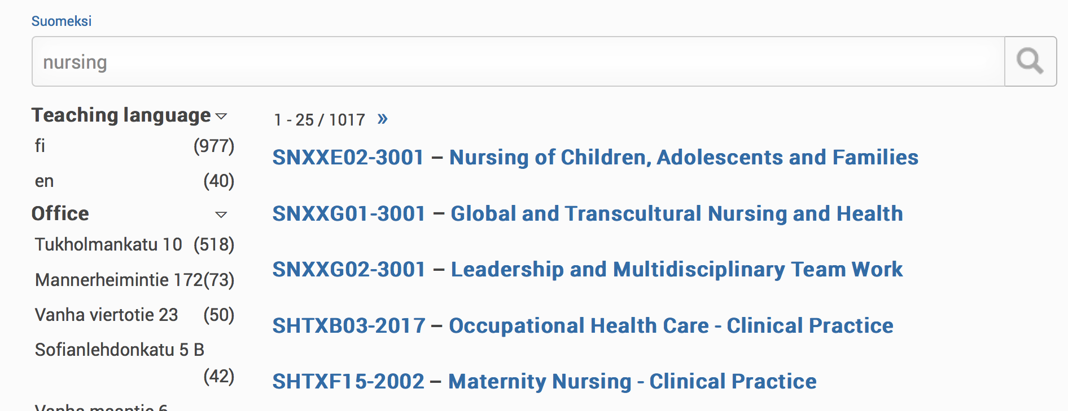
Case example: Found!
Search engine for studies
Uses Elastic search
Lightning fast search
Facets for classification
Notes:
Wikipedia: "Faceted classification is used in faceted search systems that enable a user to navigate information along multiple paths corresponding to different orderings of the facets. This contrasts with traditional taxonomies in which the hierarchy of categories is fixed and unchanging."

Slide 11
Case example 'Schedules'
Schedules for students
Information from courses
Integration to Exchange and Google calendar

Slide 12
Case example 'Mobile services'
Uses responsive design - not limited to single OS
Uses open data
  schedules
  reservation info
  lunch menus
  transportation info
  library services
Notes:
Think SOA. Make services! Don't make systems!

Slide 13
Case example 'Ihana'
Touch screens in every campus lobby
Interfaces created using responsive design
Uses multiple service interfaces located in different systems

Slide 14




Ongoing project 'Schedules with indoor positioning technology'
Student project
Uses open data from schedules
Combines indoor positioning technology with schedule information
Help students to find next classroom with lecture information
Works in mobile devices

Slide 15

Steps for opening data in higher education institution

Slide 16
Opening data in higher education institution
Decision to open data
Determine
  where the data is currently stored, what are the master data sources,what data is already public
  how is the data structured
  what data could and should be published
  architecture which will be used to publish data
Implement, create necessary services and publish them
In general: when creating new systems, think SOA. Create reusable services instead of system specific solutions.
Open services = Open data

Slide 17

Live demo
Found!
Ihana

Slide 18
Thank You!Further information:
Jaakko Rannila, Tuomas Orama, Mika Lavikainen
Helsinki Metropolia University of Applied Sciencesjaakko.rannila@metropolia.fi tuomas.orama@metropolia.fi mika.lavikainen@metropolia.fi

