Slide 1

Peppi - Next-generation ecosystem for Higher Education Institutions education management

Slide 2
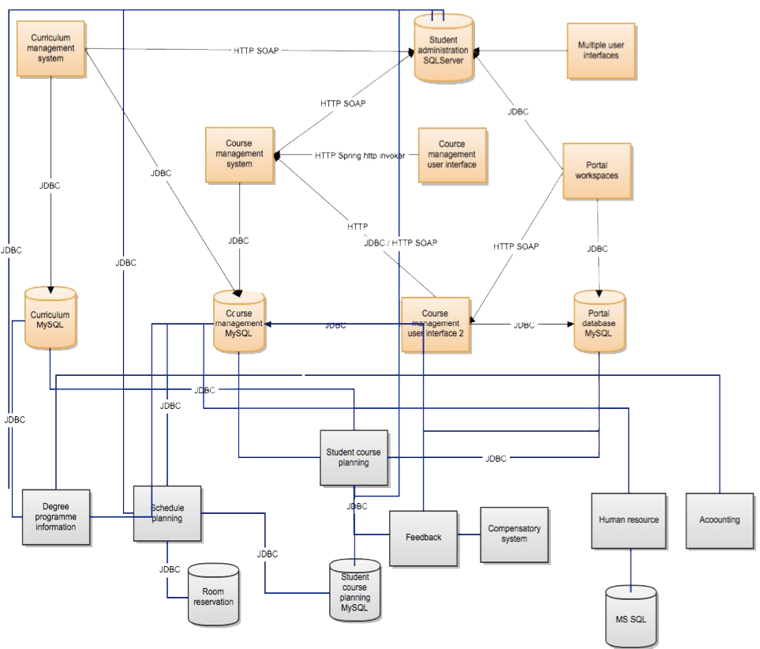
Problem 1 = spider web
Notes:
Complexity:
different protocols,
integration logic inside each system). This kind of design leads to a "spider web" of different kinds of integrations when implementing new systems to the IT environment.

Slide 3


Problem 2 = Master data handling
Duplicated data
Synchronizing
Corruption
Notes:
Master data problems. This kind of design usually leads to duplicated data when data is copied from database to another or loss of information integrity and quality when data is not synchronized correctly between different databases.

Slide 4
Problem 3 = Monolithic systems
Version 3.0
Version 2.0
Version 1.0
Generation growth
Maintaining
New features
Development is not cost-efficent
Notes:
Systems have also grown larger and more complicated because of new needs for services must be implemented to those systems.
This creates monolithic systems, which are almost impossible to maintain, develop or renew cost-efficiently.
Dependencies between the systems are also problematic. Creating point-to-point integrations, which are based on data synchronization make it hard to modernize and develop those systems independently of each other.

Slide 5
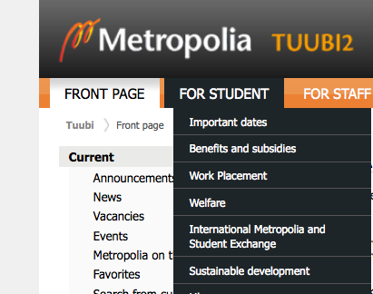
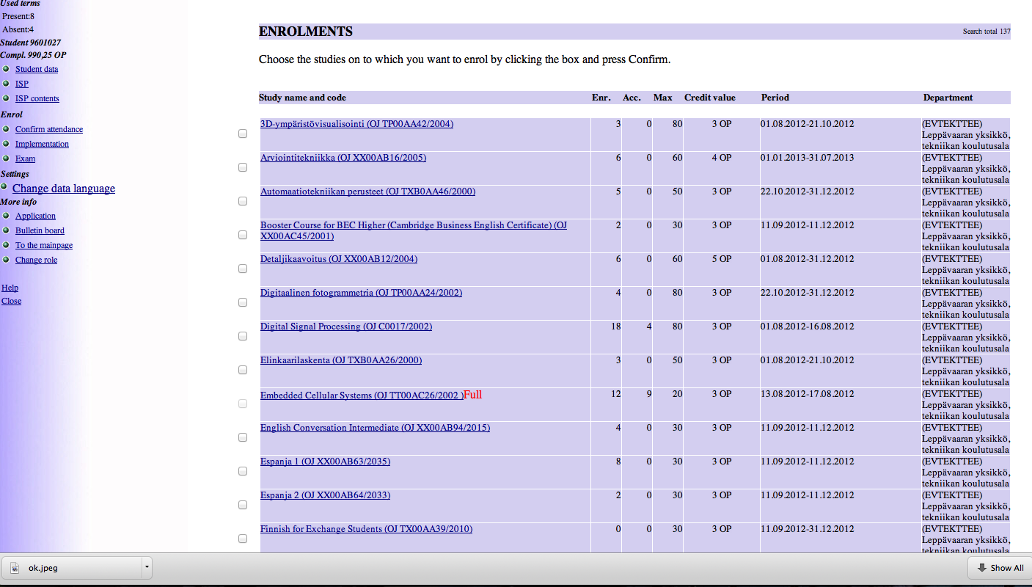
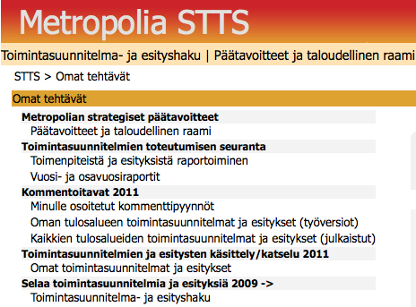
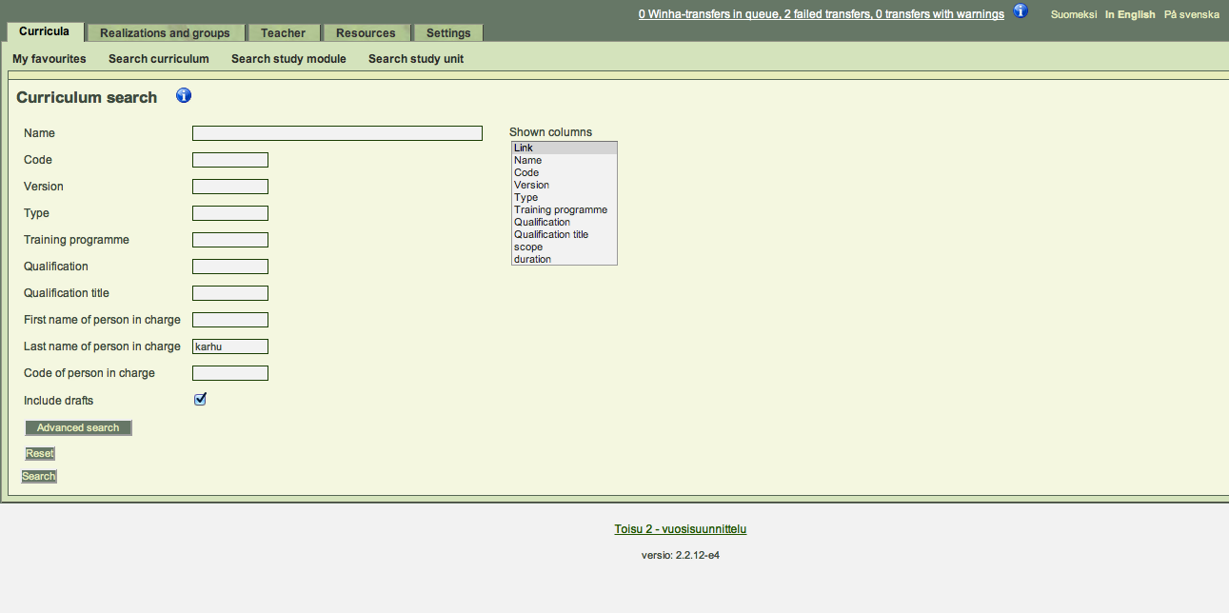
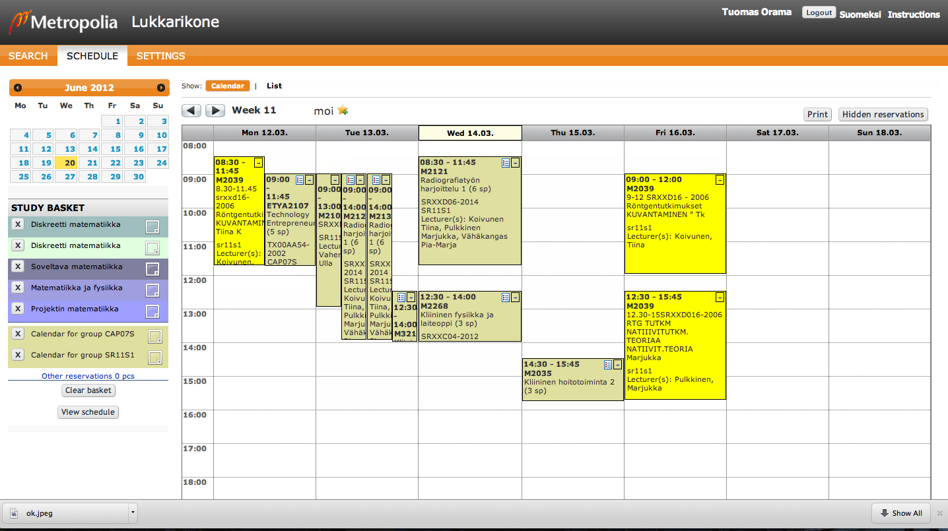
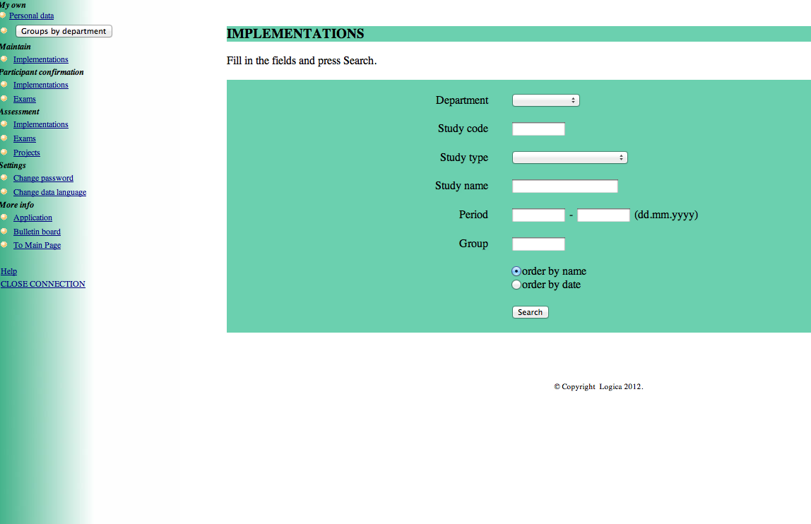
Problem 4 = user experience
Usability
Creating new interfaces to legacy systems
Notes:
Difference in user experience. Different systems have usually very different user interfaces, which lead to problems in usability. Making new user interfaces to monolithic systems can also be difficult because there can be business logic in the user interface layer.

Slide 6

Creating new university education management ecosystem using service oriented architecture - Peppi

Slide 7
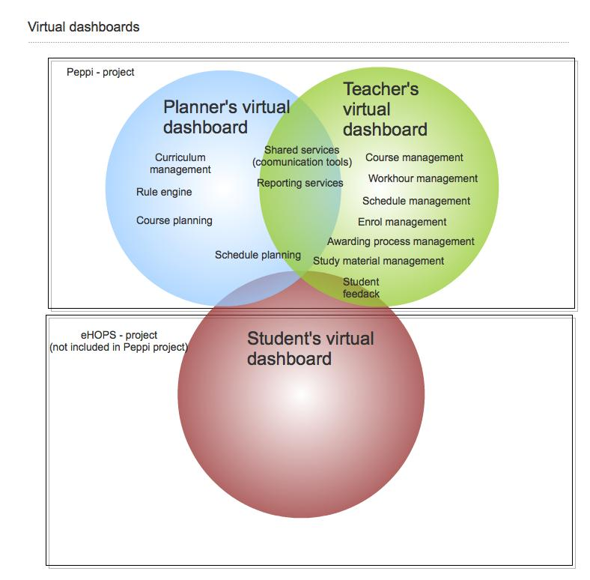
About
Peppi is a comprehensive service-oriented system for curriculum planning and related e-services for HEI management
Complete renovation of application architecture, user interfaces and design methods.
Two largest Universities of Applied Sciences in Finland will implement Peppi in 2013.
Project in numbers:
  Project members: 87
  Budget: 2,7 million euros
  Documentation: over 600 pages
  Work days used: 5500
Notes:
Metropolia adopted following design principles from SOA in the Peppi project:
1) Services are designed as reusable services,
2) Services can be composed to create new services,
3) Dependences between services are made as loose (loosely coupled) as possible,
4) Information is read and saved through service interfaces,
5) Services must be autonomous. Tight binding between services is not allowed.
6) Services are published using standard interfaces (e.g. SOAP Web service or REST).
7) Services statelessness.
8) User interfaces has no business logic

Slide 8
Services for education management
Resourcing
Scheduling
Curriculum planning
Management
Reporting
Rule engine
  curriculum/syllabus planning
  rule engine
  course planning
  course instance planning
  organization planning
  expense planning and budgeting
  teacher work hour planning and
  schedule planning
Notes:
All of the services are divided to separate modules. They are loosely coupled. They even have their own database. This means that the ecosystem is modular and scalable. Modules can be replaced with other modules or new modules can be attached to the ecosystem.

Slide 9
Services for teachers
Awarding
Scheduling
Course planning
Documents
Reporting
  Awarding process handling
  Communication tools
  Own schedule handling
  Own workload handling
  Course planning
  Material and document handling
  Support for virtual learning environments
Notes:
Here you can see services for teachers. As we mentioned before Peppi includes two dashboards. For planners and teachers. Both of them uses same almost the same services but they are implemented differently for users.

Slide 10

Peppi - Architecture

Slide 11




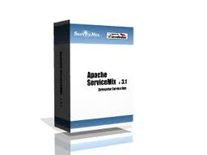
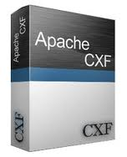




Used technologies
Interface layer
Service layer
Database layer
Notes:
Interface: Peppi will use the modern user interface technologies and support for newest web browers. User interfaces take advantage of rich interfaces like HTML5, CSS3 and AJAX.
Service layer: Peppi software will be implemented in J2EE. The main reason for choosing Java was the fact that many of the existing systems had been implemented in Java over the years and there was already a lot of in-production experience. When using OSGI-technology and making services as OSGI bundle, which are run in ServiceMix4 it is possible to run different versions of service interfaces simultaneously. This provides a significant additional value over normal J2EE behavior.
Peppi is database independent.
All the technologies shown here are open source. Using open source software in Peppi project we can achieve significant cost savings and supplier independency. Furthermore using standards in every solution we can achieve solutions that have a very long lifespan.

Slide 12
Deployment diagram
Notes:
Here is presented Peppi Deployment diagram. In the core of deployment is SOA platform (ServiceMix). ServiceMix is runtime environment for different kind of services. It also has support for Enterprise integration patterns (EIP). Service interfaces can be published for different protocols and standards. Services in Peppi are implemented with OSGi technology which interfaces are published as SOAP Web services and REST. ServiceMix contains also message queue to send and receive messages to 3rd party systems. Message queue can be configured to persist messages during message exchange. This improves fault tolerance and improves robust architecture compared to present integrations.
User interfaces are built into one centralized portal for teachers and study program administrators & planners. In Peppi there is a clear and precise separation of user interfaces from all business logic and a very lightweight approach to producing UI components is taken into use. User interfaces are made such way that they do not include business logic. All the logic is in the service. Noticeable is also that everything you do in user interface can also be done by programmatically in service interface by SOAP or REST. Graphical interface has multilingual support and they are made using portlet standards (JSR168 and JSR286). Portlets are implemented as light as possible so they can be aggregated to different kind of views to improve user experience.

Slide 13
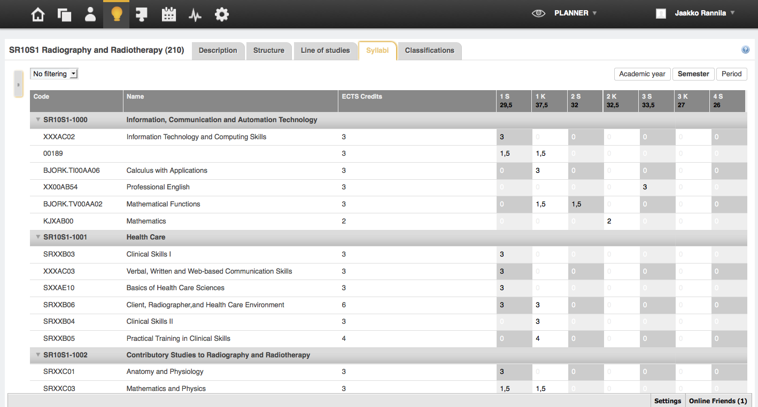
Benefits
ESB
From point to point integrations to integration logic in one place
From master data problems to master data management
Resourcing
Scheduling
Curriculum planning
Management
Reporting
Rule engine
From monolithic system to modular ecosystem
From difference in user interfaces to one UI layout in dashboards: better user experience
Notes:
We can reduce point-to point integrations. All integration logic is inside services that run Enterprice Service Bus. All services made in SOA fashion include integration logic thought their nature.
Data copying is minimized so there is less data synchronization. For every information the master place is defined. When system need that piece of data it can read it from service interface.
Through SOA principles all services are separate and loosely connected and they run in separate modules. Every module can be changed independently. Modules have their own databases = SOA is taken into data model level.
Service layer and user interface layer are separate. No business logic is in user interfaces so that they can be easily changed. There is only “one” user interface for the user presented in dashboard.

Slide 14
Benefits for IT-Services
Technology and data model are well suited for single-installation for many organizations scenarios
Can be leveraged as a cloud service for a multitude of customers
All the components are scalable and open
Enterprise service bus makes it easy to deploy new service interfaces and new schemas to the environment on-the-fly, without service interruptions
Effortless integrations with third party systems (e.g. Identity management, Collaboration systems)
Cost savings and vendor neutrality through open source software

Slide 15
Benefits for Executives and Management
  Opportunity to deal with any information exchange with other HEI's in Europe.
  Decreases resources used in HEI’s management.
  Improves information quality, based on master data principles.
  Using standards in every solution achieves solutions that have long lifespan.

Slide 16
Benefits for Users
Engaging and easy to learn interfaces
Support for multiple languages
Unparallelled performance and reliability
Decreased time spent on management
Whole education management process in one ecosystem

Slide 17
Demo https://peppi.eduix.fi/

Slide 18
Thank You!
Further information:
Jaakko Rannila, Tuomas Orama
Helsinki Metropolia University of Applied Sciences jaakko.rannila@metropolia.fi tuomas.orama@metropolia.fi

