Slide 1
Metrocket
Senior assistance tool

Slide 2
Dimensions (Seat)
seat height is 550 mm
-normal seat height of about 100 mm higher
The seat angle of the first prototype 5 degrees
Seat width: 500 mm, depth 470 mm

Slide 3
Dimensions (Treads)
Step Height: 180 mm
The lower tread depth: 210 mm, width: 500 mm
The upper step depth: 260 mm, width: 500 mm

Slide 4
Dimensions
FOR PIPE
- A standard size of 20 mm / 22 mm
HANDLES
-Handle height from the seat while sitting: 180 mm, 730 mm from ground level

Slide 5
Why to design a senior assistance tool?
The stool is to operate as a seat and the step stool.
Planning the stool, because the current market does not provide for seniors step stool, which would be supported by the handles.
Also, step stools intervals are often too high, which complicates the stool climbing and may thus lead to a dangerous situation

Slide 6
In use
The stool is intended to be located in the kitchen, in which it can be used to do the washing when sitting on stool
“ladders”
As a seat

Slide 7
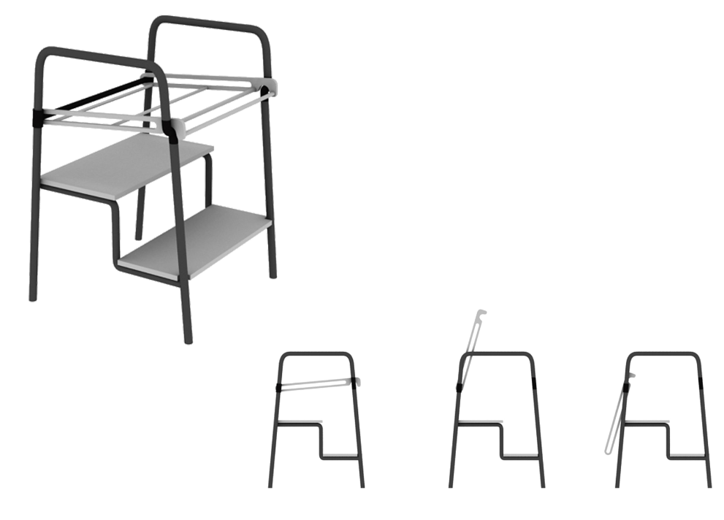
3D model of final prototype

Slide 8
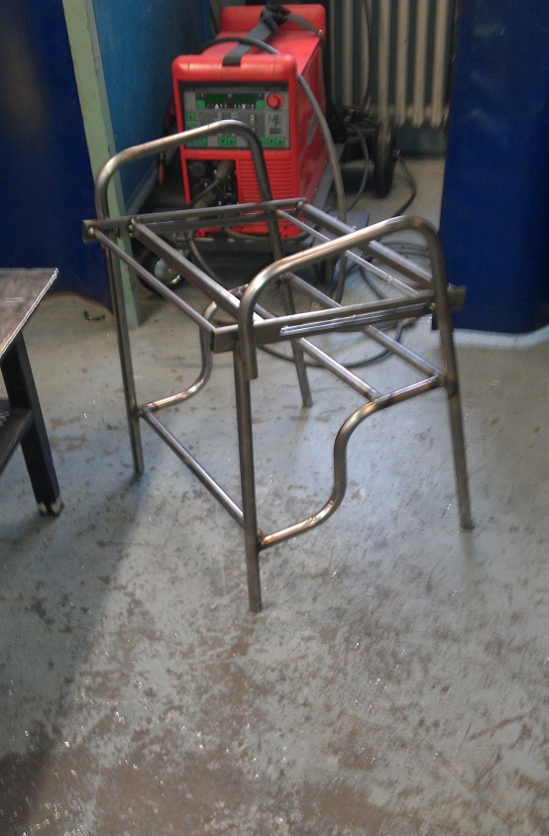
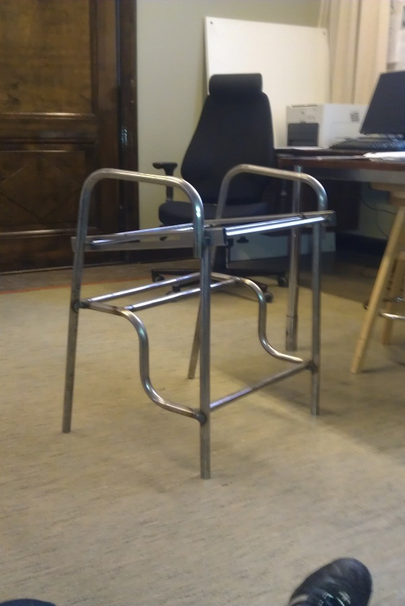
Prototype of the stool

Slide 9
¿Questions?

