Slide 1

BICYCLE TRAILER
A solution for flexible bicycle transportation

Slide 2
What, why and where?
We continued where the previous bicycle trailer innovation group finished
As city environments turn less accessible for private driving, we need new solutions for handling the transportation of our everyday items – replacing the boot or backseats of a car
Existing trailer solutions are somewhat “big-boned” and clumsy, designed mainly to transport kids, camping supplies etc.
We designed the product with Marja-Vantaa, a biking friendly region, in mind

Slide 3
Our target
Our target was to design a light-weight, agile and easy-to-use bicycle trailer for everyday use in a busy city environment
To build a working prototype of this trailer

Slide 4
Challenges
Arriving to a final product that meets the specified requirements set for it, while being universal enough for a large group of different users
Creating a product that matches the reliability and value of similar existing solutions, while being unique enough to find its own place

Slide 5
Process
Two initial paths
PERSONAL TRAILER
COMMUNITY TRAILER
Solution for light and agile everyday transportation, e.g. groceries, commuting or recreation
Existing (commercial) solutions are slightly clumsy and ”big-boned”
For personal use
A more versatile and simple solution for different transportation needs
For communities, enterprises and housing companies. Shared or rented

Slide 6
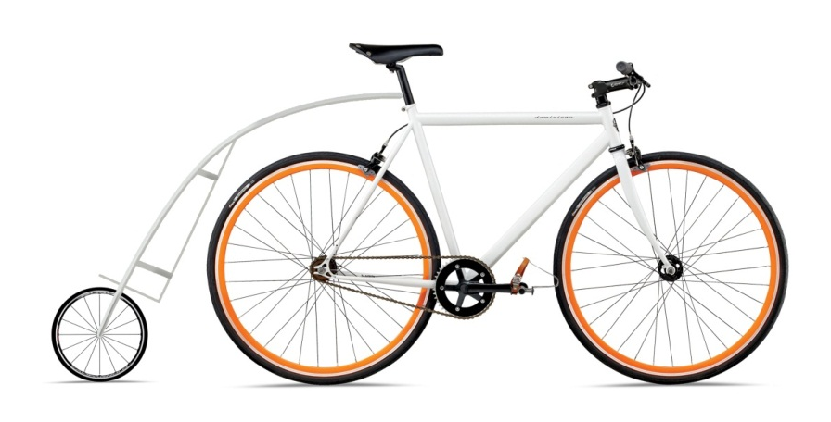
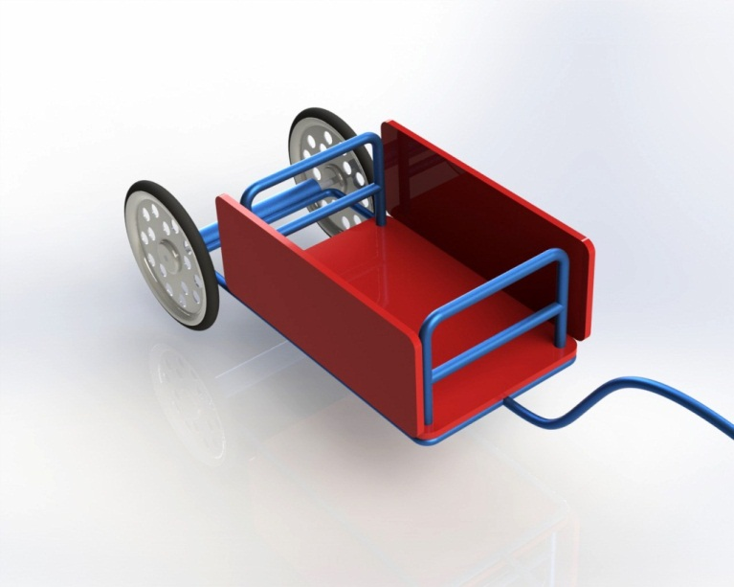
Process
Two design concepts
PERSONAL TRAILER
COMMUNITY TRAILER

Slide 7
Process
Two goals
PERSONAL TRAILER
COMMUNITY TRAILER
Prototype
Service concept

Slide 8
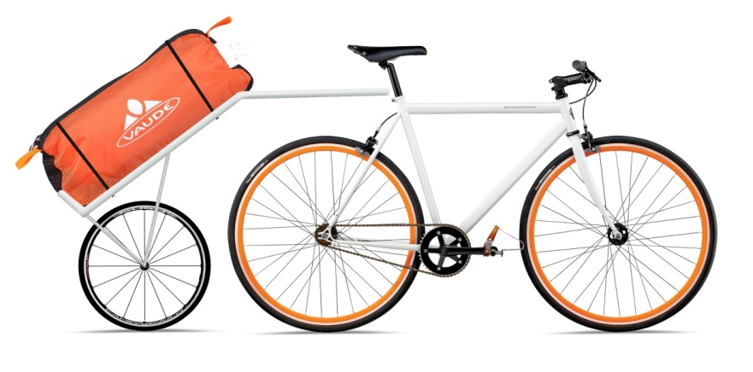
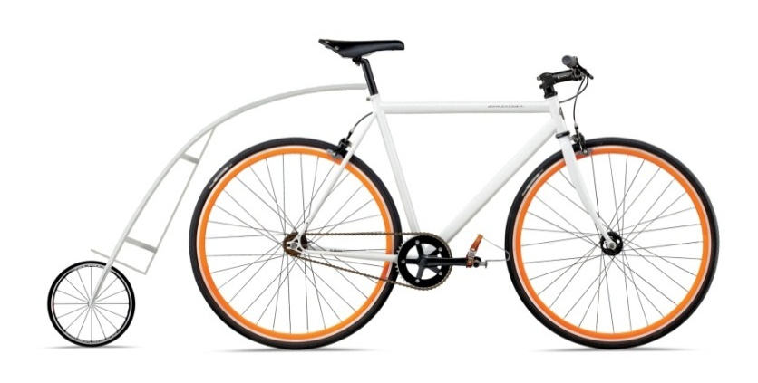
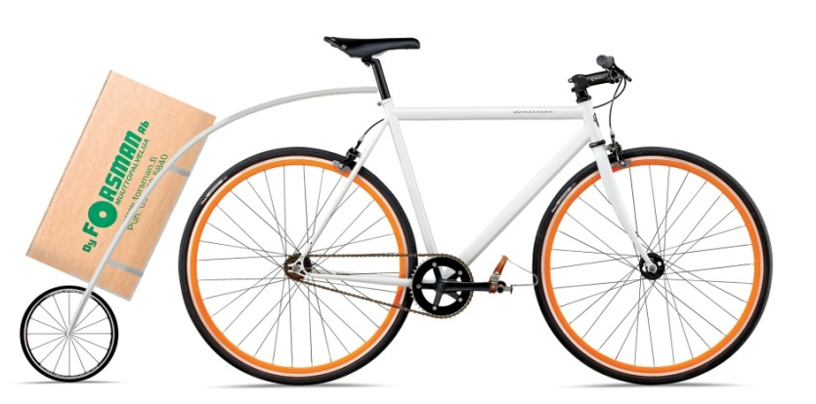
Personal trailer
Simple and compact
Light and easy to trail behind a bike
Easy attach and remove
Bag or other items are fastened to a simple frame
BAG
A unique bag from weather resistant and durable materials will be designed to be used with this trailer.

Slide 9
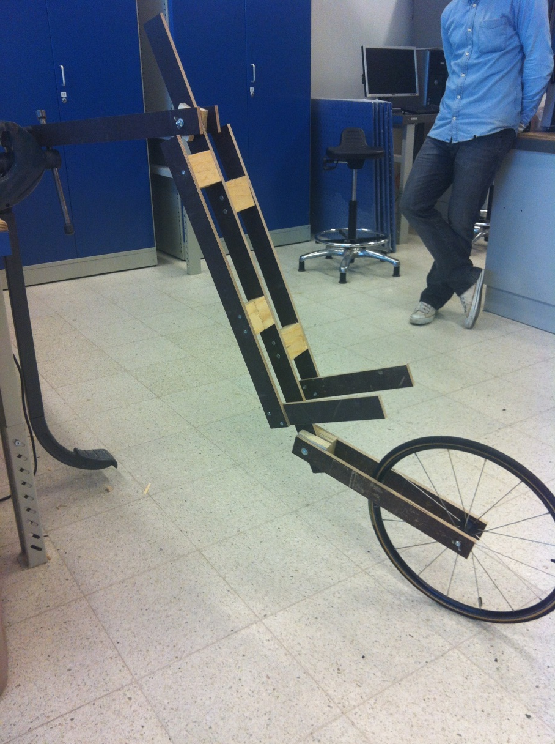
Prototyping
First version
Wooden structure
Attached to the bike’s saddle pipe
2 moving joints next to to fastening point on saddle pipe

Slide 10
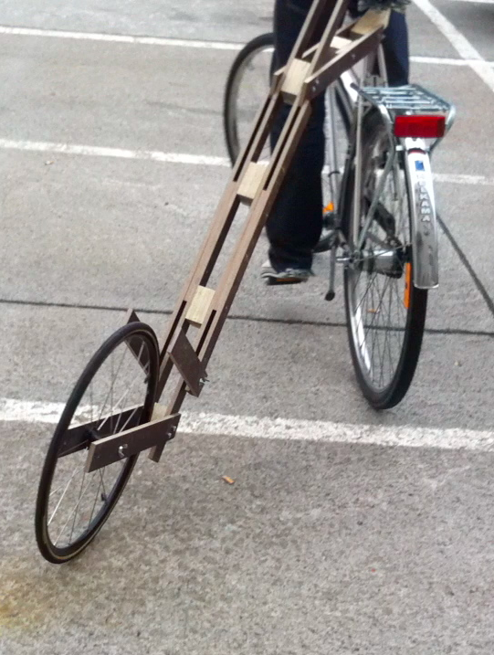
Prototyping
First version+
Enhanced strength
Less wobbling and bending

Slide 11
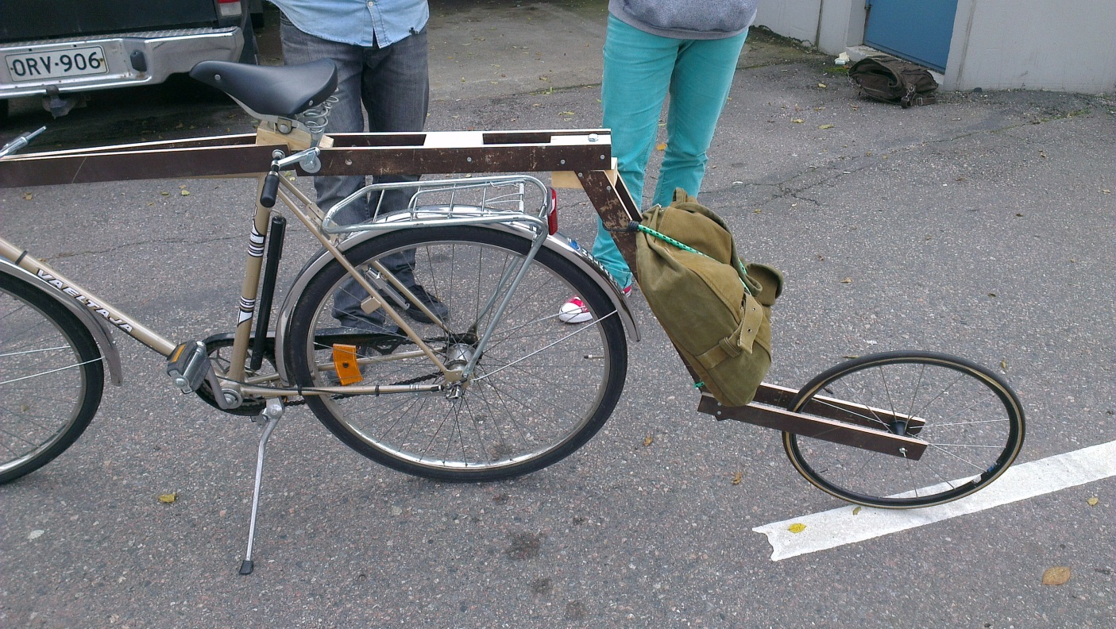
Prototyping
Second version
New location for joint/axis
When making a turn, the trailer’s pivet point limits over-rotation of the trailer
Weightlessly glides

Slide 12
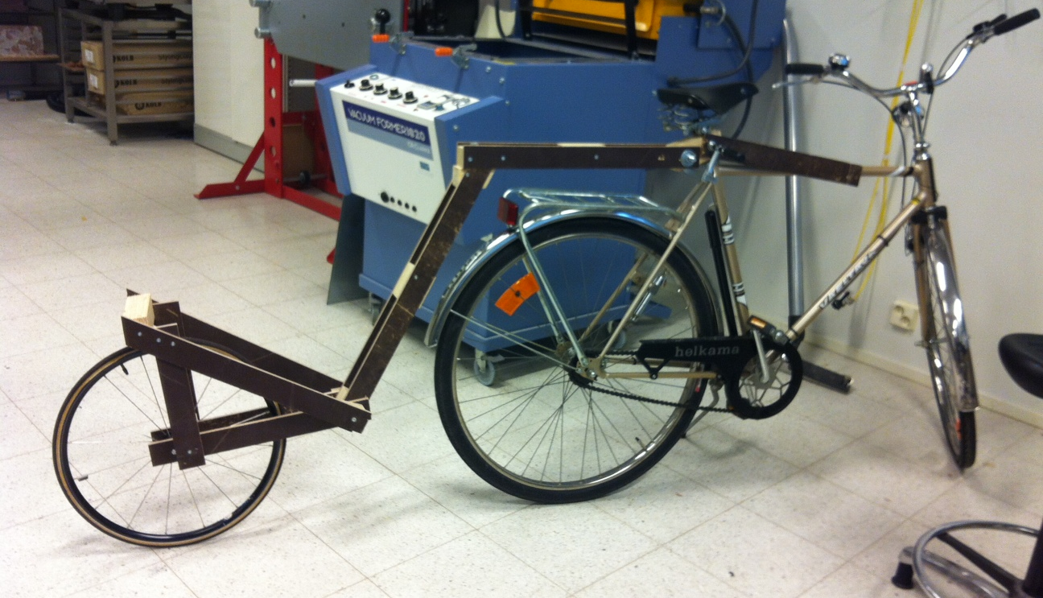
Prototyping
Second version+
Very good structural integrity, comparable to a structure made of steel or aluminium

Slide 13
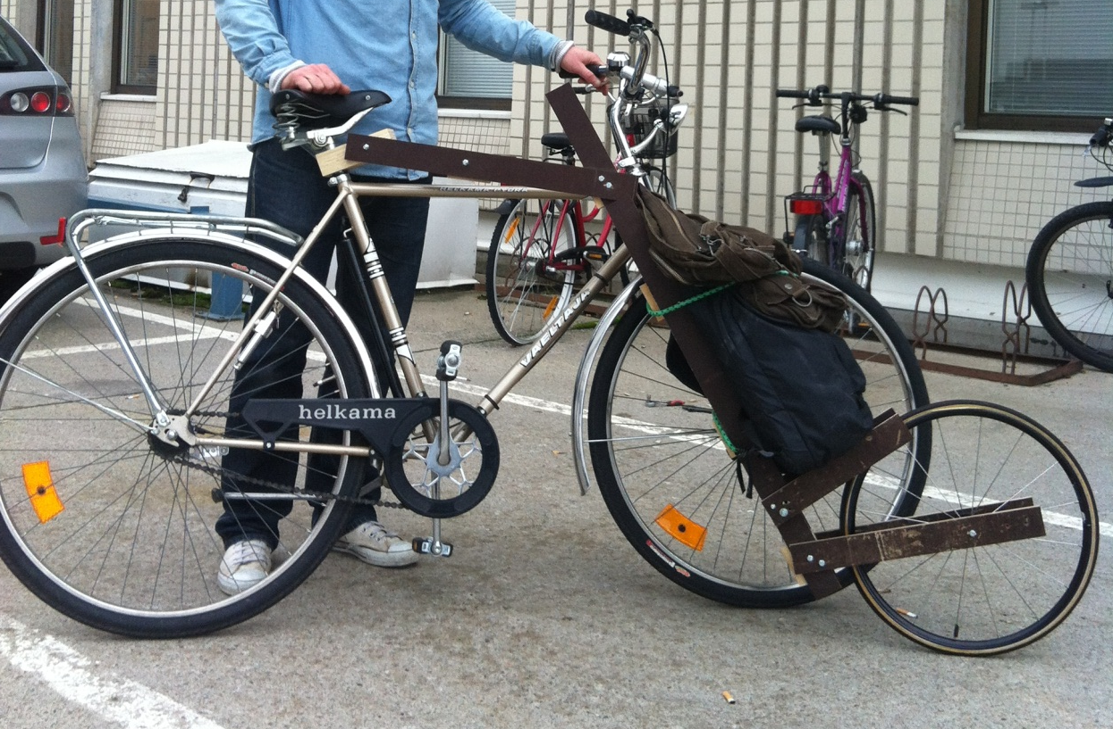
Prototyping
Pivoting functionality

Slide 14
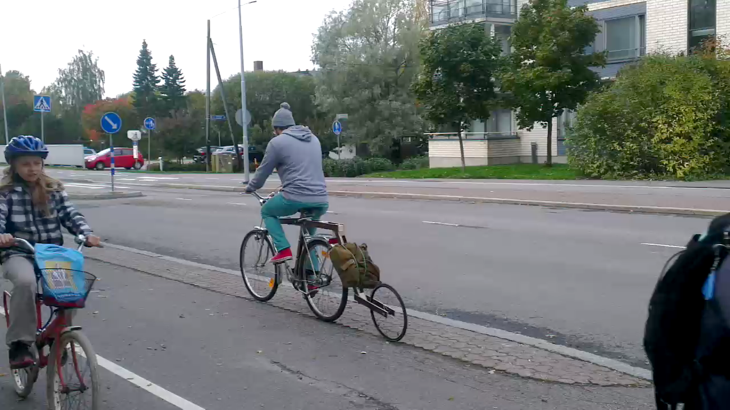
Prototyping
Second version+

Slide 15
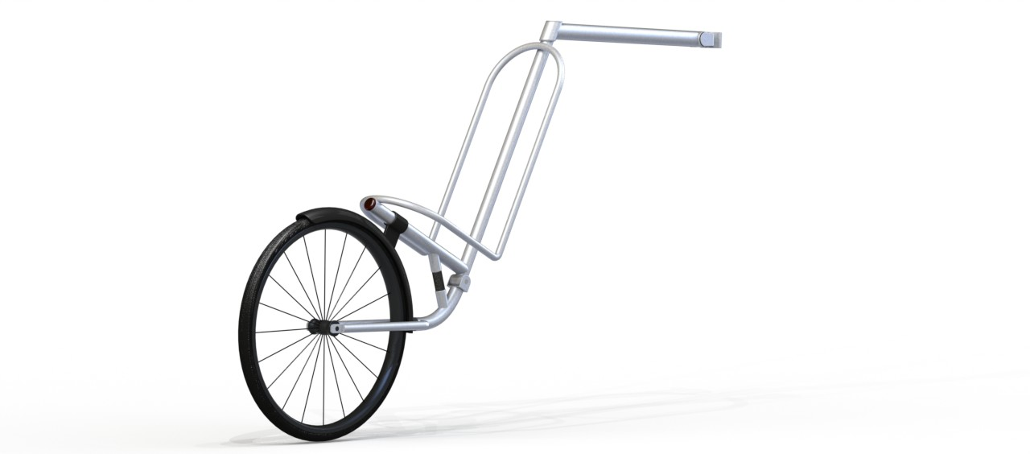
Final product

Slide 16
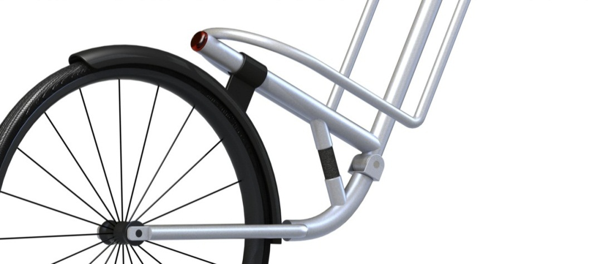
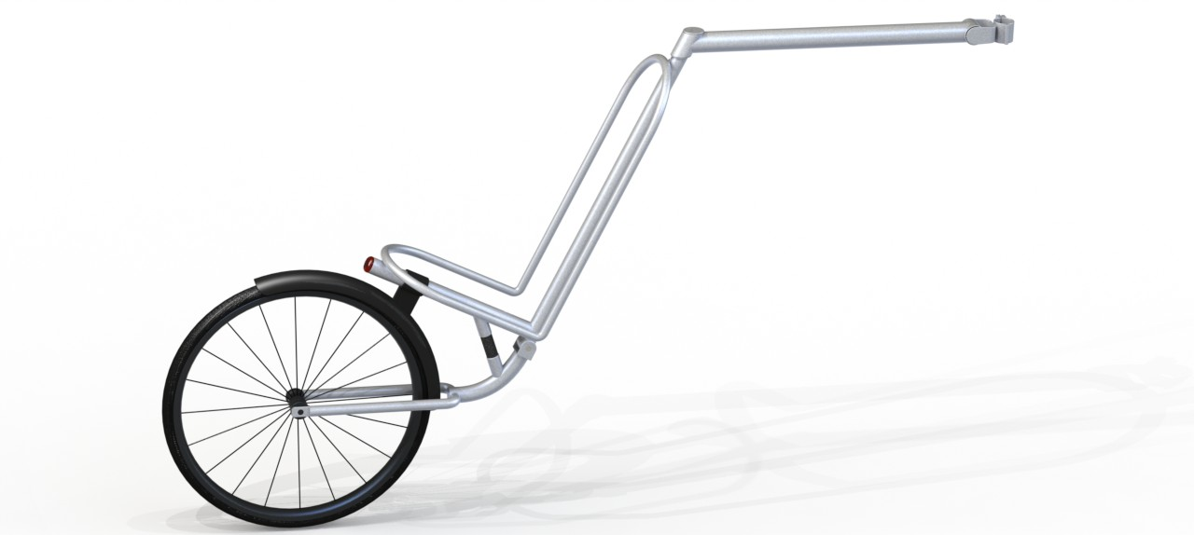
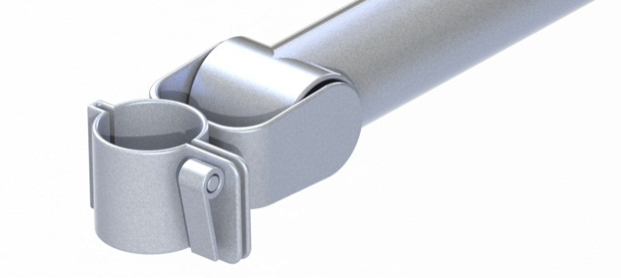
Final product

Slide 17
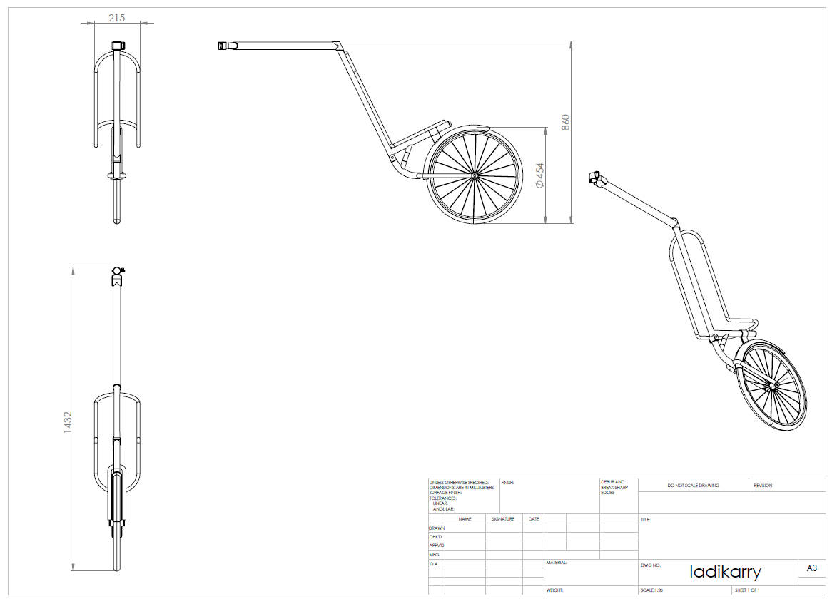

Slide 18
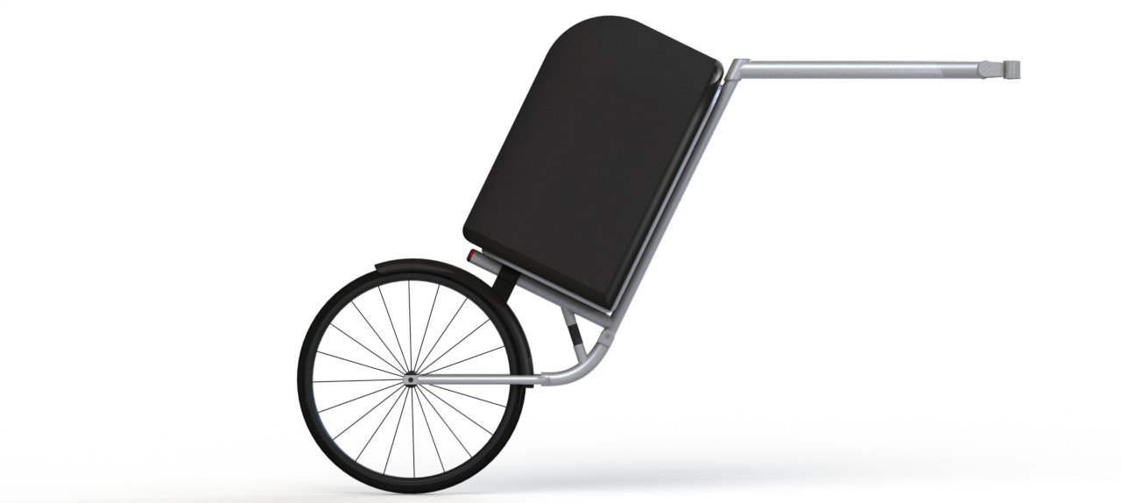
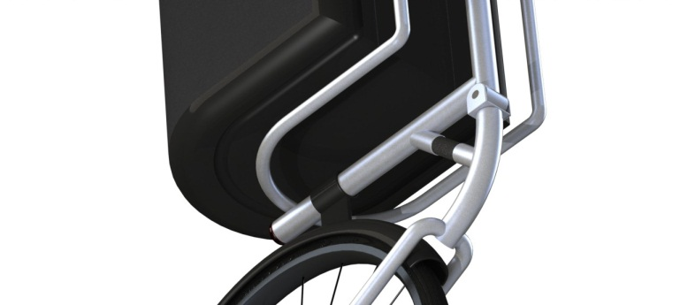
Add-ons

