Slide 1
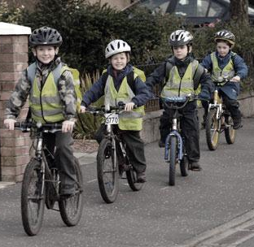
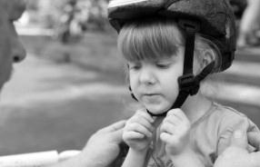

”School Path” material analysis
Minna Marttinen
Heli Pakarinen
Eija Zweygberg

Slide 2
Previous work

Slide 3
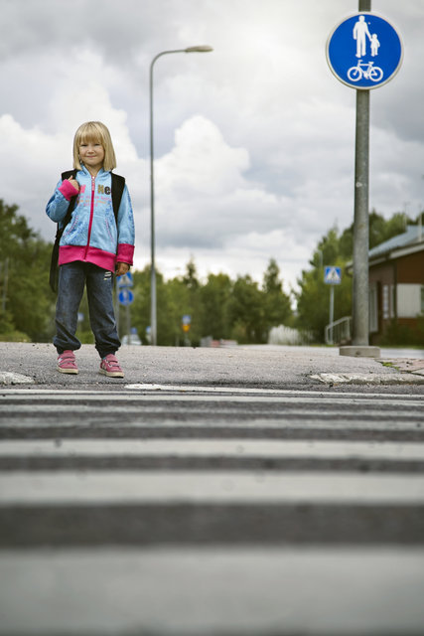
School Path
School Path is a special bike lane for children going to school in Marja-Vantaa
Previous work was concentrated to one imaginary bike lane, when our aim is to plan two actual school paths/bike lanes for two real existing schools
First we analyse previous work and material, and then we continue planning
Kuva: liikenneturva.fi

Slide 4
Previous work: analysis
School Path was located in Marja-Vantaa, but it was not a real existing project
Path was going mainly in the middle of a park, not in the middle of the other traffic (according to map)
Path was marked with traffic signs, street bumps and lowered street lights
  Traffic signs seemed to be directed for the kids, not for cars, which should be extremely important from the safety view
  Street bumps were just regular street bumps, shouldn’t there be something extra?
  Instead of to lower street lights, we’d prefer to add lights and use more intensive lightning on the path
In the school the bikes would be under supervision and there would be somebody to help kids to maintain their bikes, if something is broken
  A bit naive thought, if schools do not have extra money for this. This ”somebody” should be named person.
Path would lead also to hobbies
  There is a risk to lose the main idea (the school path) if there are too many paths

Slide 5
Previous work: Conclusion
Good idea, but it is only a start and needs to be processed a lot and make it more practical and concrete
The path was thougt mainly from the kids view, we would emphasise more the visibility also to other traffic users
  The path should be designed on two levels: 1) children 2) other traffic users, especially cars
Path signs should be added and make them more visible and more distinctive, so that the signs clearly can be separated from the normal traffic signs

Slide 6
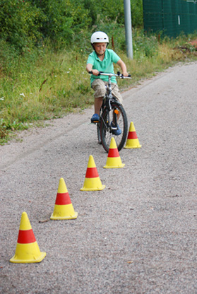
User profile analysis:
Children as cyclists
Children can not read other traffic like adults. And their ability to concentrate on traffic is not at the same level as adults. So other traffic users have to be aware, that children can do sudden moves, they can stop at some unusual places etc.
Under 12 years old can bike on pedestrian lanes, but this is can cause some dangerous situation too.
Especially children who are on the first or second class, can feel the school road very scary, because they are not yet very familiar with that. Parents probably take them to school often by cars. So the school path should have that kind of signs that they feel it’s ”their own lane” and parents feel that it’s safe for their children to use.
Some children may have a hint how the traffic works, if they have for example taken part of ”childrens’ traffic school”
Kuva: liikenneturva.fi

Slide 7
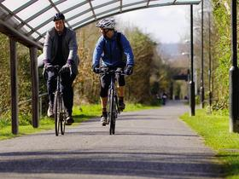
Other material
There is an ambitious plan in Bristol to cover about 20 kilometres of bike lane with hard weatherproof plastic which will be held up by metal poles.
http://Source: www.bikeradar.com/news/article/roof-for-popular-bike-path-21055/

Slide 8
New material

Slide 9
Traffic education for children
Liikenneturva produces instruction and education material for families, daycare, pre primary education and elementary school, for example ”Turvaa lapsen koulutie” material. (”Protect child’s shcool road”)
Familiarize instructors and teachers with traffic education for children
Source: www.liikenneturva.fi
Children’s traffic city provides traffic education all around the year for pre primary students and students from 1st to 3rd grades
On summer traffic city is open for all over 5 years old
Education includes theory studies and practical training with pedal cars and bicycles
Source: http://www.hel.fi/hki/nk/fi/Vapaa-aika/Liikennetoiminta/Lasten+liikennekaupunki

Slide 10
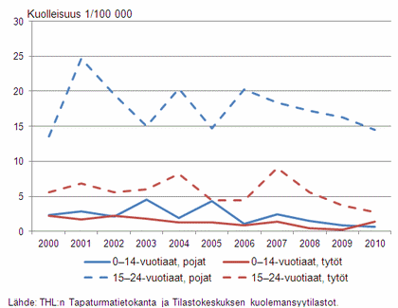
Pre emptive activities
THL (Terveyden ja Hyvinvoinnin laitos/National institute for Health and Wellfare) tries to find means to prevent traffic accidents
especially young children need special activities such as traffic education, improvements on safety on traffic environments, more active use of safety instruments (f.ex. Helmets)
Source: www.thl.fi

Slide 11
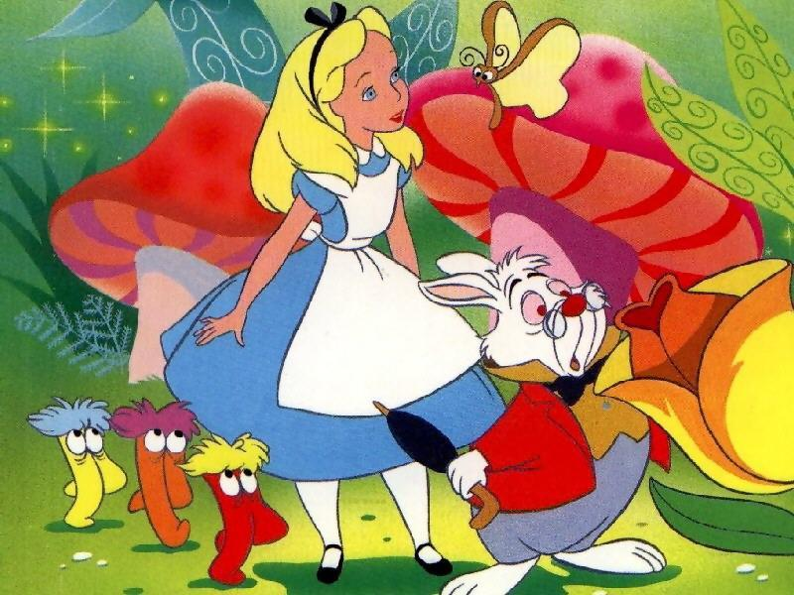
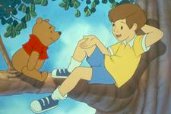
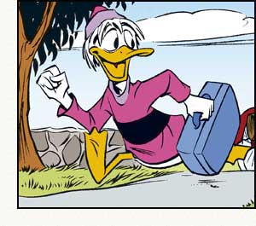
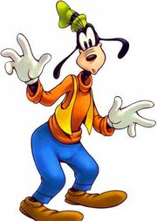
Childrens’ behaviour on traffic 1/2
According to research* made in Jyväskylä University, children on second class at school:
  Behave uncarefully on traffic, playing at the same time, so they cannot concentrate on traffic
  When they are with friends or adults, they concenrate on traffic even less
Childrens’ traffic attitude was positive and they had good knowledge on traffic regulations.
Four different kind of traffic behaviour types were found:
  Liisa Ihmemaassa (Alice in Wonderland), lives in some fantasy world
  Risto Reipas, behaves as an adult on traffic
  Touho Ankka plays on traffic and confronts traffic regulations
  Hessu Hopo (Goofy), behaves uncarefully, both intentionally and unintentionally
* Heinämäki, Ulla ja Juntunen, Sanna: Toisluokkalainen lapsi liikenteessä. 1999 Jyväskylän yliopisto

Slide 12
Childrens’ behaviour on traffic 1/2
Research* made in Uudenmaan tiepiiri, shows that:
  It’s usual that parents take their children to school by cars, if the school road is under 3 kilometres
  20 % of lower class students (1-6) and 16 % of higher class students (7-9) feel their school road as unsafe. The most common reasons for that were the lack of light traffic lane and dangerous crossings.
  The use of vital security device such as helmets and reflectors decrease when the children come older. Boys use security devices clearly less than girls.
  Children would improve safety on traffic by increasing the use of security devices, obeying traffic regulations and rewarding somehow about the good behaviour on traffic.
  Small children use their own parents traffic behaviour as an example and they need to be encouraged to be a good traffic user by their parents
*Juha Heltimo: Selvitys lasten liikennekäyttäymisestä. 2009 Uudenmaan tiepiiri.

Slide 13
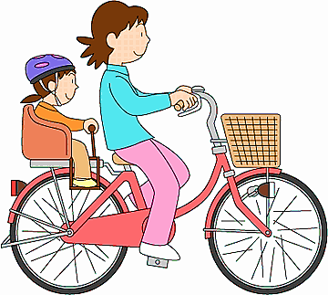
Own experiences
From the parents view:
Crossings are the most scary places for children
Children going to school among other light traffic users can be more ”safe” than going alone or just with other children
Drivers attitude and disregard towards small children among traffic

Slide 14
Plan of actions
WHAT / HOW / OUTCOME
Minna Marttinen
Heli Pakarinen
Eija Zweygberg

Slide 15
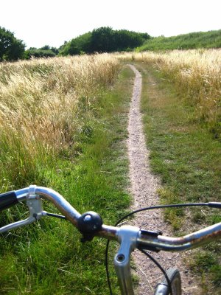
WHAT?
Our primary aim is to plan safe School Path by studying what kind of things children are scare of or worry about concerning traffic, when they are going to school by bike or by walk. We are also trying to find out how children behave on traffic and the use of security device (especially the lack of use and why it exist), in order to be able to plan right kind of signs by School Path.
The secondary aim is to study how designers can utilise the chosen method, theatre work shops, on their work.

Slide 16
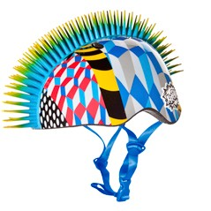
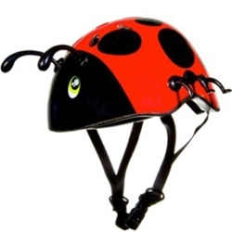
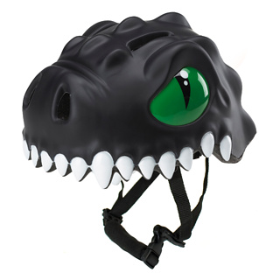
METHOD
We are going to use theatre work shops as a method
Theatre work shops are group work shops, where the participants express their feelings by playing or by empathising with some role
Theatre work shops as a study method will relax the study situation and improve interaction between researcher and study group
Especially when the study concerns children and young people, theatre work shops can provide good results, because playing is natural for them
Theatre work shops can reach some information, which is not even expected and noticed before, because this method can reveal also subconscious knowledge

Slide 17
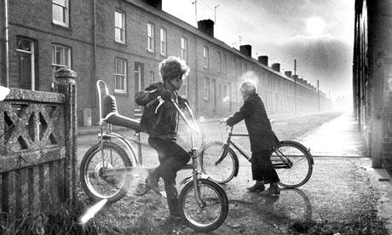
OUTCOME
The outcome of the project is the concept of School Path, which is not tied up some specific place, but can be implemented anywhere.
We are planning real and concrete means, which form the School Path
Our School Path will have two levels:
  Children: how the School Path is marked and what kind of signs there are for them
  Drivers and other traffic users: what kind of warning and attention signs are needed so that the School Path is visible for them

