Slide 1


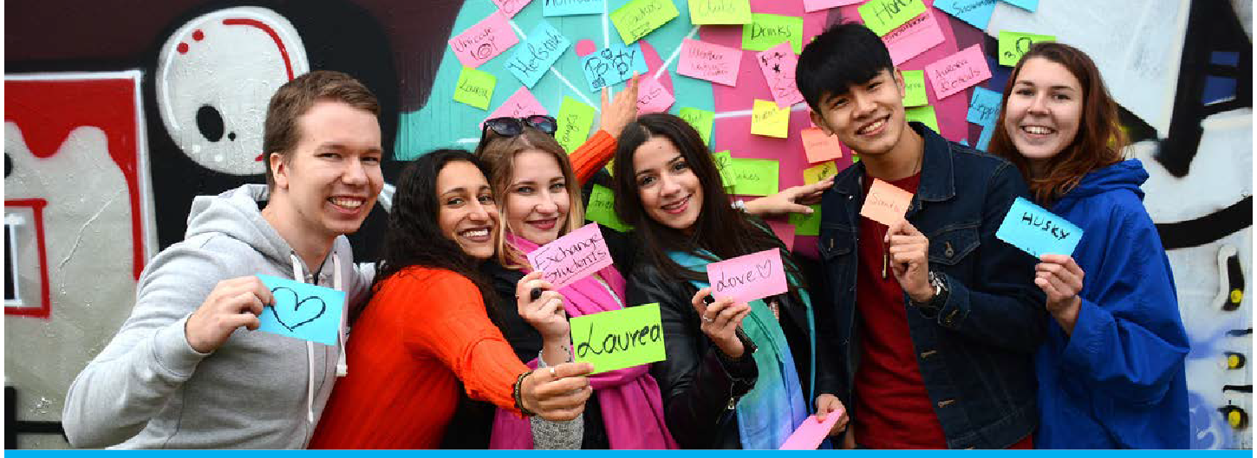
Team tasks, DL 31.10. & 5.11.2018

Slide 2
CRGP Team task
DEADLINE 31.10.2018:
1. Benchmark earning logics and related games
2. Create a Lean Business Model Canvas (lean BMC)
3. Send your lean BMC (pdf file) to annemari.kuhmonen@laurea.fi by deadline 31.10.2018
NOTE: In youtube you can find many videos teaching you how to create a lean BMC.

Slide 3
CRGP Team task
DEADLINE 5.11.2018:
1. Gather your team to make a Game demo video with team self reflection on the game development progress so far
2. Minimum 1 min video
3. Send your video in WhatsApp to 040-672 2174 (Annemari Kuhmonen) by deadline 5.11.2018
Pls note that ”Definition of done” Teamwork Workshop will be organised on November 8th, at Haaga-Helia

